Slide 1
Learning Lightweight Lane Detection CNNs by Self Attention Distillation
Yuenan Hou, Zheng Ma, Chunxiao Liu, and Chen Change Loy
The Chinese University of Hong Kong SenseTime Group Limited
Nanyang Technological University

Slide 2
1
Main idea
SAD：Self Attention Distillation
使用深层block来监督浅层block

Slide 3
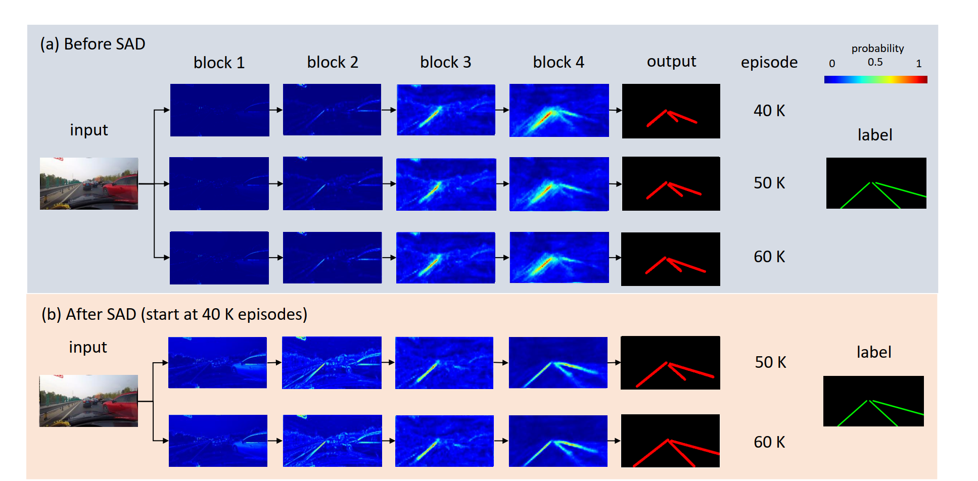

Slide 4
2
Implementation Details
从block的C*H*W输出得到H*W的activation map
p越大->越集中于highly activated area
sum相比于max->less bias
选择p=2,sum进行实验
Mimic path
引入SAD时间

Slide 5
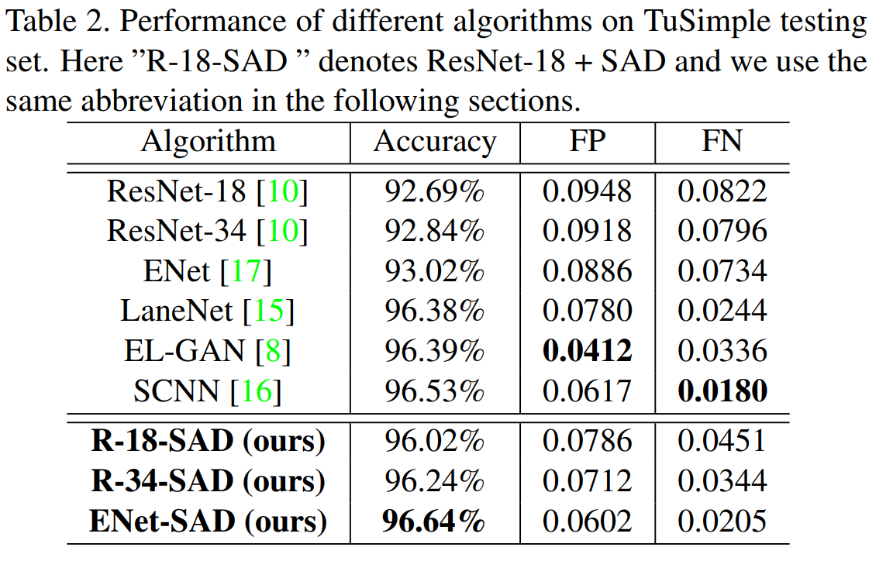
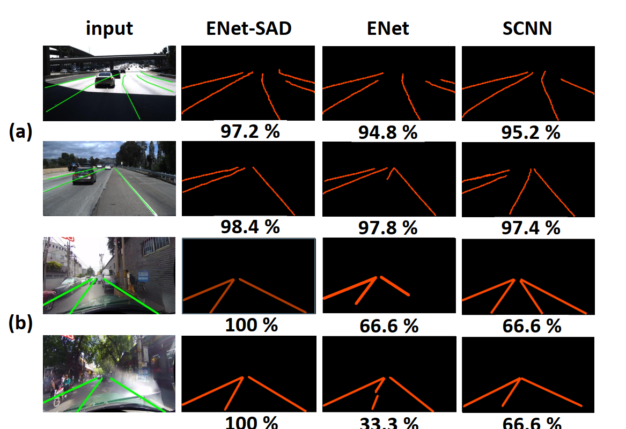
3
Experiment results

Slide 6
3
Experiment results
Mimic path:
浅层block包含较多底层语义，不适合直接用深层block监督
学习相邻层结果更佳

Slide 7
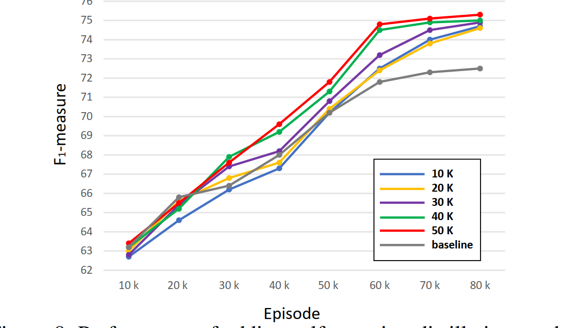
3
Experiment results
Time to introduce：过早引入影响收敛速度

