Slide 1
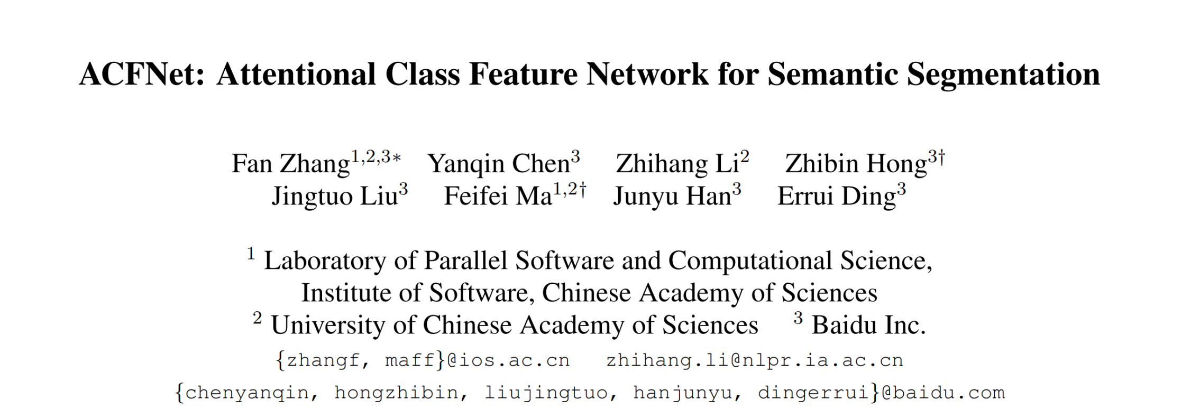

Slide 2
Contributions
Use class center to represent the class level context(categorical context)
Attentional Class Feature(ACF) module: make different pixels adaptively focus on different class centers
A coarse-to-fine segmentation structure

Slide 3
Pipeline

Slide 4
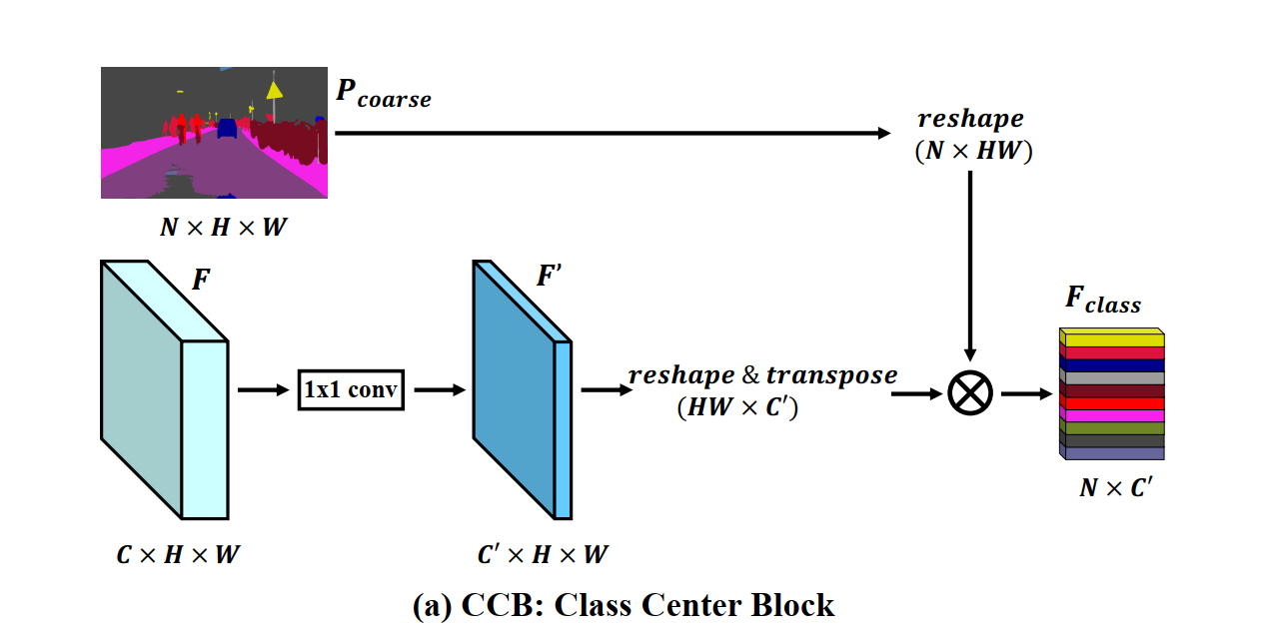
Class Center Block(CCB)

Slide 5
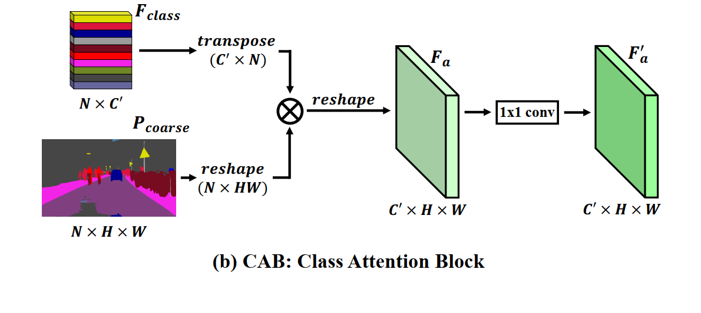
Class Attention Block(CAB)

Slide 6
Loss Function
La：Auxiliary loss
Lc: cross entropy loss for coarse segmentation
Lf: cross entropy loss for fine segmentation

Slide 7
Experiments

Slide 8
Experiments

Slide 9
Experiments

Slide 10
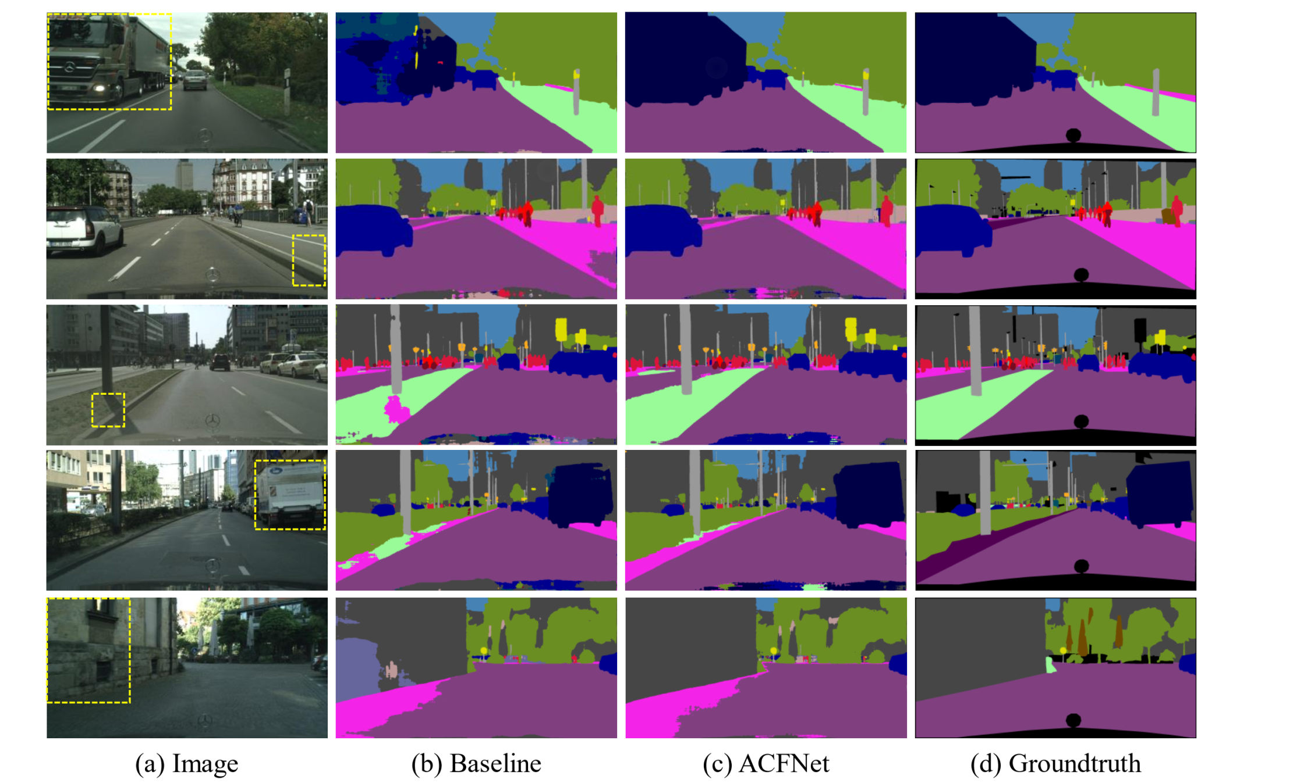
Experiments

