Slide 1
﻿Reinforced Cross-Modal Matching and Self-Supervised Imitation Learning for Vision-Language Navigation

Slide 2
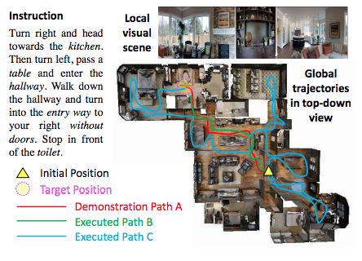
Task
Vision-Language Navigation
Given an environment, language instruction, initial position
The agent is expected to arrive the target position
Dataset: R2R dataset

Slide 3
﻿contributions
Reinforced Cross-Modal Matching (RCM) framework
﻿Both extrinsic and intrinsic rewards for reinforcement learning
﻿Cycle-reconstruction reward as the intrinsic reward
﻿ ﻿global matching: language instruction and the agent’s trajectory
﻿Introduce a new evaluation setting for VLN
﻿exploring unseen environments prior to testing is allowed
﻿propose a Self-Supervised Imitation Learning (SIL) method for exploration with self-supervision

Slide 4
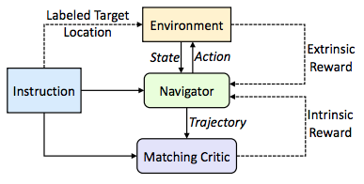
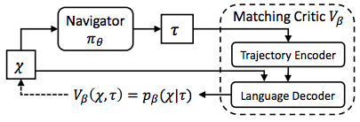
Reinforced Cross-Modal Matching
Extrinsic Reward (from env): The distance from the target position
Intrinsic Reward (from instruction):

Slide 5
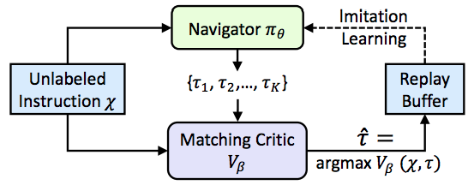
Self-Supervised Imitation Learning
A different problem setting:
To train the agent on seen environments and test it on unseen environments with exploration.
facilitates lifelong learning and adaption to new environments
Method:

Slide 6
﻿Experiments and Analysis

Slide 7
﻿Experiments and Analysis

