Slide 1
CVPR2019

Slide 2
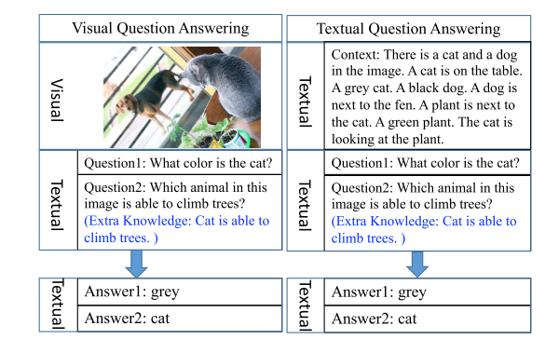
Motivation
VQA is more challenging than TQA (Text QA)
Image: High dimension and lacks the structure and grammatical rules.
Visual and textual information that come from two distinct modalities.
External knowledge can be easily integrated

Slide 3
Approach
Dense Captions + Text QA
Caption is better than attributes for image representation
Based on QANet (ICLR 2018)
CNN + self-attention for reading comprehension task

Slide 4
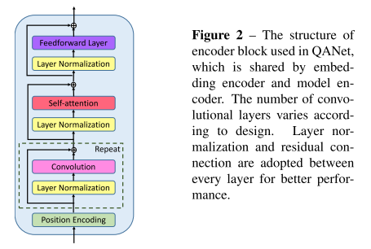
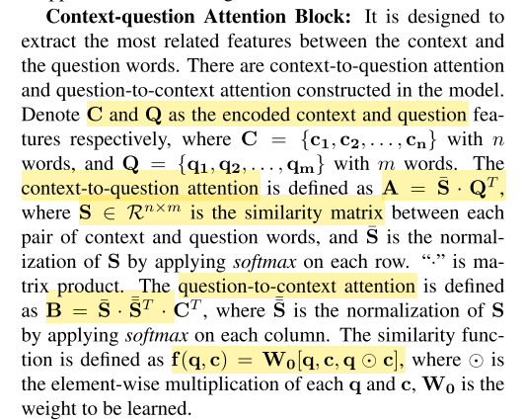
QANet
Input Embedding Block
word + character embedding -> 2-layer highway net
Embedding Encoder Block
Self-attention with CNN
Context-question Attention Block
Model Encoder Block
Output Layer
Probability of each position in the context being the start or end locations of the answer.

Slide 5
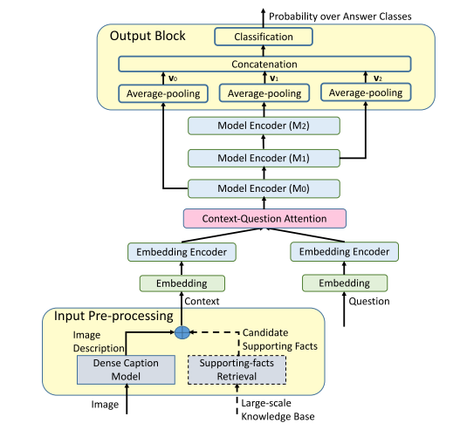
Open-ended VQA mode
Simply concatenate with Knowledge.
All the retrieved candidate supporting facts as context.
Output layer: a multi-class classification layer
Predict the probabilities over pre-defined answer classes

Slide 6
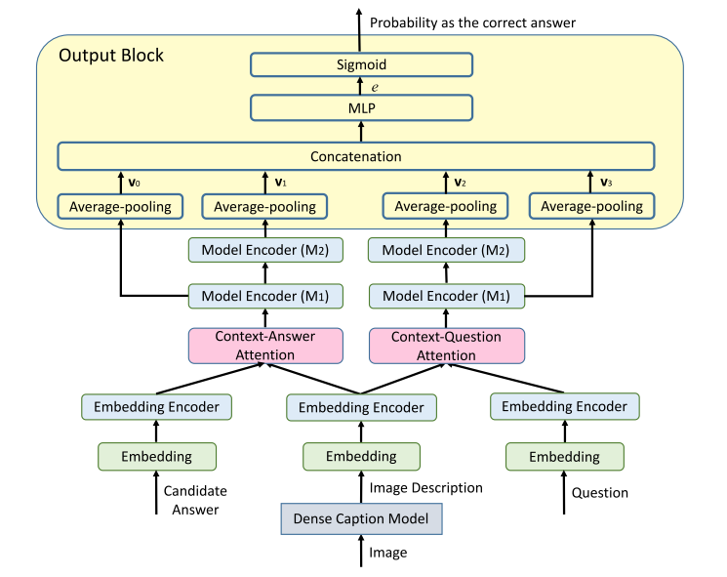
Multiple-choice VQA model
Encodes the candidate answers directly
Cover more answer choices
Embedding based method is better for similar answer expressions.

Slide 7
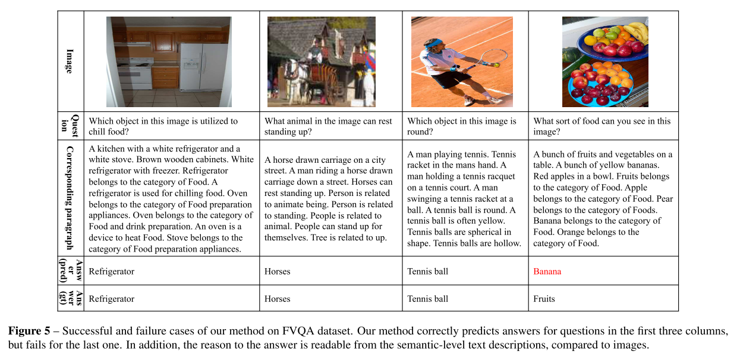
Experiments

Slide 8
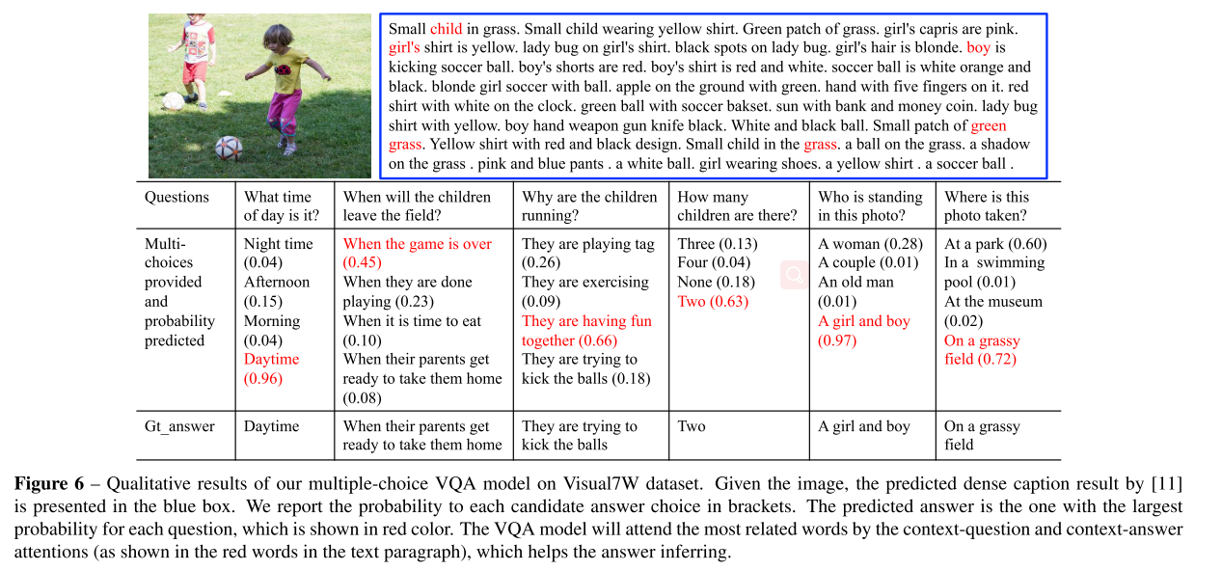

Slide 9
