Slide 2
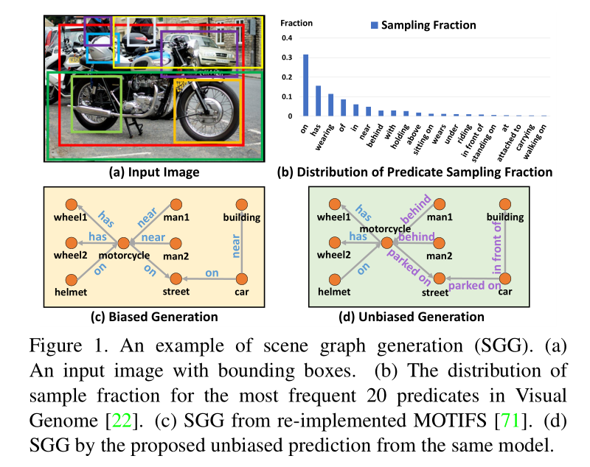
Biased training in VRD
most of the visual relationships are trivial and less informative
heavily biased generation comes from the biased training data
both our visual world per se and the way we describe it are biased
We believe that the key is to teach machines how to distinguish between the “main effect” and “side-effect”

Slide 3
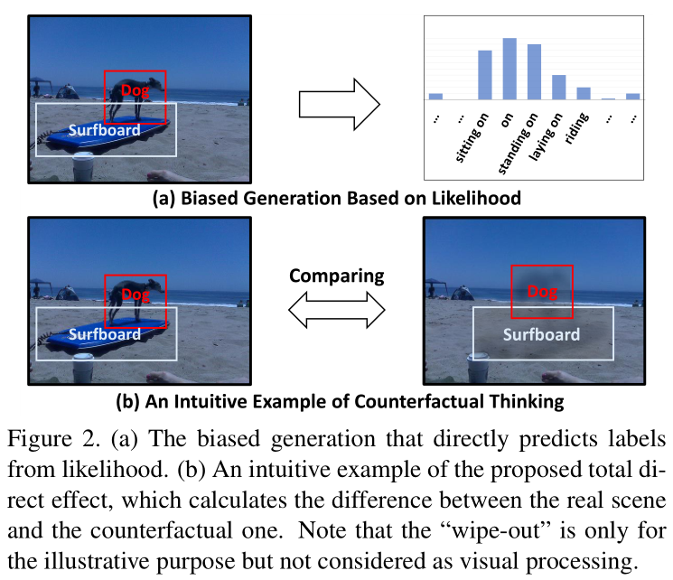
counterfactual causality
If I had not seen the content, would I still make the same prediction?
By doing this, we can focus on the main visual effects of the relationship without losing the context.

Slide 4
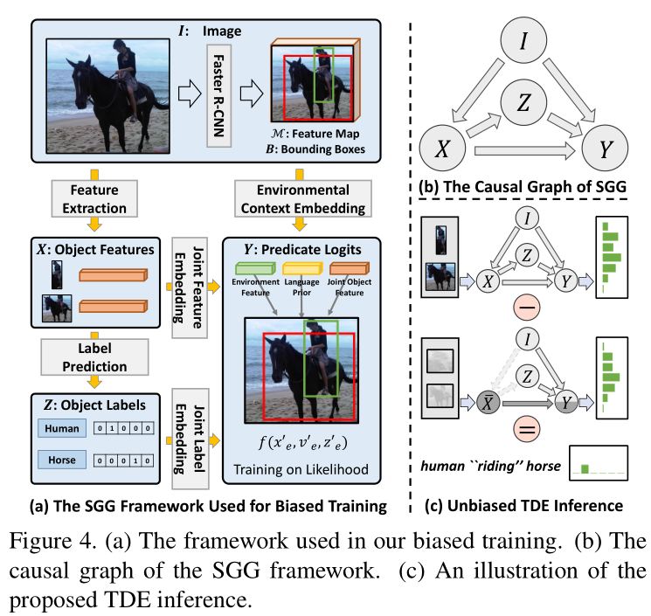
framework

Slide 5
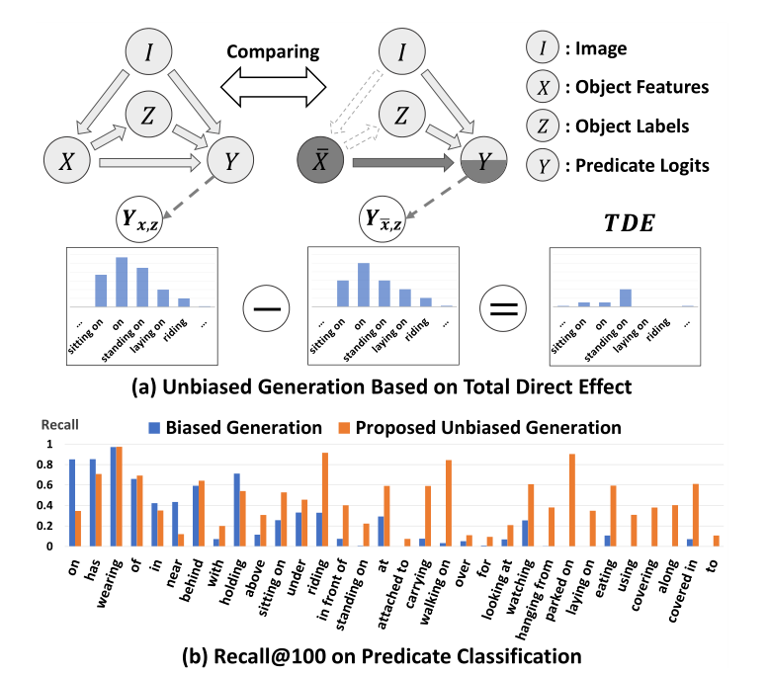
Causal Graph
I: image
X: (tentative label, bbox, object feature) -> $x_{i}$
Z: object class -> $z_{i}$
X → Y: ${x′}_{e}=f(x_{i},x_{j})$
I → Y: ${v′}_{e}=ROI(b_{i}∪b_{j})$
Z → Y: ${z′}_{e}=W_{z}[z_{i}⨂z_{j}]$
SUM: $y_{e}=W_{x}{x′}_{e}+W_{v}{v′}_{e}+{z′}_{e}$
GATE: $y_{e}=W_{r}{x′}_{e}⋅σ(W_{x}{x^{′}}_{e}+W_{v}{v^{′}}_{e}+{z^{′}}_{e})$

Slide 6
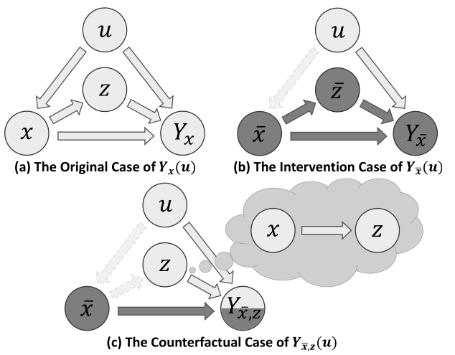
Total Direct Effect / Total Effect
Intervention: $do\left(X=\overline{x}\right)$
Causal Effect: $Y_{\overline{x}}=Y(do\left(X=\overline{x}\right)|u)$
Intervention case: $Y_{\overline{x}}$
Counterfactual case: $Y_{\overline{x},z}$

Slide 7
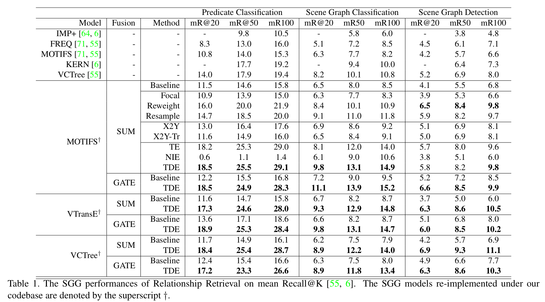
experiment

Slide 8
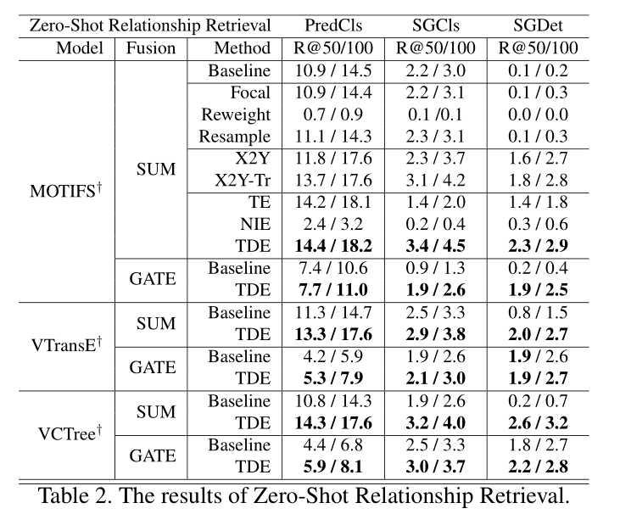
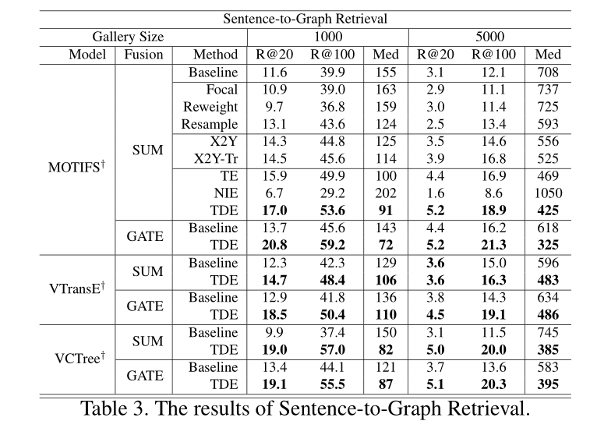
experiment

