Slide 1
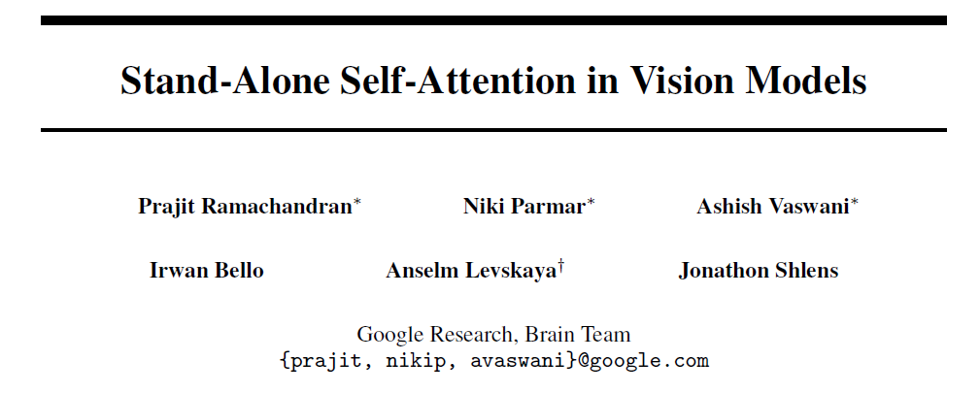

Slide 2
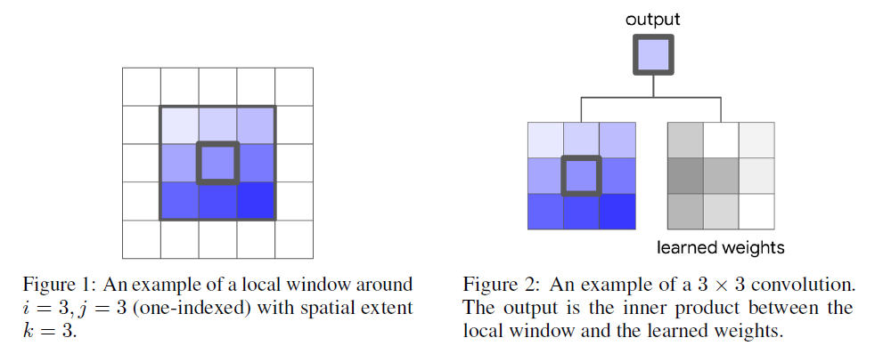
Convolution

Slide 3
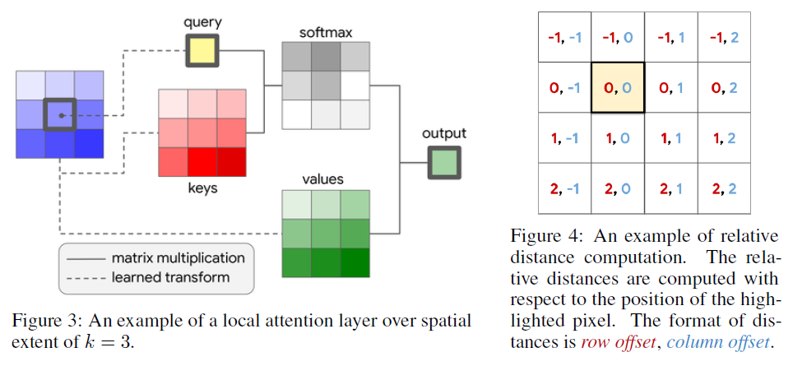
Stand-alone self-attention layer

Slide 4
Stand-alone self-attention layer
With relative position

Slide 5
Fully Attentional Vision Models
Replacing Spatial Convolutions
Replace 3x3 conv in bottlenecks
Replacing the Convolutional Stem
Spatially-varying linear transformation

Slide 6
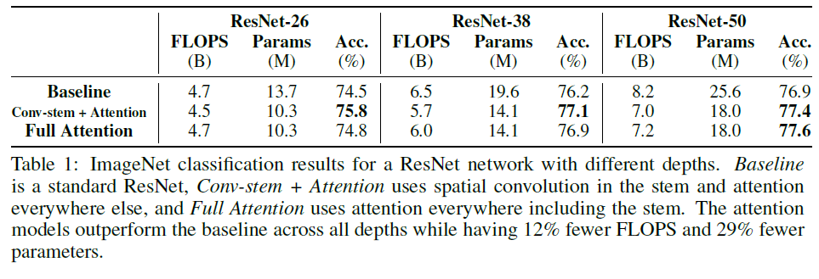
Experiments

Slide 7
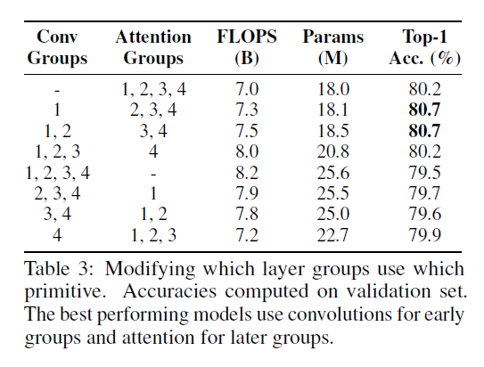

Slide 8
