Slide 2
ViTDet :exploring plain vision transformer (ViT) as backbone for object detection
Results:
61.3 AP[box] on the COCO dataset with a plain ViT-Huge backbone, using
only ImageNet-1K pre-training with no labels with MAE pre-training
Highlights:
1.不重新设计层次结构，plain, non-hierarchical backbone with minimal adaptations
2.从最后单特征图构建简单FP非常有效，不需要FPN
3.不使用shifting窗口注意力，加上很少的跨窗口块非常有效。(by default, 4)
4.使用MAE预训练的VIT，能够在CoCo上取得很好的结果。

Slide 3
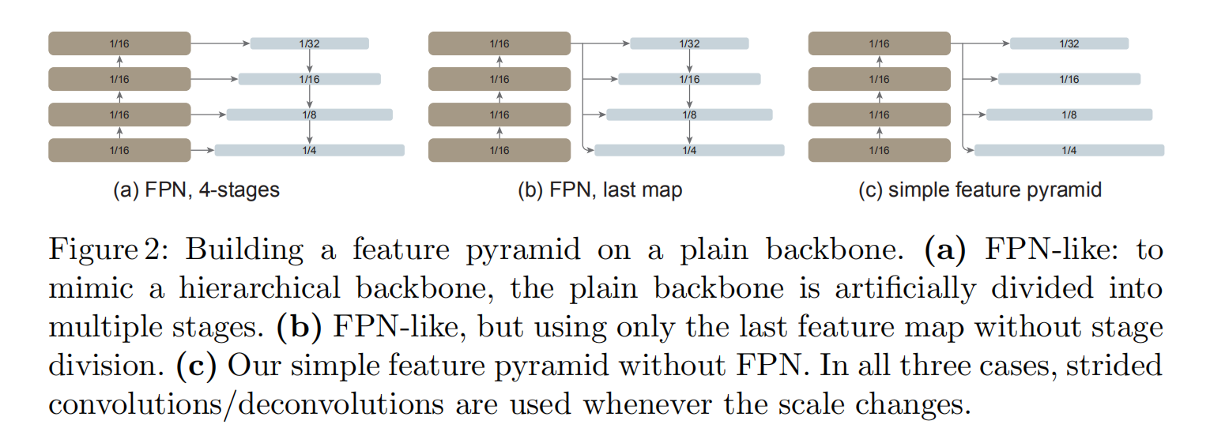
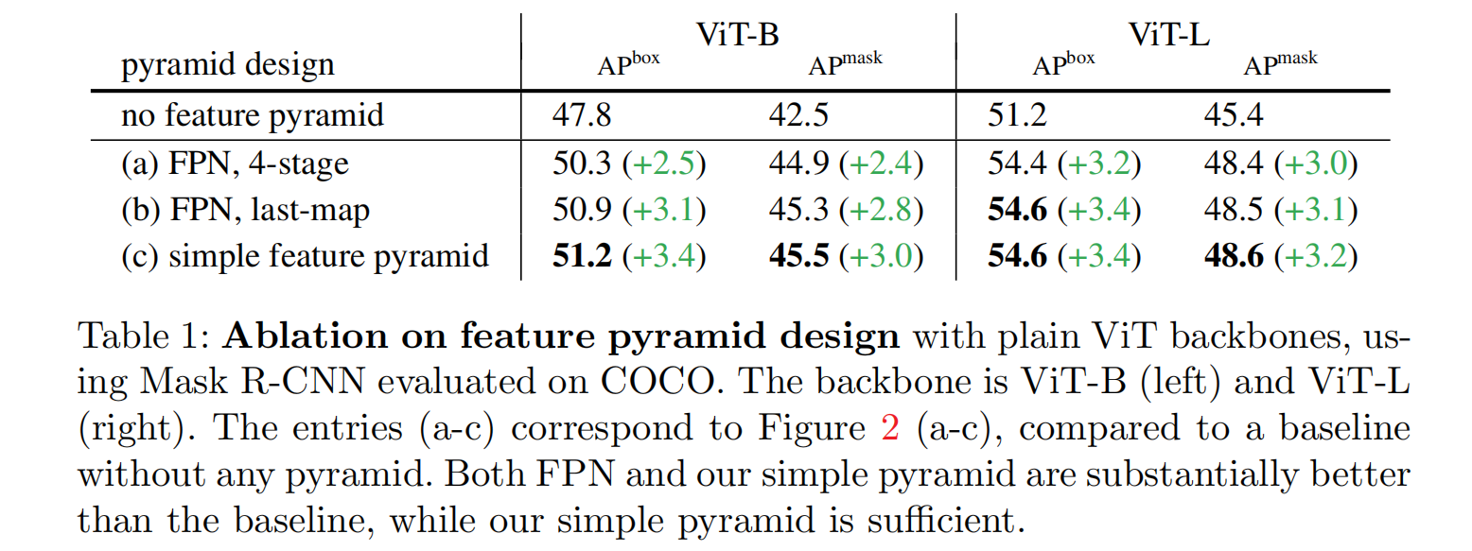
1.Simple Feature Pyramid

Slide 4
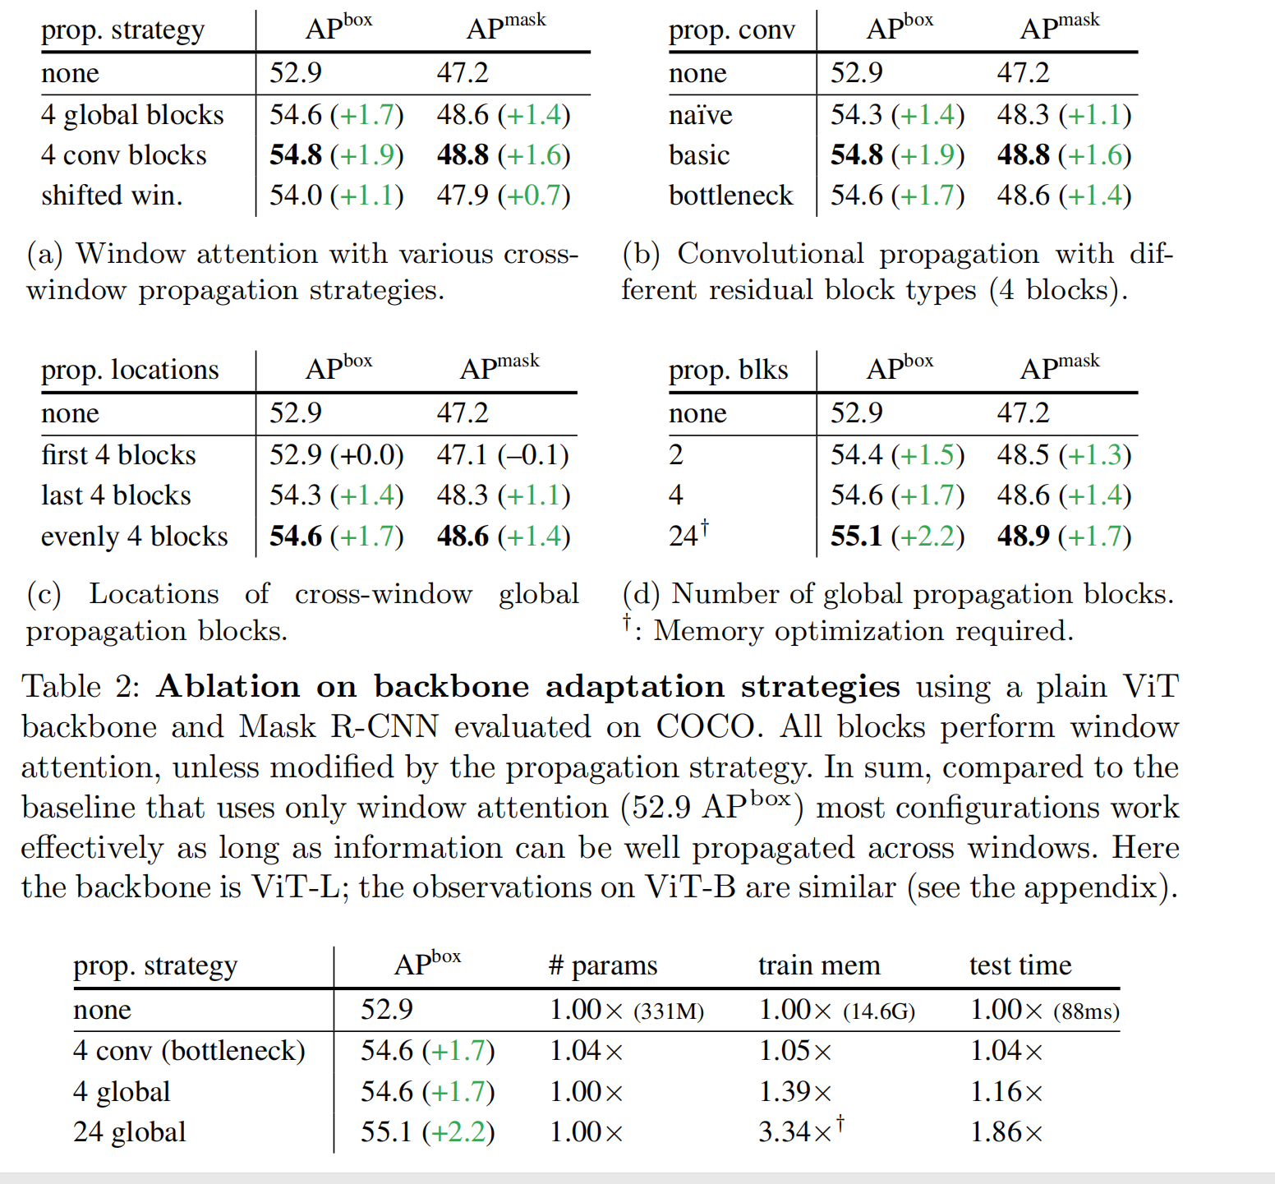
2.Backbone adaptation
Unlike Swin, do not “shift” the windows across layers. To allow information propagation, use a very few (by default, 4) blocks that can go across windows.
(i) Global propagation.
(ii) Convolutional propagation
Window attention is sufficient when aided by a few propagation blocks.

Slide 6
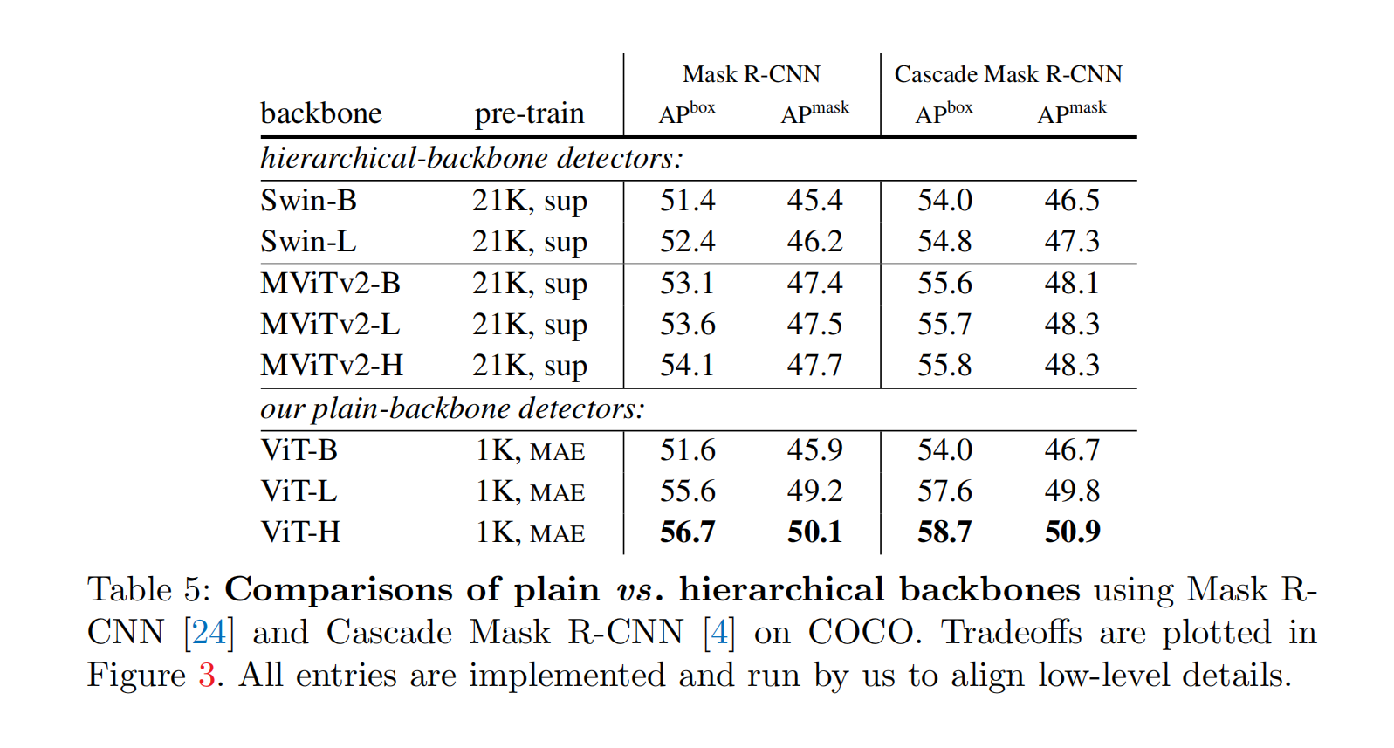

Slide 7
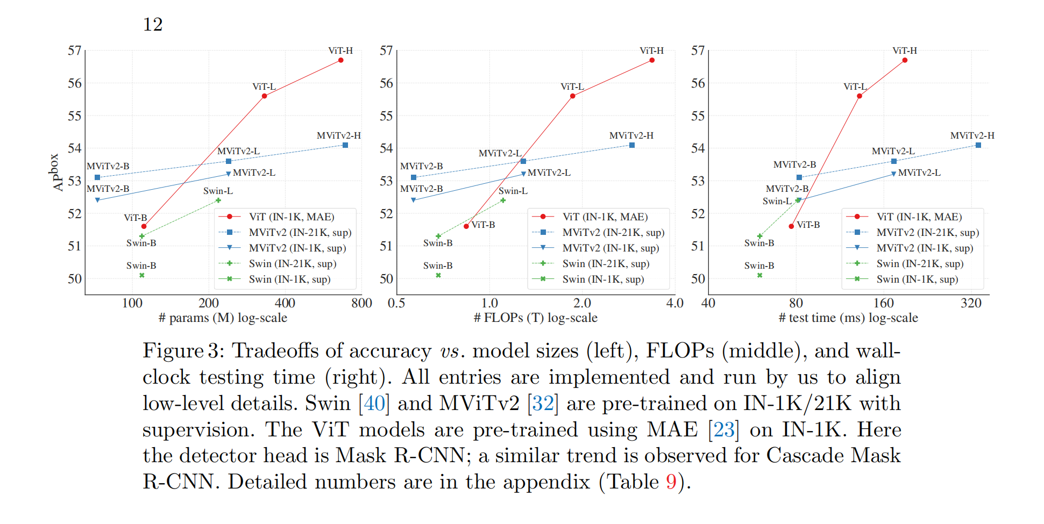

Slide 8
