Slide 1
Visual Grounding

Slide 2
Problem Definition
Visual Grounding/ Referring Expression
Matching Expression with Detected Object.
Search target object from a sets of objects in a image through an expression.

Slide 3
MAttNet: Modular Attention Network for Referring Expression Comprehension

Slide 4
Motivation
Previous Work: using a simple concatenation of all features as input and a single LSTM to encode/decode the whole expression.
Problem: ignoring the variance among different types of referring expressions.

Slide 5
Contribution
Present the first modular network for the general referring expression comprehension task.
MAttNet learns to parse expressions automatically through a soft attention based mechanism, instead of relying on an external language parser
Applying different visual attention techniques in the subject and relationship modules to allow relevant attention on the described image portions.

Slide 6
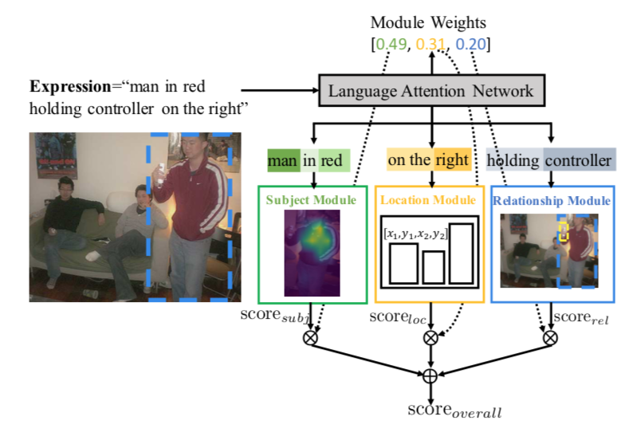
Method
Overview

Slide 7
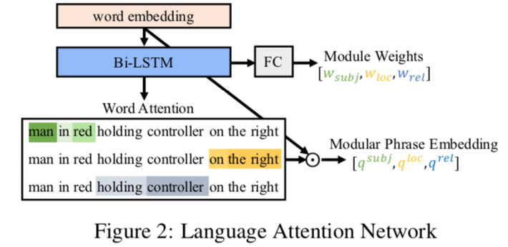
Method
Language Attention Network

Slide 8
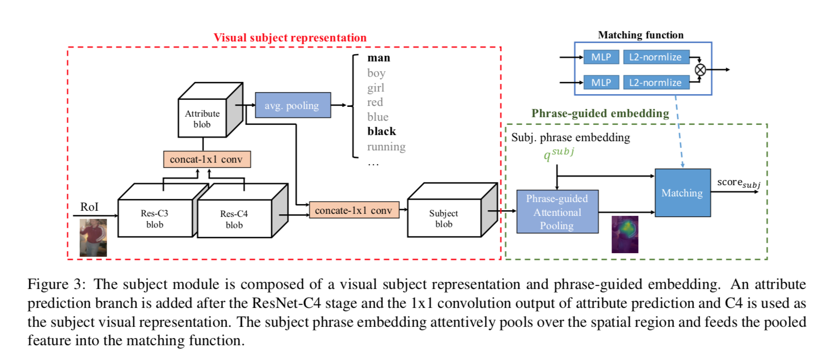
Method
Visual Modules

Slide 9
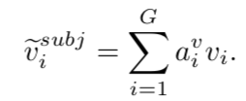
Method
Visual Modules
Subject Module
Given the C3 and C4 features of a candidate, we forward them to two tasks.
attribute prediction:
phrase-guided attentional pooling:
Given the subject phrase embedding $q^{subj}$ compute its attention on each grid location:
The weighted sum of V is the final subject visual representation for the candidate region

Slide 10
Method
Visual Modules
Matching Function:
Purpose: measure the similarity between the subject representation and phrase embedding.
Operation:
Two MLPs transform the visual and phrase representation into a common embedding space.
The inner-product of two l2-normalized representations computes their similarity score.

Slide 11
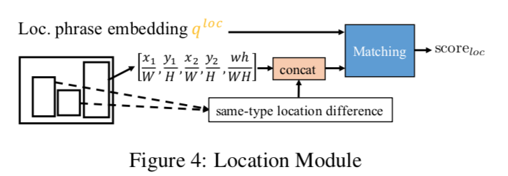
Method
Location Module
Location embedding:
Relative location embedding:
Location representation for the target object is:
Matching score:

Slide 12
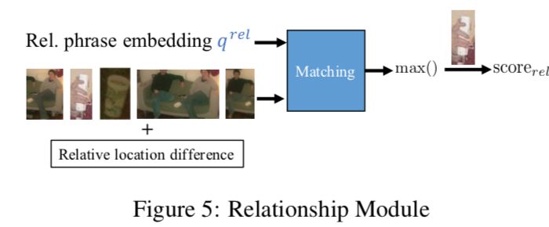
Method
Relationship Module
use the average-pooled C4 feature as the appearance feature.
we encode their offsets to the candidate object via
The visual representation for each surrounding object is:
The matching score:

Slide 13
Loss Function
Overall weighted matching score:
Combined hinge loss:

Slide 14
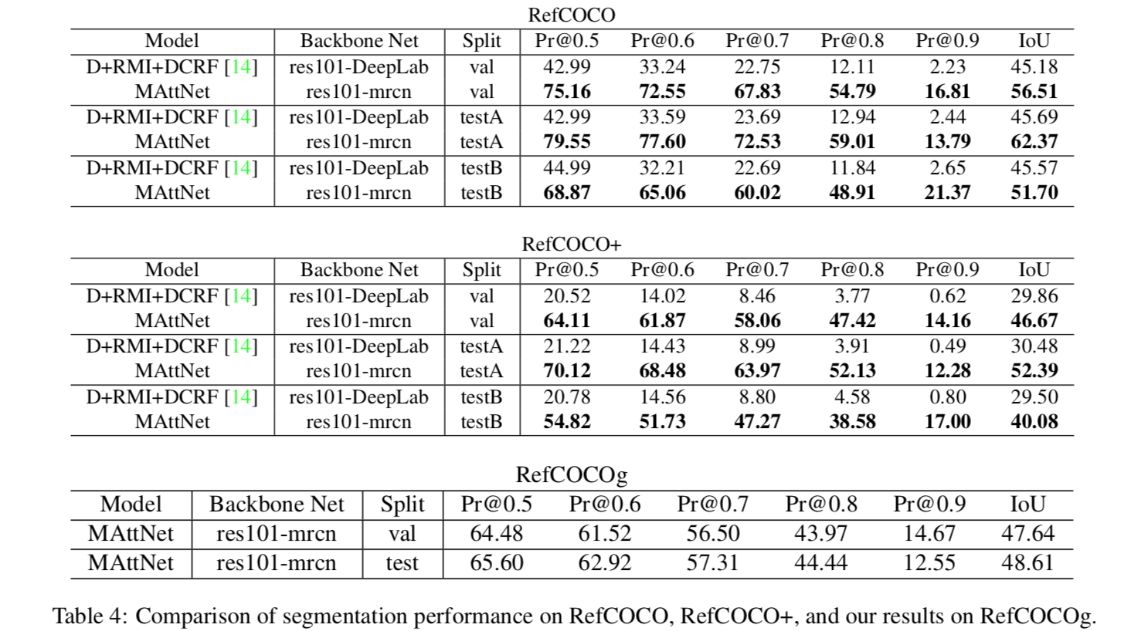
Experiment

Slide 15
Experiment

