Slide 1
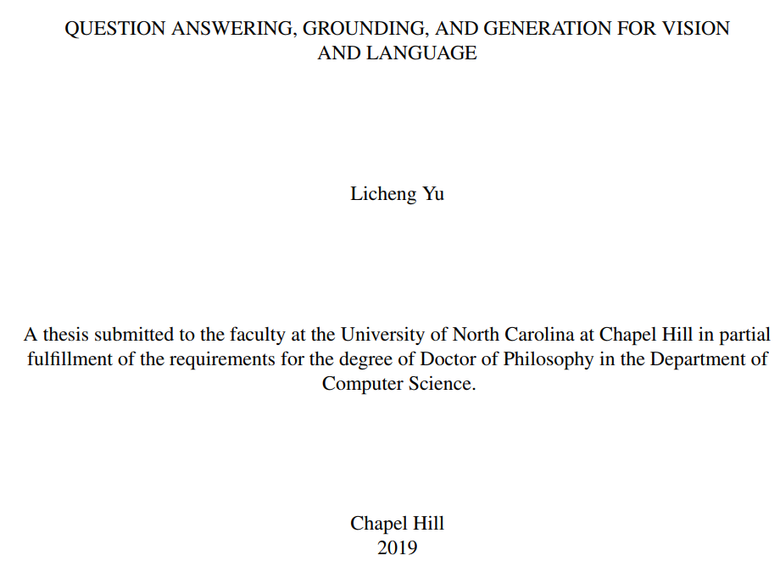

Slide 2
Introduction
Ultimate goal of AI
To build an AI agent that can listen, see, talk, and even act, to better serve us.
This thesis focus on the initialization stage
Vision and language understanding for human-robot interaction.
Include
VQA: Visual Madlibs
Language grounding: RefCOCO and RefCOCO+ / MattNet
Image-to-text generation: Speaker-listener
Embodied AI: Multi-Target Embodied Question Answering

Slide 3
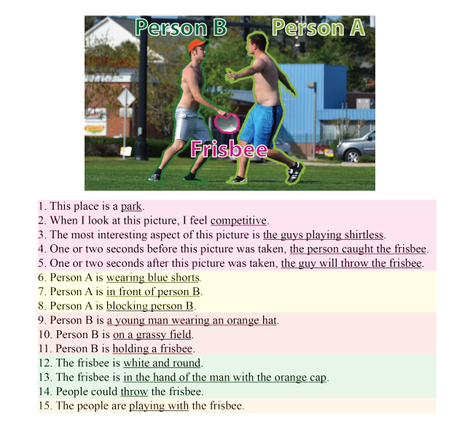
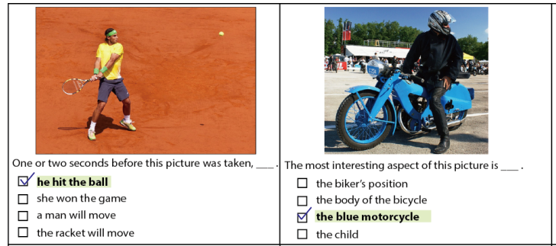
1. VQA
Visual Madlibs: Fill-in-the-blank Image Description and Question Answering. ICCV 2015
http://tamaraberg.com/visualmadlibs/overview.html
Contribution
New description collection strategy
New Dataset
Definition and evaluation on new tasks

Slide 4
Visual Madlibs
2 Tasks
Generation: fill in the blank
Multiple-choice QA
Evaluation (No new method proposed)
Canonical Correlation Analysis
CNN+LSTM
Visual Madlibs: Fill-in-the-blank Image Description and Question Answering. ICCV 2015
http://tamaraberg.com/visualmadlibs/overview.html

Slide 5
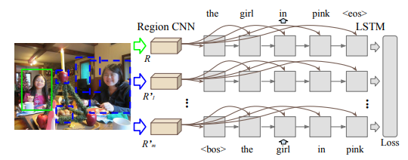
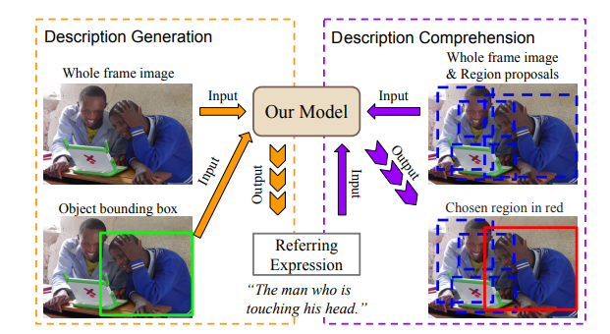
2. Referring Expression (RE)
Modeling Context in Referring Expressions. ECCV 2016
Task
RE Generation and Comprehension
Collected 2 Dataset:
RefCOCO: Free expression style.
Ref-COCO+: Abs. Loc forbidden.
Baseline approach
Object + context + location representation
CNN + LSTM
Region generation + ranking for Comprehension
Generation and comprehension of unambiguous object descriptions. In CVPR2016. a.k.a. RefCOCOg

Slide 6
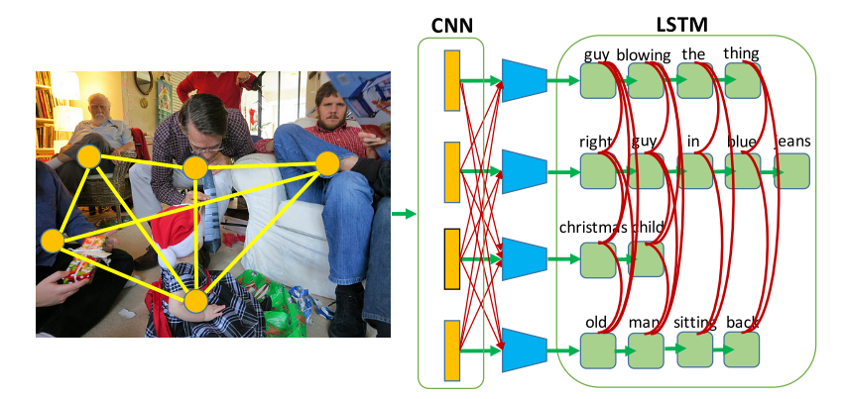
RE Generation and Comprehension
Modeling Context in Referring Expressions. ECCV 2016
What’s new?
Visual / Location difference representation
Discriminate the target object from the surrounding objects
Joint Language Generation
For all objects of the same object category in an image.
Input of LSTM
Incorporating the hidden output difference as additional information.

Slide 7
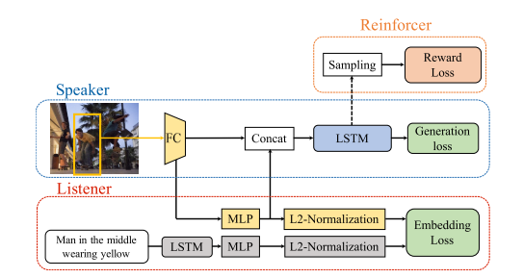
A Joint Speaker-Listener-Reinforcer Model for Referring Expressions
CVPR 2017
Generation and comprehension tasks
CNN-FC-LSTM Speaker
Triplet hinge losses
Embedding-based Listener
Embeds vectors that are visually or semantically related closer together.
Reinforcer
Guide the sampling of more discriminative expressions

Slide 8
A Joint Speaker-Listener-Reinforcer Model for Referring Expressions
Reinforcer
To generate less ambiguous expressions.
Sample words according to the categorical distribution of LSTM
Policy gradient
Concatenate + MLP + 1-d logistic regression as reward function
Joint model
Concatenate listener-aware representation to speaker

Slide 9
Comprehension and Generation
Comprehension
Ensemble the speaker and listener predictions.
Generation
Generate multiple expressions per object via beam search by Speaker.
Use listener to re-rank expressions and select the least ambiguous expression.
Consider cross comprehension as well as the diversity of expressions by minimizing:

Slide 10
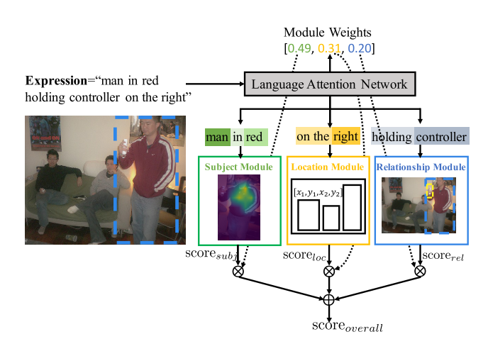
MattNet
MAttNet: Modular Attention Network for Referring Expression Comprehension. CVPR 2018
General referring expressions
Modular network
Subject
Location
Relationship
Parse expressions
Through a soft attention mechanism
Different visual attention tech
In the subject and relationship modules, named ‘in-box’ and ‘out-of-box’

Slide 11
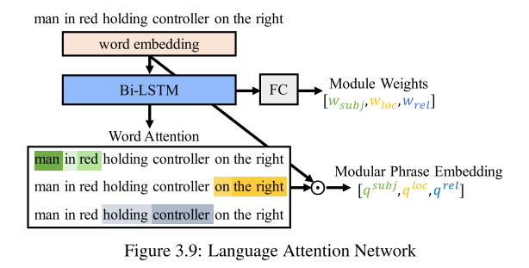
Language Attention Network

Slide 12
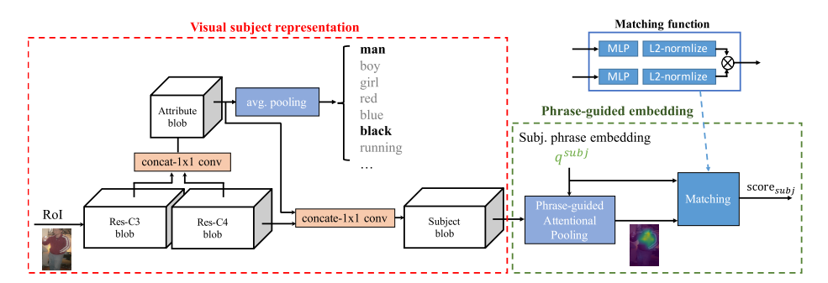
Visual Modules While

Slide 13
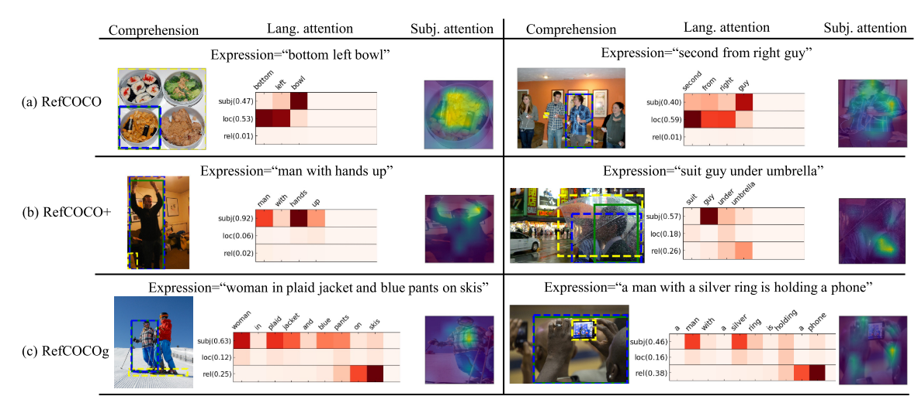
Experiment

Slide 14
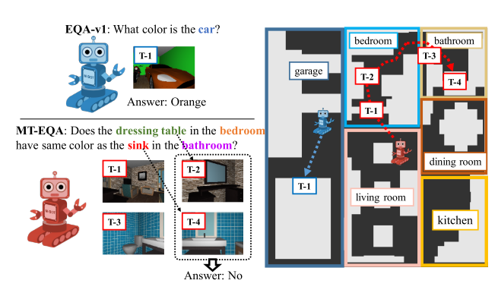
3.Embodied Question Answering
CVPR 2019
Present a generalization of EQA – multi-target EQA (MT-EQA).

Slide 15
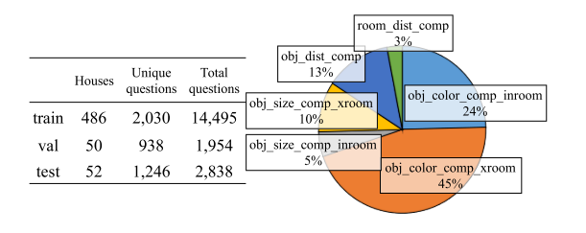
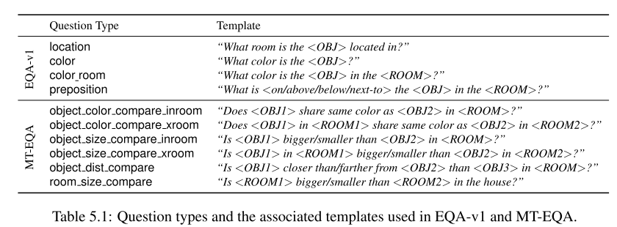
Datasets
Based on EQA-v1
Dataset collection: CLEVR
Baseline: Neural Modular Networks
Binary QA

Slide 16
Multi-Target EQA Generation
Q is represented as a series of functional programs
Shortest path
Filter unreachable room in Dataset
As GT in training process
Minimize the bias

Slide 17
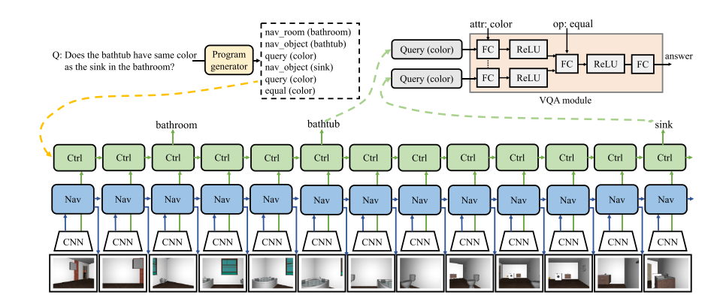
MT-EQA
A new model that consists of 4 components (Modular Models)
Program Generator
Navigator
Controller
VQA module.
Agent action
Turning left
Turning right
Moving forward

Slide 18
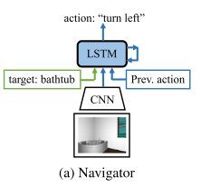
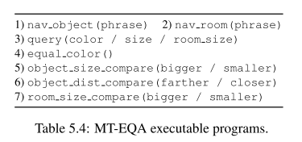
Details
Program Generator
7 types of executable programs
Template-based rules (Since questions are generated in a templated manner)
Navigator
CNN is pretrained on RGB reconstruction, segmentation, depth estimation.
2 separate navigation modules:
Output action: left; right; forward

Slide 19
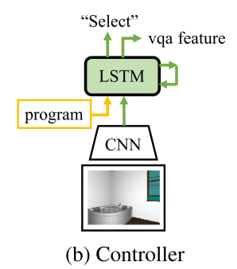
Details
Controller
Creating a plan from the program generator
Collecting the necessary observations from the navigator
Invoking the VQA module.
VQA module
FC + Relu conditioned on the operator
Output yes or no

Slide 20
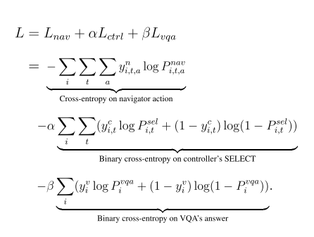
Training
Two-stage approach
Full model is trained using Imitation Learning (IL)
Shortest paths -> navigation
Key positions containing the targets -> Controller’s SELECT classifier
VQA objective at the final step
RL to fine-tune the room and object navigators
A dense reward
The distance change in the 2D bird-view distance space
A sparse reward
IOU between the target’s mask and the centered rectangle mask at termination

Slide 21
Summary
5 papers focus on Vision and Language
VQA
A new Datasets Visual Madlibs (fill in blanks)
Referring expression
2 widely used datasets: RefCOCO / RefCOCO+
Methods for Generation and Comprehension focus on discriminative expressions (Speaker-Listener-Reinforcer)
A strong baseline: MattNet
Embodied QA
A new task, new dataset and baseline
Locate, Tell, Answer and Act

