Slide 1
Learning to Detect Human-Object Interactions with Knowledge

Slide 2
Motivation
In HOI detection task, the label space is often large and intrinsically having long-tail distribution issue.
Verbs and objects in HOIs share certain characteristics across various types of scenes.

Slide 3
Contributions
Construct a knowledge graph to model the dependencies of the verbs and object categories.
offer a new perspective into HOI detection with multi-modal embeddings
Achieve improved performance on two benchmarks

Slide 4
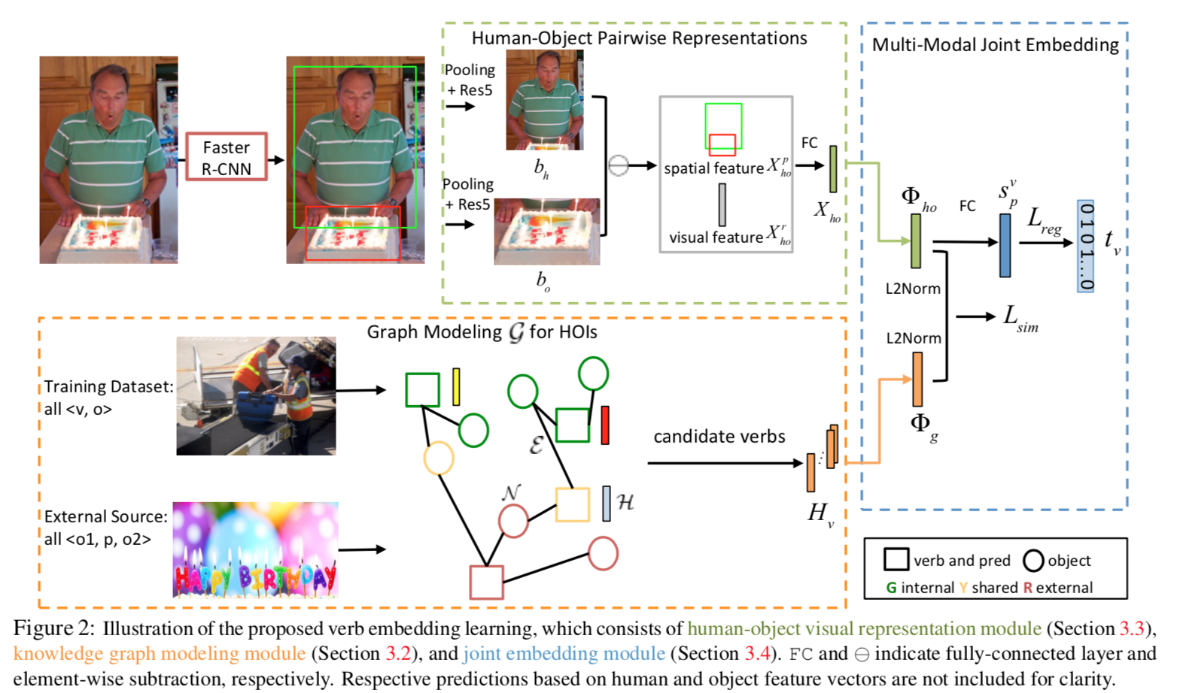
Method
Framework

Slide 5
Method
Graph Modeling for HOIs
Graph architecture:
Node: Verb word embedding or Object word embedding.
Edge: connects a valid pair of verb and object category according to the ⟨verb, object⟩ annotations from training dataset, and ⟨object1, predicate, object2⟩ triplets from general visual relationships dataset.
Adjacency Matrix: initialized with binary values defining the connections (or disconnections) of nodes.
GCN Operation
Traditional GCN:

Slide 6
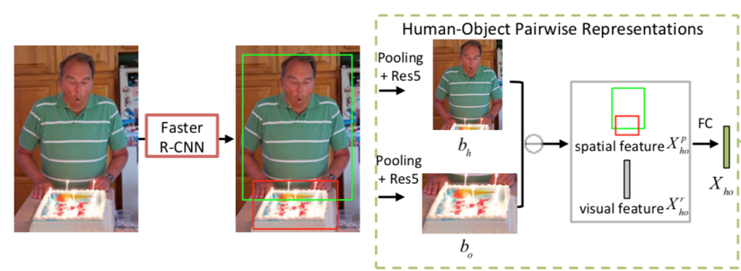
Method
Visual Representation
Same as previous works:
Appearance Feature: ROI Feature.
Spatial Feature: Relative Location Encoding:
Fused Feature:

Slide 7
Method
Multi-Modal Joint Embedding Learning
The goal is to learn the transformations of visual feature $f_{ho}\left(X_{ho}\right)→φ_{ho}$ and GCN feature $f_{g}\left(H_{v}\right)→φ_{g}$, such that the learned paired embedding
Similarity Loss:

Slide 8
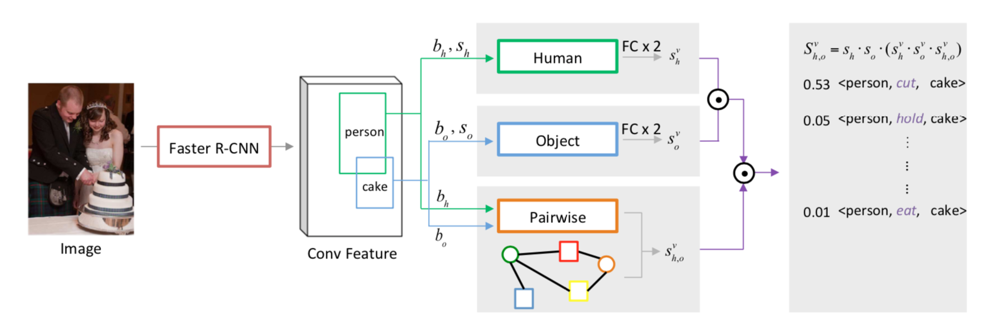
Inference

Slide 9
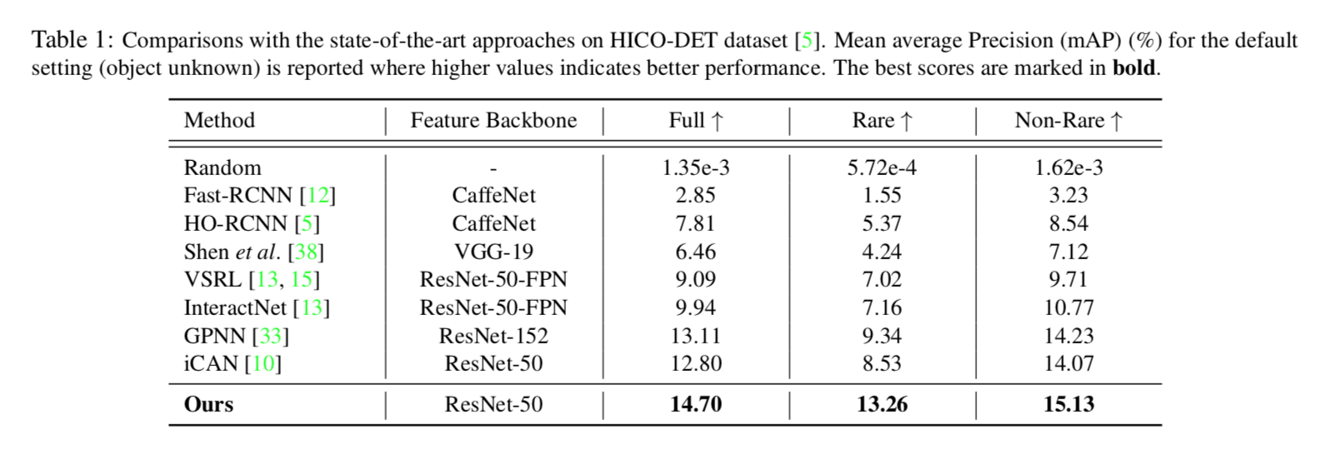
Experiments
HICO-DET

Slide 10
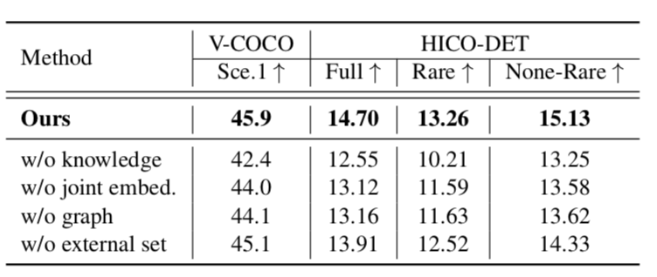
Experiments
Ablation Study

