Slide 1
Learning to Cluster Faces on an Affinity Graph

Slide 2
Contribution
We make the first attempt to perform top-down face clustering in a supervised manner.
It is the first work that formulates clustering as a detection and segmentation pipeline based on graph convolution networks.

Slide 3
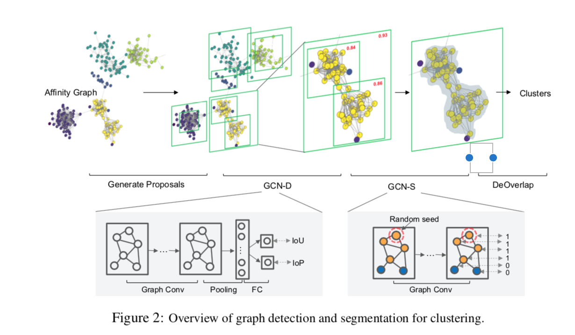
Methodology
Framework

Slide 4
Methodology
Purpose
Generate Sub-graph(proposal) from Affinity Graph.
Operation
Super-vertex: A sub-graph containing a small number of vertices that are closely connected to each other.

Slide 5
Methodology
Cluster Detection
Purpose
Select high-quality clusters
Operation
4-layers GCN
Metric
IoU and IoP score
Training IoU > 0.7 positive example, IoU < 0.3 negative example.
Testing IoU > 0.5.

Slide 6
Methodology
Cluster Segmentation
Purpose
Exclude the outliers from the proposal
Operation
4-layers GCN
Nodes classification.

