Slide 1
Language model and Recurrent neural networks

Slide 2
Overview
Language Model
Language modeling
N-gram language model
Window based neural language model
Recurrent neural networks (RNNs)
Vanilla RNN
LSTM
GRU
Bi-RNN
Stacked RNN

Slide 3
Overview
Language Model
Language modeling
N-gram language model
Neural language model
Recurrent neural networks (RNNs)
Vanilla RNN
LSTM
GRU
Bi-RNN
Stacked RNN

Slide 4
Language modeling
Language modeling : 预测下一个单词是什么
给定单词序列$x^{\left(1\right)}, x^{\left(2\right)}, …, x^{\left(t\right)}$, language modeling预测下一个单词的概率分布：

Slide 5
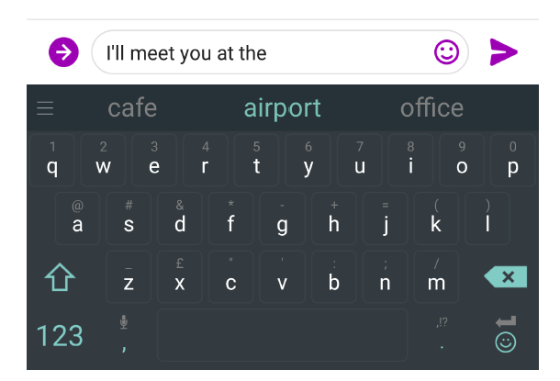
Examples of language models

Slide 6
N-gram language models
N-gram: 连续的n个单词
Unigrams：the, students, opened, their
Bigrams: the students, students opened, opened their
Trigrams: the students opened, students opened their
4-gram: the students opened their
N-gram language model对n-gram进行统计，根据不同n-gram出现次数对下一个单词进行采样

Slide 7
N-gram language model
As the proctor started the clock the students opened their ______
假设我们采用4-gram language model
Students opened their：1000 times
Students opened their books: 400 times -> 0.4
Students opened their exams: 100 times -> 0.1
Conditioned on

Slide 8
N-gram language model
缺点
Sparsity problem：N取值越大，n-gram分布越稀疏
Storage problem：对于n-gram language model，需要存放所有n-gram和所有(n-1)-gram

Slide 9
Window based neural language model
假设window size为4
As the proctor started the clock the students opened their ______
Fixed window

Slide 10
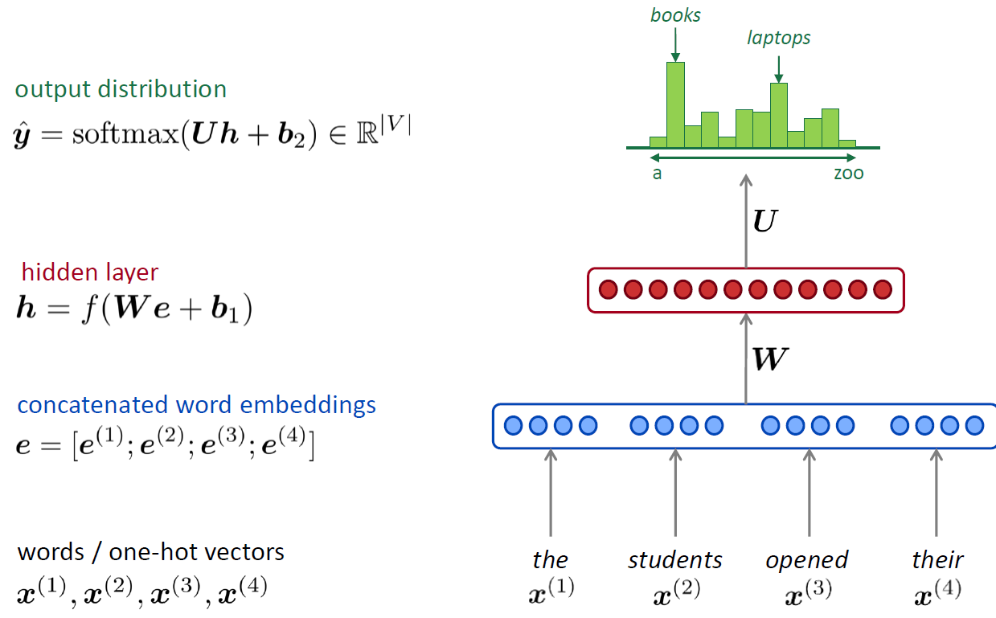
Neural language model

Slide 11
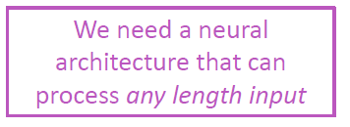
Neural language model
优点
没有sparsity problem
不需要存放所有n-gram
缺点
Windows size固定，限长context
参数量与windows size相关
不同单词权重不一样，有重复

Slide 12
Overview
Language Model
Language modeling
N-gram language model
Neural language model
Recurrent neural networks (RNNs)
Vanilla RNN
LSTM
GRU
Bi-RNN
Stacked RNN

Slide 13
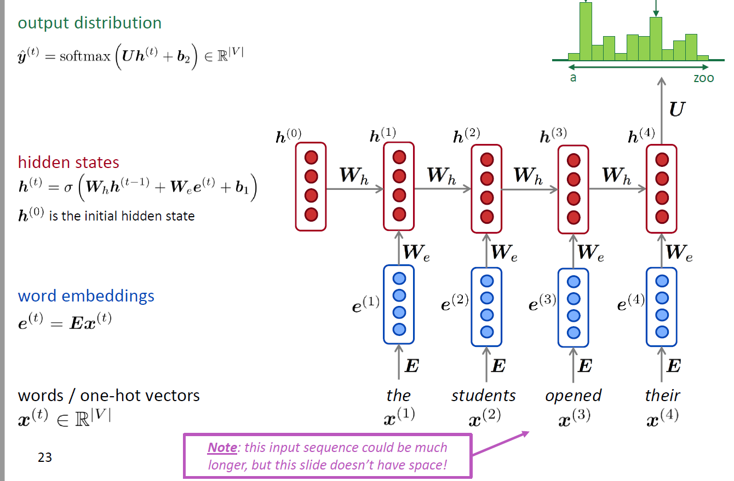
Recurrent Neural Network (RNN)

Slide 14
训练RNN language model
Loss function
Timestep t：
Overall loss

Slide 15
Recurrent Neural Network (RNN)
优点
可以处理任意长度的输入
T时间的输出依赖于T之前所有时间步
模型大小与输入长度无关
模型参数重用
缺点
并行度差，句子越长，处理时间越长 -> Transformer
梯度消失问题严重，并不能真正实现长时间记忆 -> LSTM

Slide 16
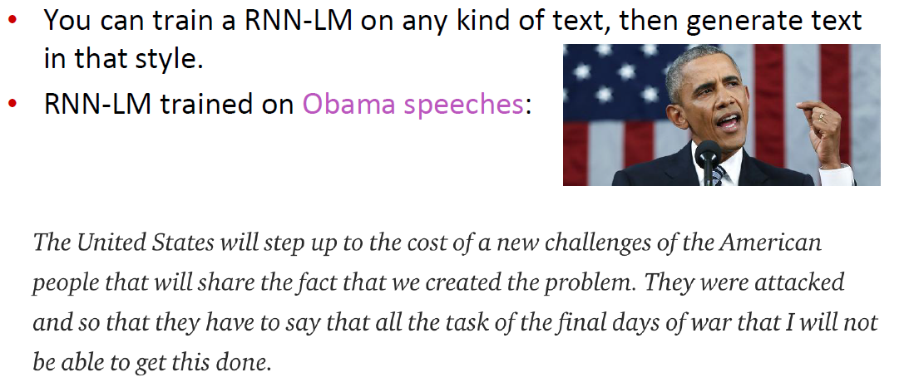
RNN language model生成结果

Slide 17
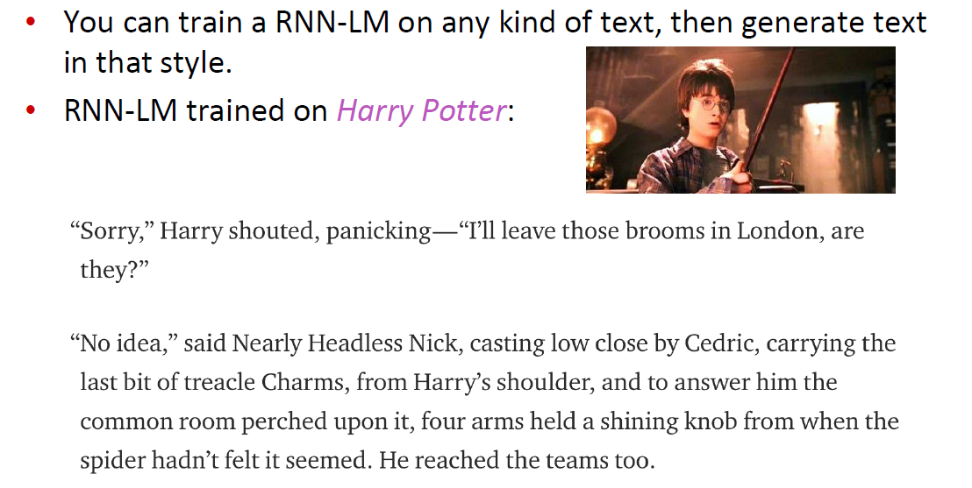
RNN language model生成结果

Slide 18
Recurrent Neural Network
注意！
Language Model: 预测下一个单词模型
Recurrent Neural Network $≠$ Language model

Slide 19
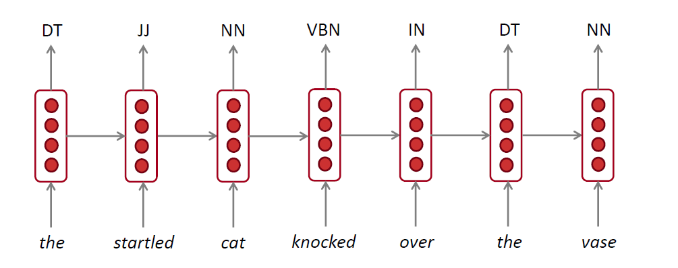
RNN for POS tagging

Slide 20
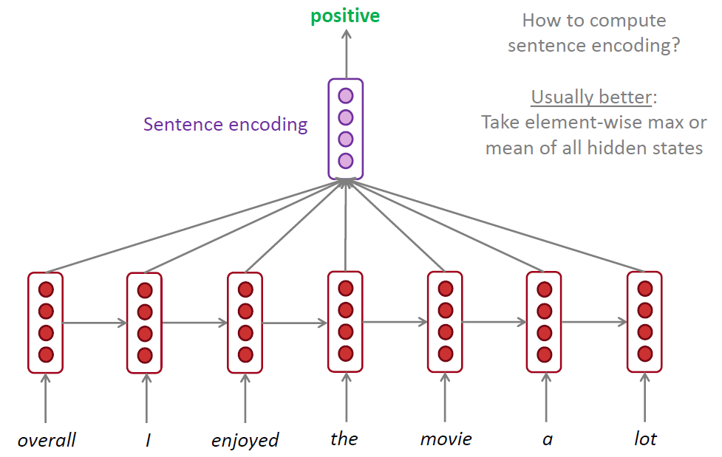
RNN for sentence classification

Slide 21
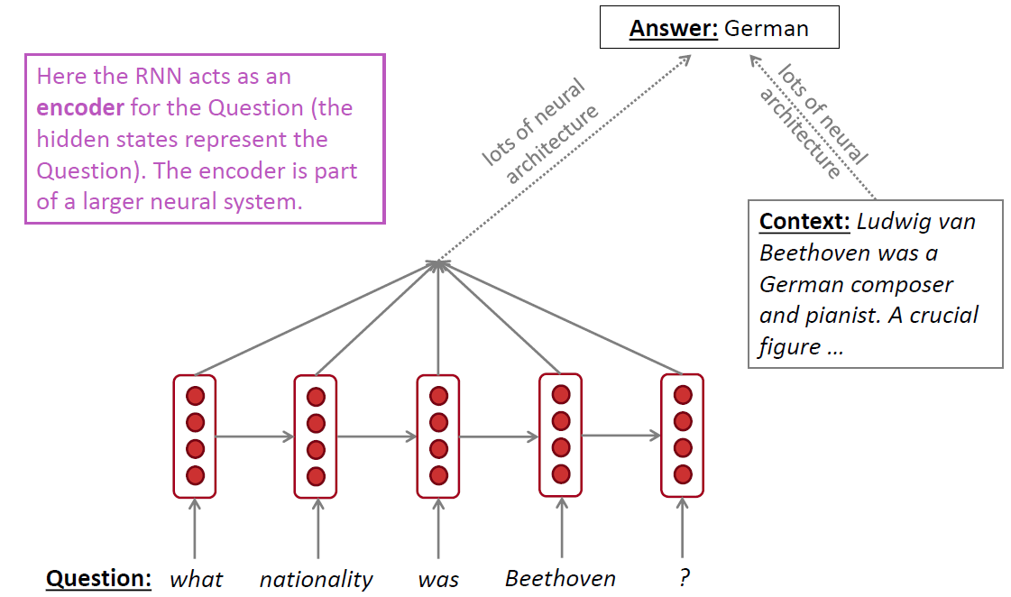
RNN as an encoder module

Slide 22
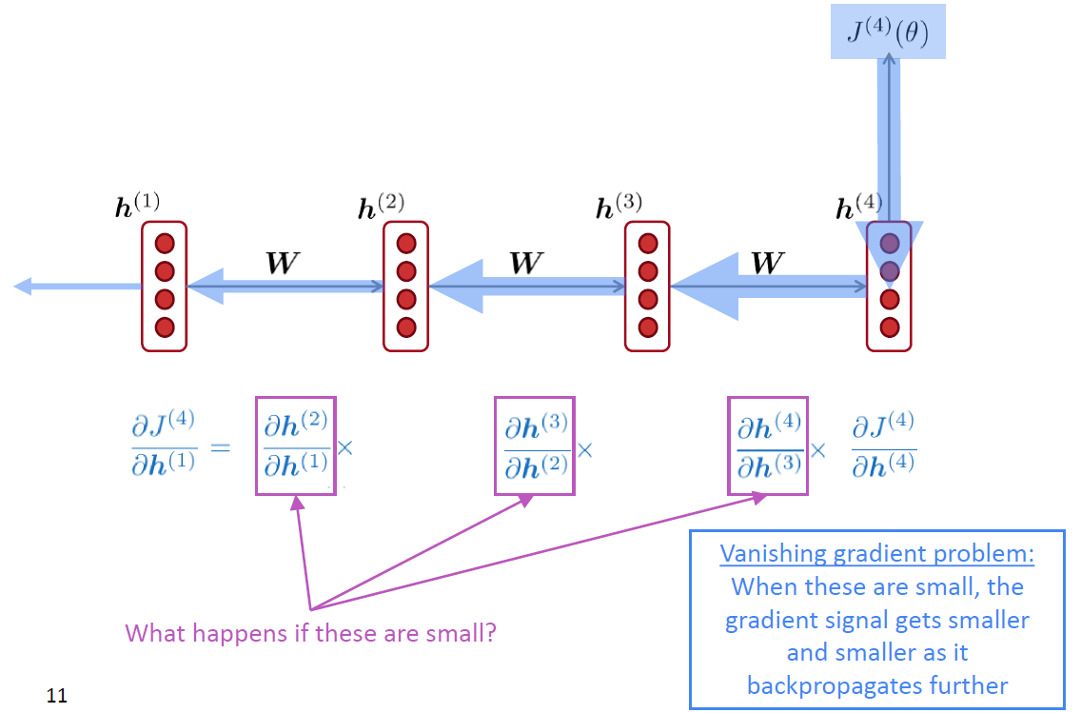
Vanishing gradient for RNN

Slide 23
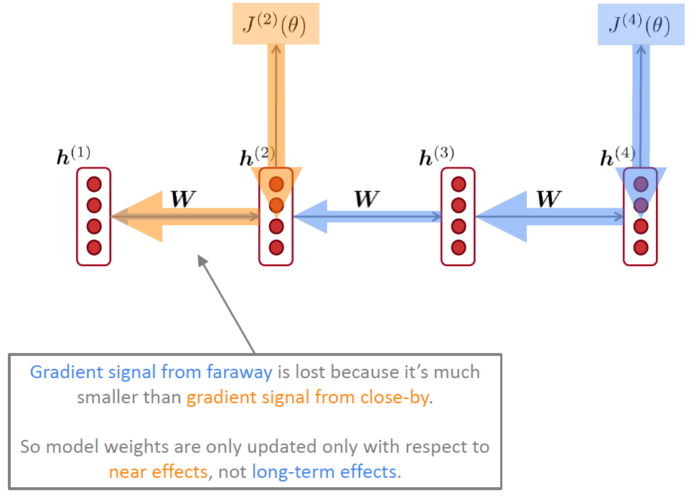
Vanishing gradient for RNN
LSTM

Slide 24
Long Short-Term Memory (LSTM)
Vanilla RNN
每个时间步计算一个hidden state $h^{\left(t\right)}$
LSTM
每个时间步计算hidden state $h^{\left(t\right)}$和cell state $c^{\left(t\right)}$
Cell state存放long-term information
通过3个门控制记忆、写、读
Input gate：控制读入哪些信息到cell content
Output gate：控制写入哪些信息到hidden state
Forget gate：控制保留或遗忘之前时间步cell state的哪些信息

Slide 25
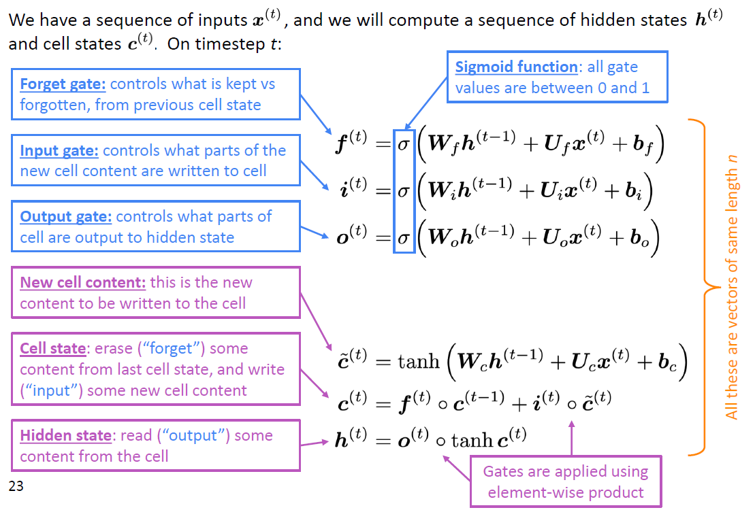
Long Short-Term Memory (LSTM)

Slide 26
Long Short-Term Memory (LSTM)

Slide 27
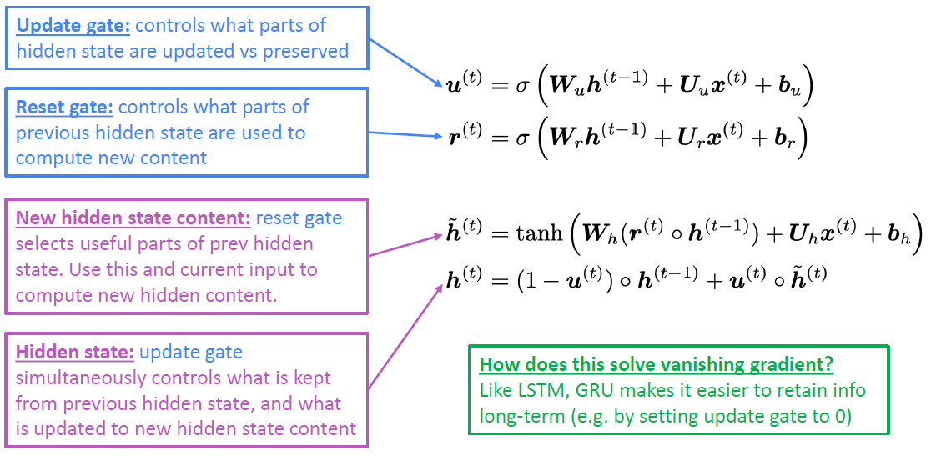
Gated Recurrent Units (GRU)
GRU对LSTM中的操作进行简化，去掉cell state，只保留hidden state

Slide 28
LSTM vs GRU
性能：LSTM和GRU在performance上没有明显的优劣之分
速度：GRU比LSTM快，并且GRU参数比LSTM少
如果有很多training data，并且数据具有明显的long dependencies，LSTM是不错的默认选择
如果对速度要求更高，选择GRU

Slide 29
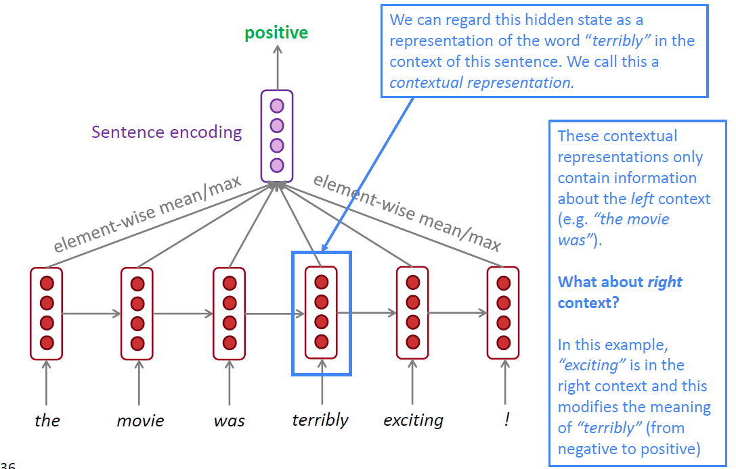
Bidirectional RNN
Motivation

Slide 30
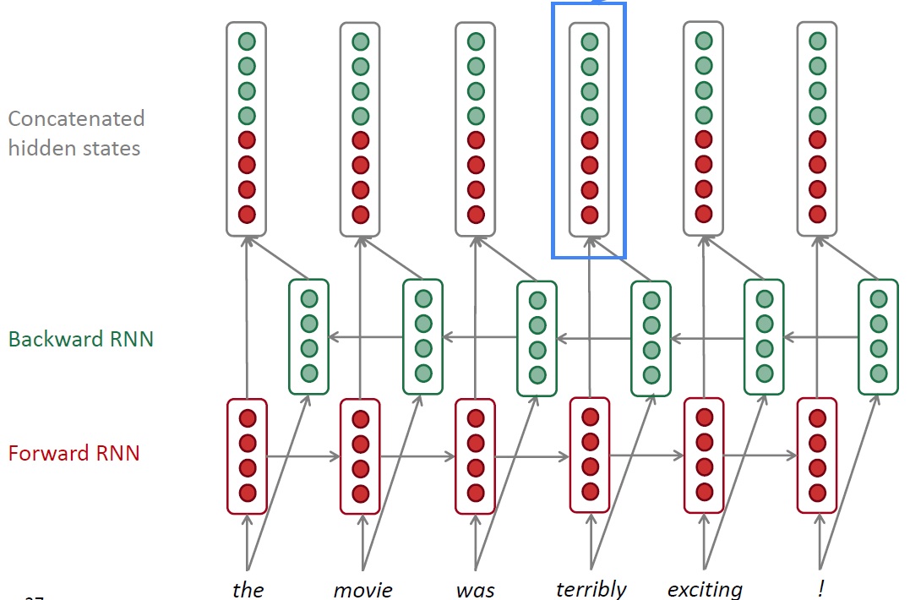
Bidirectional RNN

Slide 31
Bidirectional RNN
只有可以接触到整个输入sequence时，可以选择bidirectional RNN
作为Language model时，无法使用bi-RNN
作为encoder时，可选择bi-RNN

Slide 32
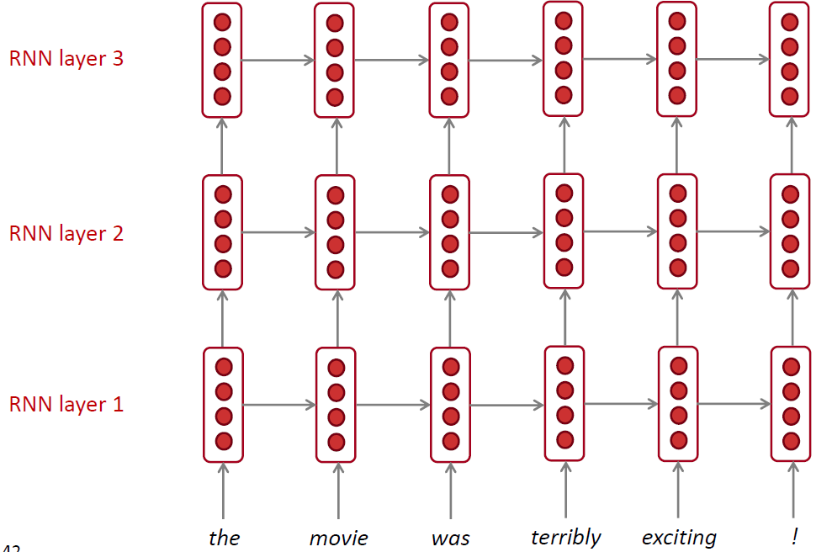
Stacked RNN (Multi-layer RNN)
网络加深
底层网络提取low-level信息，如语法信息等
深层网络提取high-level信息，如语义信息等

Slide 33
Stacked RNN in practice
通常多层RNN表现比单层好
RNN并非层数越多越好
Encoder rnn：2-4层最好
Decoder rnn：4层最好
Transformer-based network可以达到24层（因为有skip connection）

Slide 34
总结

Slide 35
Take-home messages
通常，LSTM比较强，但是GRU速度更快
如果可能的话，尽量使用bidirectional模型
Multi-layer RNN很强，但是如果想要更深的网络，需要加入skip-connection

