Slide 1
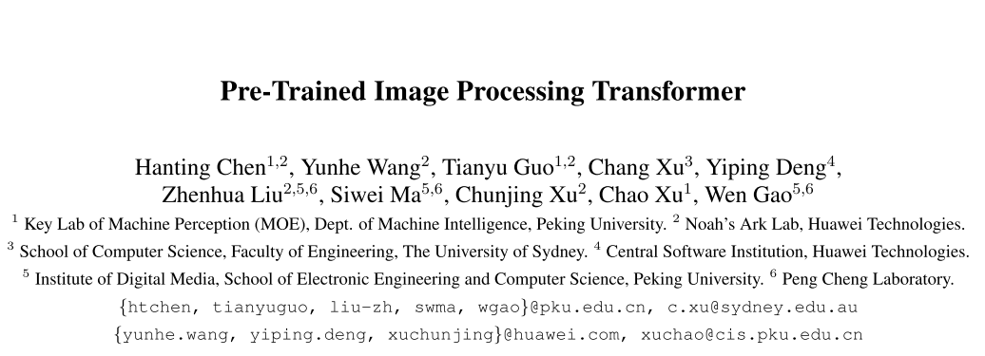
2020-12-20

Slide 2
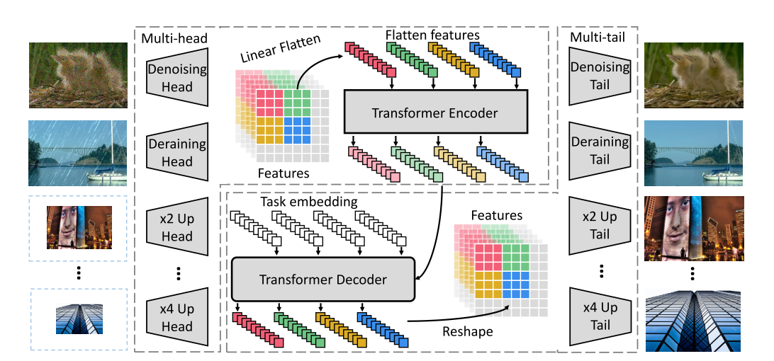
framework

Slide 3
Train & Test
数据集构造：ImageNet构造pair对
每个batch选择一种任务
在fine-tuning中只有对应的head和tail

Slide 4
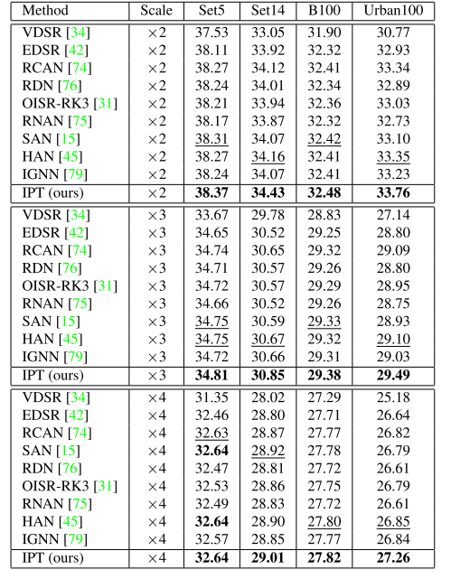
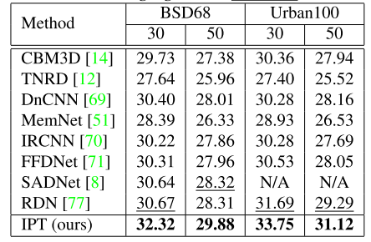
Experiments
Super-resolution
Denoising
Deraining

Slide 5
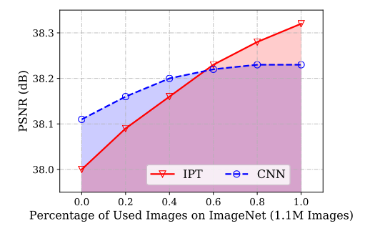
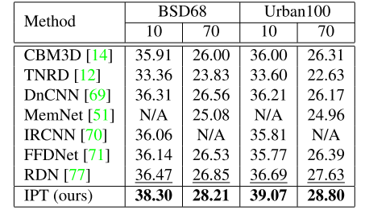
Experiments
loss
Generalization Ability
Generalization Ability

