Slide 2
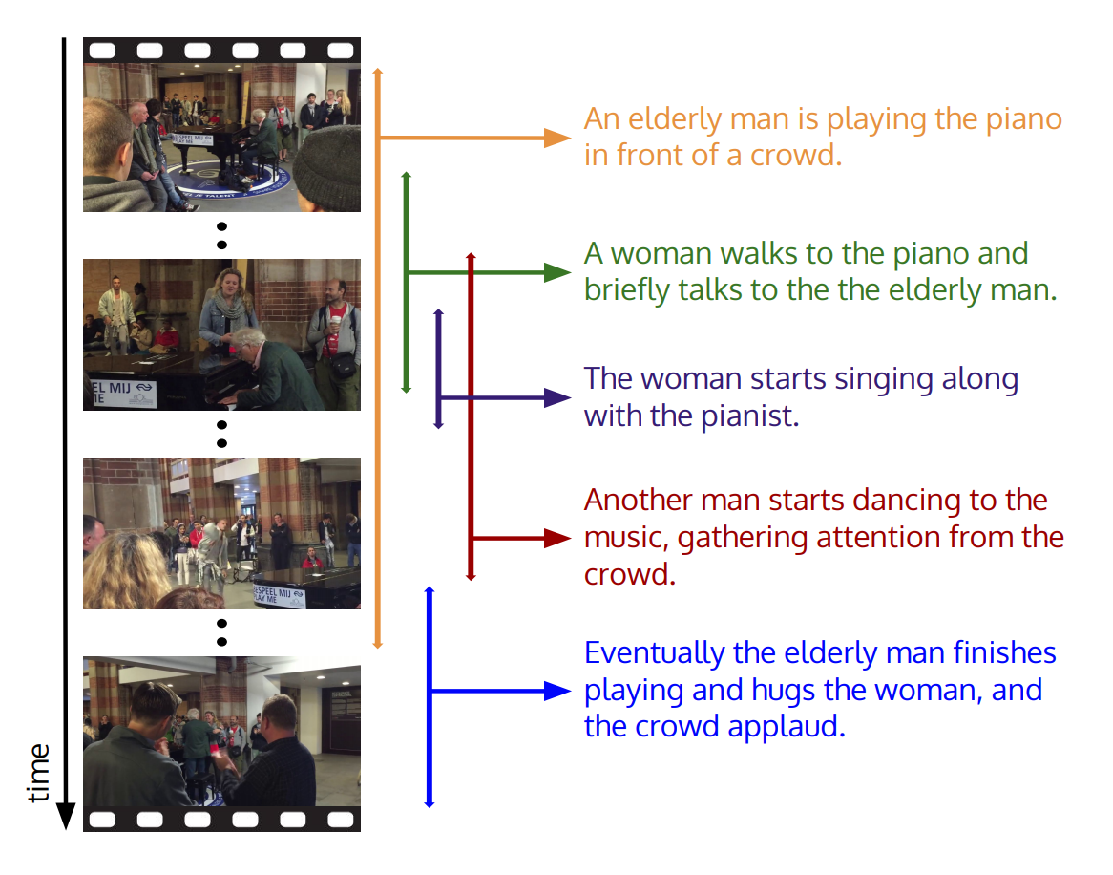
Dense Captioning Events in Videos
Step 1: detecting multiple events that occur in a video
Step 2: describing each event using natural language

Slide 3
Dense Video Captioning System
Motivation：Being aware of contexts of an event not only can provide holistic information to understand the event more accurately, but also tell differences between target event and its context to generate more diverse captions
Segment Feature Extraction
Event Proposal Generation
Event Caption Generation
Proposal and Caption Re-ranking
提取视频特征
基于视频特征，得到事件proposal
对每个proposal进行描述
对proposal和对应描述重新排序

Slide 4
Segment Feature Extraction
每64帧为一个segment，segment之间不重叠，共T个segment
Features：
Basic feature $V_{b}=\{v_{b}^{1},…, v_{b}^{T}\}$
Object feature $V_{o}=\{v_{o}^{1},…, v_{o}^{T}\}$
Semantic feature $V_{s}∈ℝ^{C}$, 共C个concepts（nouns && verbs）
Contextual feature $V_{c},$在前两个特征基础上训练一个LSTM来预测当前segment的concept

Slide 5
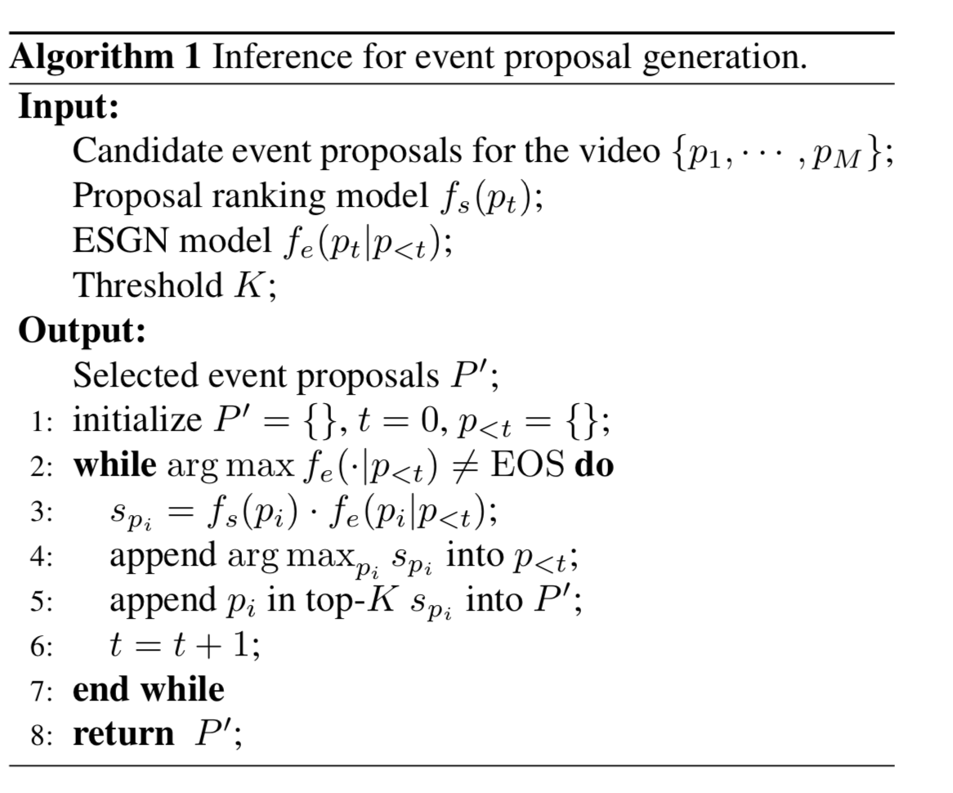
Event Proposal Generation
Step1: 利用sliding window得到proposal候选
Step2: 对proposal候选进行打分排序

Slide 6
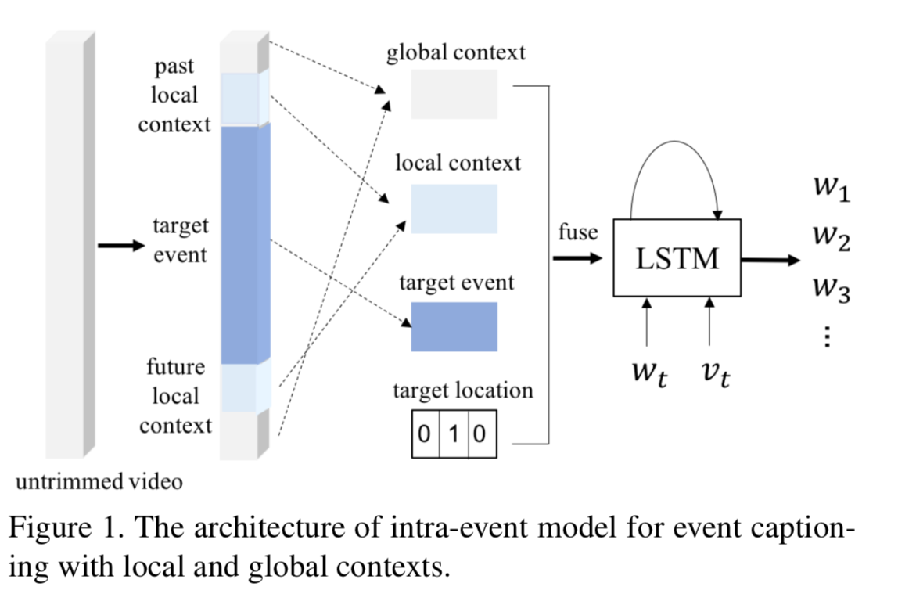
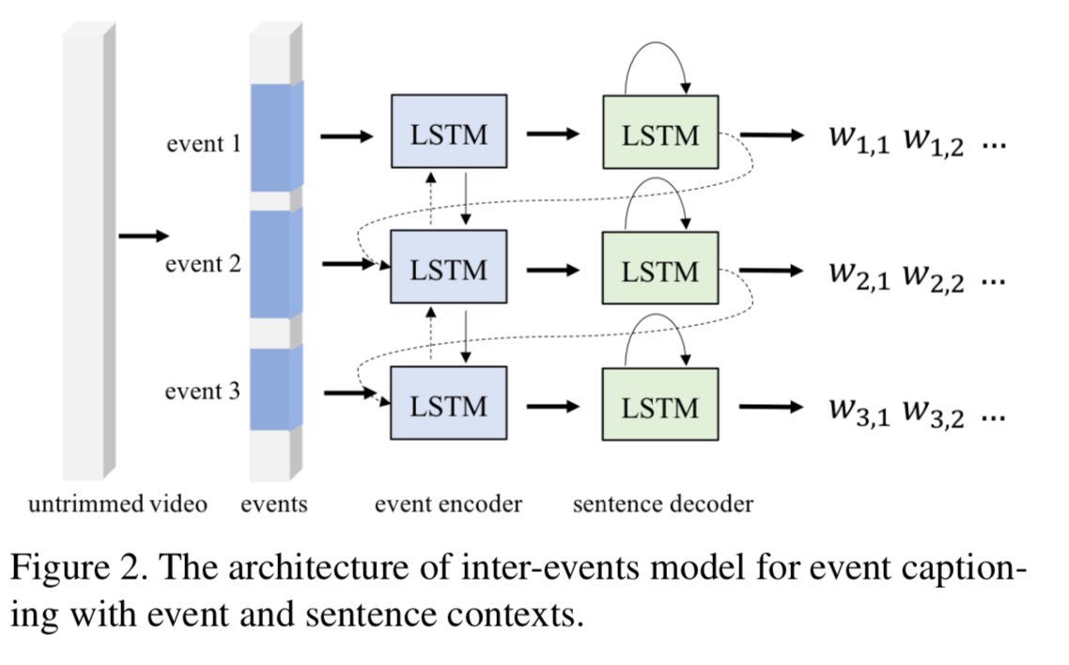
Event Caption Generation
Intra-event Model
Inter-event Model

Slide 7
Proposal and Caption Re-ranking
Proposal Re-rank
Proposal quality from proposal generation models
Describability of the proposal
Position
Length
Caption Re-rank
Number of unique words
Matching of generated words with predicted concepts

Slide 8
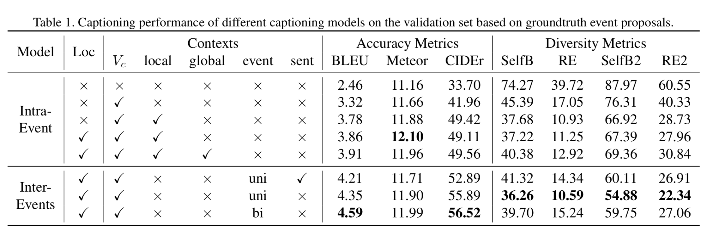
Experiment

Slide 9
