Slide 1
ICCV 2019

Slide 2
Motivation
Learning portable neural networks for edge devices
Deep neural network compression and speed-up methods are effective for training compact deep models, when we can directly access the training dataset﻿
Practice constrains: training data unavailable, architecture unknown

Slide 3
Contributions
Propose a novel ﻿framework for training efficient deep neural networks by exploiting GANs
Achieve comparable performance

Slide 4
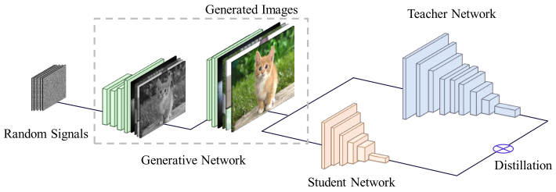
Framework: Data-free Student Network learning
Fixed discriminator
Pursue synthetic images that have the similar distribution as that of the training data previously used for training the teacher network

Slide 5
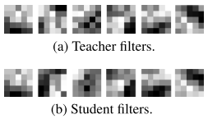
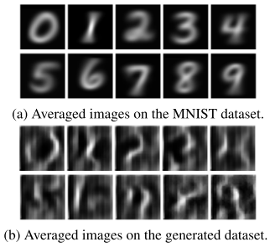
Experiments
acquire valuable knowledge
Indicates that the generator can somehow learn the data distribution

Slide 6
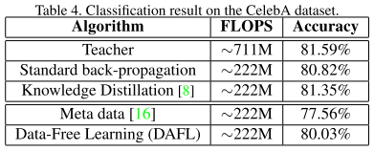
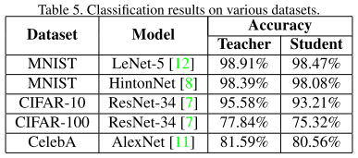
Experiments

