Slide 1
ICCV 2019

Slide 2
Task
Regress the object shape to a short vector to reduce computational consumption of instance segmentation (ESE-Net).
Summarize
locate an inner center point as origin point
Inner-center Radius
sampling the contour points according to the angle
Explicit Shape Encoding
Decoding Shape Vector

Slide 3
Motivation
Forwarding each object instance through an upsampling network to obtain the instance shape is quite computation-consuming.
If the network can also regress the object shape to a short vector, and decode the vector to the shape in a simple way, it can reach almost equal computational efficiency to the object detection.

Slide 4
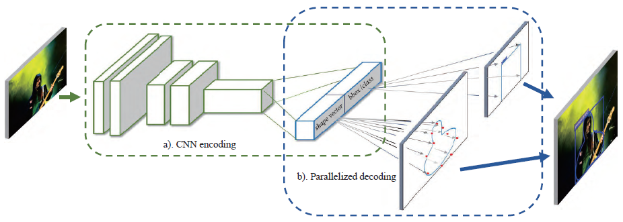
Pipeline

Slide 5
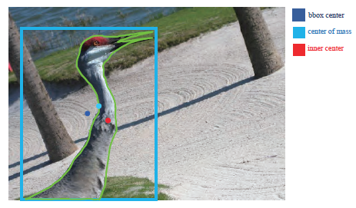
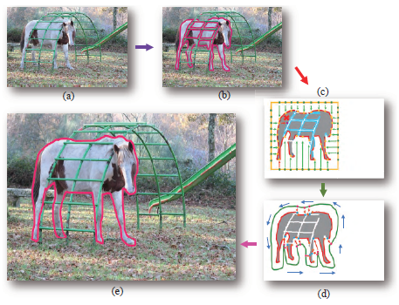
Inner-center Radius Shape Signature
Inner Center
defined by most far-way point from the contour
dilate the broken areas to a single one and then find the contour of the dilated shape

Slide 6
Inner-center Radius Shape Signature
Dense Contour Sampling
Sample the contour points according to the angles at the interval of $γ$ around inner-center point, thus a contour will result in N = $\frac{2π}{γ}$ points.
The function f($θ$) is denoted as radius at different angles $θ$
If the ray casting from the inner-center intersects more than once to the contour, collect the point with the largest radius only.

Slide 7
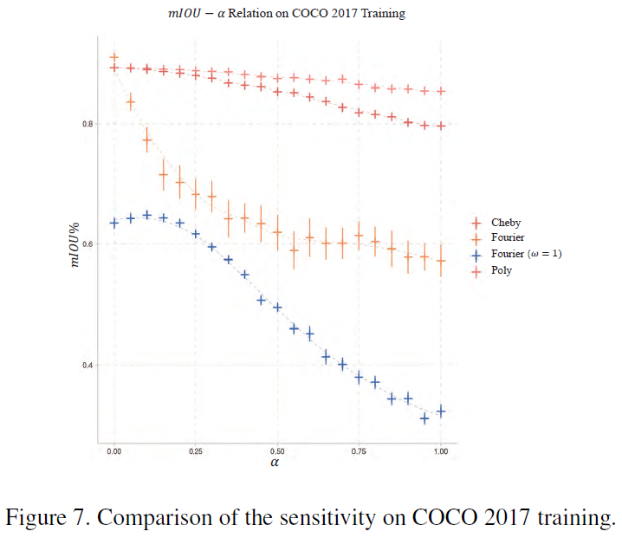
Inner-center Radius Shape Signature
Chebyshev polynomials
Formula
Given the IR shape signature, the Chebyshev approximation is to find the coefficients in

Slide 8
Regression Under Object Detection Framework
The network will learn to predict the inner center $\hat{p}$, the shape vector $\hat{k}$, along with the object bounding box.
Overall Loss Function
Loss Function
(two-stage detectors indicate a type of object detection framework with CNN)

Slide 9
Decoding Shape Vector to Shape

Slide 10
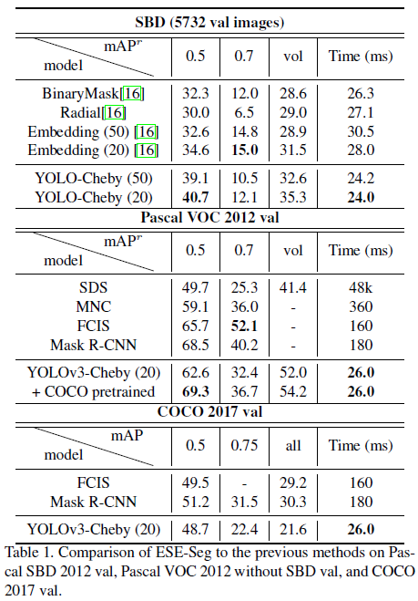
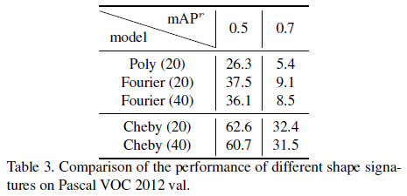
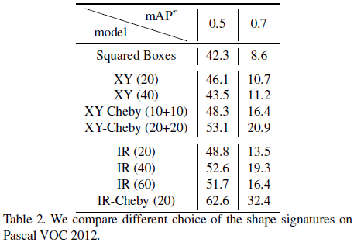
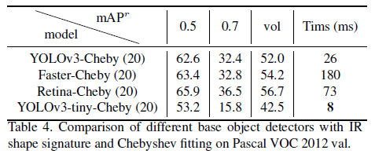
Experiment
We denote model trained on 2D vertices “XY”

