Slide 2
Motivation
Data augmentation methods
Use numerous coarsely annotated images
Generate synthetic data
Utilize video prediction models to create more training samples (Ours)

Slide 3
Contributions
Utilize video prediction models to propagate labels to immediate neighbor frames
Introduce joint image-label propagation to alleviate mis-alignment problem
Relax one-hot label training along boundary

Slide 4
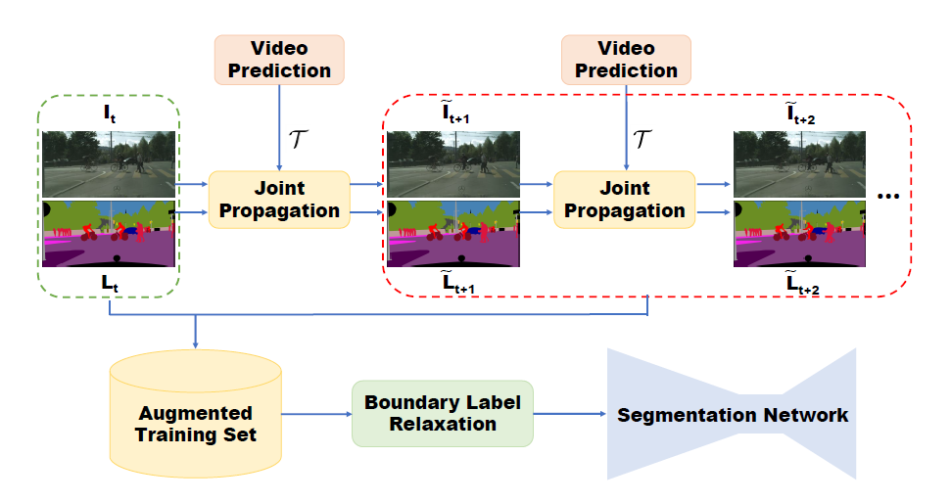
Framework

Slide 5
Video prediction
Input video $I∈ℝ^{n×W×H}$
Semantic labels $L∈ℝ^{m×W×H}$
Video prediction
${\tilde{I}}_{t+1}=𝒯(𝒢\left(I_{1:t},F_{2:t}\right),I_{t})$
${\tilde{L}}_{t+1}=𝒯(𝒢\left(I_{1:t},F_{2:t}\right),L_{t})$
Video Reconstruction
${\tilde{I}}_{t+1}=𝒯(𝒢\left(I_{1:t+1},F_{2:t+1}\right),I_{t})$
Motion vector $(u,v)$

Slide 6
Joint Image-label propagation
Total training samples: (2k+1)m

Slide 7
Boundary label relaxation
$$ℒ_{boundary}=−logΣ_{C∈𝒩}P\left(C\right)$$
$𝒩$: set of classes within a 3x3 window of a pixel

Slide 8
Experiment

Slide 9
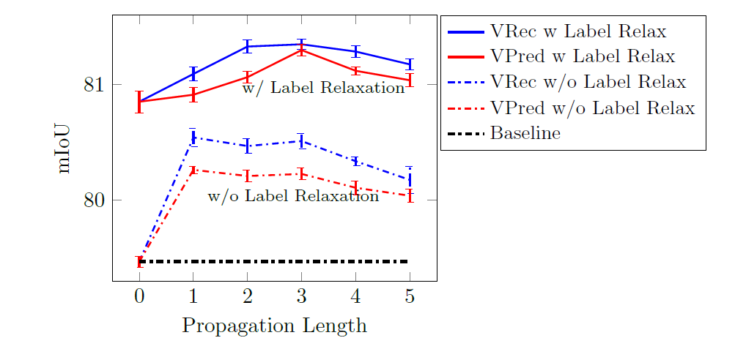

Slide 10
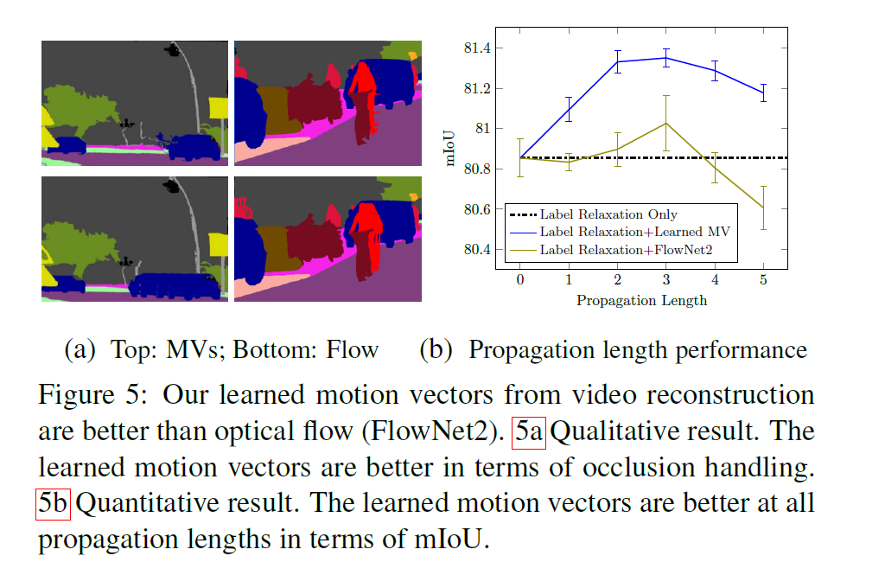

Slide 13
Motivation
Bounding box用于弱监督，bbox标注还是会带来一定成本
利用image-level的监督进行分割
之前：利用Class Attention Maps（CAM）进行分割，得到的结果很粗糙
本文：利用image-level得到pseudo instance segmentation labels进行训练

Slide 14
Contributions
Propose a new approach to identify and localize instances with image-level supervision
Propose a new way to learn and predict semantic affinities between pixels

Slide 15
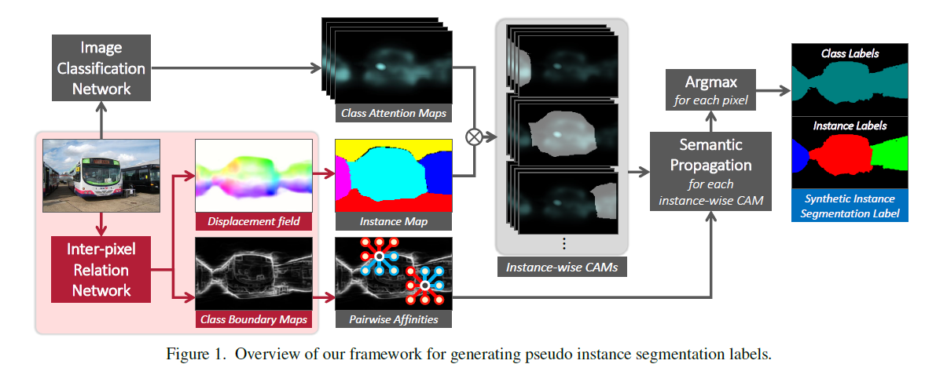
Framework

Slide 16
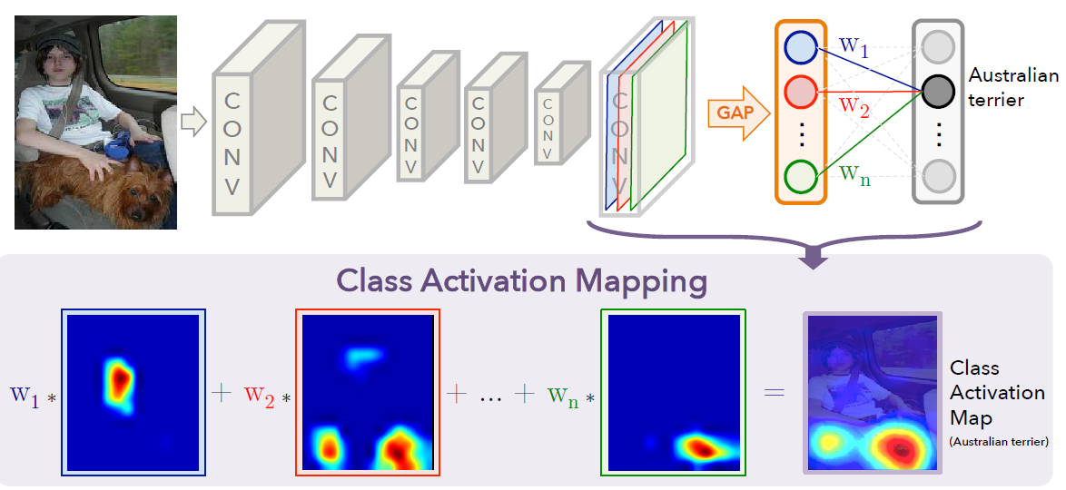
CAM
第c类的CAM：

Slide 17
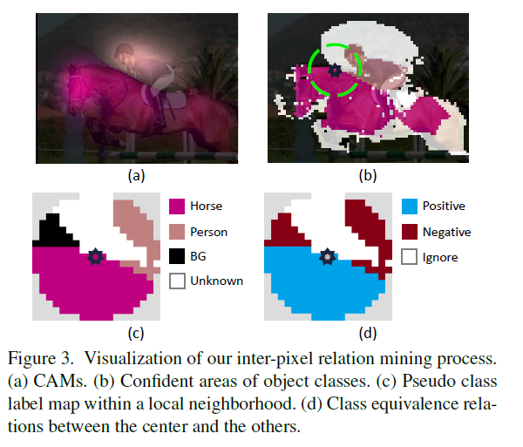
Loss functions
Inter-pixel relation mining from CAMs
>0.3 foreground,
<0.05 background

Slide 18
Loss functions
Loss for displacement field prediction
Assume
For same instance pair $x_{i}, x_{j}:x_{i}+𝒟\left(x_{i}\right)=x_{j}+𝒟\left(x_{j}\right)$
For each instance : $Σ_{x}𝒟\left(x\right)=0$（自然可以满足）
$$δ\left(i,j\right)=𝒟\left(x_{i}\right)−𝒟\left(x_{j}\right), \hat{δ}\left(i,j\right)=x_{i}−x_{j}$$

Slide 19
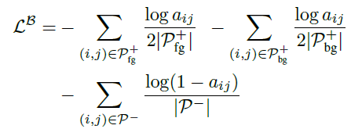
Loss functions
Loss for class boundary detection
Assume: a class boundary exists somewhere between a pair of pixels with different pseudo class labels
Joint learning

Slide 20
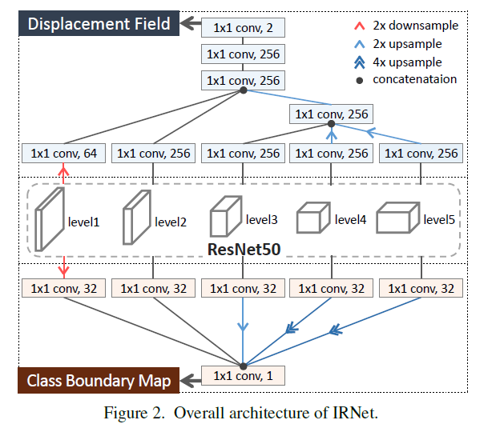
Inter-pixel relation network（IRNet）
Displacement field
$𝒟\left(x\right)∈ℝ^{w×h×2}$：x距离所属instance中心的vector
Class Boundary map
$ℬ∈{\left[0,1\right]}^{w×h}$

Slide 21
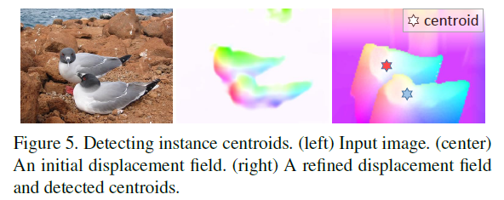
Label synthesis using IRNet
Generating class-agnostic instance map

Slide 22
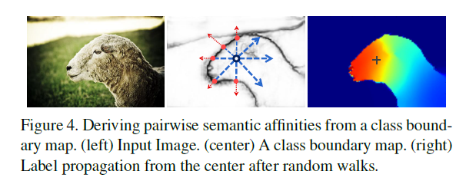
Label synthesis using IRNet
Combine CAMs with class-agnostic instance map:
Semantic propagation with random walk:

Slide 23
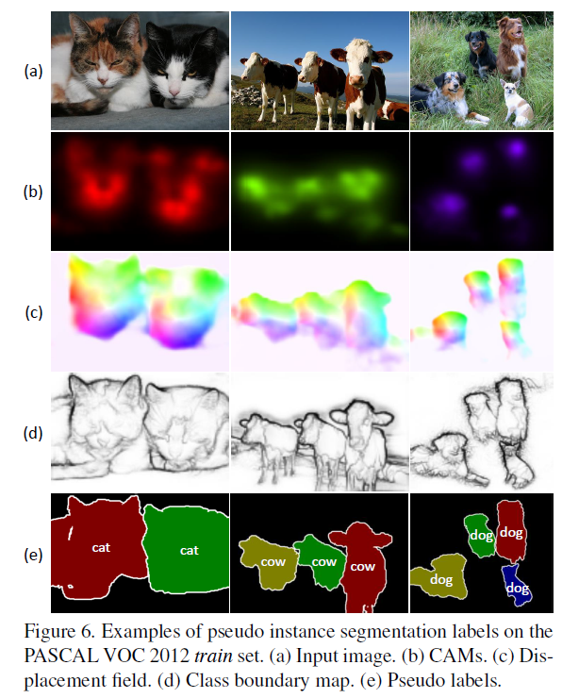
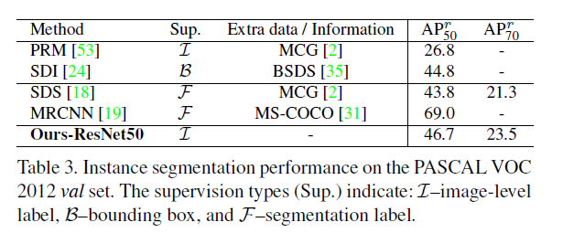
Experiment

