Slide 2
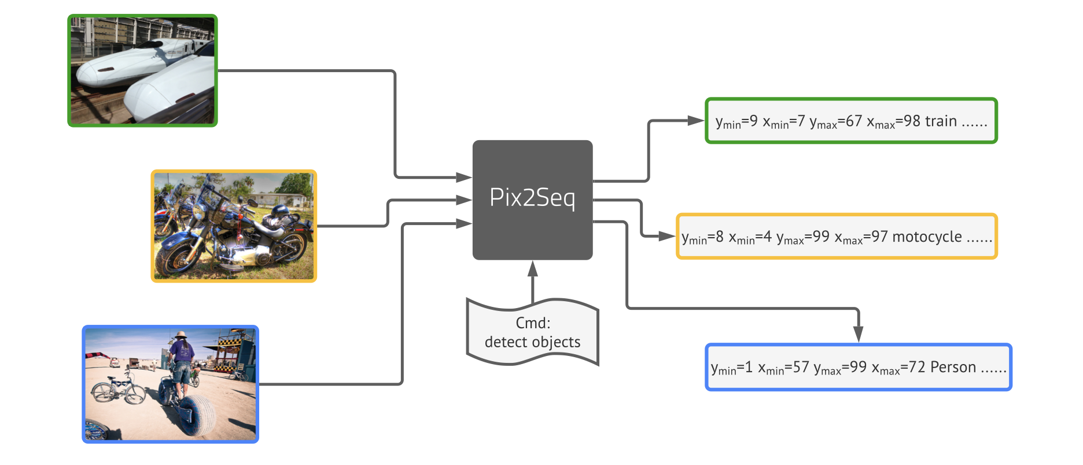

Slide 4
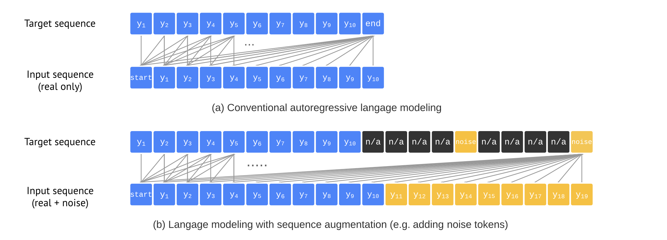

Slide 6
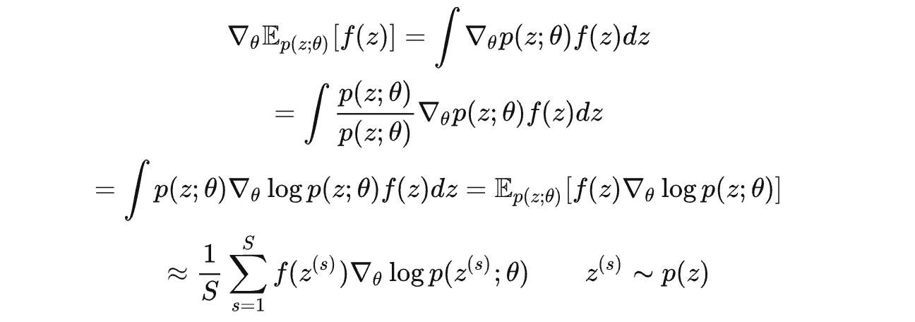
log-derivative trick
最大化R(x,y) 的更新可以采用

Slide 7
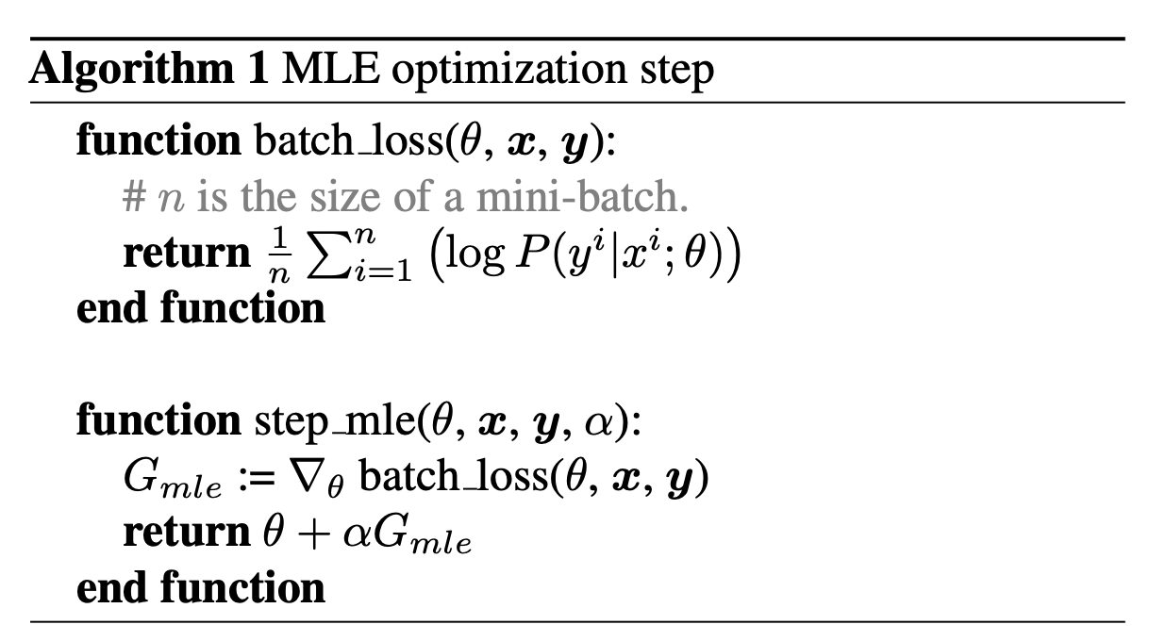
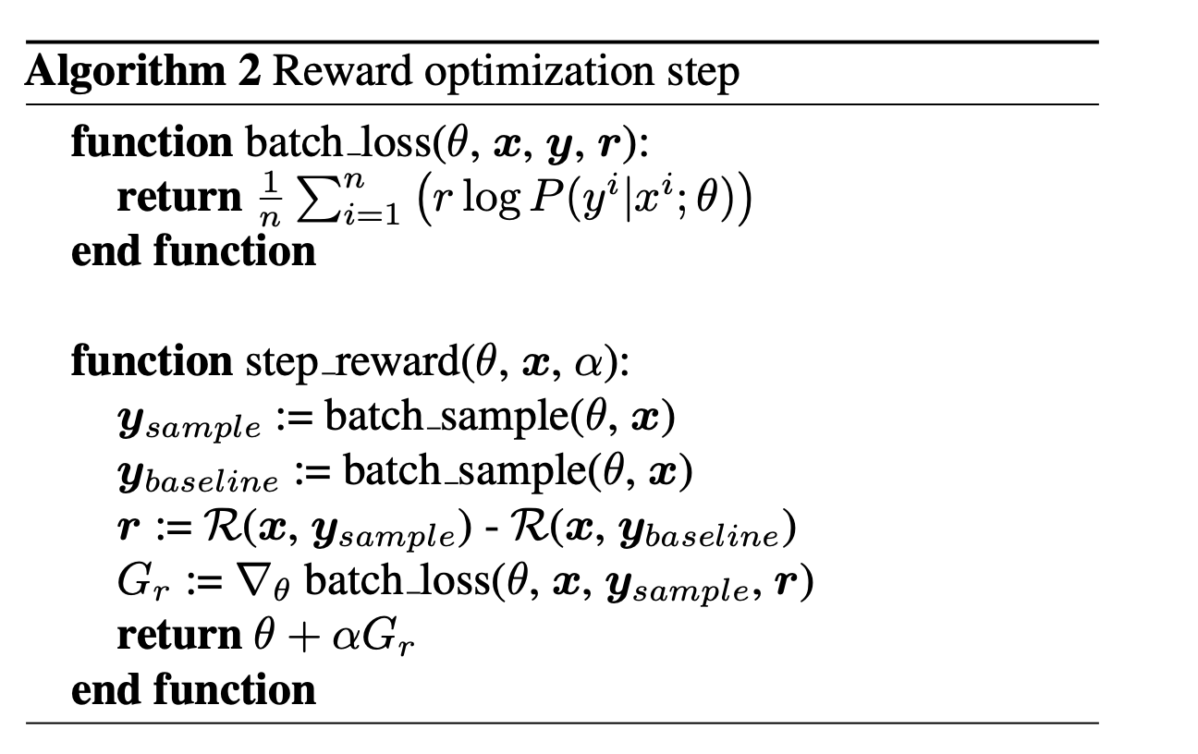

Slide 8
Panoptic segmentation
Object detection
Average recall @ N
Mean average preci- sion (mAP)

