Slide 2
Memory
Spatial Memory
  Spatial LSTM
  Precise location
  Computationally expensive
topological memory
  Animal behavior
Bayesian Relational Memory
  Topological memory + Bayesian

Slide 3
Framework

Slide 4
Symbols
Dataset: House3D
K: number of room category
Graph:
  K nodes
  K(K − 1)/2 edges
Zi,j: the probability of“near by”

Slide 5
Semantic Classifier
Multi labels classifier (sigmoid)
Panoramic view
K- dimensional binary vector c_{t} ∈ {0, 1}^{K} at time t

Slide 6
Graph update and planning
Update and planning for every N steps
c_{t},c_{t+1},c_{t+2},…,c_{N}
B = c_{t} | c_{t+1} | c_{t+2},… | c_{N}
Y_{i,j} = 1 if two targets appear concurrently (B(T_{i}) = B(T_{j}))

Slide 7
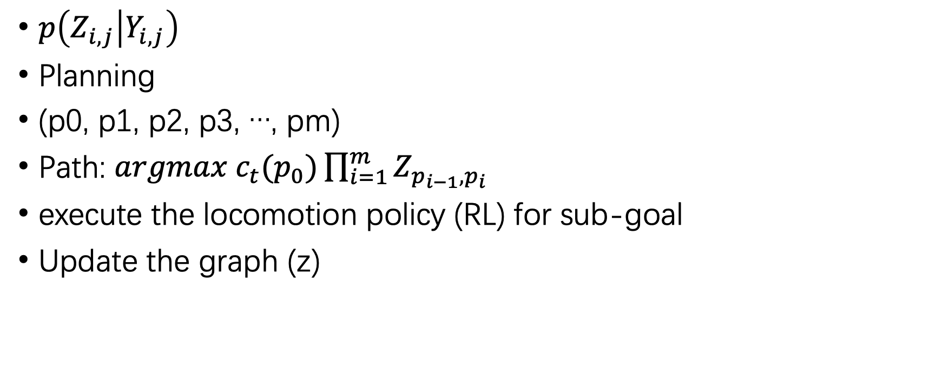
Graph update and planning
$p\left(Z_{i,j} | Y_{i,j}\right)$
Planning
(p0, p1, p2, p3, …, pm)
Path: $argmax c_{t}(p_{0})\prod_{i=1}^{m}{Z_{p_{i−1},p_{i}}}$
execute the locomotion policy (RL) for sub-goal
Update the graph (z)

Slide 8

Bayesian
$p\left(Z_{i,j} | Y_{i,j}\right)= \frac{p\left(Y_{i,j} | Z_{i,j}\right) p(Z_{i,j})}{p(Y_{i,j})}$
Z: latent variable
Y: observed variable

Slide 9

Bayesian
$p\left(Y_{i,j} | Z_{i,j}\right)$
$p(Z_{i,j})$
  Pre: random exploration
$p(Y_{i,j})$
  Not mentioned

Slide 10
Experiment

