Slide 2
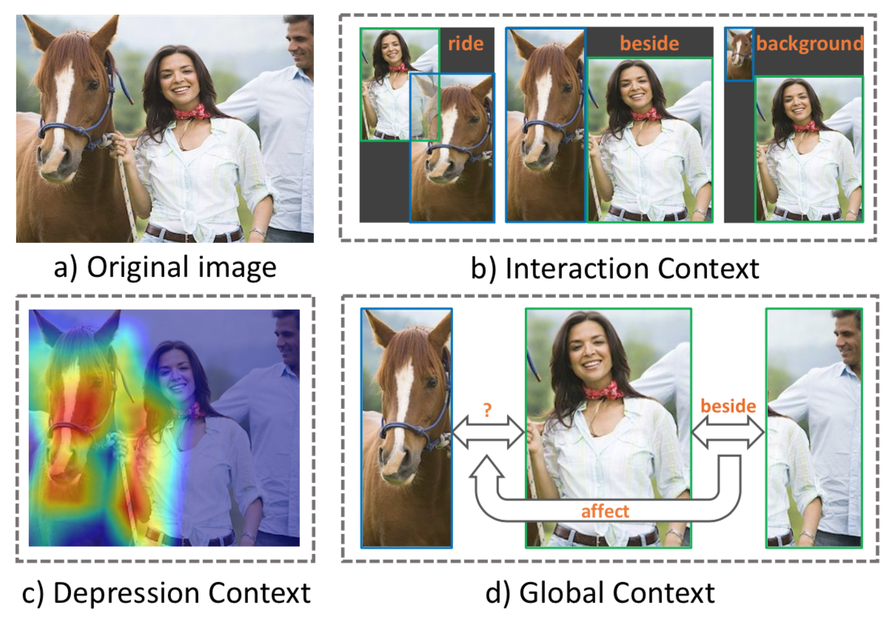
Motivation

Slide 3
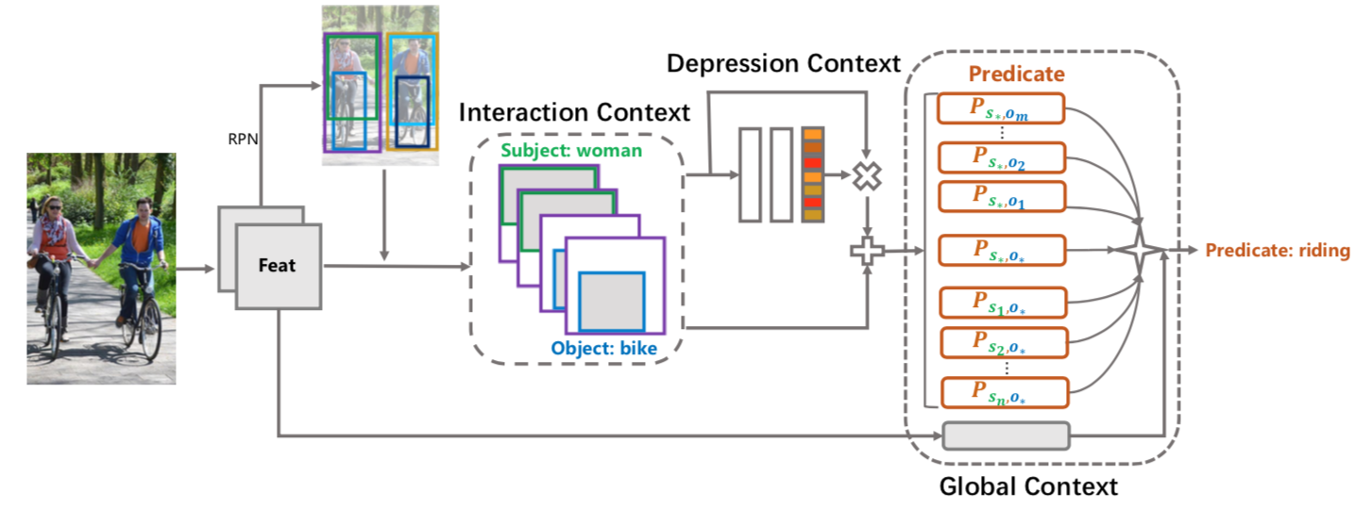
Framework

Slide 4
20200313

Slide 5
Motivation
AutoML only focused on the architecture of neural network and relied on sophisticated expert-designed layers as building blocks—or similarly restrictive search spaces
The goal of this paper is to automatically discover complete machine learning algorithms just using basic mathematical operations as building blocks.

Slide 6
Method
Define a very large space of algorithms
Use some method to search: grid/evolutionary
Eval on a proxy task
Select the best of the candidates by measuring their performance on actual val set.

Slide 7
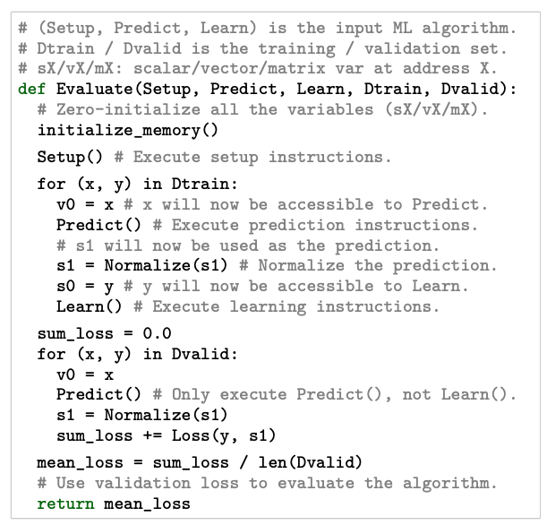
Search space
Virtual memory
scalar, vector and matrix variables
Ops:
multiply a scalar with a vector etc
NO high-school level ops:
e.g. matrix decompositions

Slide 8
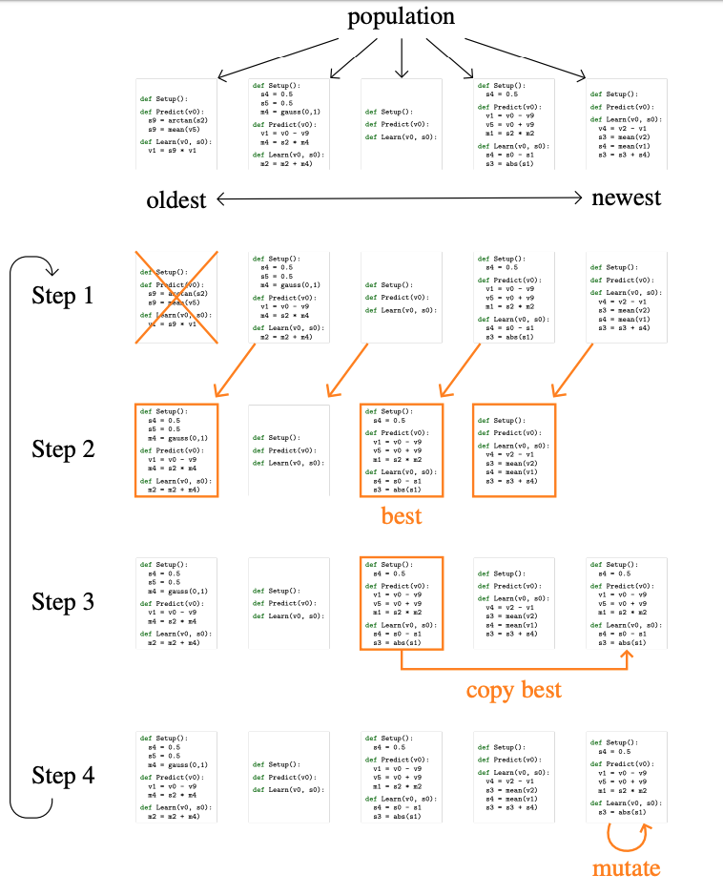
Search Method

Slide 9
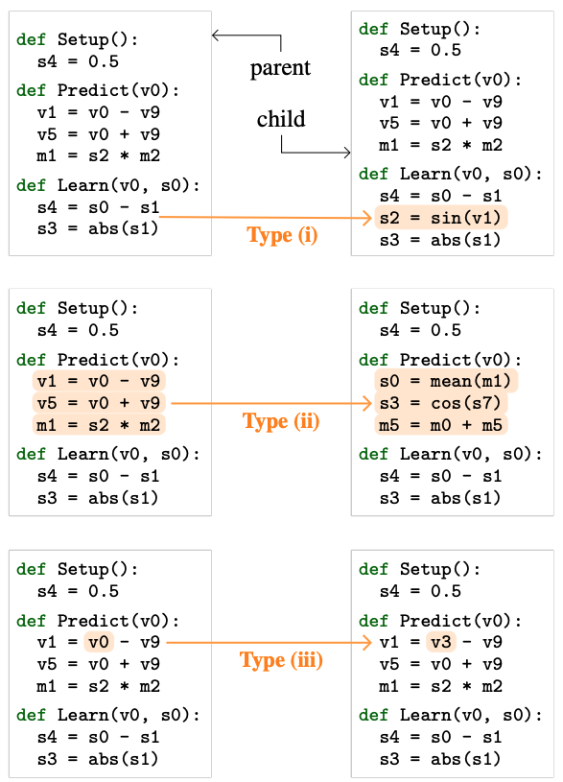
Mutations

Slide 10
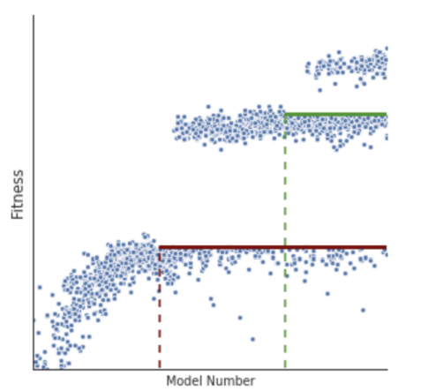
Accelerate search
In order to reach a throughput of 2k–10k algorithms/second/cpu, besides the use of small proxy tasks, we apply two additional upgrades:
detects equivalent supervised ML algorithms 4x
hurdles(The Evolved Transformer) 5x
Notes:
由于train比较慢，引入跨栏的机制，先训练s1个step，然后计算m个模型的平分均值。下一次进化产生m个子模型，这些子模型训练到s1时，其结果需要超过上一轮平均数的才能进入下一个训练阶段，一次类推

Slide 11
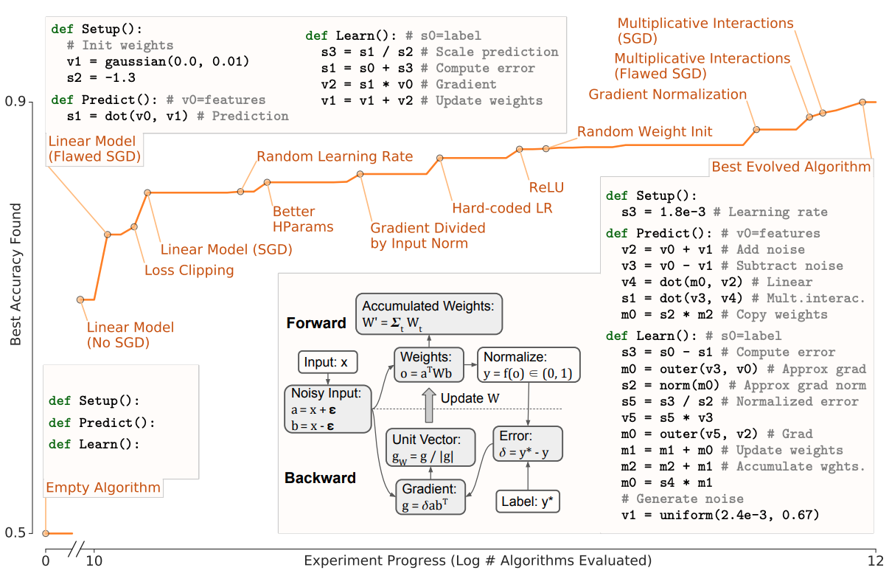
Experiment
CIFAR
cost: 10k cpu、5 day

