Slide 2
Motivation
Semantic Transformation Module
Most of the existing works neglect the semantic relationship between the visual feature and linguistic knowledge, and the intrinsic connection among the triplet.
Effectively extracting a whole joint graph representation to model entire scene graph for reasoning is promising but remains an arduous problem
Graph Self-Attention Module

Slide 3
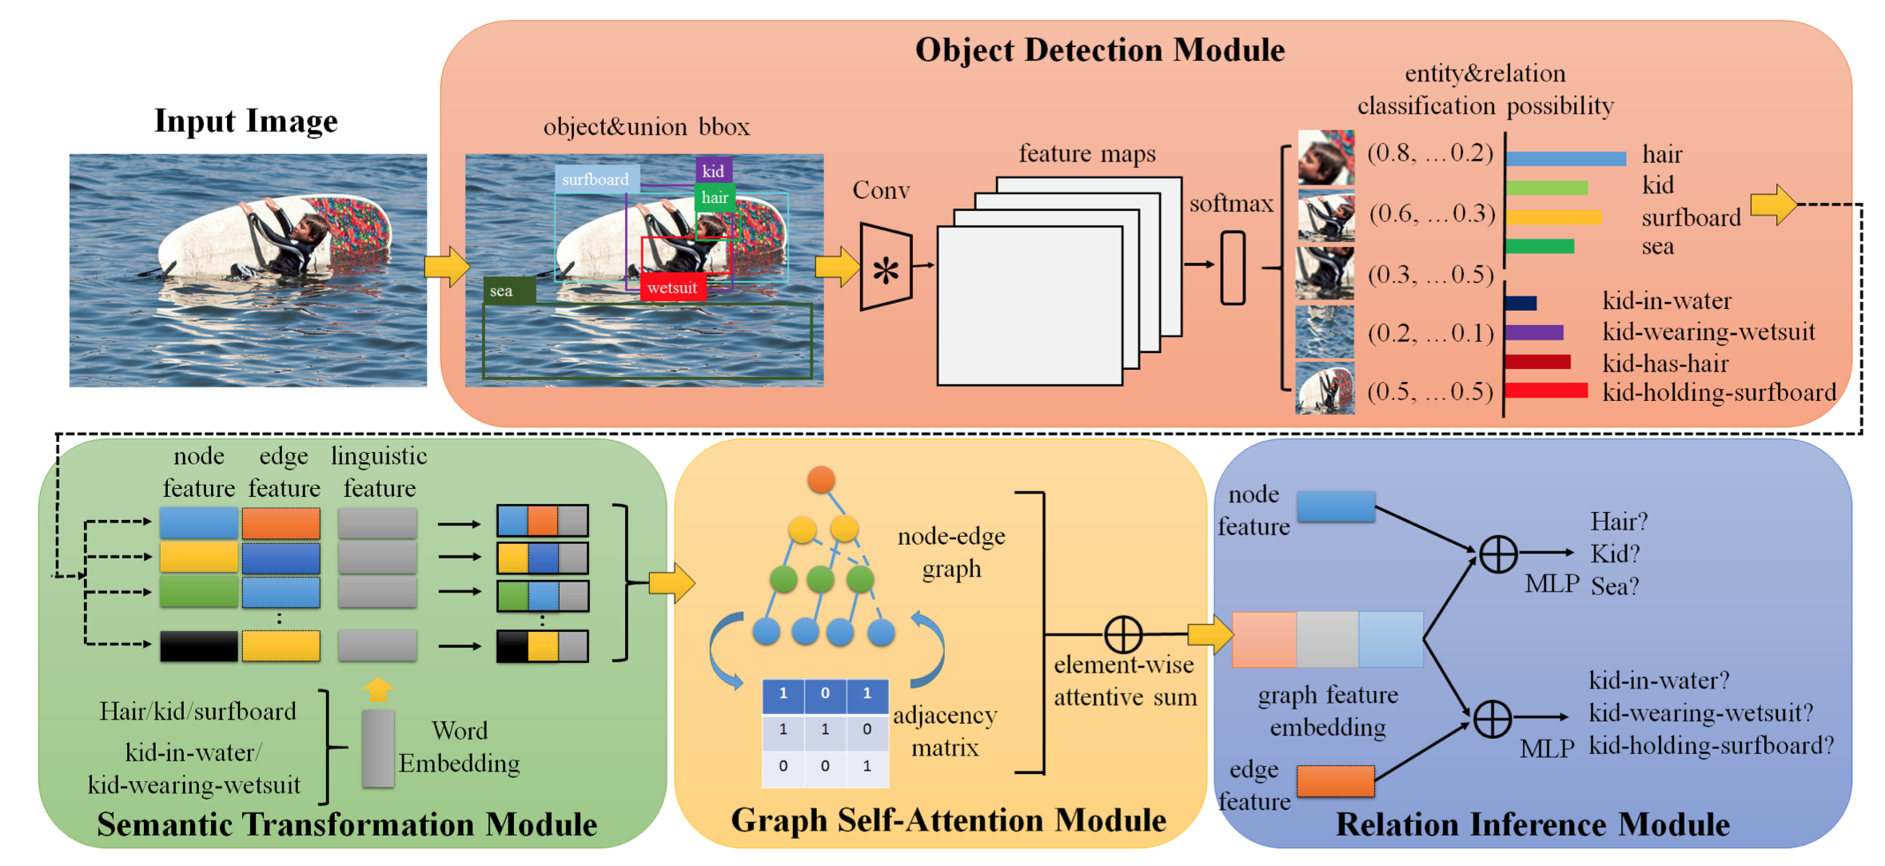
Framework

Slide 4
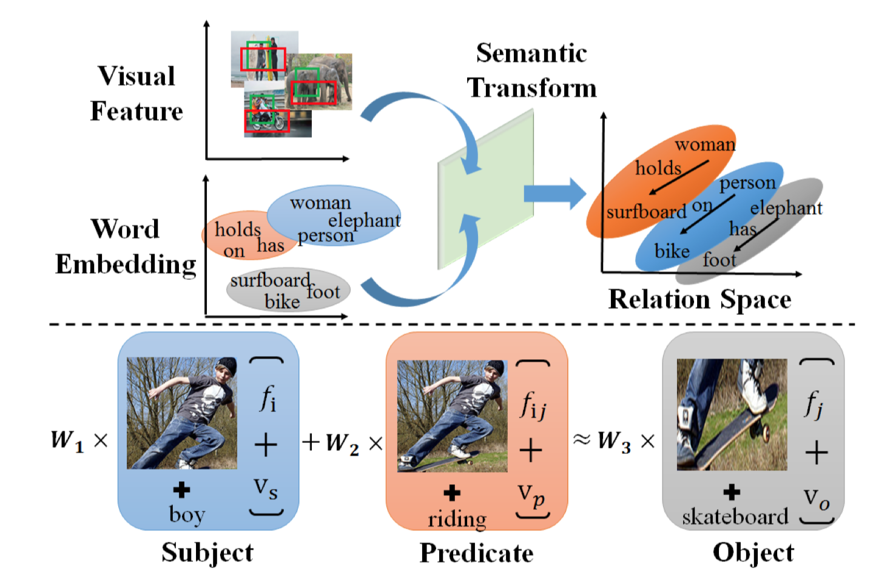
Semantic Transformation Module
In computational linguistic area, it is known that a valid semantic relation can be expressed as the following：
Similar for visual features：
L2 loss is used to guide the learning process:
semantic transformed representation
of relation $f_{ij}$ is as follow:

Slide 5
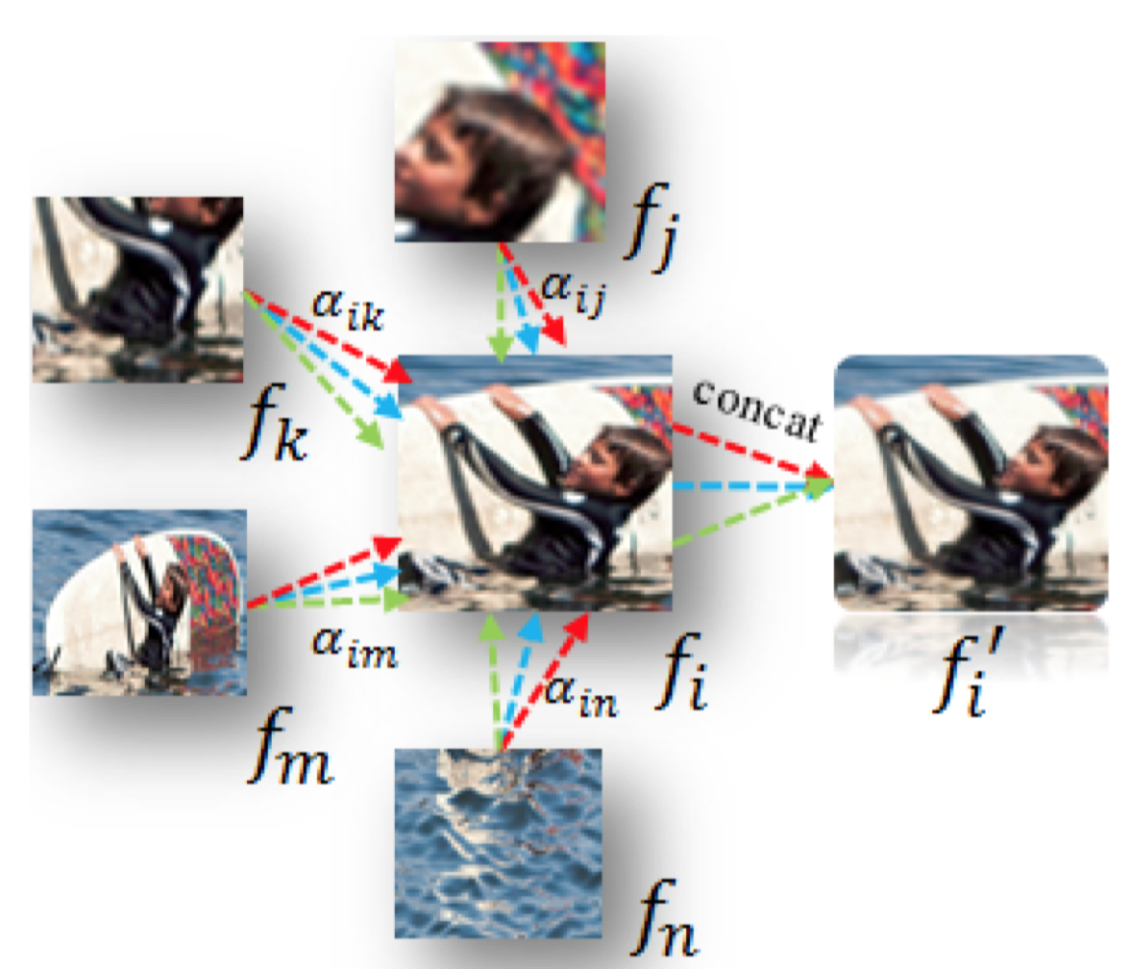
Graph Self-Attention Module
K independent attention heads:
Setting of Adjacent Matrix:
Inside Neighbor
Cover Neighbor
Overlap Neighbor
Relative Neighbor

Slide 6
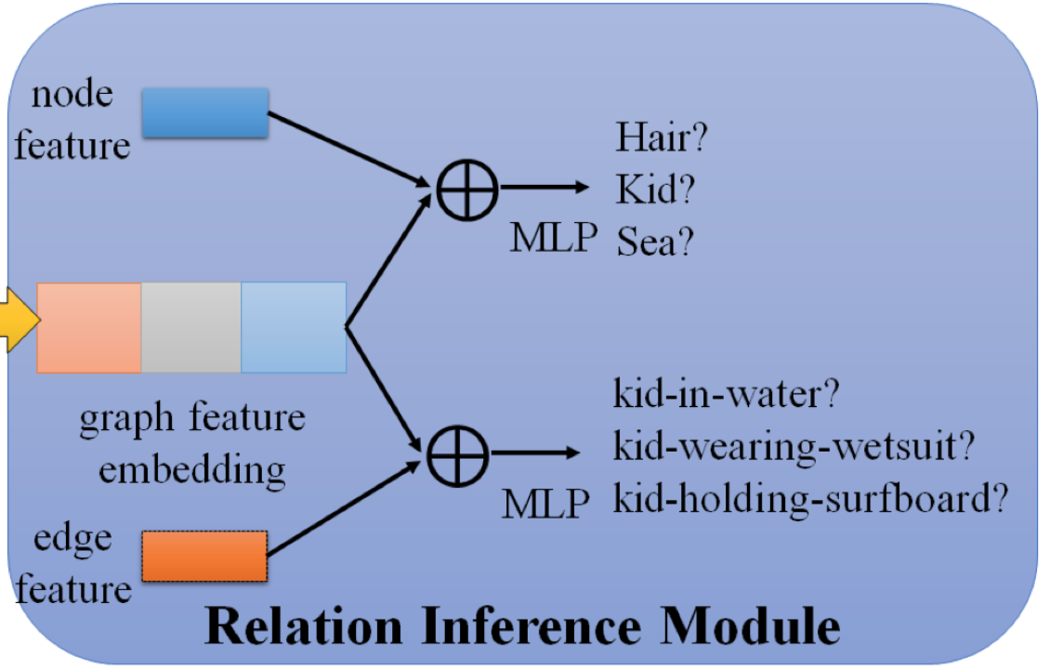
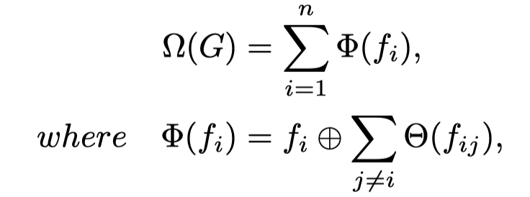
Relation Inference Module
a global scene graph representation:

Slide 7
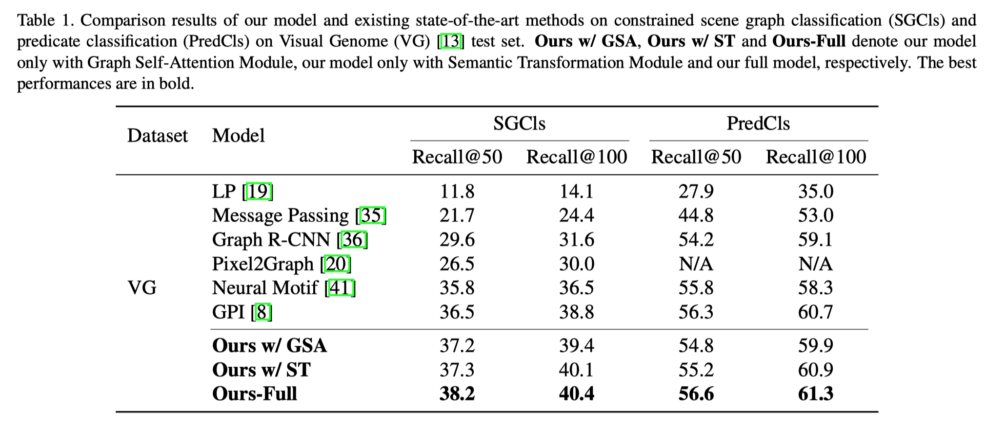
Experiments

