Slide 1
ACL 2019

Slide 2
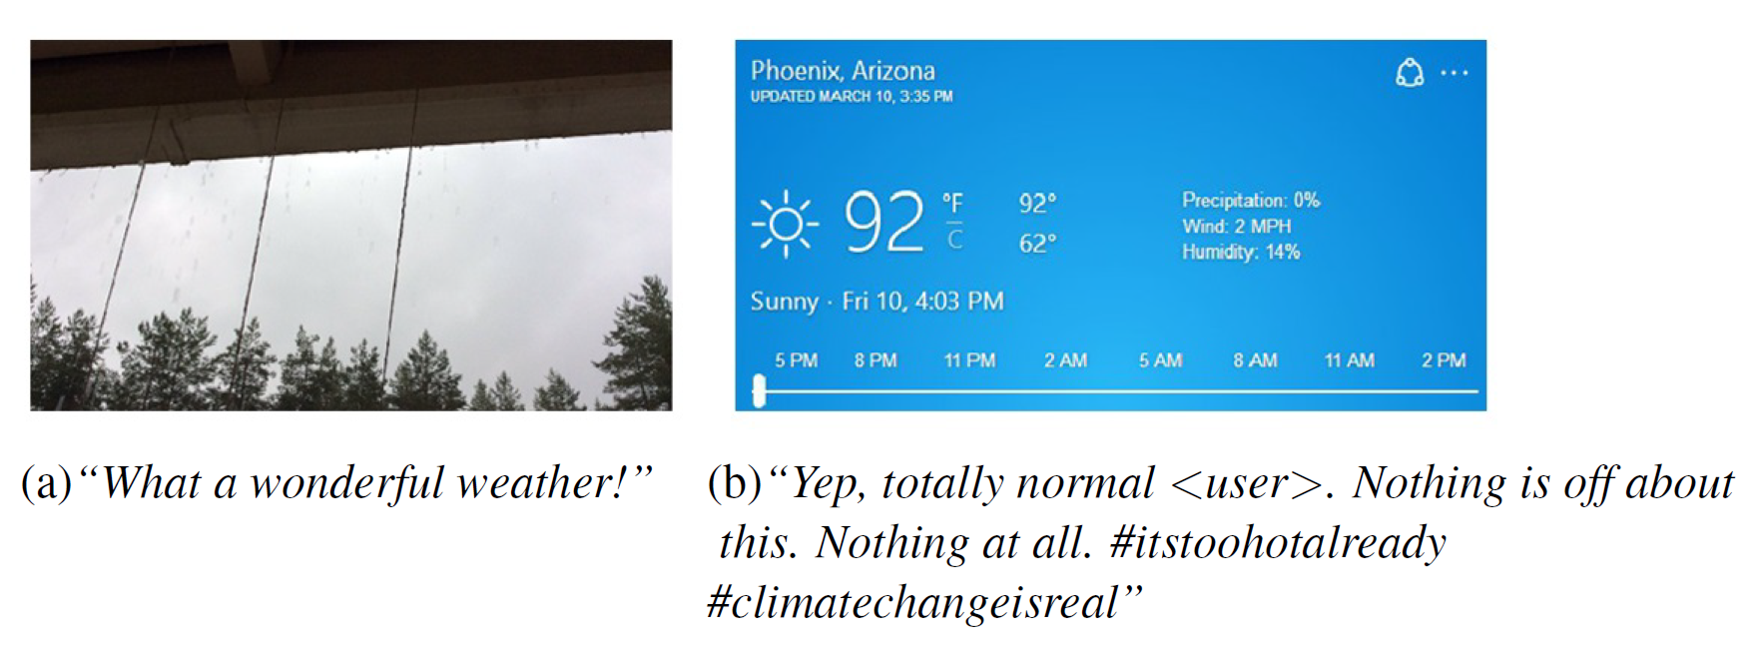
Task
Sarcasm detection is important to the tasks that require knowledge of people’s real sentiment.

Slide 3
Contribution
Propose a novel hierarchical fusion model involving image, attribute and text modalities
Create a new dataset for multi-modal Twitter sarcasm detection and release it
Quantitatively show the significance of each modality in Twitter sarcasm detection. Image attributes need to be further considered to fully unleash the potential of images

Slide 4
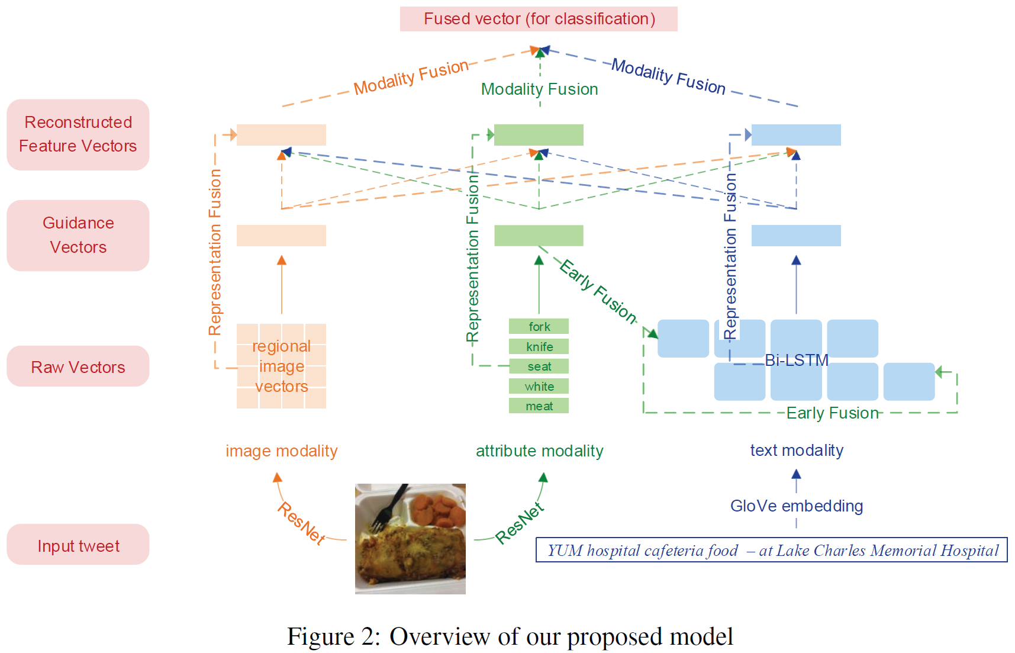
Method

Slide 5
Image Feature Representation
A input image $I$ is resized to 448 x 448 and divided into 14 x 14 regions
Each region $I_{i} (i=1;2…;196)$is then sent through the ResNet model to obtain a regional feature representation $v_{region_{i}}$ , a.k.a. a raw image vector
The image guidance vector $v_{image}$ is the average of all regional image vectors

Slide 6
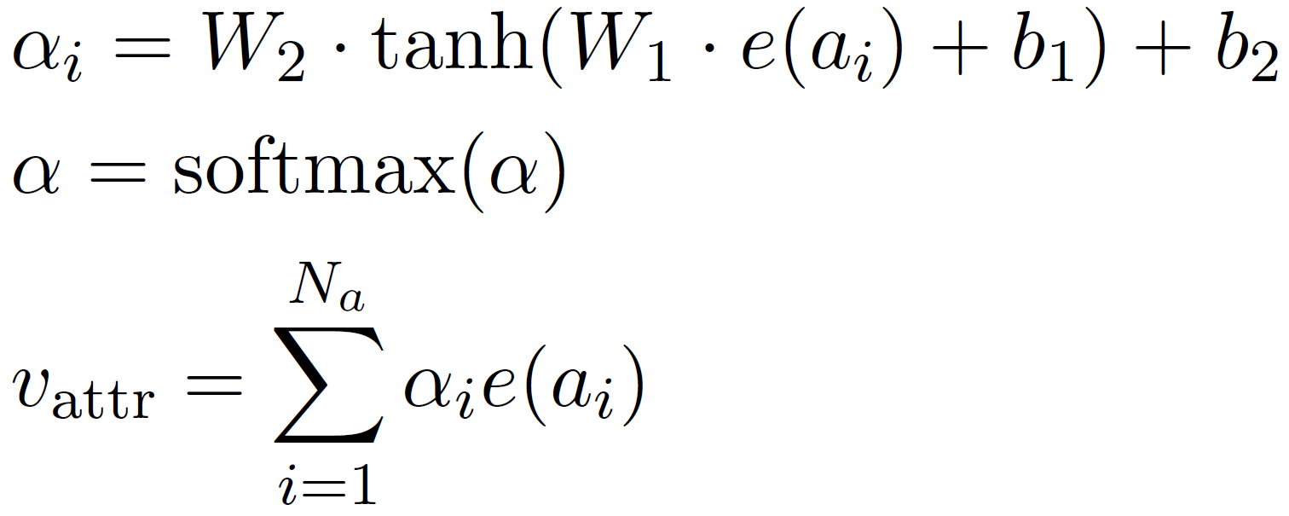
Attribute Feature Representation
First train an attribute predictor with ResNet-101 and COCO image captioning dataset
Then the attribute predictor is used to predict five attributes $a_{i} (i=1;…;5)$ for each image
The attribute guidance vector is obtained by weighted average

Slide 7
Text Feature Representation
Bi-LSTM
The text guidance vector is the arithmetic average of hidden states in each time step
Early fusion: use attribute guidance vector as the initial state of Bi-LSTM

Slide 8
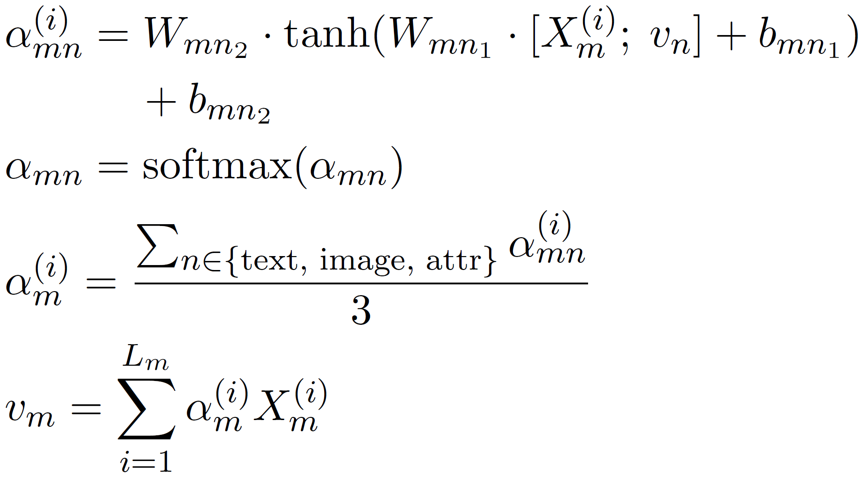
Representation Fusion
$X_{m}^{(i)}$ is the $i$-th raw vector from modality $m$ (which may be text, image or attribute)
$v_{n}$ is the guidance vector of the modality $n$ (which may be text, image or attribute)

Slide 9
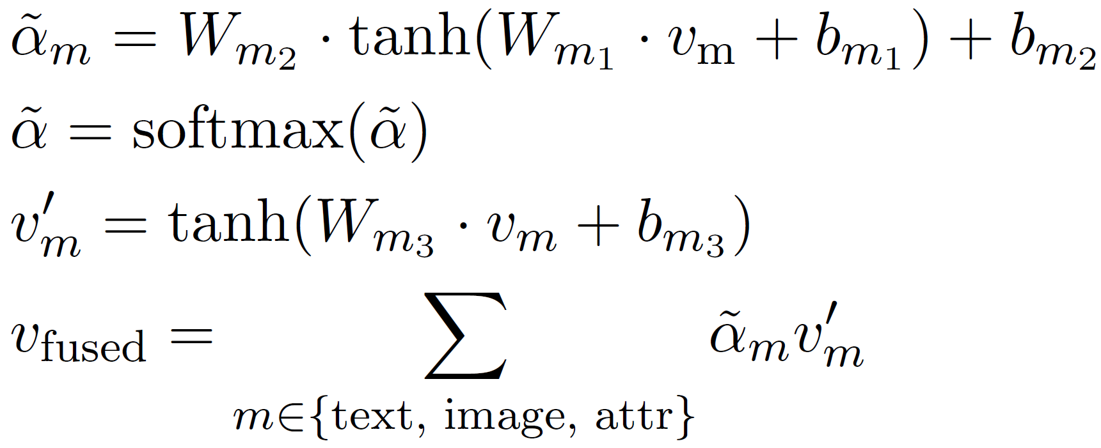
Modality Fusion

Slide 10
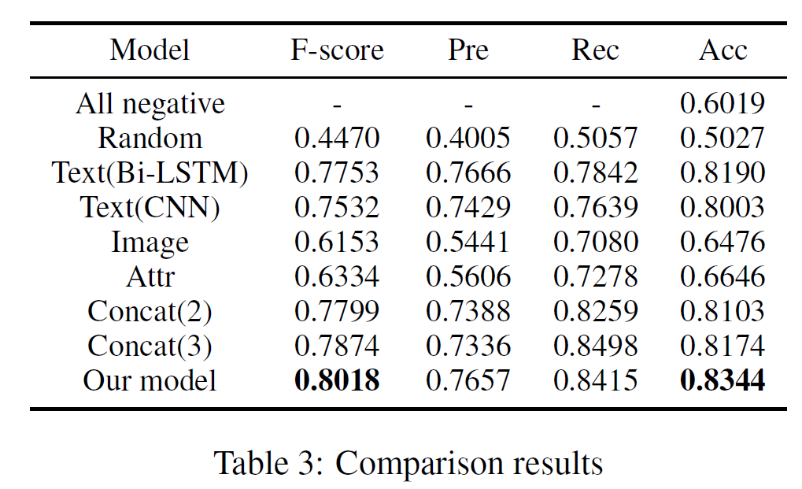
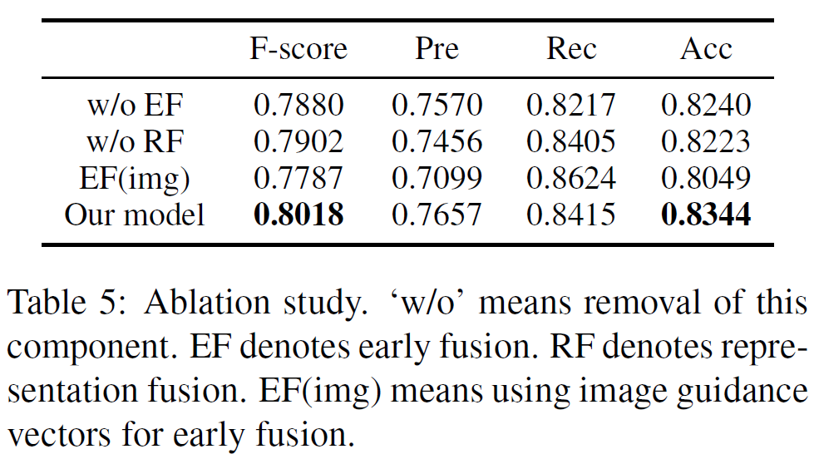
Experiments

Slide 11
Visualization

