Slide 2
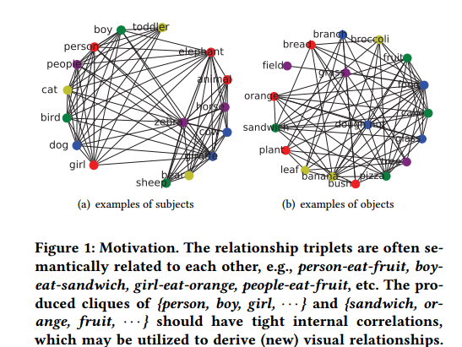
Motivation
The subjects/objects are correlated to each other under semantic relationships

Slide 3
Contributions
We propose a context-dependent diﬀusion network (CDDN) framework to deal with visual relationship detection
Semantic graphs to encapsule semantic priors of subjects/objects
Visual scene graphs to capture the surrounding context
Graph diffusion network to learn latent representations of objects

Slide 4
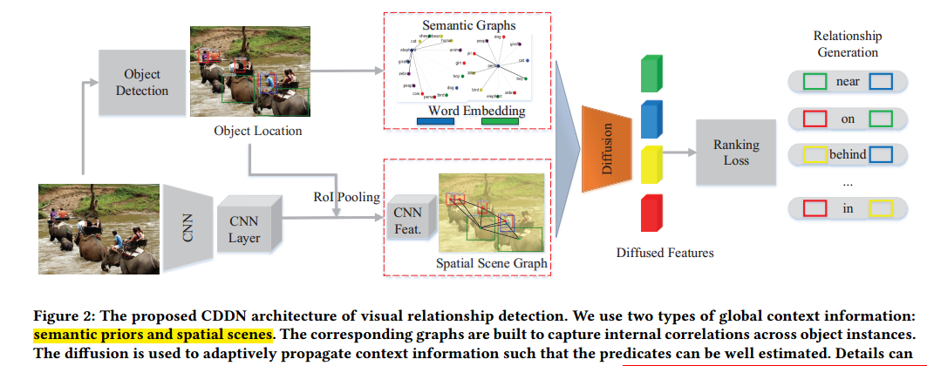
Architecture

Slide 5

Object Association
Global Semantic Graph：$𝒢_{1}=\left\{𝒱_{1},ℰ_{1}\right\}$ (Whole training set)
$𝓋:$ object
$ℯ$:
Spatial Scene Graph: $𝒢_{2}=\left\{𝒱_{2},ℰ_{2}\right\}$ (single picture)
$𝓋$: bounding box $b_{i}, b_{j}$
$ℯ$:

Slide 6

Diffusion Layer
$𝒢=\left(𝒱,A,X\right) , 𝒱=\left\{v_{1},v_{2},…v_{N}\right\}, A∈ℝ^{N×N},$
$X=\left\{x_{1},x_{2},…x_{N}\right\}∈ℝ^{N×d}$
$\hat{A}∈ℝ^{N×H×N}$: H power series of A
$W∈ℝ^{N×H×N}$

Slide 7
Ranking Loss
Triplet $r=\left(s, p, o\right)$

Slide 8
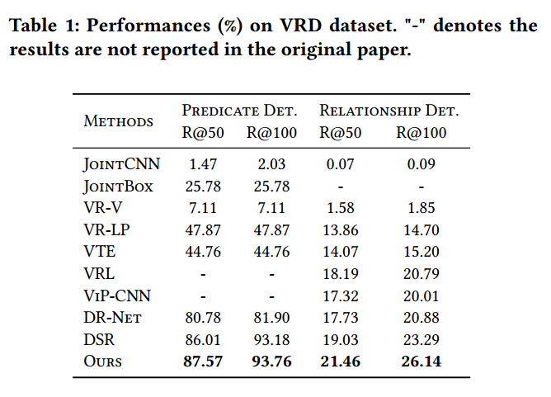
Experiment

Slide 9
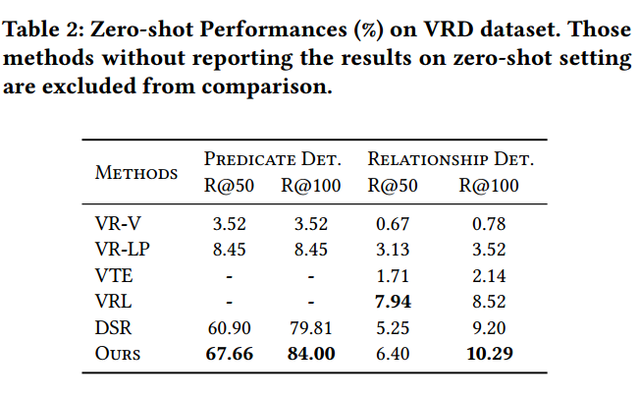
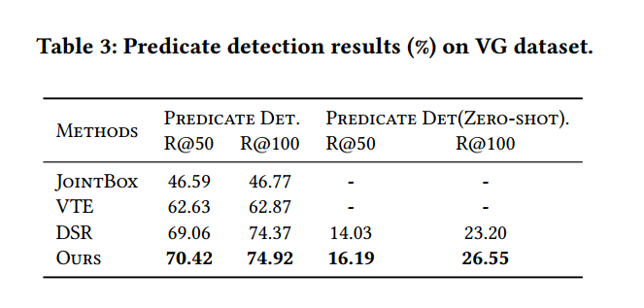

Slide 10
