Slide 1
CVPR2018

Slide 2
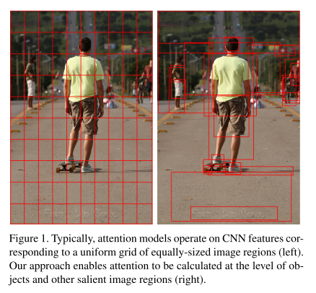
Motivation
Attention mechanisms
Top-down: driven by non-visual or task-specific context
Bottom-up: purely visual feed-forward attention mechanisms
Most visual attention mechanisms used in image captioning and VQA are of the top-down variety.
Gives little consideration to how the image regions that are subject to attention are determined.

Slide 3
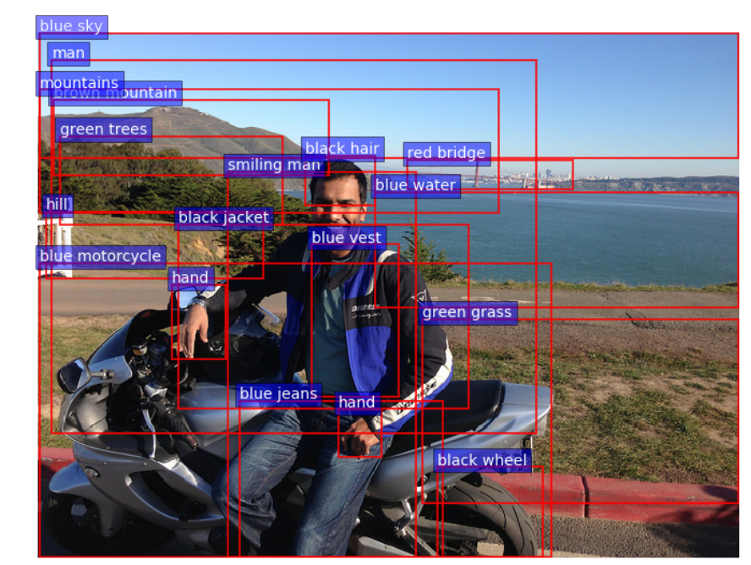
Approach-VQA
Bottom-up: proposes a set of salient image regions. (with attributes)
Top-down: uses task-specific context to predict an attention distribution over the image regions.

Slide 4
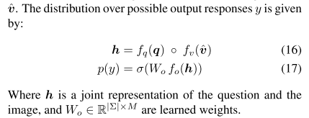
Details

Slide 5
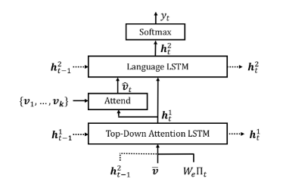
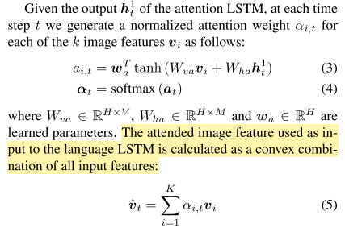
Approach-Captioning

Slide 6
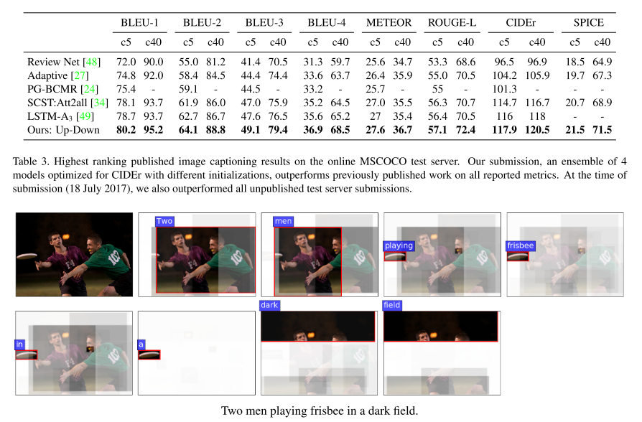
Experiment-Captioning
VG-pretrain bottom-up attention model

Slide 7
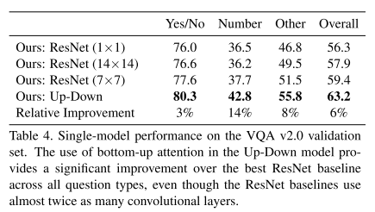
Experiment-VQA

