Slide 1
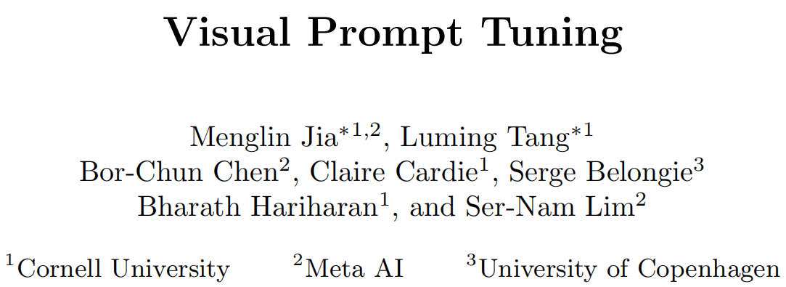
空白演示
单击输入您的封面副标题

Slide 2
VPT injects a small number of learnable parameters into Transformer’s input space and keeps the backbone frozen during the downstream training stage.

Slide 4
baseline
(a)Full
(b)classification head
Linear: only use a linear layer as the classification head.
Partial-k: fine-tune the last k layers of backbone while freezing the others
Mlp-k: utilize a multilayer perceptron (MLP) with k layers
(c)update a subset backbone parameters or add new trainable parameters to backbone
Sidetune: train a “side” network and linear interpolate between pretrained features and side-tuned features before being fed into the head.
– Bias: fine-tune only the bias terms of a pre-trained backbone.
– Adapter: insert new MLP modules with residual connection inside Transformer layers.

Slide 5
backbones are pre-trained on supervised ImageNet-21k:ViT,Swin
FGVC consists of 5 benchmarked Fine-Grained Visual Classification tasks
VTAB-1k [80] is a collection of 19 diverse visual classification tasks

Slide 6
Main Results
1. VPT-Deep outperforms Full on 3 out of the 4 problem classes (20 out of 24 tasks)
2. VPT-Deep outperforms all the other parameter-efficient tuning protocols across all task groups
3.Although sub-optimal than VPT-deep, VPT-shallow still offers non-trivial performance gain than head-oriented tuning methods

Slide 7
Ablation on prompt location

Slide 8
Ablation on prompt length

Slide 9
Ablation on prompt depth

Slide 10
Ablation on final output

Slide 11
Effect of expanding input sequence

Slide 12
Effect of sharing prompts

Slide 13
Effect of prompt initialization

Slide 14
Sensitivity to prompt length for the prompt depth experiments

Slide 15
can we create prompts with pixels instead?
In other words, can pretrained vision models be adapted to a new task solely by adding pixels to their inputs?

Slide 16
pre-trained vision models be adapted to a new task solely by adding pixels to their inputs
difficult to hand-craft prompts as in NLP,a simple gradient-based approach where we directly optimize the visual prompt
prompt parameters φ and the model parameters θ, the gradient updates are applied only to the prompt parameters φ and the model parameters θ remain frozen
在训练过程中，该模型使正确的标签y的可能性最大化
evaluation

Slide 17
one vision-language model and three standard vision models
1.How much does visual prompting help to improve performance of a text-prompted CLIP?
2. can visual prompts be generally used to adapt arbitrary vision models?

Slide 18
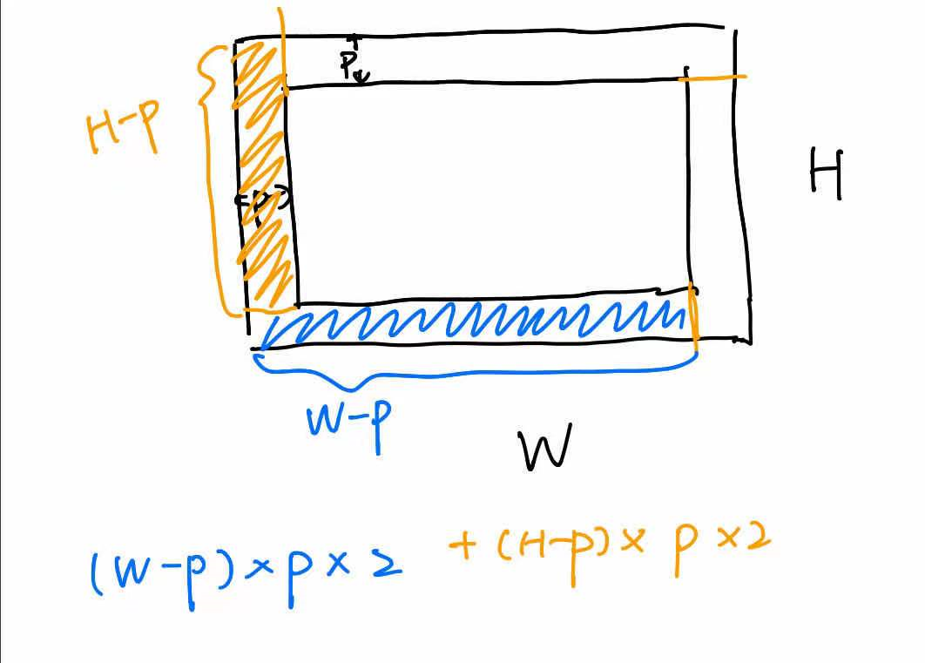
Prompt Design
visual templates
pixel patch at random location
pixel patch at fixed location
padding
prompt sizes p
patches:C * p²
padding: 2Cp(H−p)+2Cp(W−p)
padding with p = 30 achieves the best performance over other design choices

Slide 19
Mapping to Unseen Classes
Standard vision models
arbitrarily map downstream class indices to pre-trained class indices, and discard unassigned indices for loss computation.
CLIP
using text prompts for image classification,where class names are prompted by context-bearing words (e.g. “a photo of a [cat]”) for zero-shot transfer.

Slide 20
Implementation Details
Standard vision models
compute cross entropy loss over new class indices.
CLIP
Only compute cross entropy loss over images, where a set of prompted text strings is processed through the text encoder to produce weights of a linear classifier

Slide 21
Baseline Methods
text prompting
linear probing
Note that visual prompting is restricted to learning in pixel space, thus it may be used with linear probing or fine-tuning for better performance.

Slide 23
Robustness to Distribution Shift

Slide 24
How Do Text Prompts Affect Learning a Visual Prompt

Slide 25
What Properties Make for a Good Visual Prompt

Slide 26
While prompting does under-perform linear probe in some cases, we would like to stress that the goal of this work is to show the existence of a prompting mechanism in “pixel space", which works across multipledatasets and pretrained models, and reveals new avenues for how vision models can be effectively adapted. Our focus in this work is not to outperform state-of-the-art performance; we note that there are several approaches one could use to improve performance further including ensembling multiple prompts, using prompts in conjunction with linear probes or fine-tuning, or scaling of the pre-trained model (e.g. ViT-L/14 of CLIP, which is unfortunately not available to the public).

