Slide 1
MM 2019

Slide 2
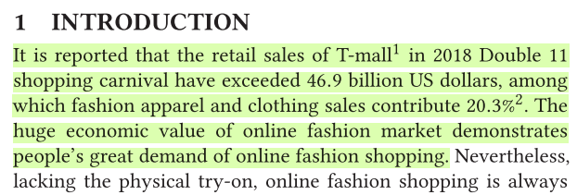
Motivation
To improve the user experience of ﻿online fashion shopping
﻿﻿﻿Economic 2D modeling (3D-based methods have achieved promising success)
The huge labor costs for 3D data annotation and economic costs for scanning equipment
﻿Trying on with arbitrary poses (﻿single-view try-on)
﻿Creating a new large-scale FashionTryOn dataset

Slide 3
Contributions
The first to address the new task of generating realistic try-on images with any desired pose
﻿﻿Propose an effective method to solve the task
﻿Create a large-scale benchmark dataset, FashionTryOn

Slide 4
Framework
﻿Geometric Matching Module (GMM)
﻿spatial transformation parameters θ

Slide 5
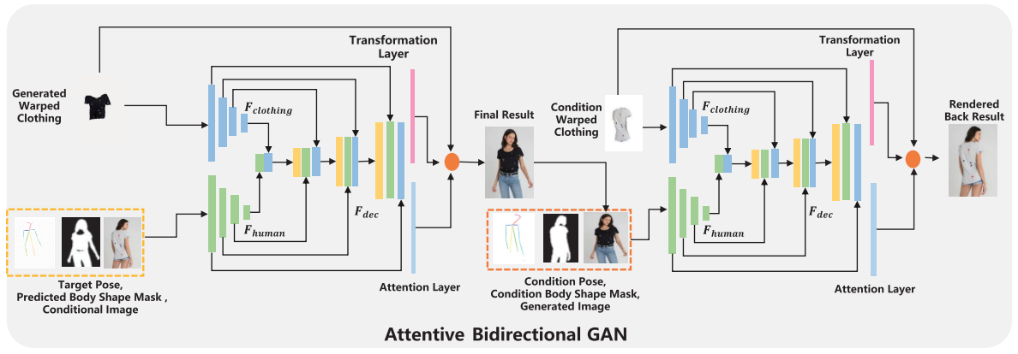
Framework
﻿try-on region mask
Notes:
Attention layer ，双向无意义

Slide 6
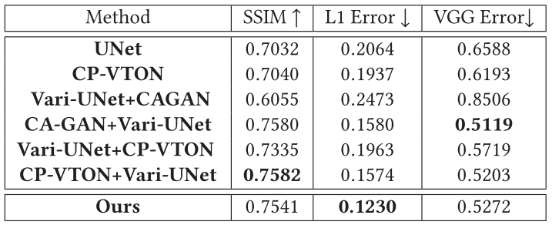
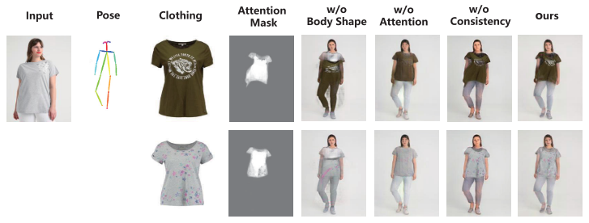
Experiments

Slide 7
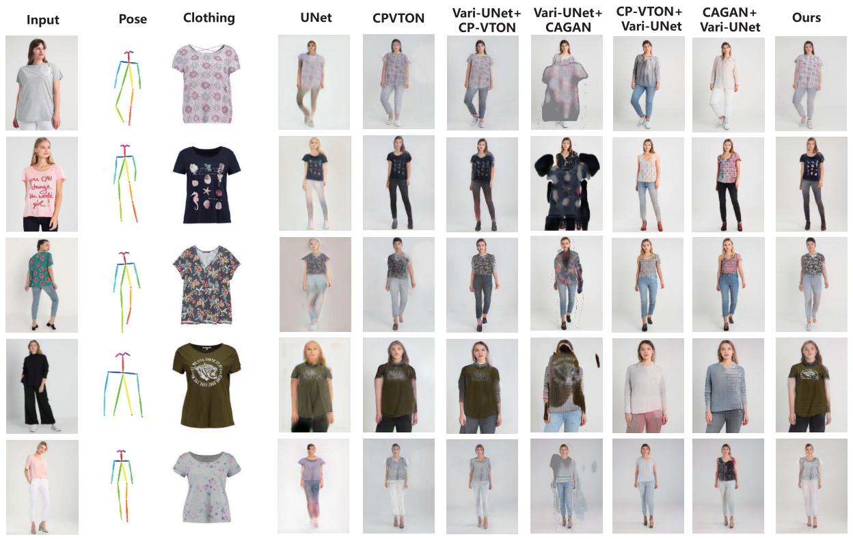
Experiments

Slide 8
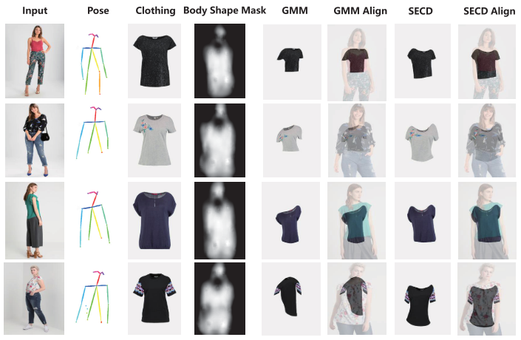
Experiments

