Slide 1
Video Visual Relation Detection Survey

Slide 2
Definition
Input: a video segment
Output: list of relation instances
relation triplet label< object, predicate, subject >
bbox trajectory of object
bbox trajectory of subject

Slide 3
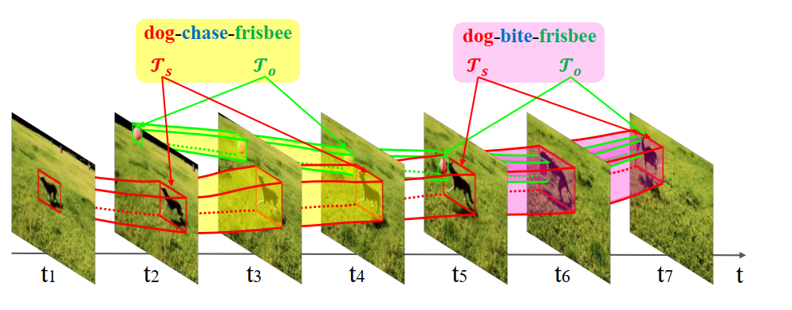
Example

Slide 4
Challenges comparing to VRD
relation more changeable(walk, run)
occluded: occurrence and disappearance
same object and subject pair but relation changed

Slide 5
VidOR(Video Object Relation) Dataset
scale
10000 user-generated videos(web)
average length: 30s
80 categories of objects
50 categories of predicates
split
7000 train,835 val,2165 test
Annotations
38602 objects annotated
297352 relations annotated
50 categories of basic predicates
42 atomic actions
8 spatial predicate
relation triplets
6258 in train
2410 in val
2115 in both
295 only in val(zero shot)

Slide 6
[mm17] Video Visual Relation Detection
Pipeline
Object Tracklet Proposal:
Detector: Faster R-CNN with Res101
Tracking
NMS
Relation Prediction
Relation Feature Extraction:
Object feature: iDT feature with HoG(histogram of gradient), HoF（histogram of flow) and MBH( Motion Boundary Histograms)
Relative feature: coordinate, size, relative coordinate/size, temporal scale change
Relation Modeling: combined predictor(loss for each possible triplet, prob calculated by multiply scores or corresponding obj,sub,pred)

Slide 7
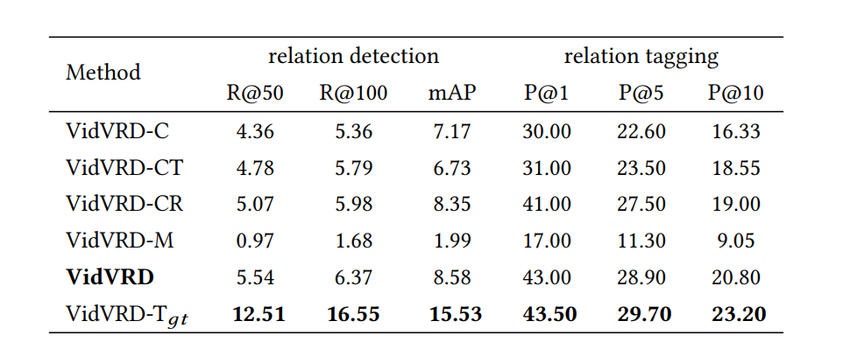
[mm17] Video Visual Relation Detection
Experiments Conclusion
multi-modal feature matters
combined predictor matters a lot
GT Tracklet only helps relation tagging a bit

Slide 8
[mm19] Video Visual Relation Detection via Multi-modal Feature Fusion
Pipeline
Object trajectory detection:
FGFA（Flow Guided feature aggregation) -> 300 object bboxs per-frame
seq-NMS -> short-term preliminary trajectories(with merge) -> 20 trajectory instances
KCF(Kernelized Correlation Filter)
Relation prediction:
trajectory pairs -> segments with fix duration -> relative location feature + motion feature = spatial-temporal feature
language context feature 600*2-D(object,subject) extracted by word2vec
two-layer FC Net with leaky ReLU for the two features independently
fuse the score of the two FC Net
mAP:6.56, tagging Precision: 51.20

Slide 9
[mm19] Relation Understanding in Videos
Data Analysis:
data unbalance -> extra data from ILSVRC DET and MS COCO + focal loss
label missing -> complement annotation based on experiments([person,ride,horse] -> [person,on,horse])
only sample 10 key frames per video

Slide 10
[mm19] Relation Understanding in Videos
Pipeline:
Object Detection
RefineDet with VGG16 as backbone
Object Tracking
similarity score of two consecutive key frame
filtering: short or small trajectory confidence score
NMS
Relation Prediction
Deep Structral Ranking
pair genaration with NMS
Appearance feature by i3D
Spatial feature by coordinates
language semantic feature by BERT
mAP:1.47, tagging Precision: 33.05

Slide 11
Summary
Pipeline: Tracking + Relation Prediction
Which feature to use?(language, visual, motion, spatial, statistic, or …)
How to supervise?

