Slide 1
CVPR2022

Slide 2
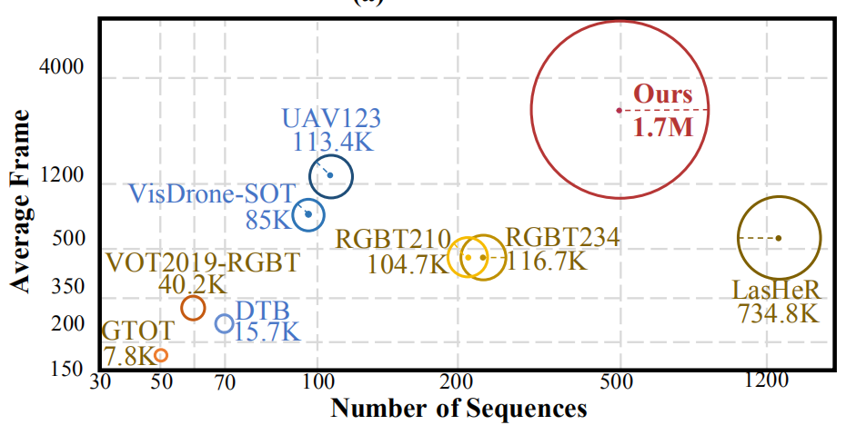
Visible Thermal UAV tracking (VTUAV)

Slide 3
250 sequences as training set and the other 250 sequences as test set.
325 sequences are captured at daytime and 175 sequences are at night with different conditions.
In the training set, there are 207 short-term sequences and 43 long-term sequences.
74 and 176 in testing set.
100 sequences selected in short-term subset (50 sequences for training and 50 sequences for test).
5 super-classes and 13 sub-classes, captured at 15 scenes cross two cities.
13 attributes, including target blur (TB), camera movement (CM), extreme illumination (EI), deformation (DEF), partial occlusion (PO), full occlusion (FO), scale variation (SV), thermal crossover (TC), fast moving (FM), background clustering (BC), out-of-view (OV), lowresolution (LR) and thermal-visible separation (TVS)

Slide 4
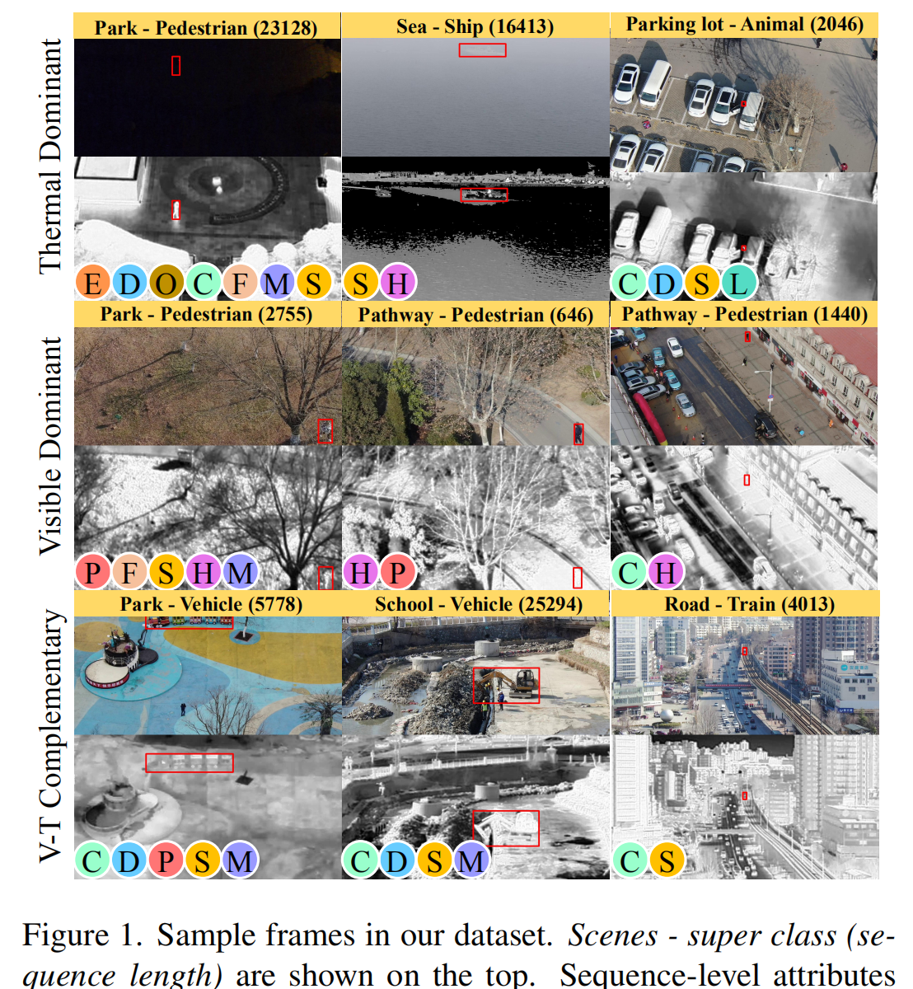
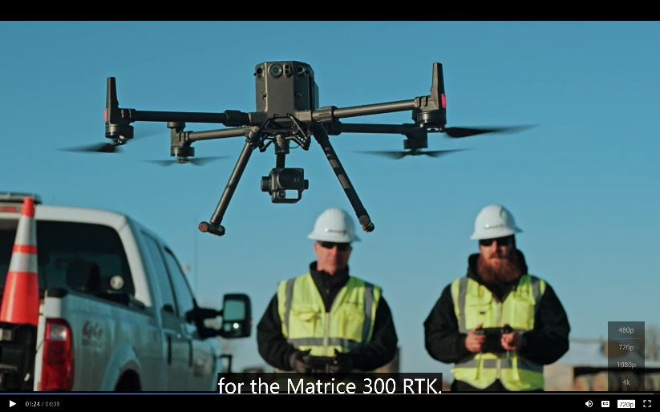
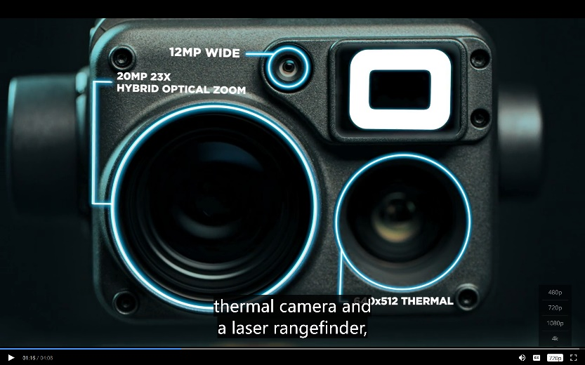
UAV (DJI Ma trice 300 RTK) with Zenmuse H20T camera

Slide 5
Alignment
we operate modality alignment in the initial frame for each video and apply it to all frames.
Annotation
Annotate bounding boxes for both modalities, individually.
Provide sparse annotations in an interval of 10 frames, 326,961 high-quality bounding box annotations in total
Annotate the target mask at 1 fps for visible and thermal images. A total of 24,464 masks
Frame-level attribute annotations, 301,678 frames with 430,960 attributes and provide 500 * 13 sequence-level annotations

Slide 6
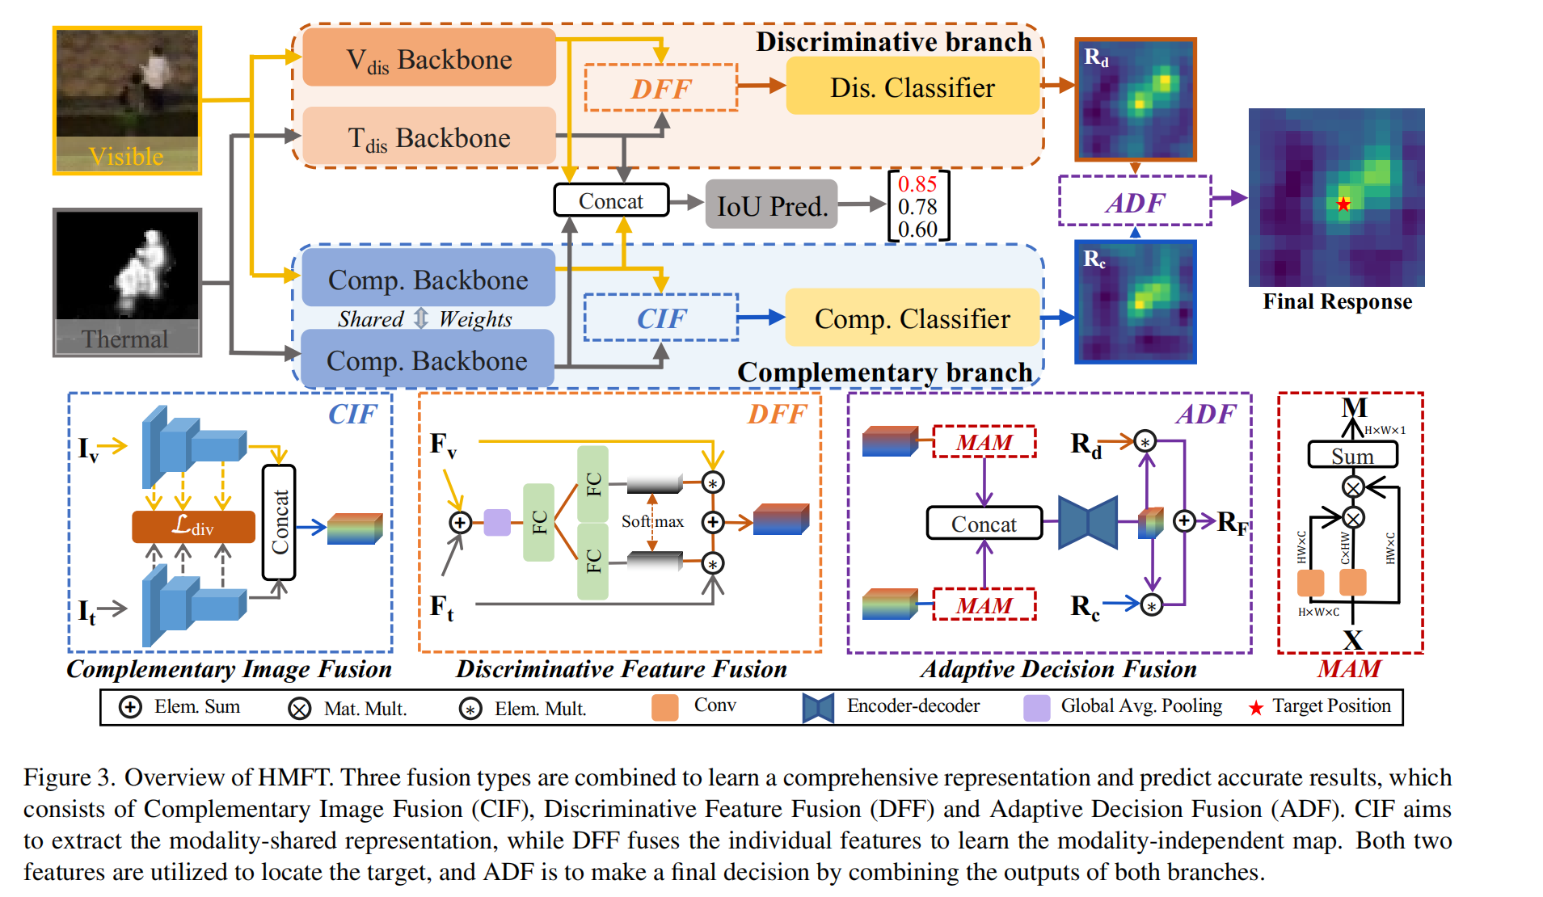

Slide 7
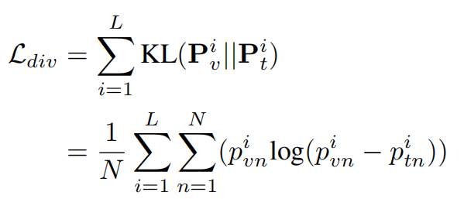
Complementary Image Fusion
ResNet50
a divergence loss Ldiv
Discriminative Feature Fusion
Adaptive Decision Fusion

Slide 8
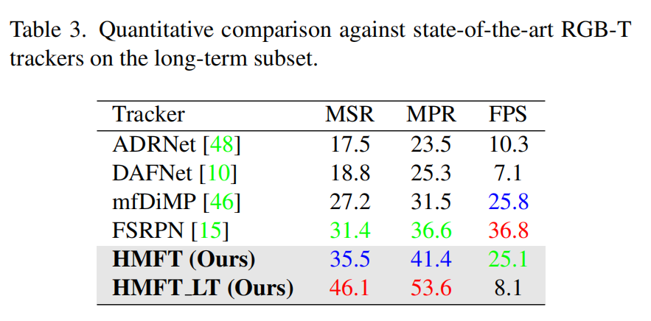
Implementation
First, train both backbones for discriminative and complementary branches
Then, the learned backbones are fxed, and we learn DFF module and the classifers
Finally, with all the backbones fxed, we start to learn ADF and IoU prediction modules and fine-tune both classifers to fit the learned representations

Slide 9
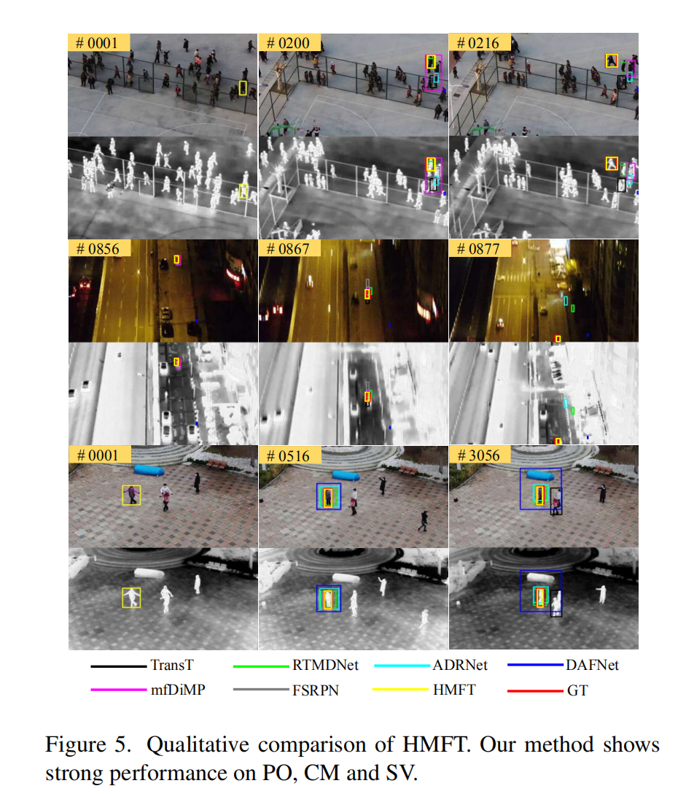
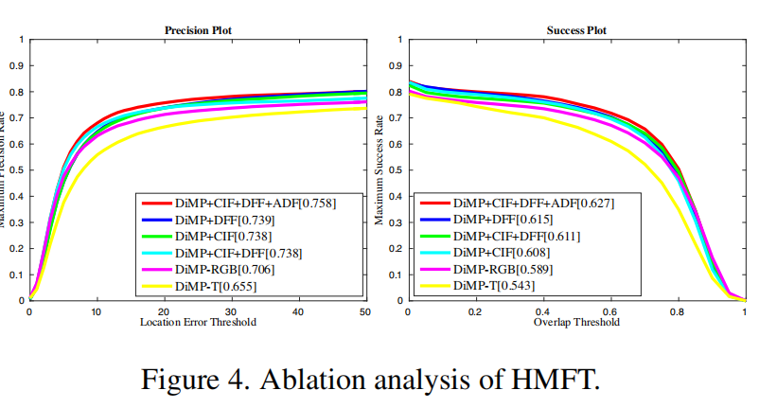
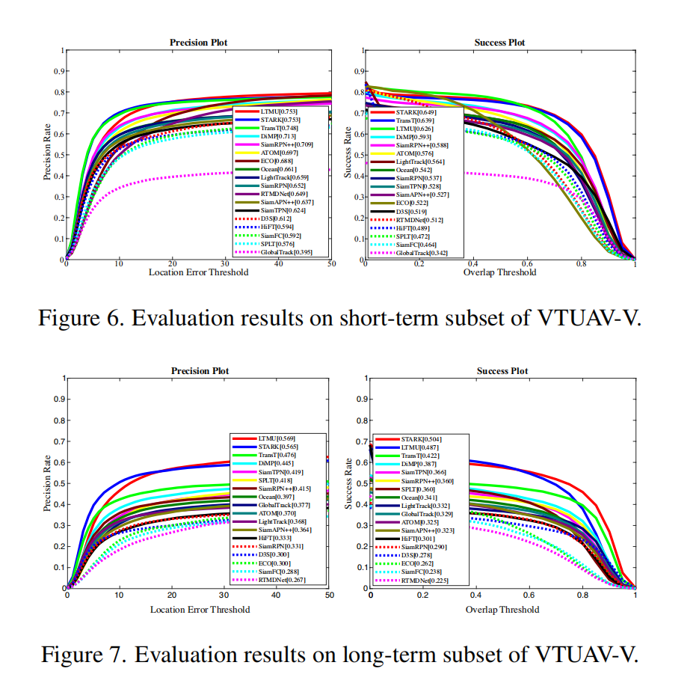
Implementation

