Slide 1
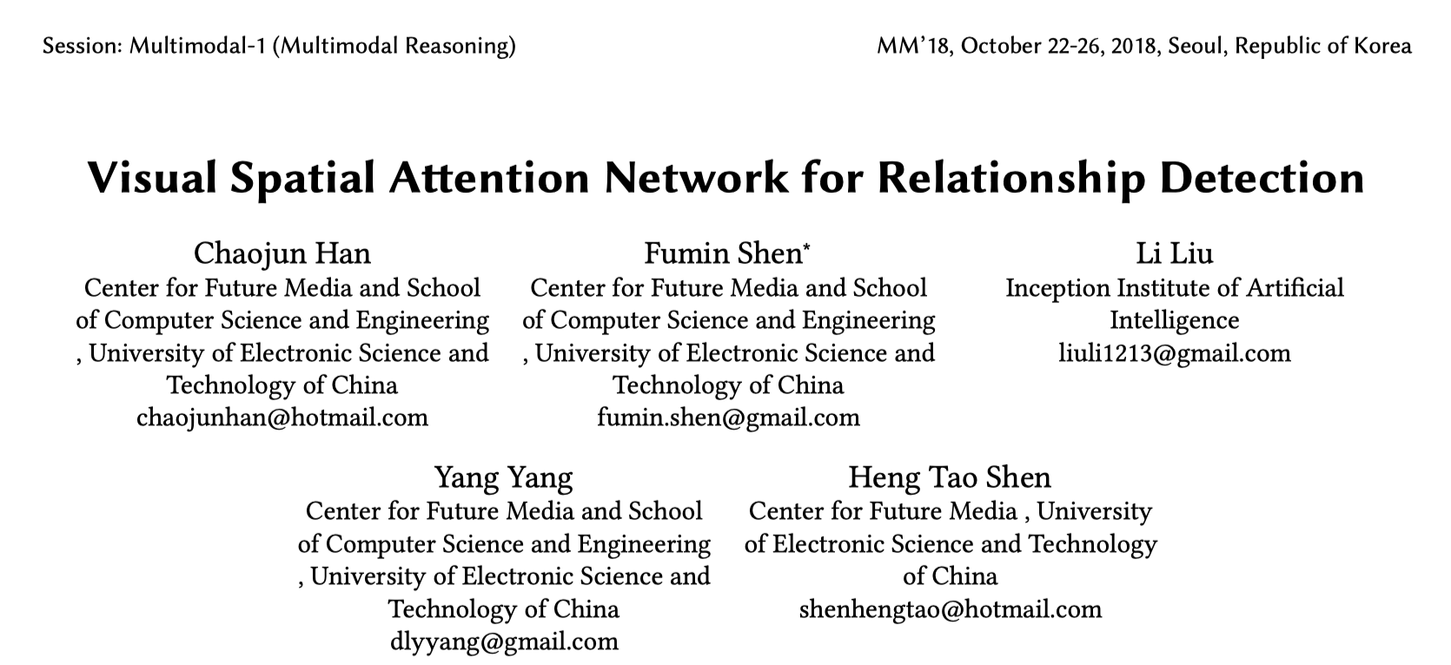

Slide 2
Motivation
2-dim Normal Distribution Attention
Attention机制应当对小物体分配相对更大的权重
预测关系前应对主语和宾语做区分，从而预测出更多合理的关系
Subject Object Layer

Slide 3
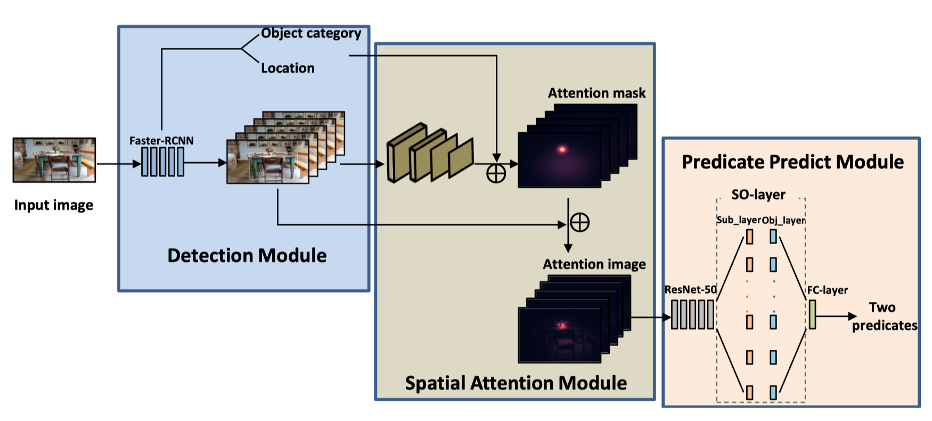
Framework

Slide 4
Traditional Attention Mechanism

Slide 5
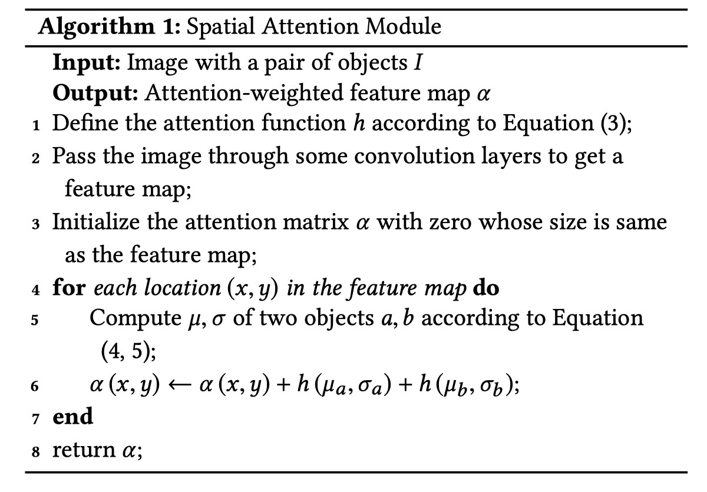
2-dim Normal Distribution Attention

Slide 6
2-dim Normal Distribution Attention

Slide 7
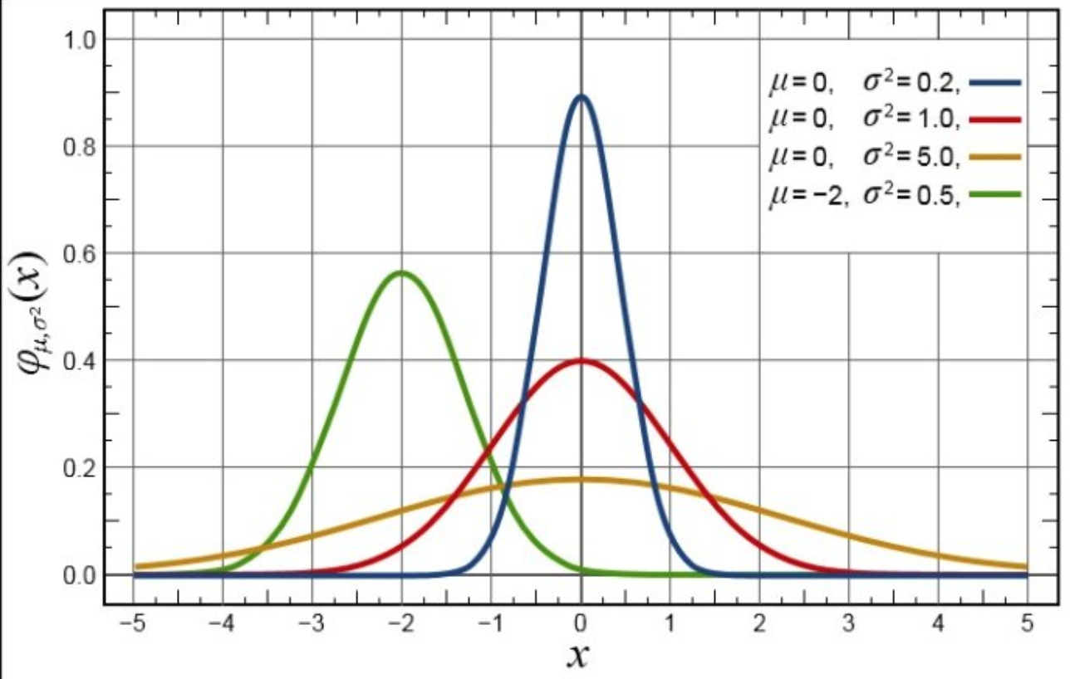

Slide 8
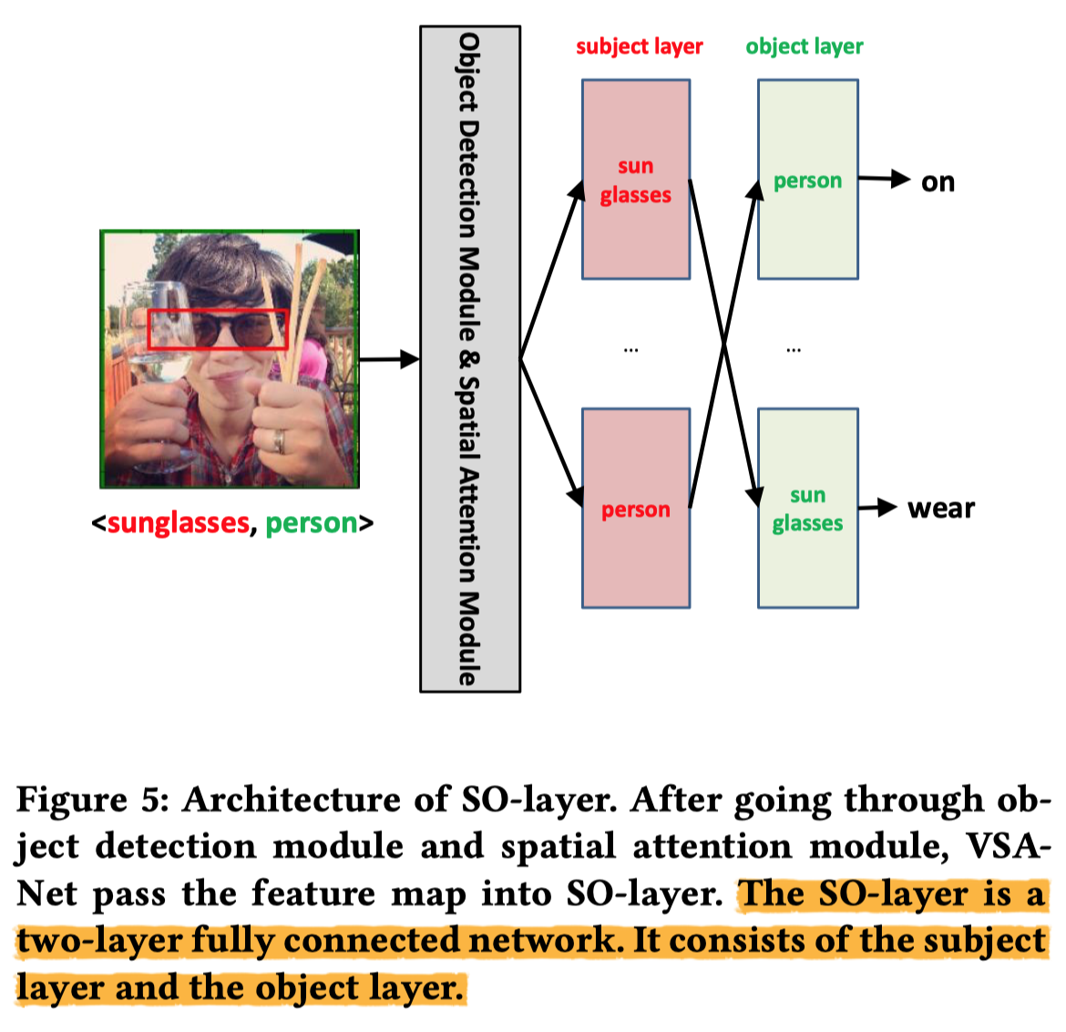
SOLayer

Slide 9
Experiments

Slide 10
Experiments

