Slide 2
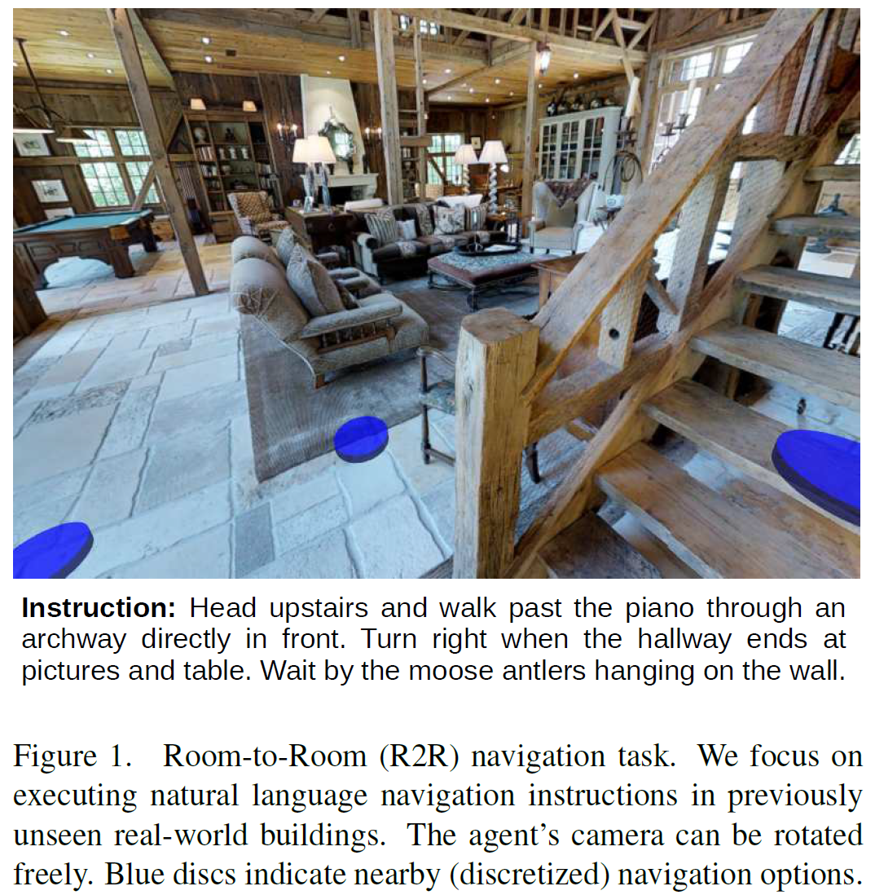
Task

Slide 3
Motivation
Recent success of RNN methods for the joint interpretation of images and natural language that motivates the VLN task and R2R dataset
Previous approaches to natural language command of robots have often neglected the visual information processing aspect of the problem
Use rendered, rather than real images
Present the Matterport3D Simulator and Room-to-Room dataset
Require the agent to interpret a previously unseen natural-language navigation command in light of images generated by a previously unseen real environment

Slide 4
Matterport3D Simulator
--- Matterport3D Dataset
Matterport3D dataset contains a comprehensive set of panoramic views
10,800 panoramic views
194,400 RGB-D images
90 building-scale scenes
Each panoramic view is comprised of 18 RGB-D images captured from a single 3D position at the approximate height of a standing person
Matterport scenes encompass a range of buildings including houses, apartments, hotels, offices and churches of varying size and complexity

Slide 5
Matterport3D Simulator
--- Simulator (Observation)
To construct the simulator, we allow an embodied agent to virtually ‘move’ throughout a scene by adopting poses coinciding with panoramic viewpoints
Agent pose
3D position , heading , camera elevation
At each step $t$, the simulator outputs an RGB image observation $o_{t}$ corresponding to the agent’s first person camera view

Slide 6
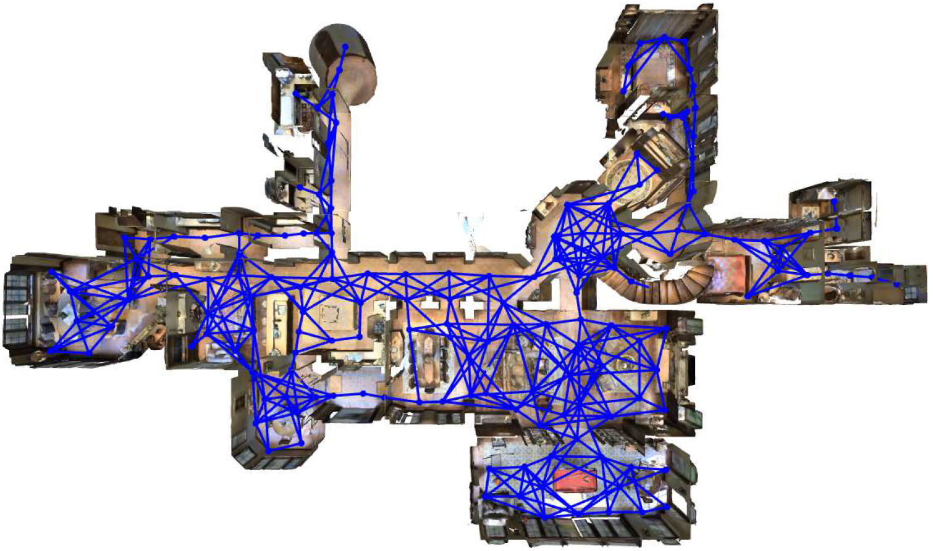
Matterport3D Simulator
--- Simulator (Action Space)
At each step $t$ the simulator also outputs a set of next step reachable viewpoints
Agents interact with the simulator by selecting a new viewpoint , and nominating camera heading , and elevation adjustments

Slide 7
Matterport3D Simulator
--- Simulator (Biases)
The majority of captured living spaces are scrupulously clean and tidy, and often luxurious
The dataset contains very few people and animals, which are a mainstay of many other vision and language datasets
Selected viewpoints generally offer commanding views of the environment

Slide 8
Room-to-Room (R2R) Navigation
--- Task
The R2R task requires an embodied agent to follow natural language instructions to navigate from a starting pose to a goal location in the Matterport3D Simulator
Input a natural language instruction
The agent observes an initial RGB image $o_{0}$, determined by initial pose
The agent must execute a sequence of actions
Each action $a_{t}$ leading to a new pose
The episode ends when the agent selects the special stop action

Slide 9
Room-to-Room (R2R) Navigation
--- Data Collection
Use the Matterport3D region annotations to sample start pose $s_{0}$ and goal location $v^{∗}$ pairs that are (predominantly) in different rooms
For each pair, find the shortest path $v_{0} : v^{∗}$ in the relevant weighted, undirected navigation graph $G$
Sample 7,189 paths capturing most of the visual diversity in the dataset
For each path, collect three associated navigation instructions using AMT

Slide 10
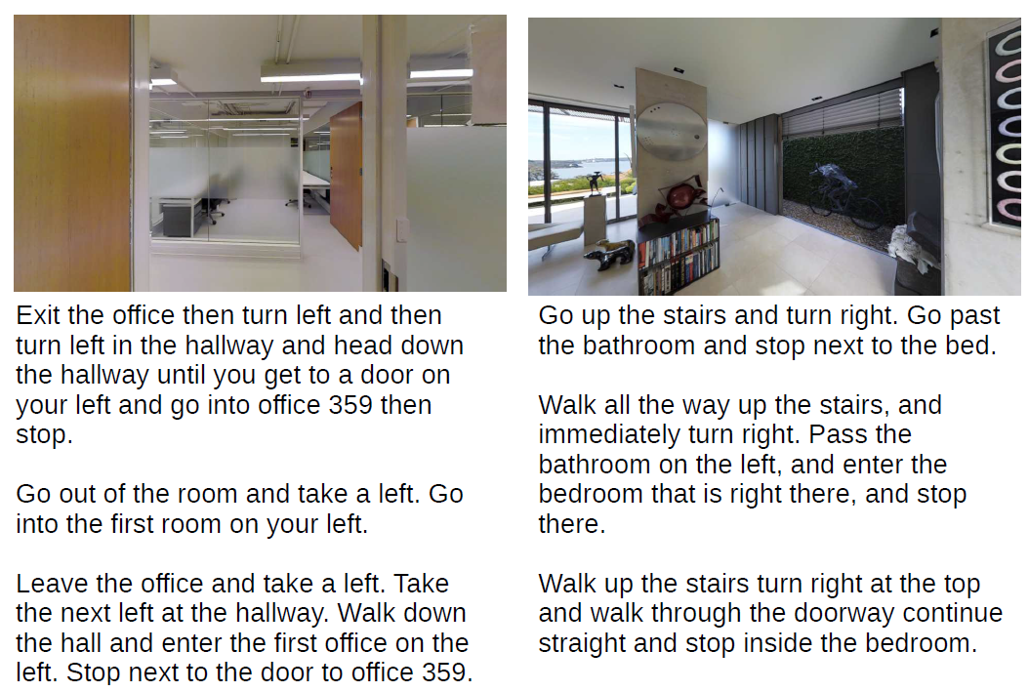
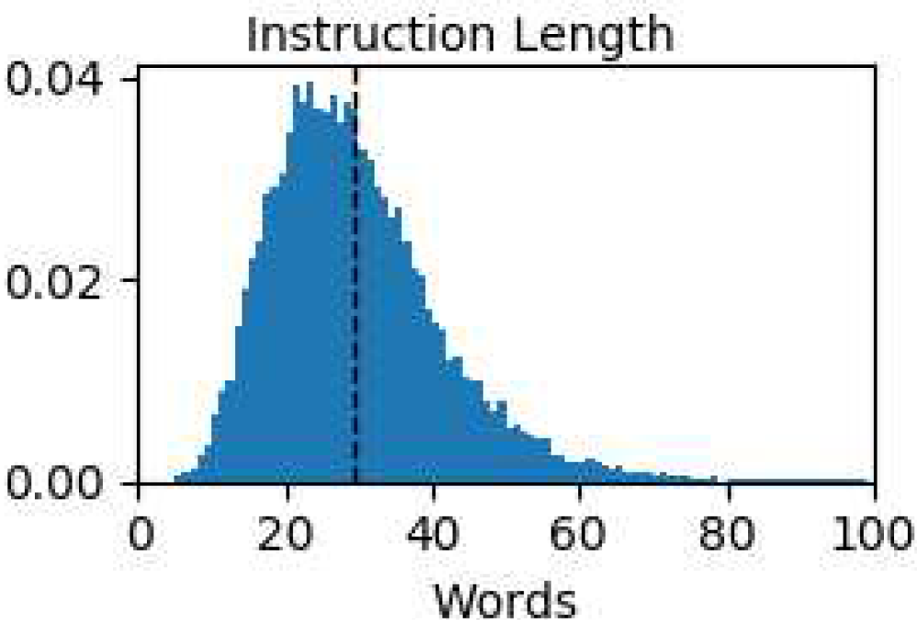
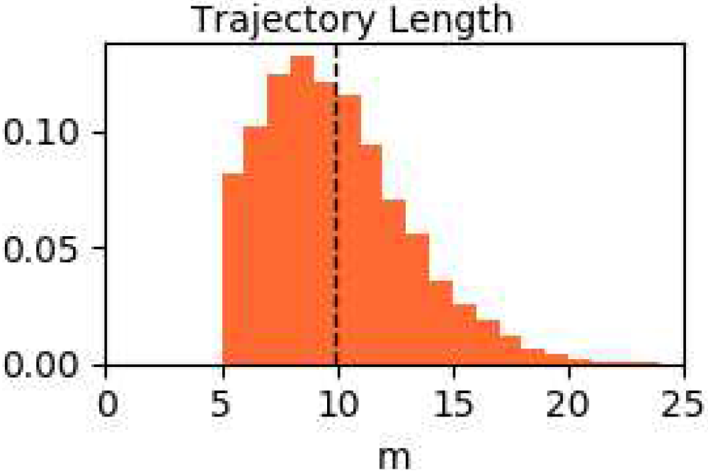
Room-to-Room (R2R) Navigation
--- Dataset Analysis

Slide 11
Room-to-Room (R2R) Navigation
--- Evaluation Protocol
Navigation error : the shortest path distance in the navigation graph G between the agent’s final position $v_{T}$ and the goal location $v^{∗}$
Success : the navigation error is less than 3m
an oracle stopping rule: if the agent stopped at the closest point to the goal on its trajectory

Slide 12
Vision-and-Language Navigation Agents
--- Sequence-to-Sequence Model

Slide 13
Vision-and-Language Navigation Agents
--- Training
At each step, use cross entropy loss to train the prediction of actions
Teacher-forcing: use ground-truth target action $a_{t}^{∗}$
Limits exploration to only states that are in ground-truth shortest-path trajectory
Student-forcing: not use $a_{t}^{∗}$

Slide 14
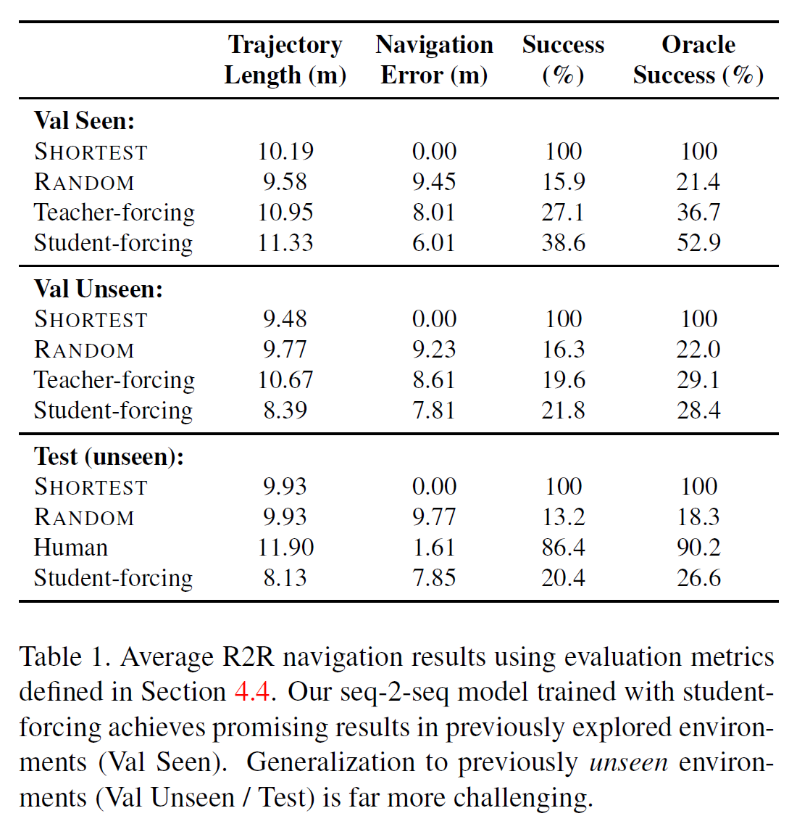
Vision-and-Language Navigation Agents
--- Experiments

