Slide 1
CVPR 22

Slide 2
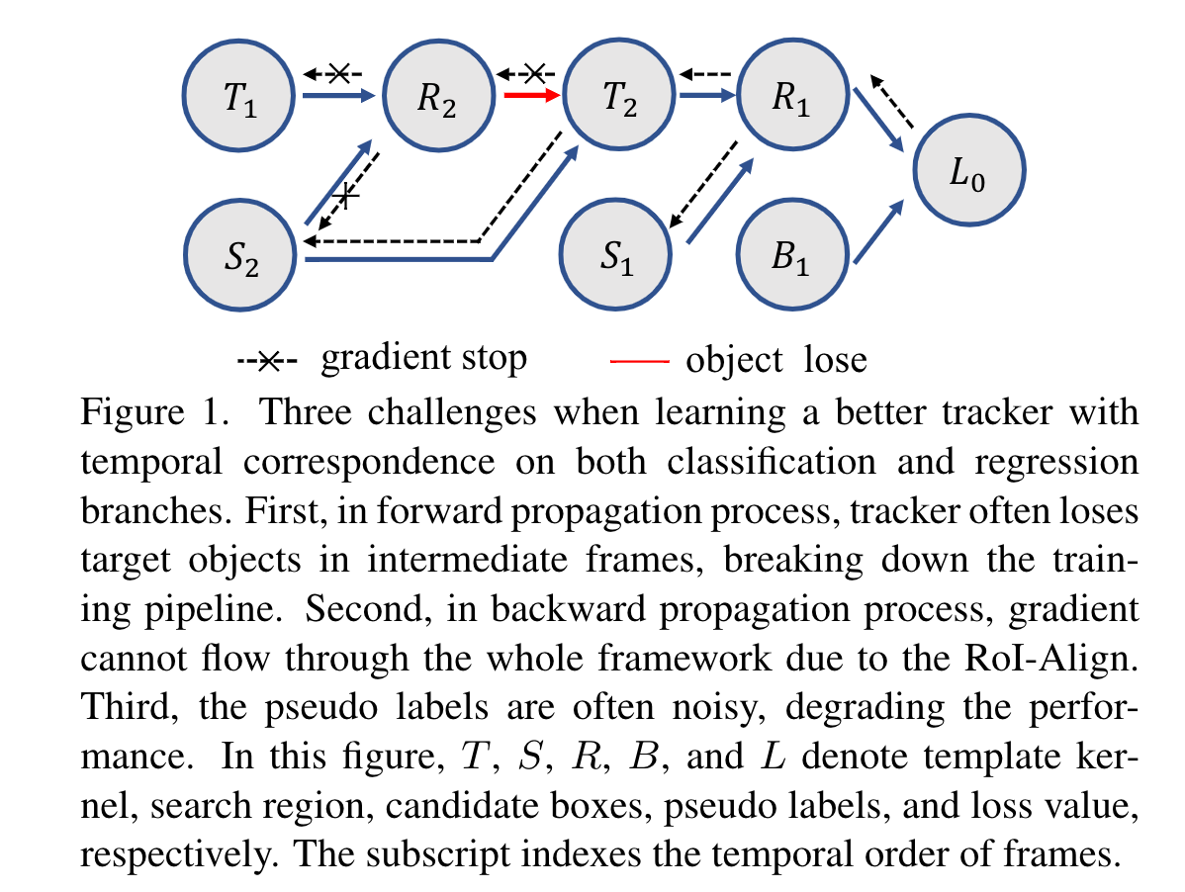

Slide 3
consistency propagation transformation
region mask operation
mask-guided loss re-weighting

Slide 4
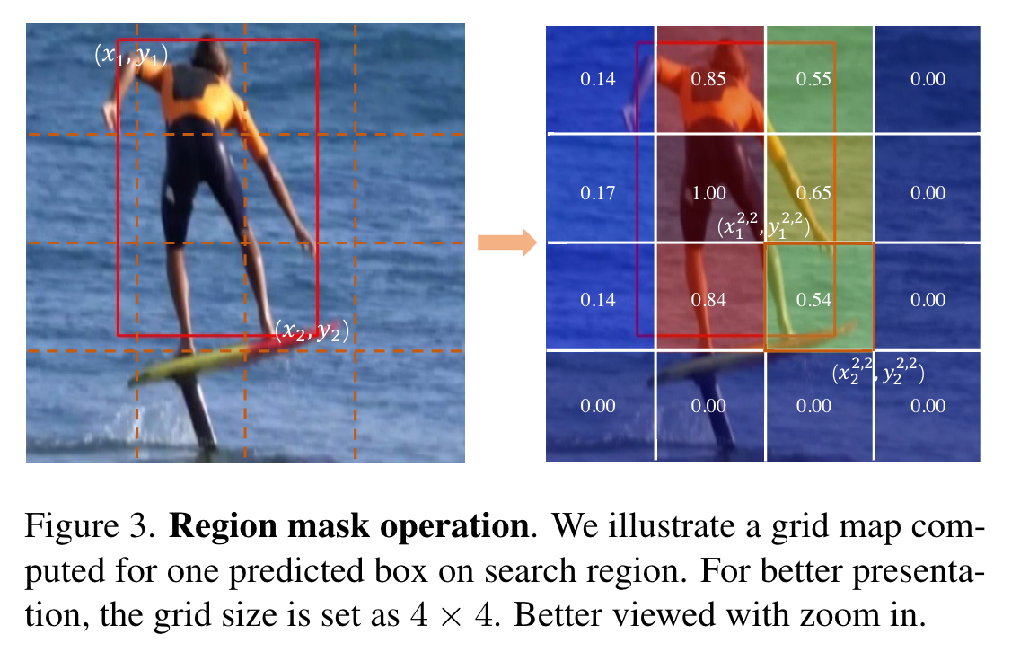
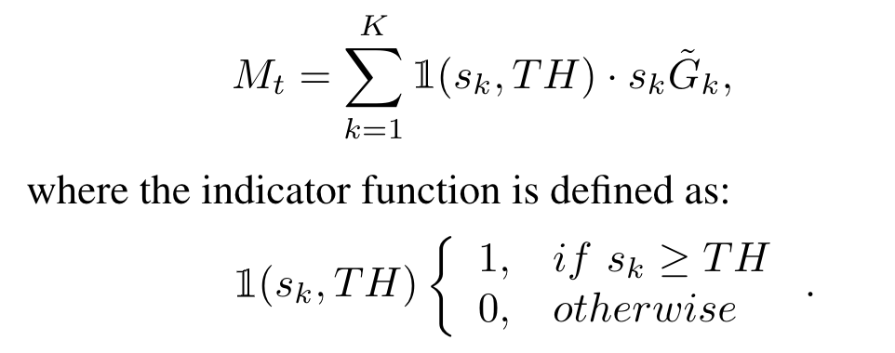
Region Mask Operation
初始化一个grid，W，H与 S相同
represents the overlap ratio of the fixed grid with predicted box.
K个框得到集合G(K)
按照RPN的置信度更新G(K)

Slide 5
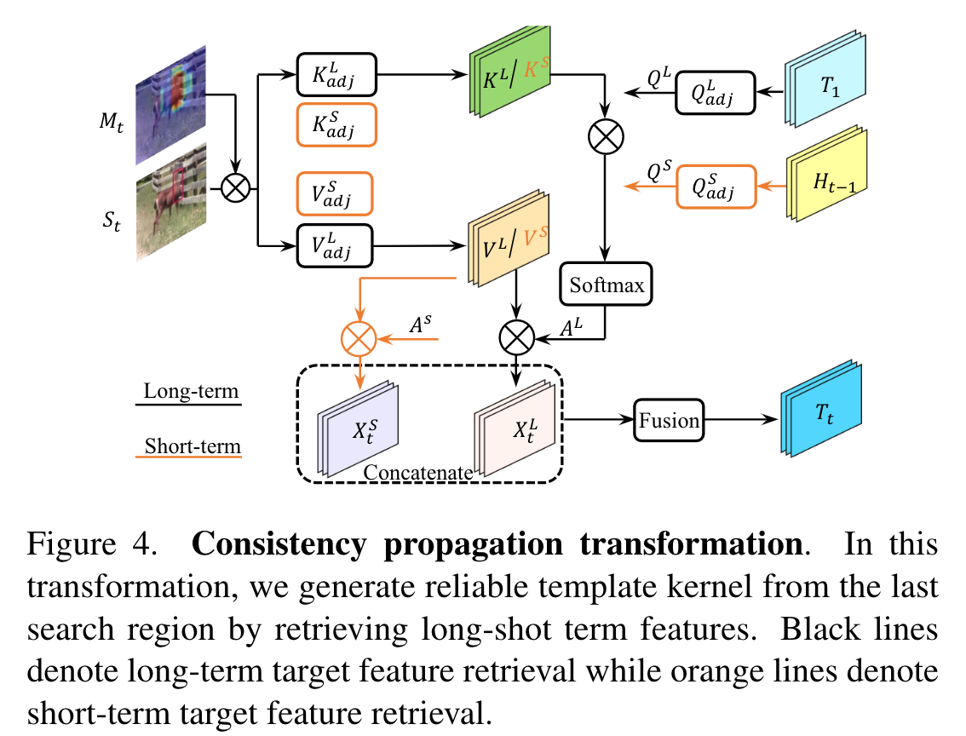
Consistency propagation transformation (CPT)

Slide 6
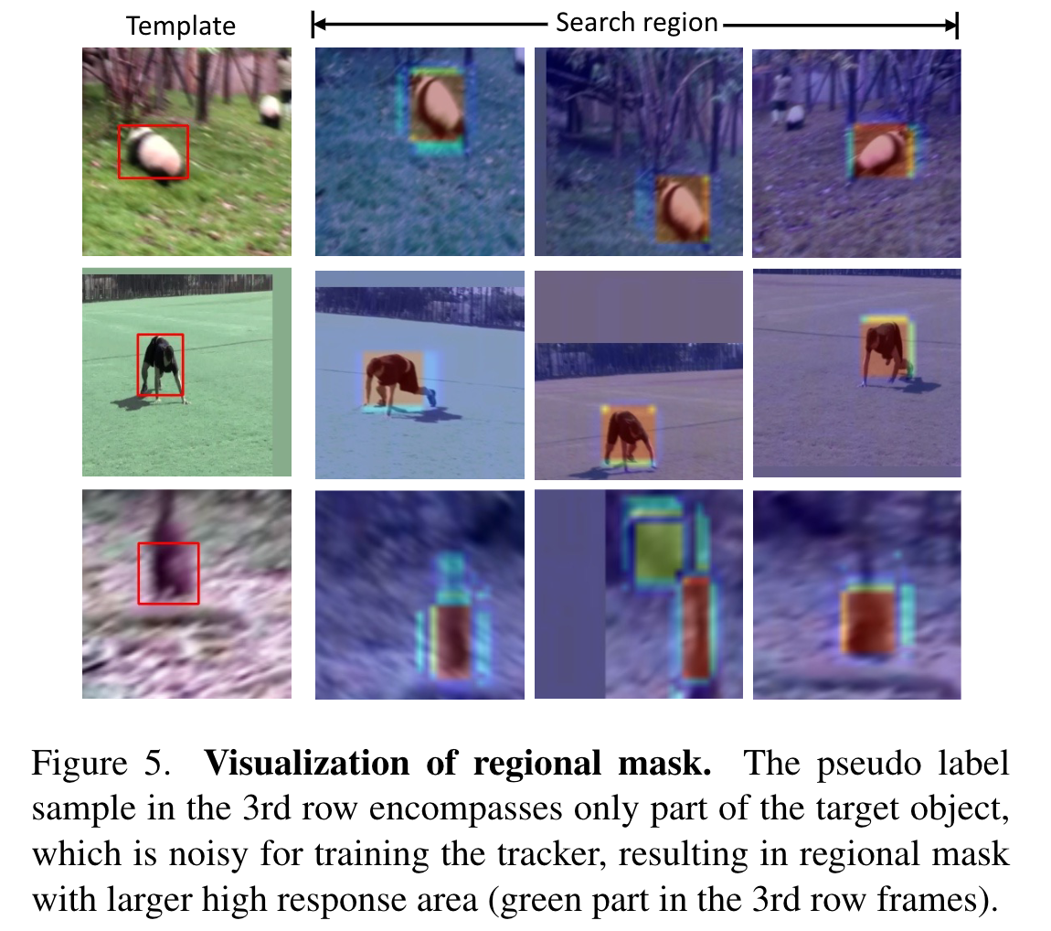
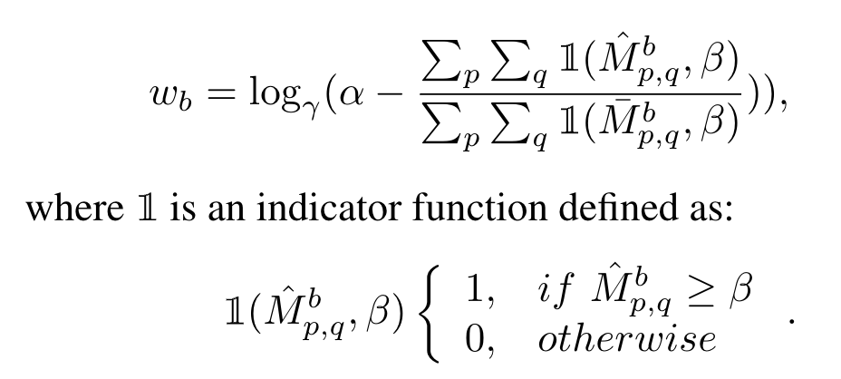
Mask-guided loss re-weighting
一个Batch里：
每sample一段视频：
使用第一帧的模版和搜索区域生成mask region
生成一个只包含伪标签框的mask region

Slide 7
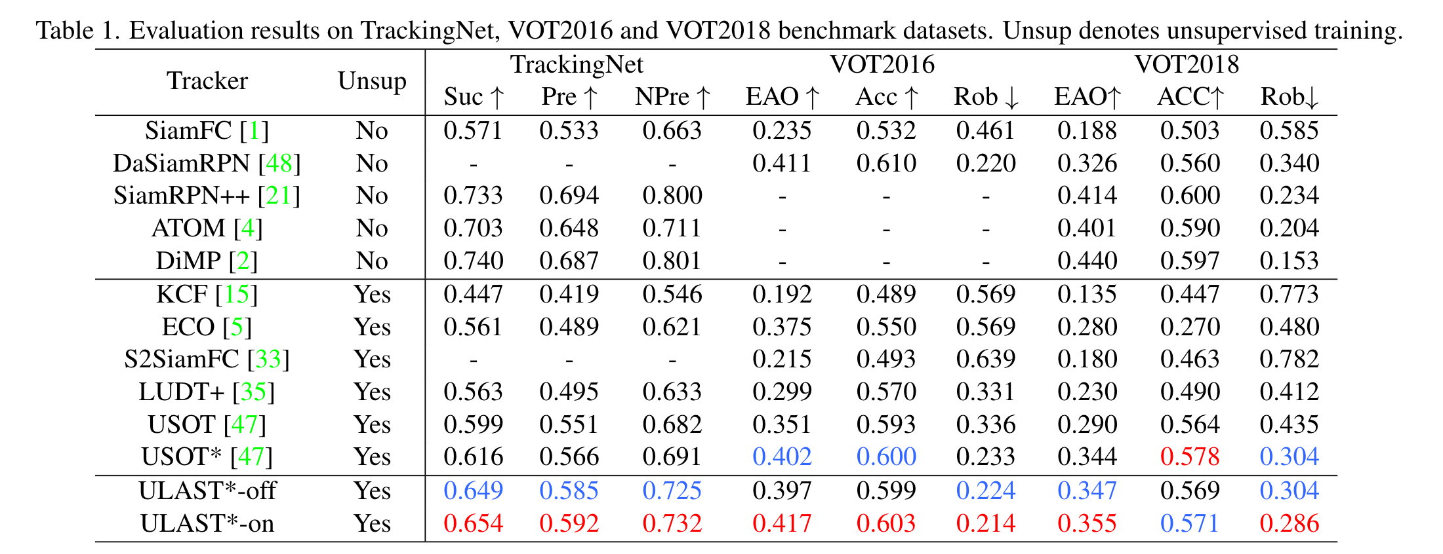

Slide 8
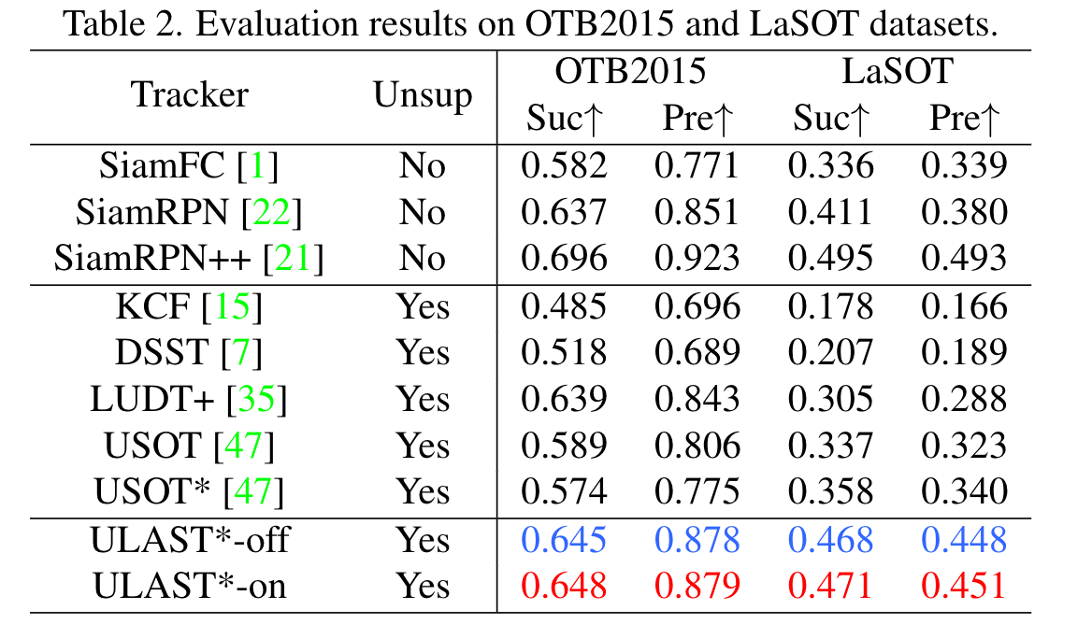

Slide 9
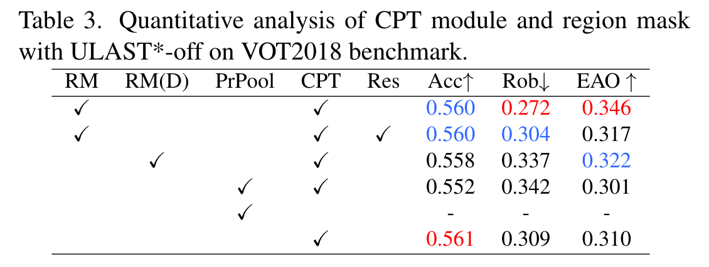

Slide 10
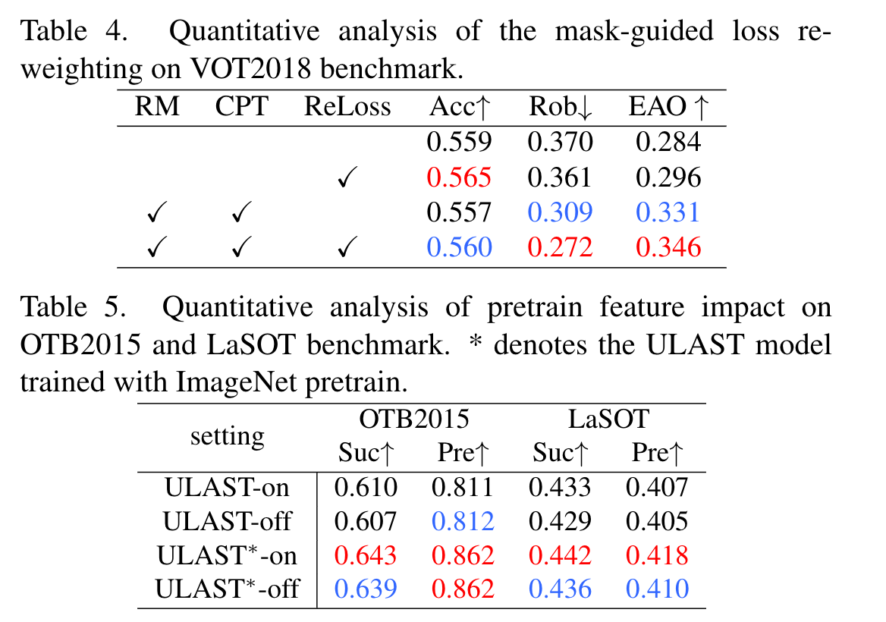

Slide 11
