Slide 1
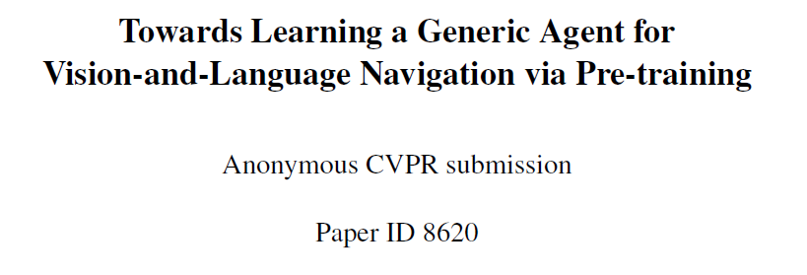

Slide 2
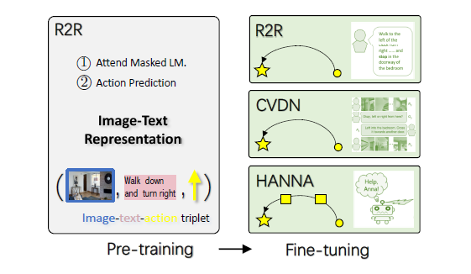
every instruction only partially characterizes the trajectory.
pre-train an encoder to align language
instructions and visual states for joint representations.

Slide 3
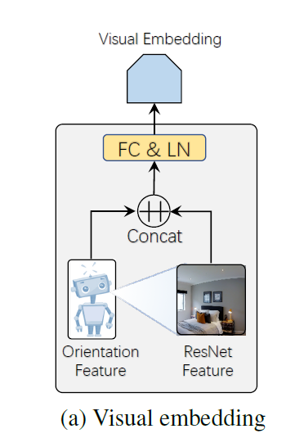
Visual Embedding
12 angles, and 3 camera poses per angle
sv output by a Residual Network (ResNet) of the image
Sp:

Slide 4
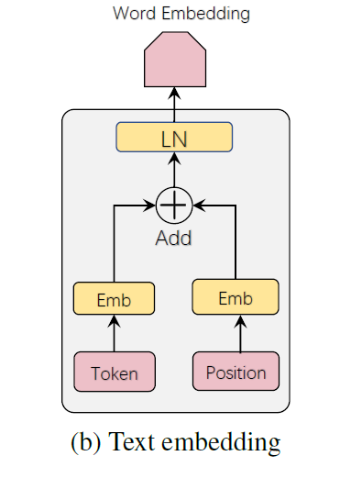
Word embedding
the standard Transformer

Slide 5
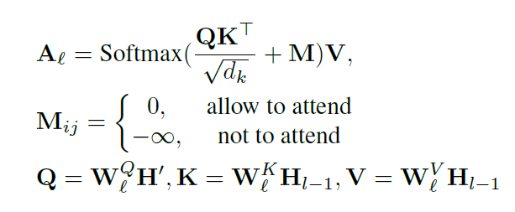
Encoder Architecture

Slide 6
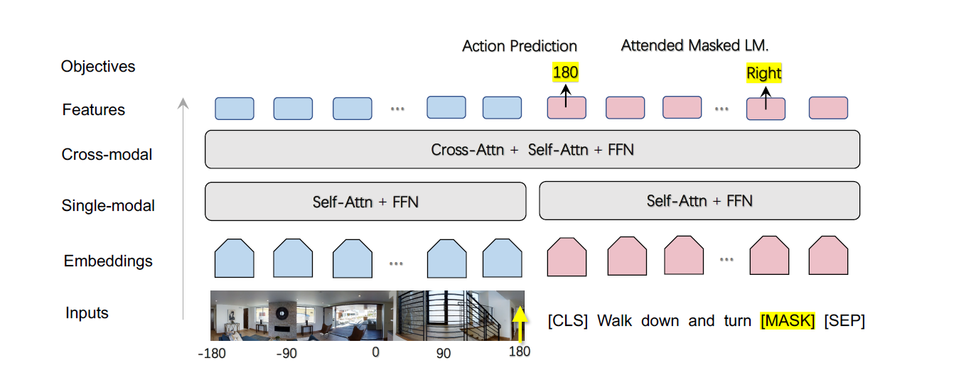
Action Prediction: apply an FC layer at the output of [cls]
Attended Masked Language Modeling : The goal is to predict these masked words

Slide 7
Adapting to new tasks
Room-to-Room
Cooperative Vision-and-Dialogue Navigation
HANNA: Interactive Imitation Learning

Slide 8
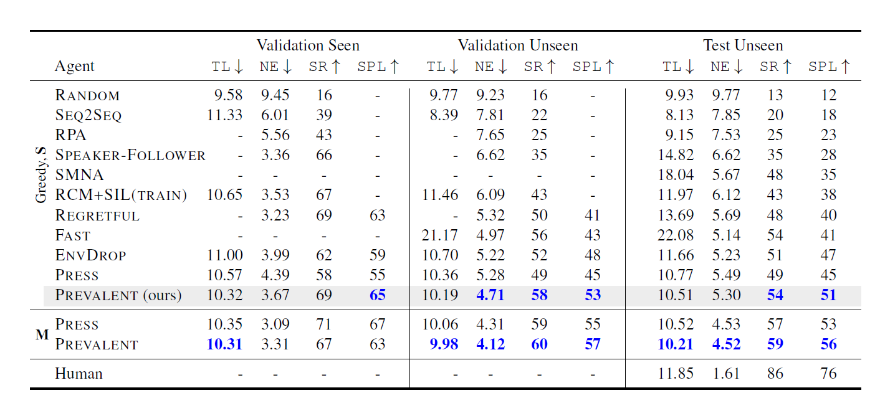
Experiment

