Slide 1
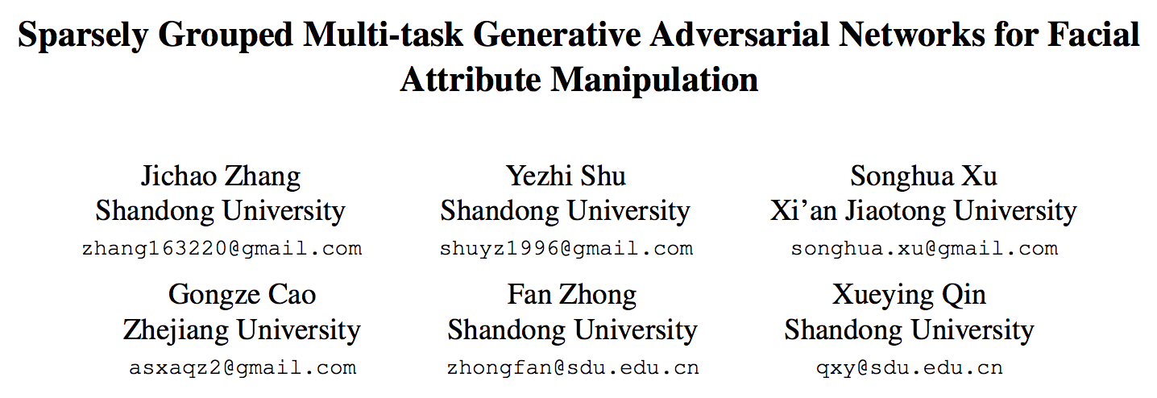
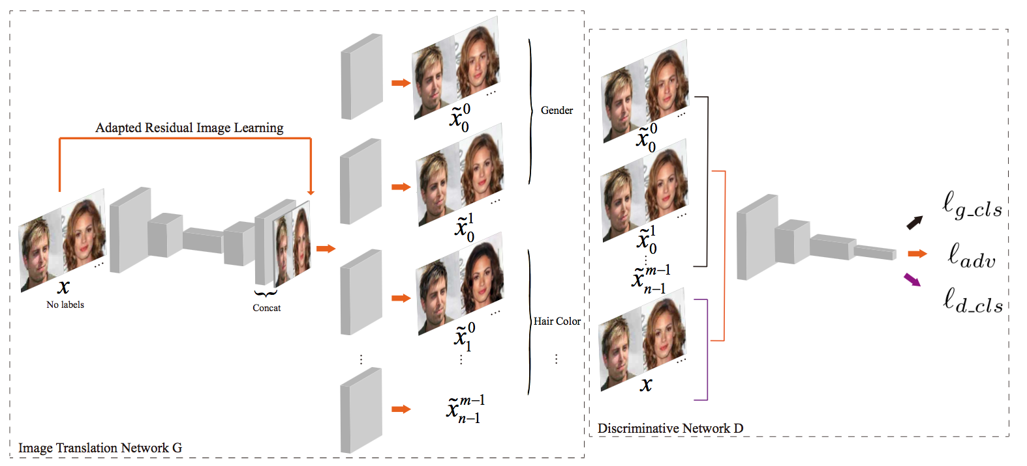
one-input multi-output architecture
semi-supervised classifier

Slide 2
Extra Condition-based Methods

Slide 3
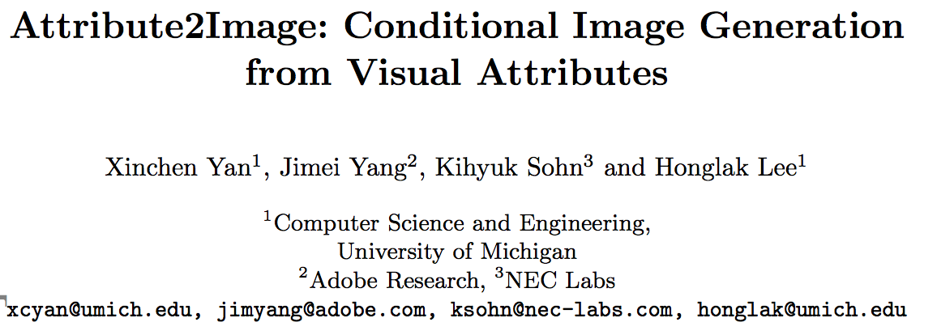
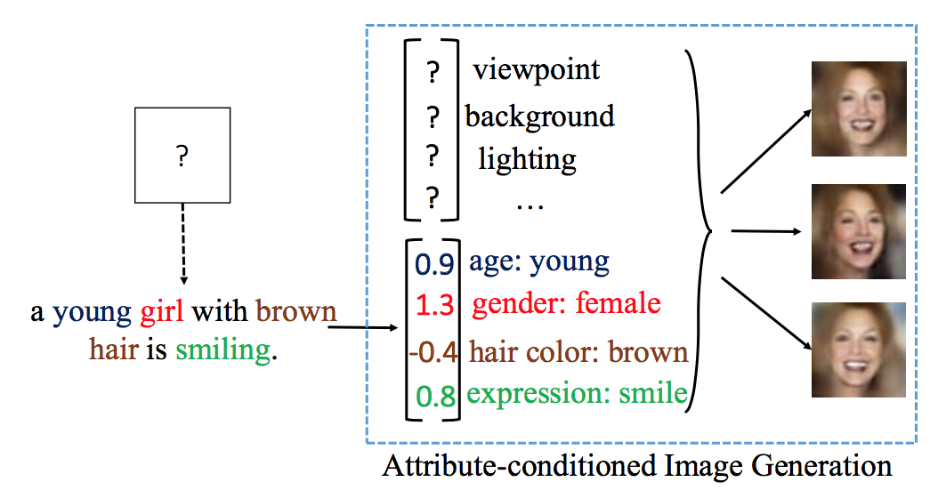
Conditional variational auto-encoders (CVAE) -> generate images from visual attributes
foreground and the background parts, each part is combined with the defined attribute vector
提高生成复杂图片的能力

Slide 4
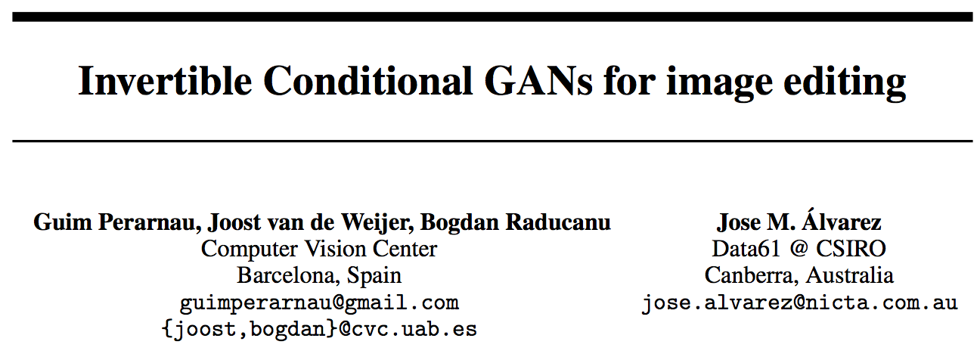
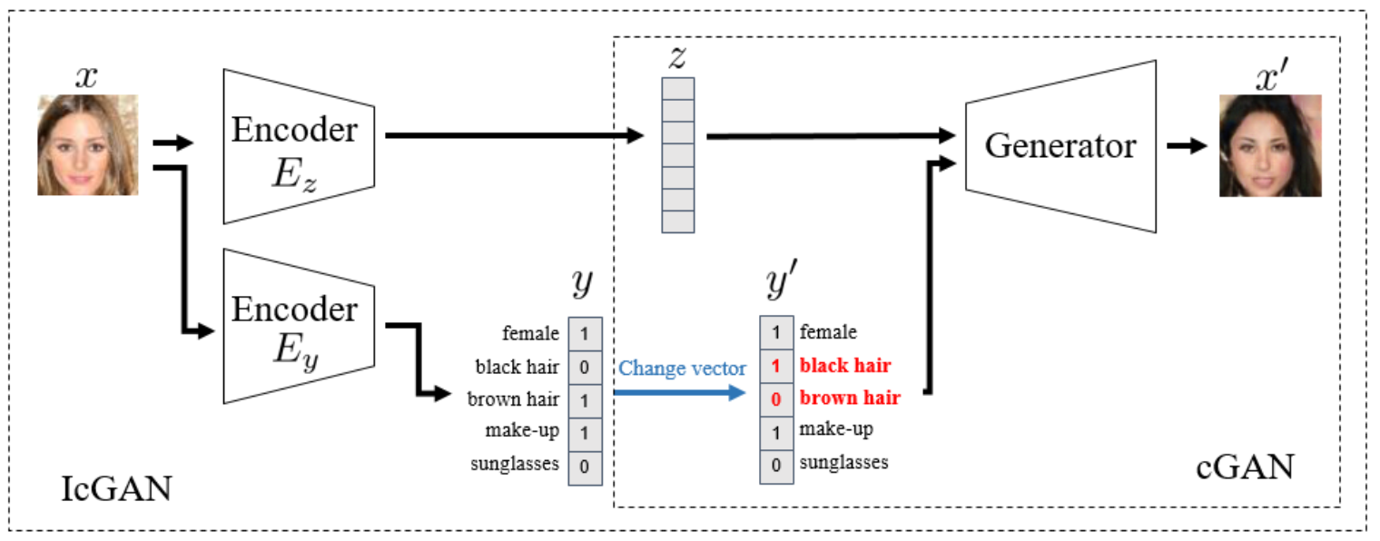
modify real images of faces conditioning on arbitrary attributes

Slide 5
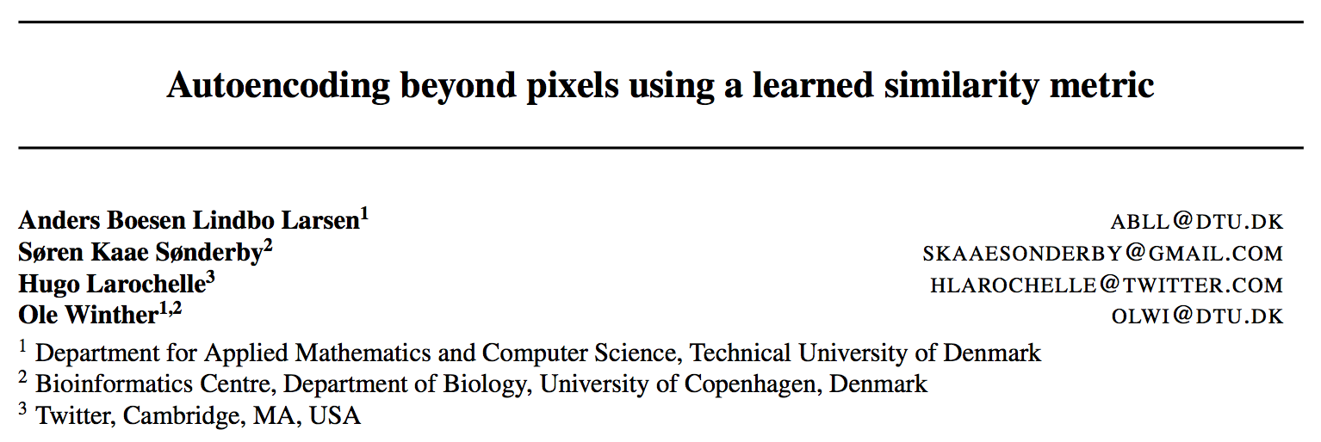
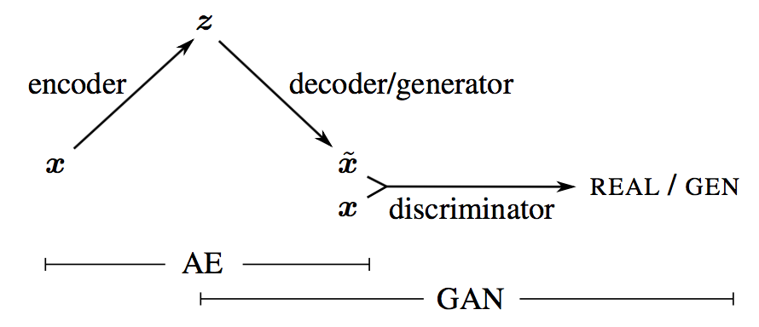
VAE decoder and the GAN generator are collapsed into one

Slide 6
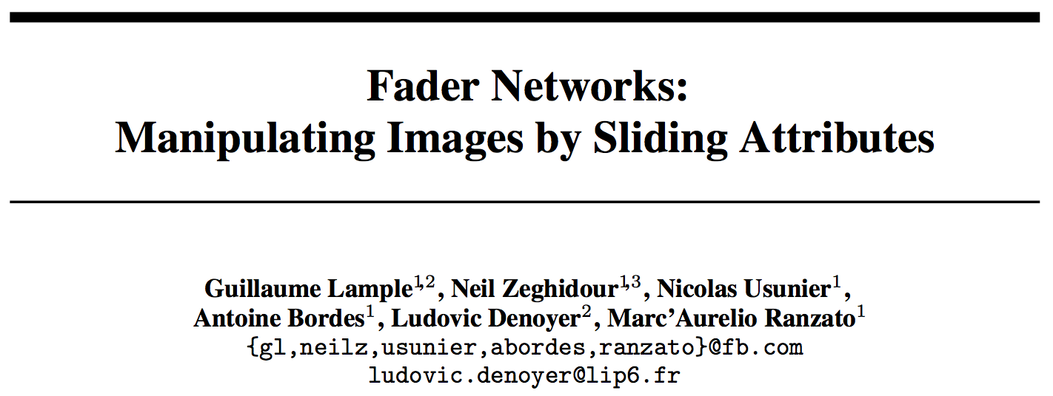
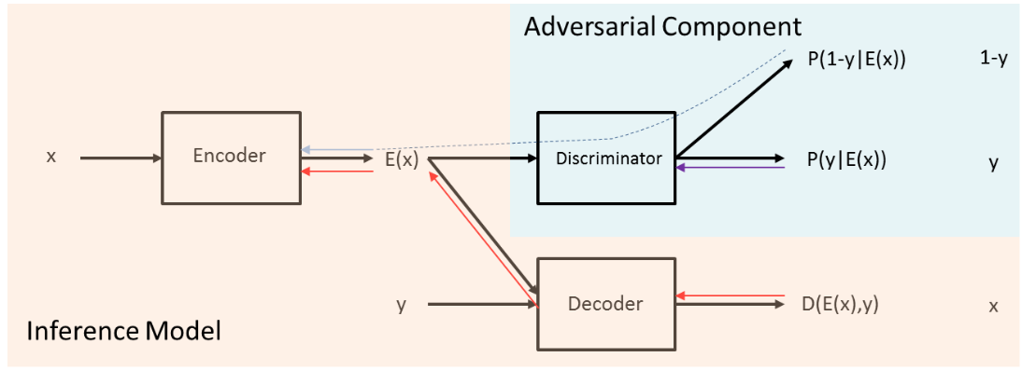
Using continuous attribute values to modify attributes through sliding knobs
Disentangling the salient information of the image and the values of attributes directly in the latent space

