Slide 1
Textured Neural Avatars
Notes:
有质感的神经性化身

Slide 2
Abstract
A system for learning full body neural avatars, produce full body rendering for varying body pose and varying camera pose.
Middle path of between classical graphics pipeline and directly image to image translation.
Estimate an explicit two-dimensional texture map of modal surface.
Can train on videos annotated with 3D poses and foreground masks.
Texture map → better generalization → compared with directly image to image translation.
Notes:
对于不同的身体姿态和不同的相机角度全身渲染
处于传统方法和直接转换的中间方法
估计了一个对于模型表面的2维的texture map
能够在videos上训练
相比于直接方法有更好的泛化能力

Slide 3
Visualization
Train for a single person and can produce renderings of this person from novel viewpoints and in a new body pose unseen during training.
Notes:
这个模型为了增强泛化特征，保持了原图的纹理特征，随着rendering neural network而学习

Slide 4
Why do this
Recent work all generate views of a person with a varying body pose but with fixed camera position.
Neural Avatars capable of rendering person under varying body pose and varying camera position.(body joint replace human pose ,easy to capture)
Simplify the classic pipeline, but however network generalize poorly to new camera views. So we need this modal.
Notes:
目前的工作都生成了不同的身体姿态，但是都来自固定的相机位置
NA能够生成个人全身的效果图，显现多变的身体姿势和相机位置（用身体关节去代替身体姿态，更易于捕捉）
该模型简化了传统的方法，但是众多的研究方法已经证明，无论如何简化，对于新机位的泛化能力都很差。

Slide 5
So we …
A neural avatar system that does full body rendering, combines the ideas from the classic computer graphics, with deep CNNs.
Explicitly estimate 2D textures of body parts , to boost generalization across such transforms.
Notes:
这是从神经出发的人类化身的效果图，但并未重塑身体的几何结构。
这个神经替身网络做了全身的化身图
估计二维纹理增强泛化能力。

Slide 6
Model
Input:${ B}_{i}$(a feature map stack represent skeleton, $B_{i}^{j}$a single map represent a bone, one channel one bone)
Output: an RGB image $I_{i}$ and a single channel mask $M_{i}$.
Baseline: Direct translation
Give a pose defined by $B_{i}$, predict the stack $P_{i}$of body part assignment and the stack $C_{i}$.
The $P_{i}^{k}$interpreted as the probability of the pixel to belong to the k-th body part, and coordinate of the k-th part is $C_{i}^{2k}$ and $C_{i}^{2k+1}$
Notes:
有质感的神经性化身的综述。输入姿势被定义为一堆“骨架”的光栅化（一条信道上有一根骨头）。完全卷积的网络（发电机）会处理输入，从而生成人体部位分配的地图堆以及人体部位协调的地图堆。这些地图堆之后会用于对人体肌理地图的取样，人体部位的协调堆规定了取样地点，并使用人体部位分配堆规定权值，制作RGB图像。除此以外，最后的人体分配地图堆与背景可能性保持一致。在学习过程中，掩码和RGB图像均需同真实情况作比较。通过在完全卷积的网络运转中、肌理上取样，所得损失进行反向传播，最终更新模型。

Slide 7
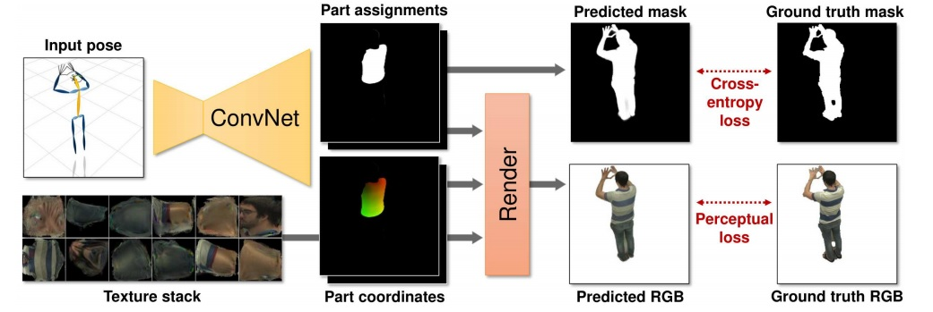
Visualization

Slide 8
Model
Use the $P_{i}$and $C_{i}$ and texture map to output the RGB map stack
A convolutional network $g_{∅}$with learnable parameters $∅$ to translate the input $B_{i}$ into body part assignments and body part coordinates.
Lost function:
Notes:
这些地图堆之后会用于对人体肌理地图的取样，人体部位的协调堆规定了取样地点，并使用人体部位分配堆规定权值，制作RGB图像。除此以外，最后的人体分配地图堆与背景可能性保持一致。在学习过程中，掩码和RGB图像均需同真实情况作比较。通过在完全卷积的网络运转中、肌理上取样，所得损失进行反向传播，最终更新模型。

Slide 9
Model
Addition: mask prediction
Initialization strategy:
use the DensePose system to initialize(pretrain $g_{∅}$)

Slide 10
Experiment

Slide 11
Limitation
Generalization is still limited. (when a person rendering considerably different from the training set)
Some errors on exhibit hand and face.

