Slide 1
outdoor scenes: street-view images
long-range navigation
instructions with 70 words

Slide 2
Instructions
visual landmark descriptions + local directional instructions

Slide 3
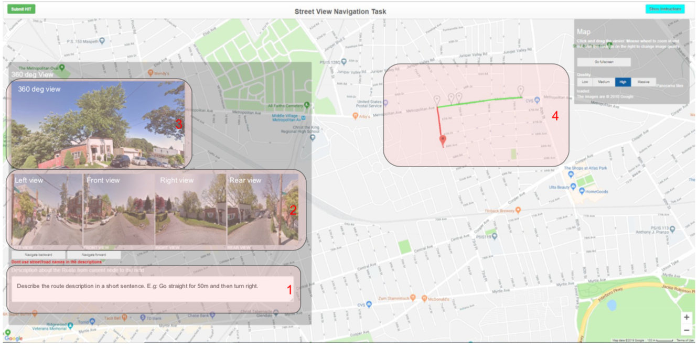
Annotation Interface

Slide 4
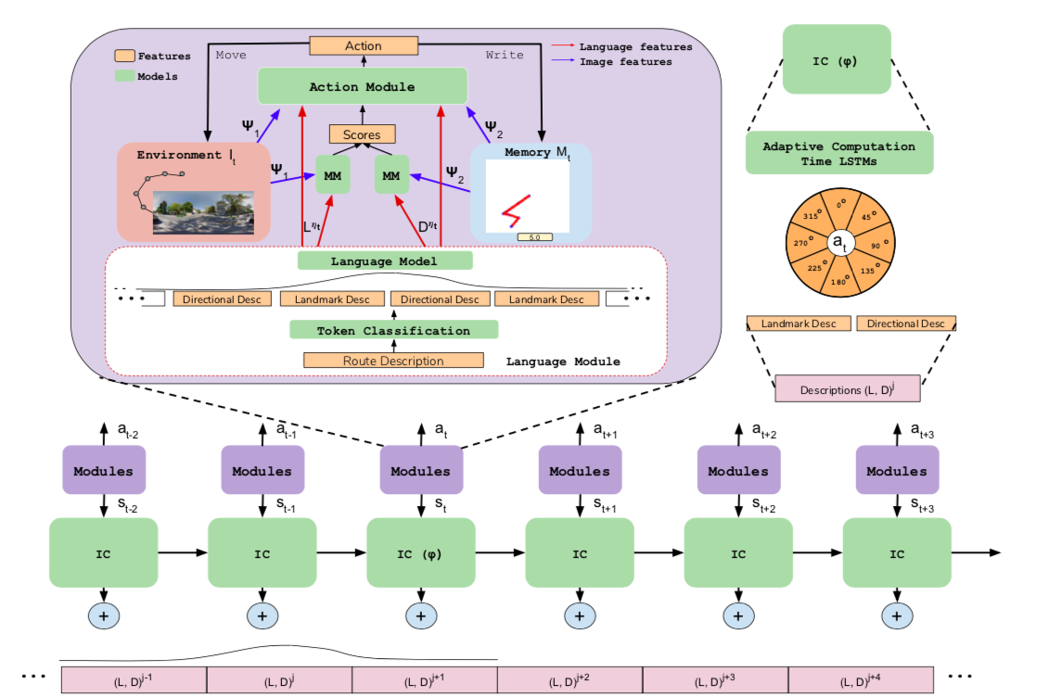
Pipeline

Slide 5
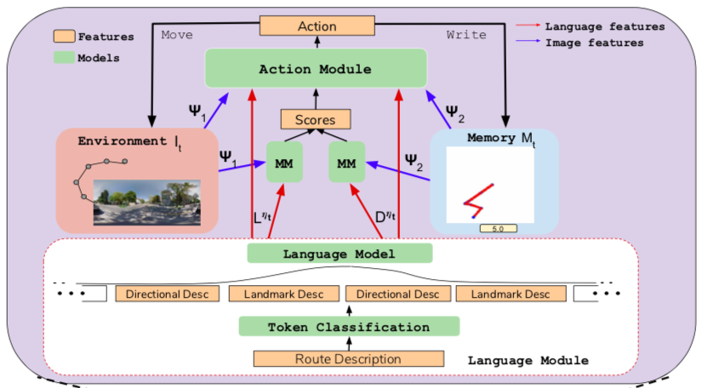
Language
BERT transformer model: classify each token of the instruction

Slide 6
Visual Observation + Spatial Memory + Matching Module
Adaptive Computation Time LSTM

Slide 7
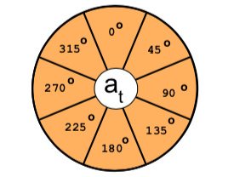
Action Module
Learning

Slide 8
