Slide 2
Motivation
2D CNN : computationally cheap but cannot capture temporal relationships
3D CNN : good performance but computationally intensive
How to make a better trade-off?

Slide 3
TSM: Temporal Shift Module

Slide 4
Problems of Naïve TSM
Not efficient: shift operation is conceptually zero FLOP but incurs data movement -> latency increase
Not accurate: shifting too many channels in a network will significantly hurt the spatial modeling ability and result in performance degradation.

Slide 5
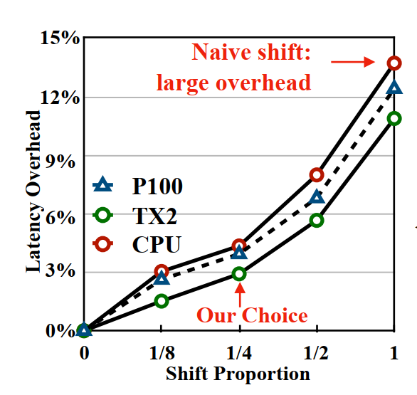
Solutions
To reduce data movement
-> Partial Shift : only shift a small proportion of channels.

Slide 6
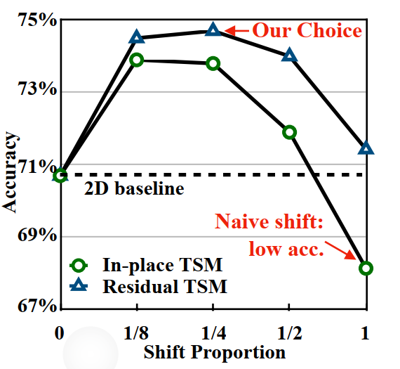
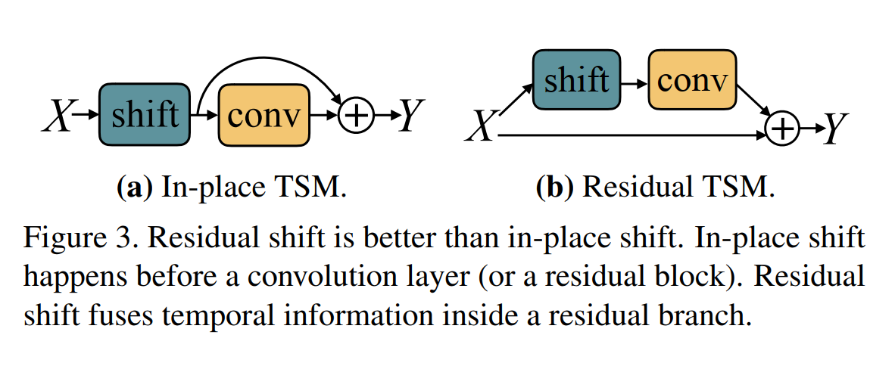
Solutions
To keep spatial feature learning capacity
->Use Residual shift rather than In-place shift

Slide 7
Online TSM

Slide 8
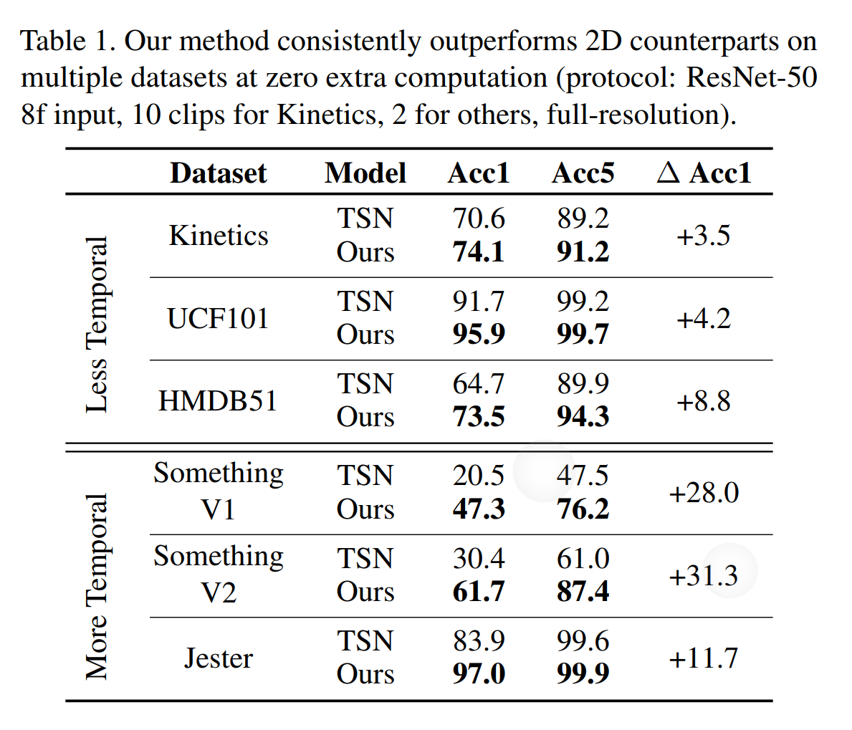
Experiments: Compare to 2D-CNN

Slide 9
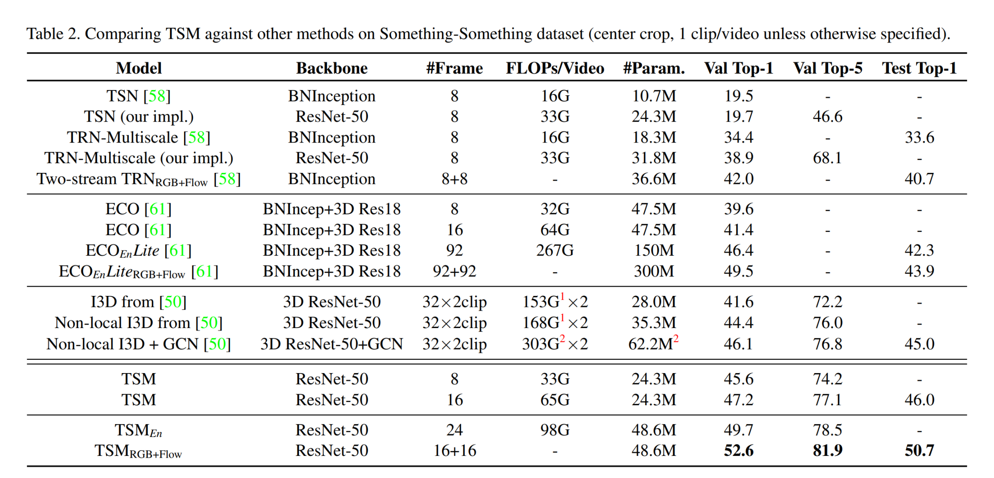
Experiments: Compare to SOTAs

Slide 10
Experiments: Compare to SOTAs

Slide 11
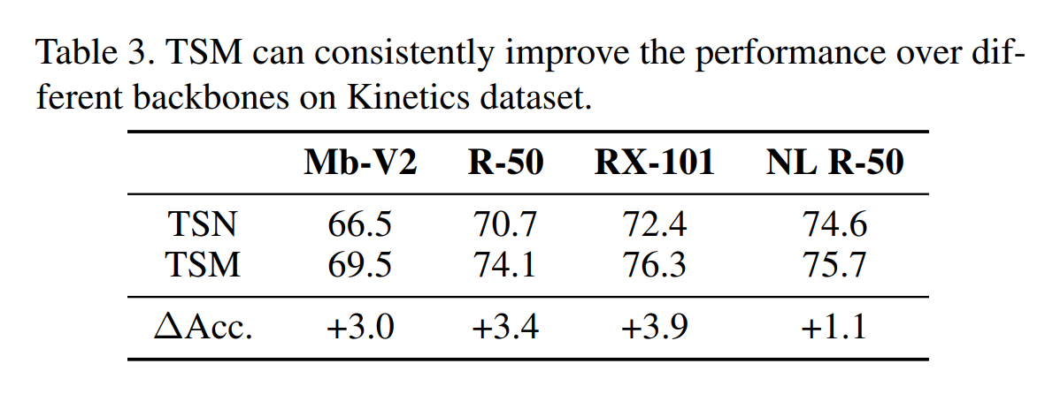
Experiments: Different backbones

Slide 12
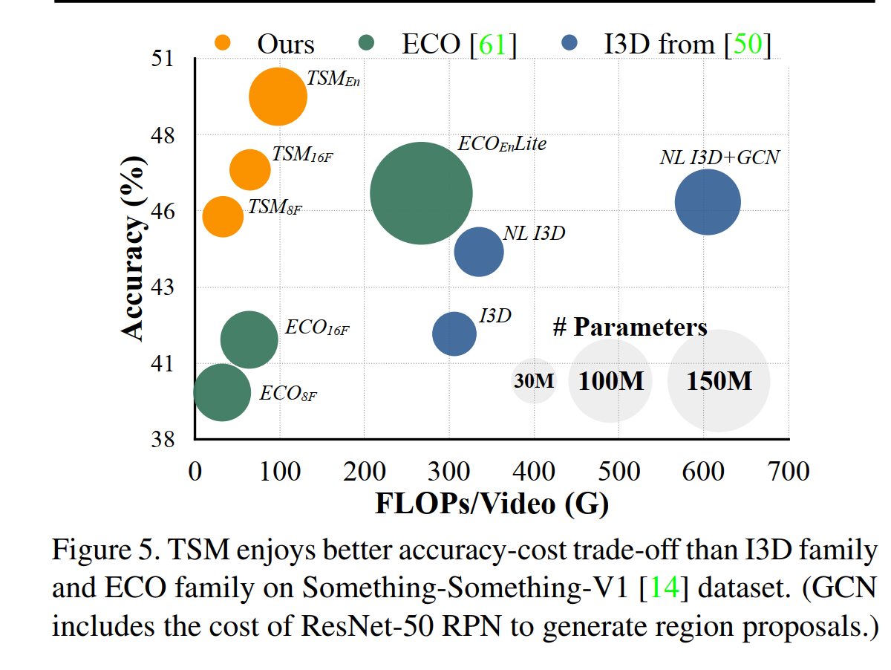
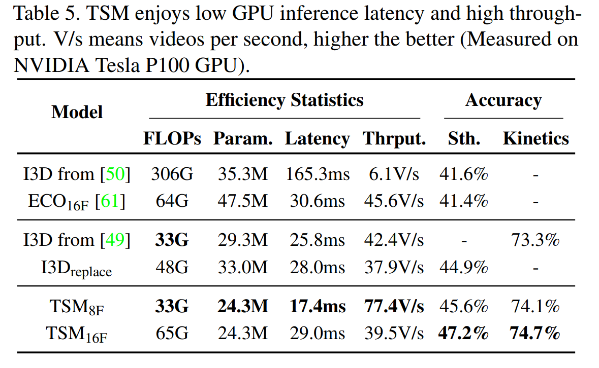
Experiments: Latency and Throughput

Slide 13
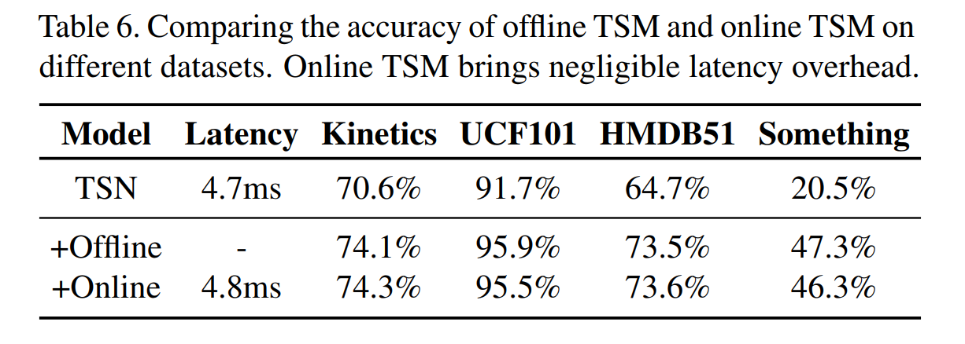
Experiments: Online vs. Offline

Slide 14
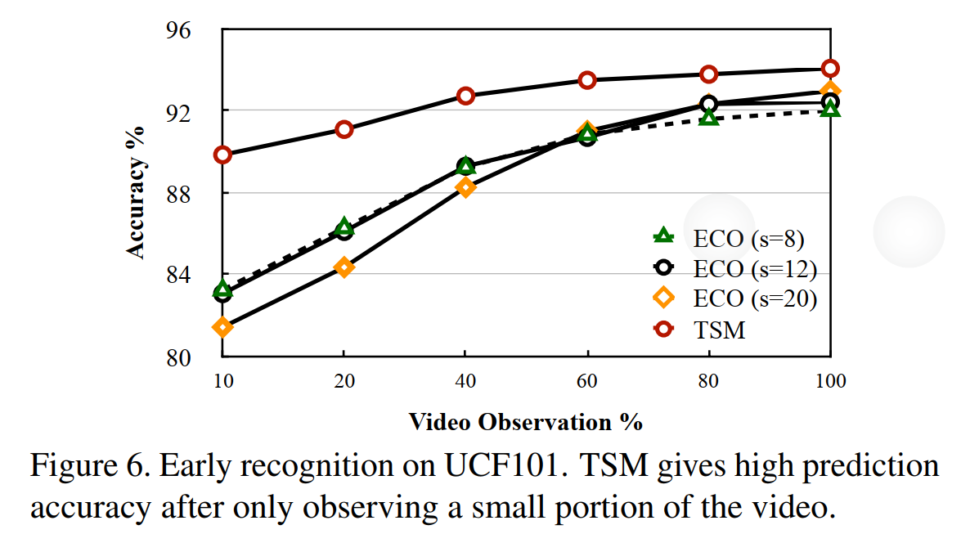
Experiments: Early Recognition

Slide 15
贡献/不足
贡献：
不增加任何参数，计算上几乎零成本（需要index操作）
编程复杂度低，简单切片操作
对比 3D convolution/tow stream，速度快，显存占用低，精度高
即插即用，兼容其他经典的video算法
不足：（seg level的不足）
前后帧特征在空间上不对齐
对于抽帧较稀疏的情景不一定适用
对于频繁转场场景不一定是用

Slide 16
使用情况/可能改进点
使用情况：
结合MOCO自监督表示学习
视频检索效果还是不如单帧特征
工程部署上不一定支持shift操作（需要pytorch 1.3以上）
可能改进点：
结合image matching算法：match前后帧key point
结合场景改进，如电影场景（时间长，分镜，转场）：
找出有某个明星戏份的所有片段（instance retrieval），及其该片段的内容（language）

