Slide 1
Introduction
Reasoning over visual elements and general knowledge to infer the correct answer.
Answer (a few words or a short phrase)
Binary (Yes / No)
Multiple-choice
Fill in blank
Challenge
Much higher dimensional and more noisy.
Lack the structure and grammatical rules.
Capture more of the richness of the real world.

Slide 2
Methods
Joint embedding approaches
Attention mechanisms
Compositional models
Knowledge base-enhanced approaches.
Current SOTA methods
Future work
Notes:
The joint embedding approaches are straightforward in their principle and constitute the base of most current approaches to VQA.

Slide 3
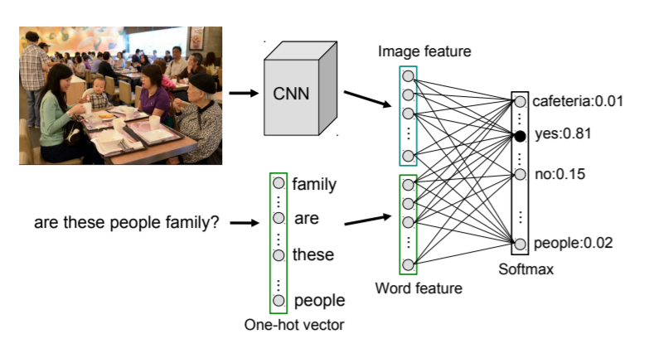
Joint embedding approaches
iBOWIMG
GoogleNet
Bag-of-word
Classification
Zhou B, Tian Y, Sukhbaatar S, et al. Simple baseline for visual question answering[J]. arXiv preprint arXiv:1512.02167, 2015.

Slide 4
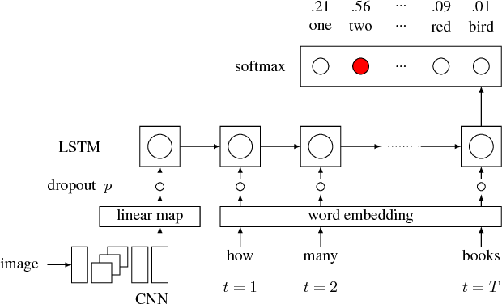
Joint embedding approaches
Vis-LSTM
Fed image feature to the LSTM at the start.
Ren M, Kiros R, Zemel R. Image question answering: A visual semantic embedding model and a new dataset[J]. Proc. Advances in Neural Inf. Process. Syst, 2015, 1(2): 5.

Slide 5
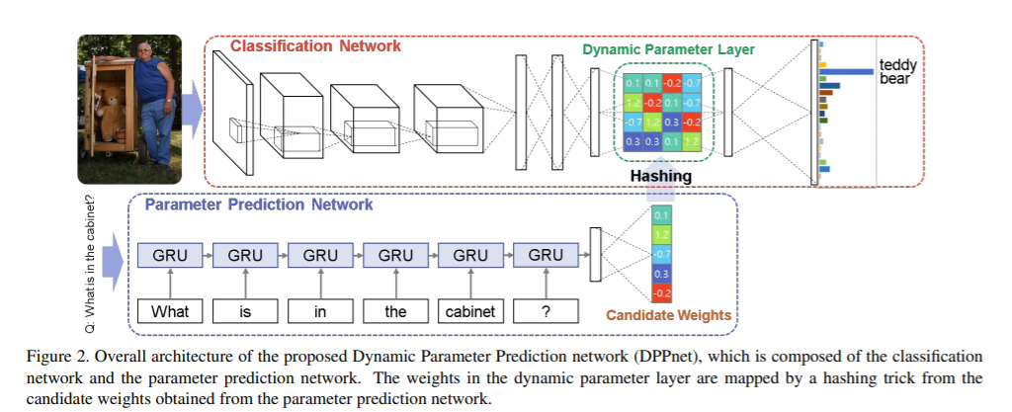
Joint embedding approaches
Dynamic Parameter Prediction (DPPNet)
Predict parameters of visual fc layer by another fc layer (from question).
Using hashing trick to reduce the number of parameters
Noh H, Hongsuck Seo P, Han B. Image question answering using convolutional neural network with dynamic parameter prediction[C]//Proceedings of the IEEE conference on computer vision and pattern recognition. 2016: 30-38.

Slide 6
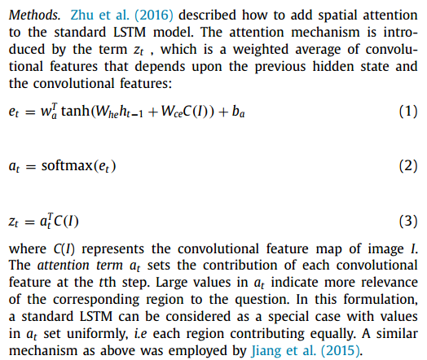
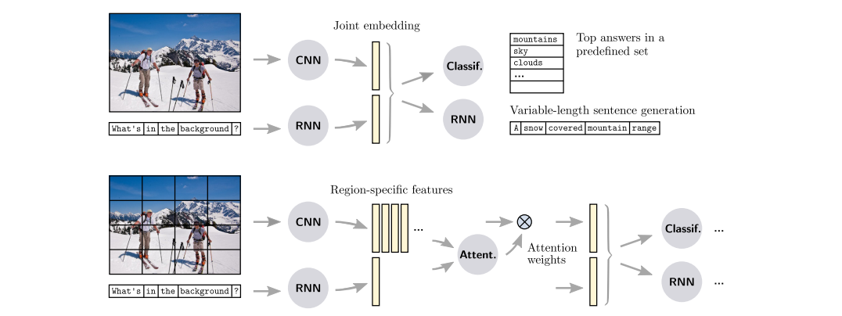
Attention mechanisms
Motivation
Using global (image-wide) features to represent the visual input may feed irrelevant or noisy information to the prediction stage.

Slide 7
Attention mechanisms
Where to Look
Attention on every region -> weighted average
Shih K J, Singh S, Hoiem D. Where to look: Focus regions for visual question answering[C]//Proceedings of the IEEE conference on computer vision and pattern recognition. 2016: 4613-4621.

Slide 8
Attention mechanisms
Bottom-Up and Top-Down Attention
Anderson P, He X, Buehler C, et al. Bottom-up and top-down attention for image captioning and visual question answering[C]//Proceedings of the IEEE conference on computer vision and pattern recognition. 2018: 6077-6086.

Slide 9
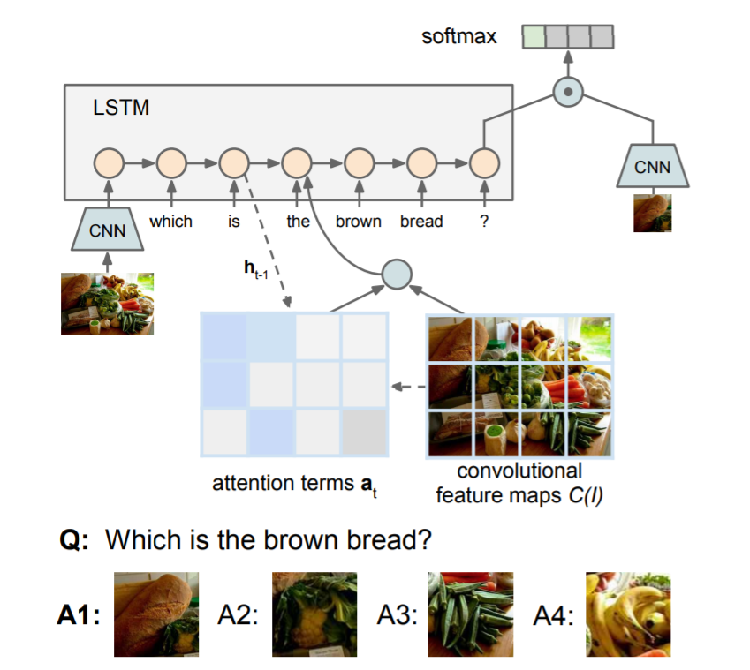
Attention mechanisms
Recurrent Spatial Attention (Visual7W)
Calculate an attention map at each LSTM step.
Multiple-choice QA pairs
Zhu Y, Groth O, Bernstein M, et al. Visual7w: Grounded question answering in images[C]//Proceedings of the IEEE conference on computer vision and pattern recognition. 2016: 4995-5004.

Slide 10
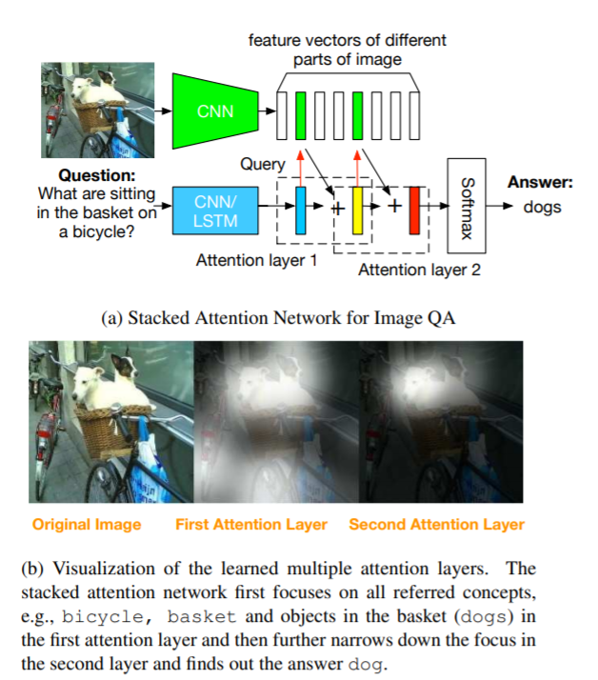
Attention mechanisms
Stacked attention network
Visual feat: 14x14(x512)
Multi-step attention
Concatenate features
Yang Z, He X, Gao J, et al. Stacked attention networks for image question answering[C]//Proceedings of the IEEE conference on computer vision and pattern recognition. 2016: 21-29.

Slide 11
Attention mechanisms
Summary
Improve accuracy on all VQA datasets, but show little benefit on binary (yes/no) questions.
Binary questions typically require longer chains of reasoning.

Slide 12
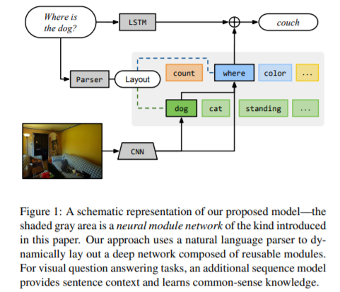
Compositional models
Neural Module Networks (NMN)
Some questions require multiple processing step.
Contribution: logical reasoning over continuous visual features, instead of discrete or logical predicates.
Andreas J, Rohrbach M, Darrell T, et al. Neural module networks[C]//Proceedings of the IEEE Conference on Computer Vision and Pattern Recognition. 2016: 39-48.

Slide 13
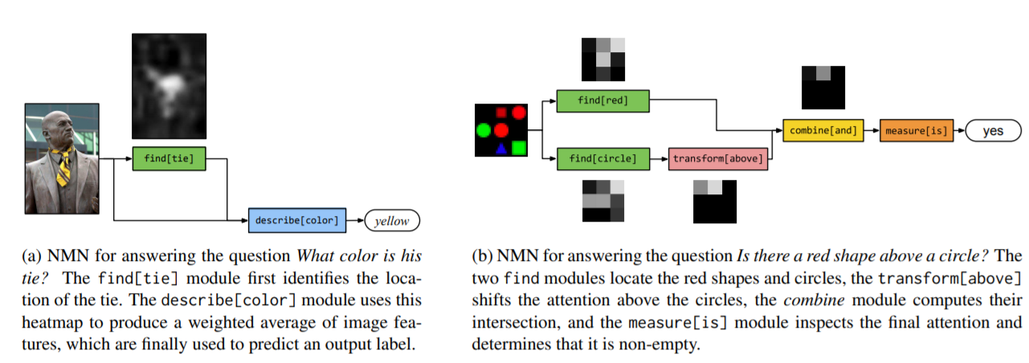
Neural Module Networks (NMN)
Parsing each question with the Stanford Parser.
Use ad hoc hand-written rules to deterministically transform parse trees into structured queries.
The inputs and outputs of the modules can be of 3 types: image features, attentions (regions), labels (classification decisions)
Notes:
在具有结构性的问题上表现得更好，但是受限于question的parsing效果

Slide 14
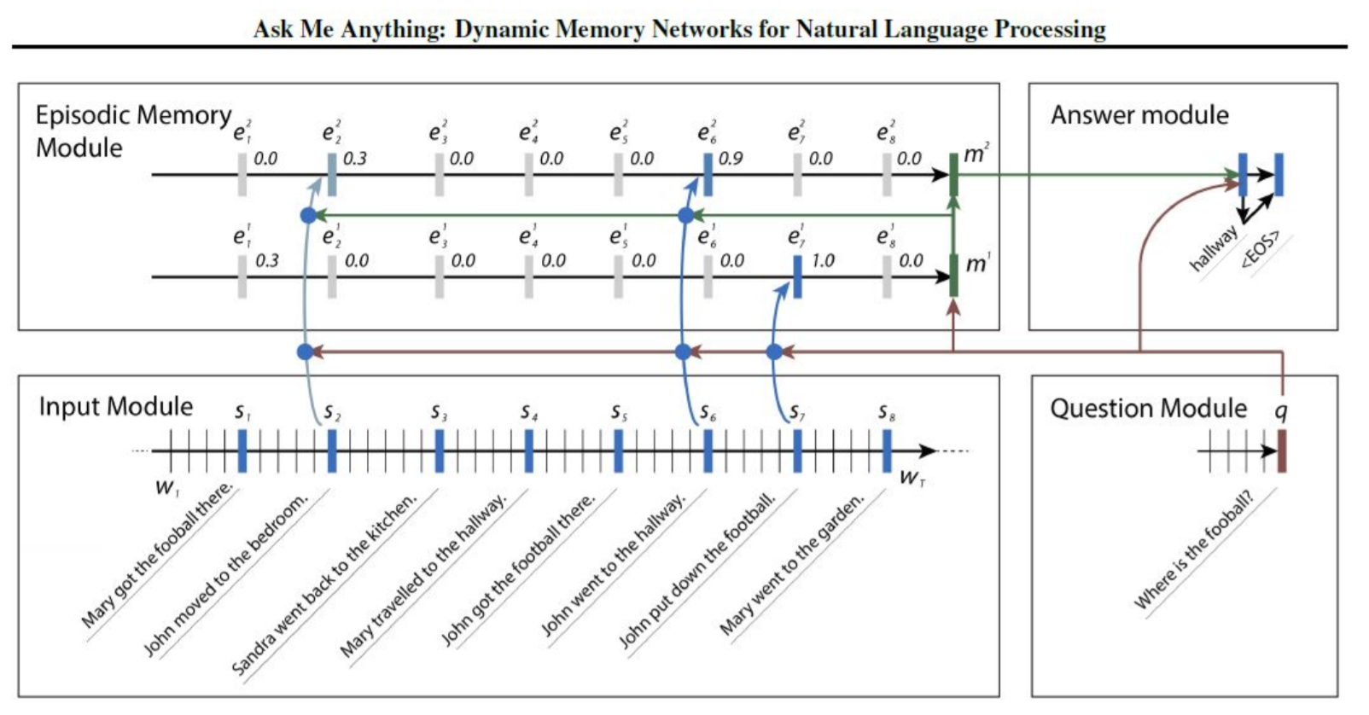
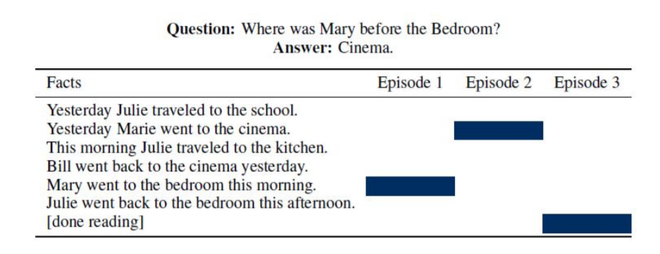
Dynamic Memory Networks (DMN+)
Motivation
Designed to address tasks that require complex logical reasoning by modeling interaction between multiple parts of the data.
Xiong C, Merity S, Socher R. Dynamic memory networks for visual and textual question answering[C]//International conference on machine learning. 2016: 2397-2406.

Slide 15
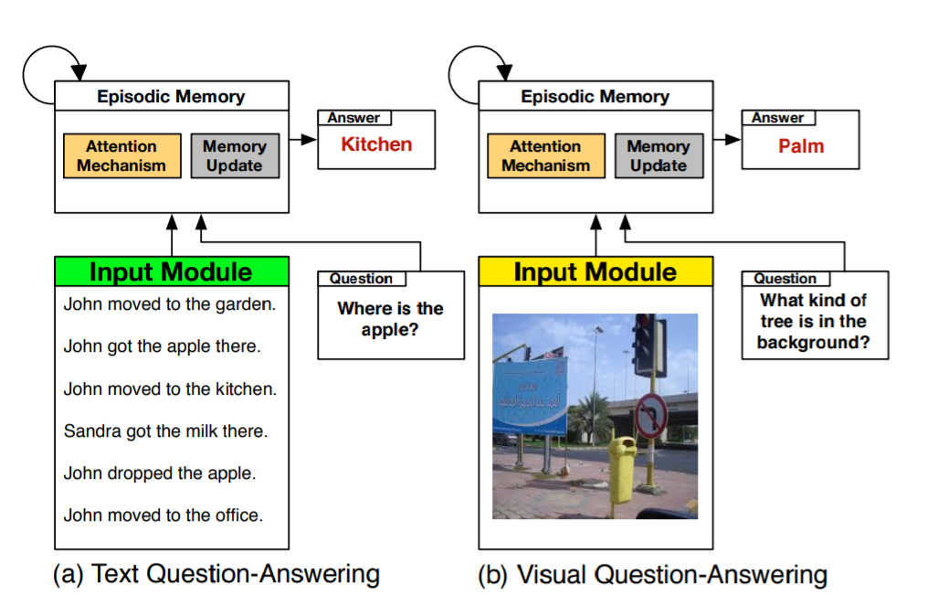
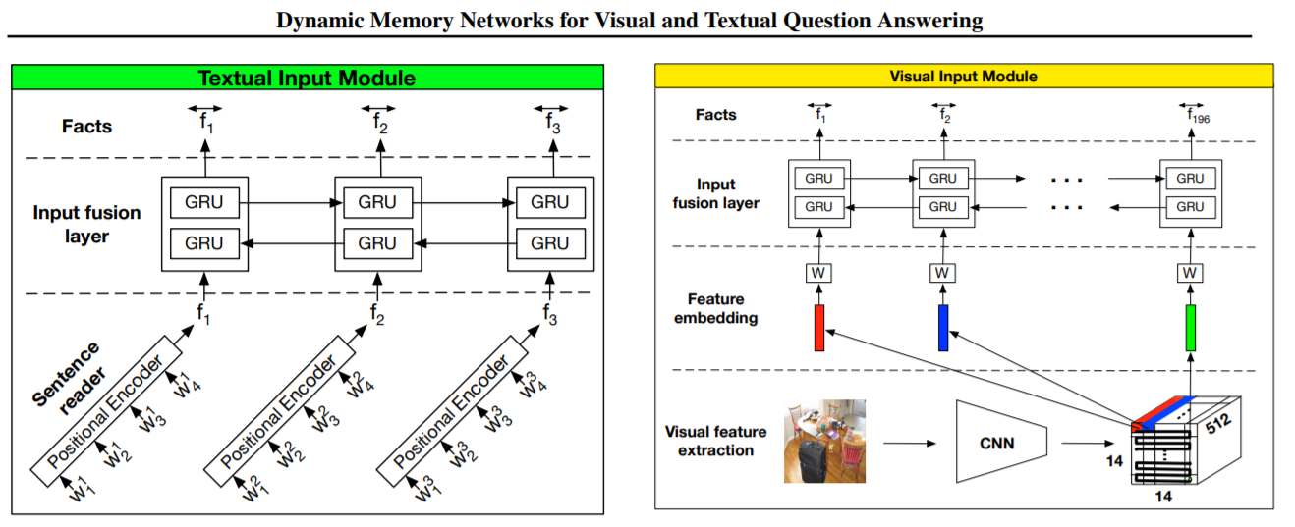
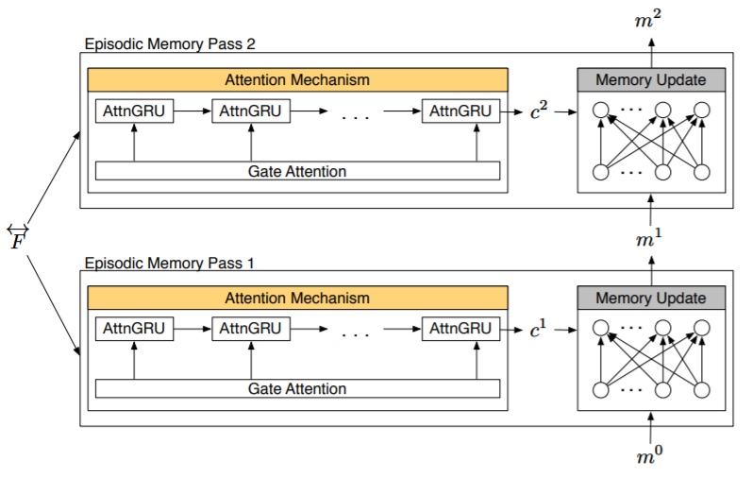
Dynamic Memory Networks (DMN+)
Input Module split in two
New memory GRU
Visual input added
Xiong C, Merity S, Socher R. Dynamic memory networks for visual and textual question answering[C]//International conference on machine learning. 2016: 2397-2406.

Slide 16
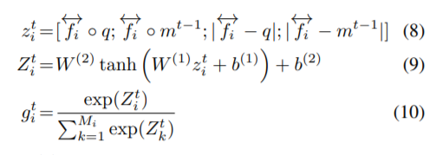
Dynamic Memory Networks (DMN+)
Answer Module
Input:
Single word: fc + softmax
Sequence: RNN
Xiong C, Merity S, Socher R. Dynamic memory networks for visual and textual question answering[C]//International conference on machine learning. 2016: 2397-2406.

Slide 17
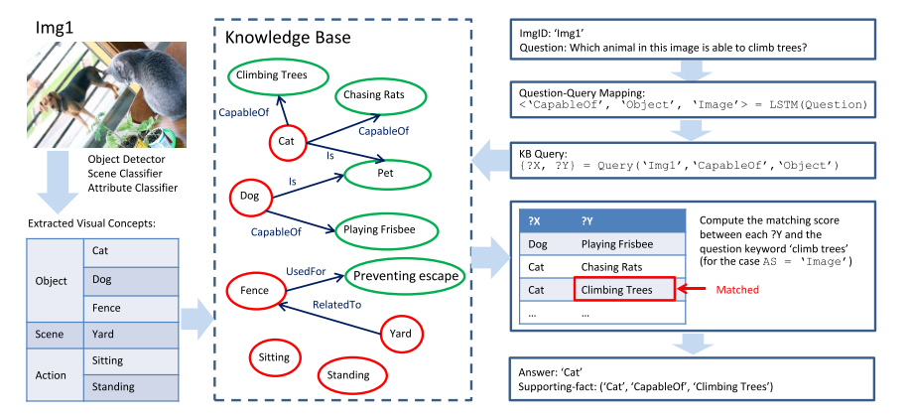
Knowledge base-enhanced approaches
Image, Question -> KB-queries -> Answer
Learn the mapping between questions and a set of KB-queries.
Wang P, Wu Q, Shen C, et al. Fvqa: Fact-based visual question answering[J]. IEEE transactions on pattern analysis and machine intelligence, 2018, 40(10): 2413-2427.

Slide 18
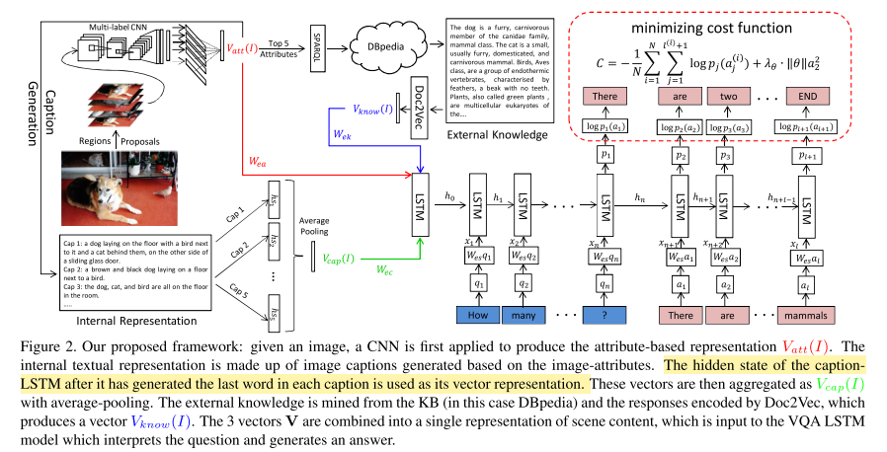
Knowledge base-enhanced approaches
Construct a textual representation.
Attributes and captions.
Merge representation with textual knowledge from a KB.
Feed the merged information to an LSTM.
Generate words.
Wu Q, Wang P, Shen C, et al. Ask me anything: Free-form visual question answering based on knowledge from external sources[C]//Proceedings of the IEEE Conference on Computer Vision and Pattern Recognition. 2016: 4622-4630.

Slide 19
Current SOTA methods
Bilinear Attention Network (BAN)
Visual feat: Bottom-Up Top-Down object proposal features
Question: GRU
Attention: Multiple Bilinear Attention Maps
Feature Fusion:
Multiple glimpses
Kim J H, Jun J, Zhang B T. Bilinear attention networks[C]//Advances in Neural Information Processing Systems. 2018: 1564-1574.

Slide 20
Current SOTA methods
Intra- Inter- Modality Attention
Using transformer in VQA
Gao P, Jiang Z, You H, et al. Dynamic fusion with intra-and inter-modality attention flow for visual question answering[C]//Proceedings of the IEEE Conference on Computer Vision and Pattern Recognition. 2019: 6639-6648.

Slide 21
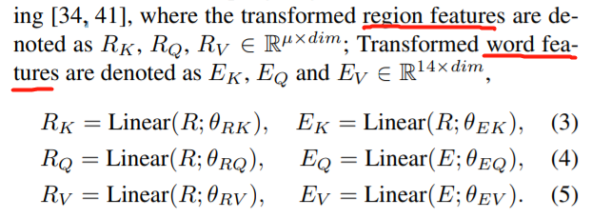
Intra- Inter- Modality Attention
Inter-modality attention
Gao P, Jiang Z, You H, et al. Dynamic fusion with intra-and inter-modality attention flow for visual question answering[C]//Proceedings of the IEEE Conference on Computer Vision and Pattern Recognition. 2019: 6639-6648.

Slide 22
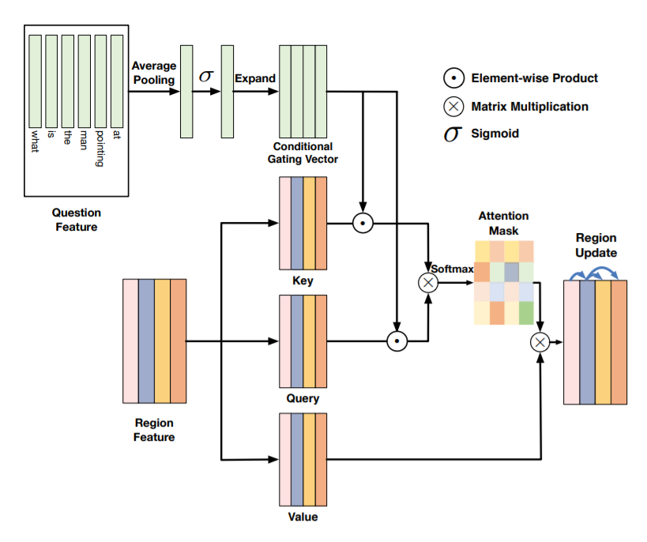
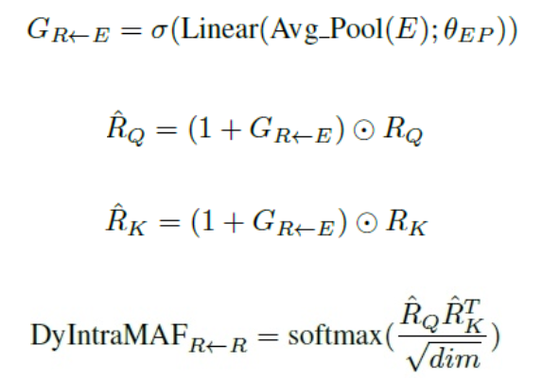
Intra- Inter- Modality Attention
Dynamic Intra-modality attention
Condition on other modality via gating vector
Gao P, Jiang Z, You H, et al. Dynamic fusion with intra-and inter-modality attention flow for visual question answering[C]//Proceedings of the IEEE Conference on Computer Vision and Pattern Recognition. 2019: 6639-6648.

Slide 23
Future directions
External knowledge
Commonsense VQA
Knowledge based VQA
Inspiration from NLP community
Semantic parsing approaches focus on a better understanding of the question
Better Language models
Text-VQA
OCR+VQA
Notes:
Structure queries

