Slide 1
ECCV 2018

Slide 2
Motivation
Answering of questions based on context and general knowledge is most natural.
However, the majority of the questions can be answered by solely examining the visual content of the image.
FVQA extracts keywords from the question and retrieves facts that contain those keywords from the knowledge base.
Clearly, synonyms and homographs pose challenges which are hard to recover from.

Slide 3
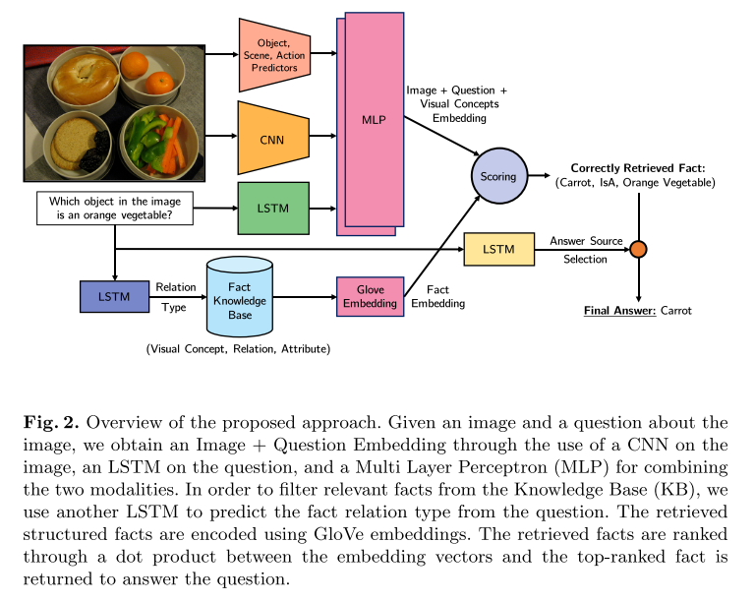
Learning Knowledge Base Retrieval
Image + Question + Visual Concepts Embedding.
Feed Q into LSTM, predict relation type, and filter Fact Embedding using GloVe.
Calculate Cosine similarity score between embedding mentioned above.
Predict binary answer source using LSTM, select answer from fact

Slide 4
Details
Learn to transform extracted visual concepts into a vector close to a relevant fact in the learned embedding space.
2 LSTM classifier
13 Relation types
2 answer sources
1 MLP for fact score.
Select fact with highest score.

Slide 5
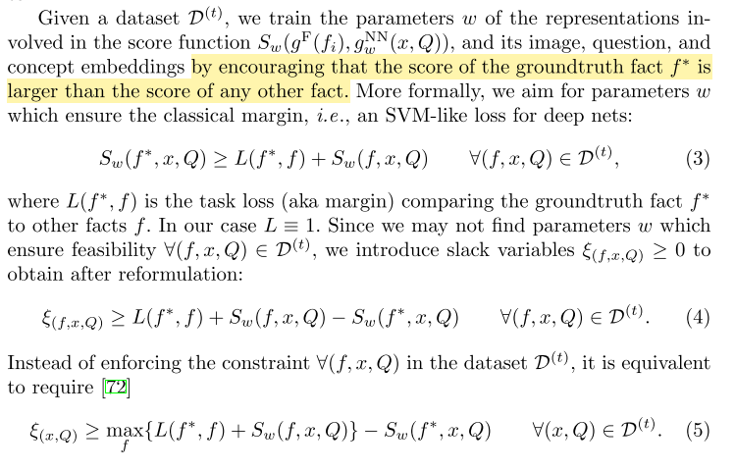
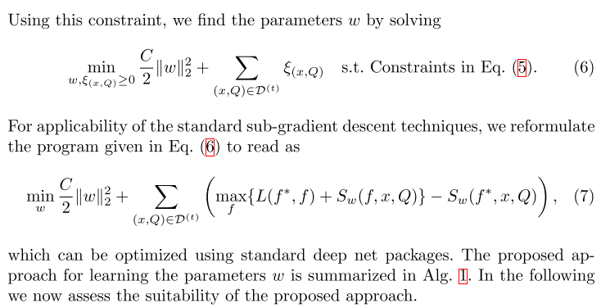
Details of Training
An SVM-like loss for deep nets

Slide 6
Details of Training
Mining Hard Negatives

Slide 7
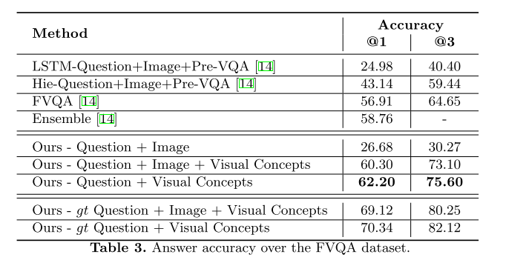
Results
Others
Better in Synonyms and Homographs. (Test by WordNet)

