Slide 2
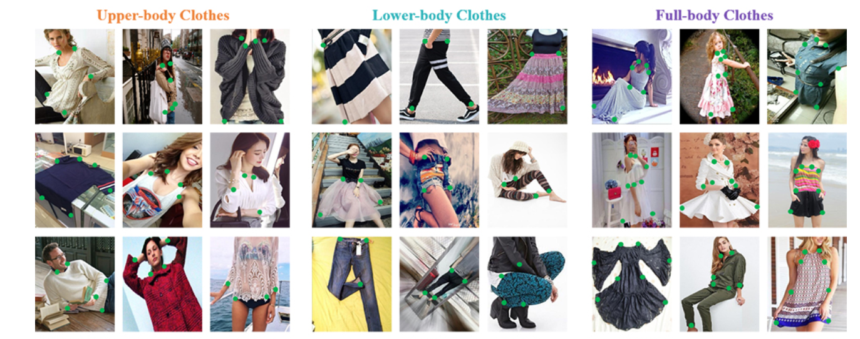
Task
Fashion Landmark Detection

Slide 3
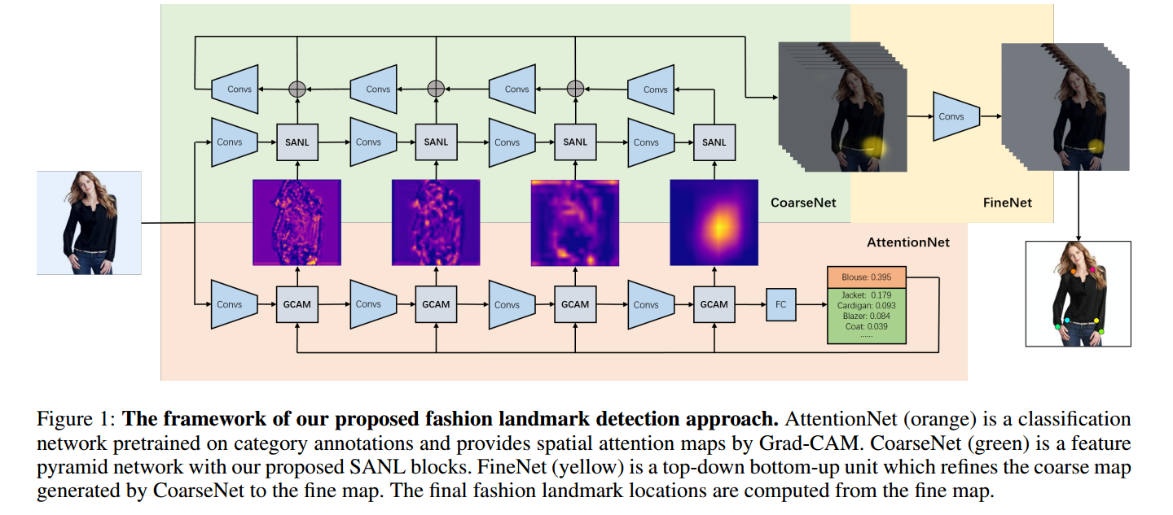
Framework
CoarseNet
FPN + Non-local
AttentionNet
Visual Explanation for Deep Networks
FineNet
Multi-scale refine

Slide 4
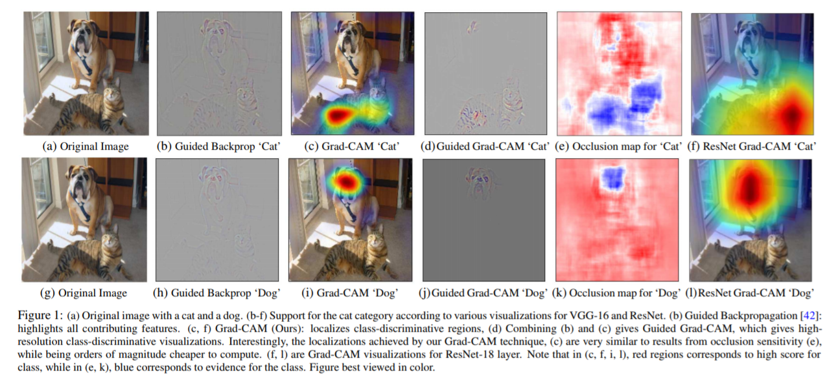
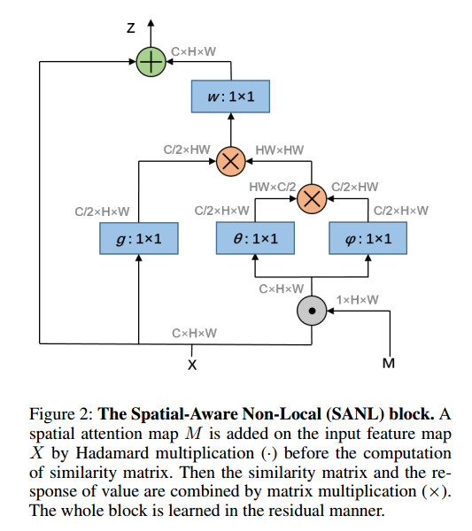
Spatial-Aware Non-Local (SANL)
Mask is generated by Gradient-weighted Class Activation Mapping (Grad-CAM).

Slide 5
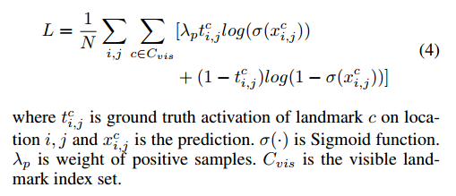
FineNet
Weighted binary cross-entropy loss instead of MSE loss.
Optimize on visible landmarks instead of on all the feature maps.

Slide 6
Contribution
Spatial-Aware Non-Local (SANL): Spatial attention + non-local block
A feasible way to deploy: Feeding spatial attention from Grad-CAM to SANL
State-of-the-art in fashion landmark detection

Slide 7
Experiment

