Slide 1
rgh

Slide 2
Motivation
A person is always in the “person” category even though he/she can transit from walking to running. The recognition of the categorical semantics (as well as their colors, textures, lighting etc.) can be refreshed relatively slowly.
The motion being performed can evolve much faster than their subject identities, such as clapping, waving, shaking, walking, or jumping. It can be desired to use fast refreshing frames (high temporal resolution) to effectively model the potentially fast changing motion.

Slide 3
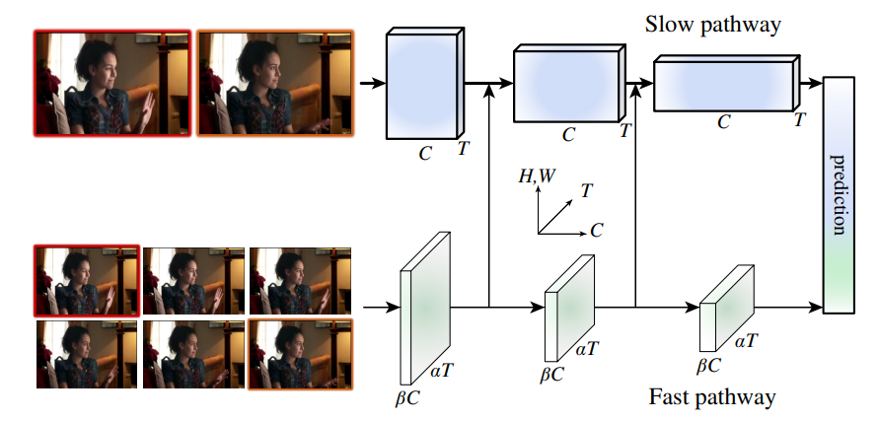
Framework

Slide 4
Review 3D Conv

Slide 5
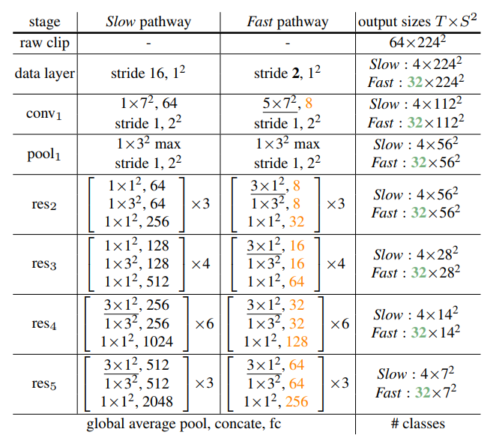
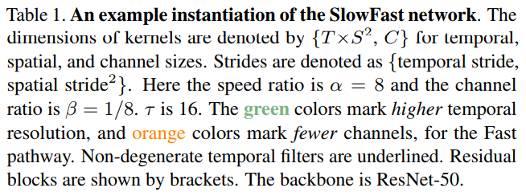
An example instantiation of the SlowFast network.

Slide 6
Slow pathway
The key concept in our Slow pathway is a large temporal stride τ on input frames, i.e., it processes only one out of τ frames.
A typical value of τ we studied is 16—this refreshing speed is roughly 2 frames sampled per second for 30-fps videos
Denoting the number of frames sampled by the Slow pathway as T, the raw clip length is T × τ frames.

Slide 7
Fast pathway
High frame rate
High temporal resolution features.
Low channel capacity

Slide 8
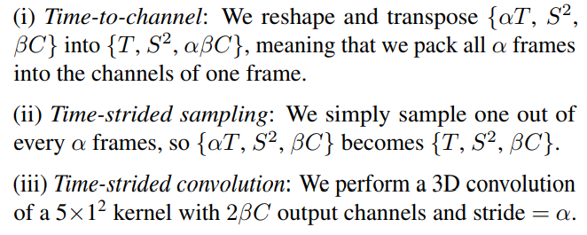
Lateral connections

Slide 9
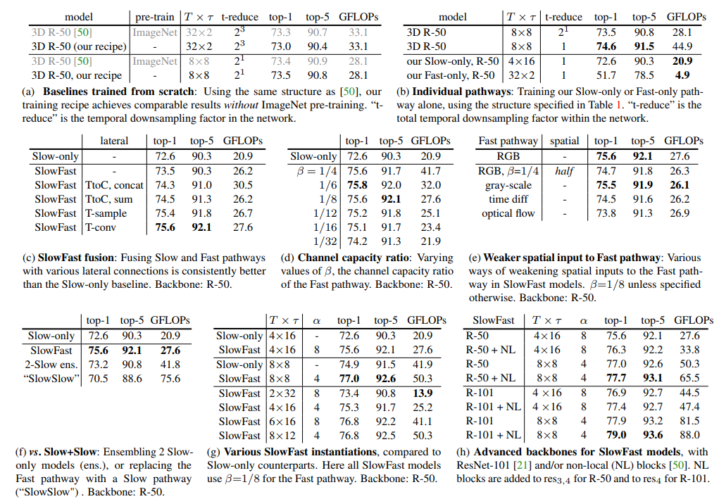
Experiment

Slide 10
一点看法
贡献点很明确
实验太太太充分了，各种消融
能不能在时间维度加deformable conv的思想

