Slide 1
rgh

Slide 2
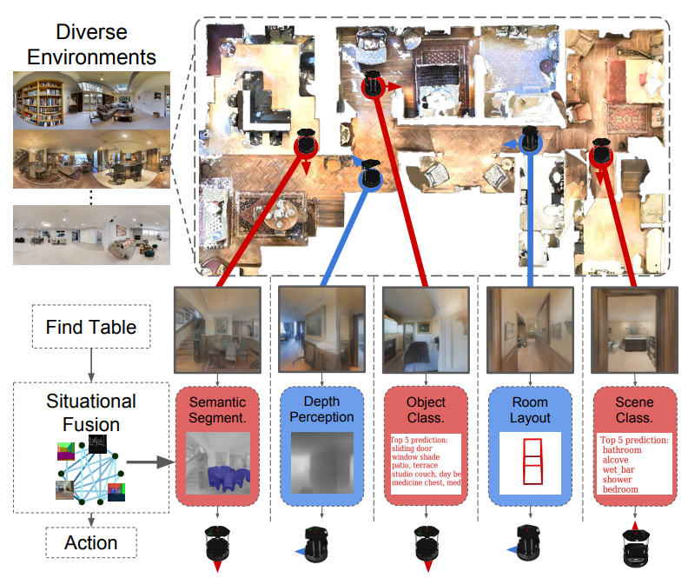
Motivation
A situational understanding of the visual environment can empower these navigation models in unseen visual environments.
Notes:
For example, to “go to the nearest chair”, the agent might need to identify a chair in a living room using semantics, follow along a hallway using vanishing point cues, and avoid obstacles using depth.
The repertoire of visual representations and their affinity measures from Taskonomy offer a basis for our model to learn generalizable navigation policies that transfer to unseen environments.

Slide 3
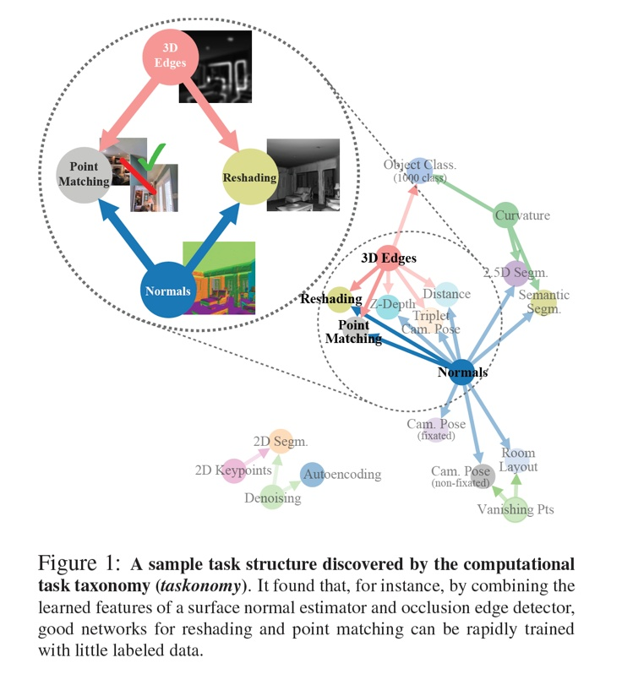
Preview-Taskonomy
用有限的监督预算来最有效地解决一组任务
量化了视觉任务的关联性，并基于求得的affinity matrix最优化得到如何分配任务监督数据量
Notes:
现有方法大多尝试将视觉任务逐一击破。这种方法造成了两个问题：第一， 逐一击破需要为每一项任务收集大量数据，随着任务数量的增多，这将会是不可行的；第二，逐一击破会带来不同任务之间的冗余计算和重复学习。总的来说，逐一击破的策略忽略了视觉任务之间的关联性，比如法线 (Surface Normals) 是由深度 (Depth) 求导得来，语义分割 (Semantic Segmentation) 又似乎和遮挡边缘测试 (Occlusion edge detection) 有着千丝万缕的关联。基于上述两个问题，我们希望能有效测量并利用视觉任务之间的关联来避免重复学习，从而用更少的数据学习我们感兴趣的一组任务

Slide 4
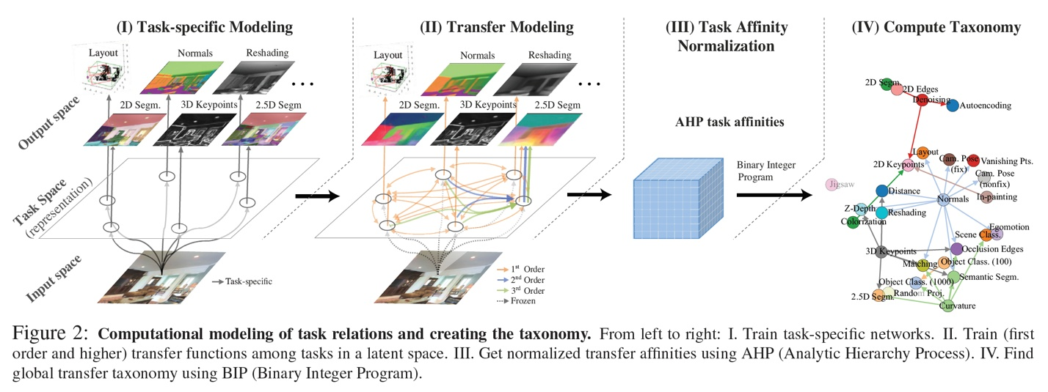
Preview-Taskonomy
Notes:
每个图片都有26个任务的标注，共用encoder进行训练
固定a任务的encoder，然后在b任务上训练，最后可以得到各个任务之间的关联度
根据关联度，可以构建一个迁移的路线图

Slide 5
Problem Formulation
At the beginning of an episode, the agent is randomly spawned at location p0 = (x0, y0) in an environment E
给定RGB图片，利用taskonomy得到n个representation
根据n个representation得到n个动作的策略

Slide 6
. Situational Representation Fusion
Notes:
直接把特征fuse起来会有干扰 ，会被某些特征主导或者泛化性不好
a few dominating representations and is prone to poor generalization performance
Visual Navigation： 其他方法是利用某个视觉任务特征然后从头训练导航任务，而不是复用很多视觉任务特征
Policy Learning

Slide 7
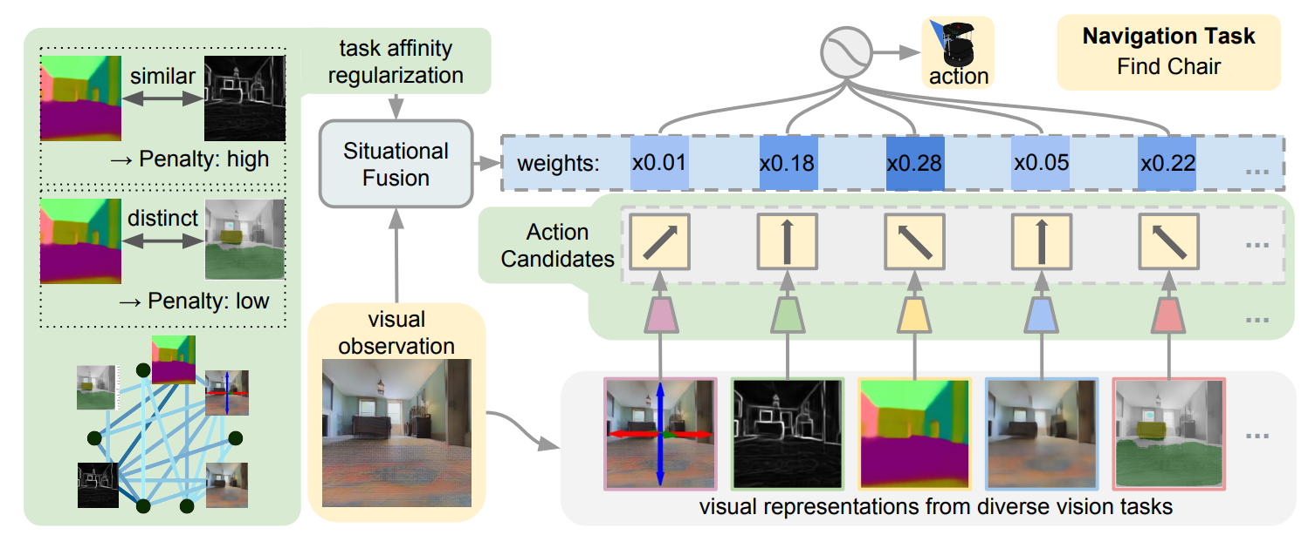
Framework
Notes:
Use 25 distinct computer vision from Taskonomy
affinity score from Taskonomy
共n个视觉任务，pai是给定表示ri，给出的动作，g是该任务的权重，这个权重会根据affinity进行惩罚

Slide 8
Experiments
Evaluation Protocol
An episode is judged to be successfully completed if the agent, given a maximum of 39 steps, ends in a location within 3 steps from the specified object.
During testing, we randomly sample a fixed set of 1024 starting locations in the test environments, and report the success rate of each model.

Slide 9
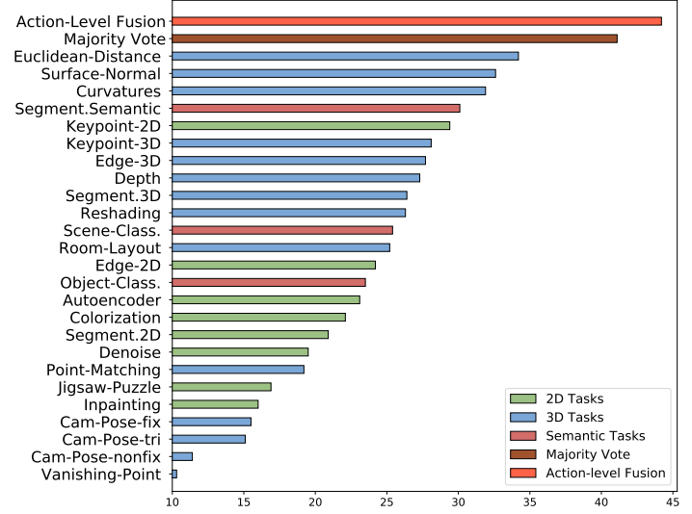
Experiments
Comparison among our action-level fusion model, majority-voting baseline and each individual representation’s performance

