Slide 1
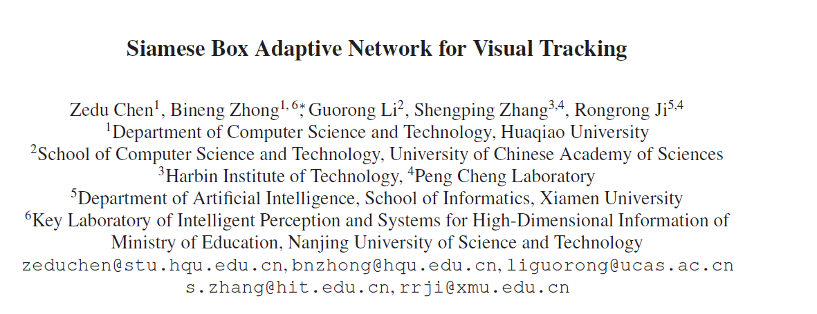

Slide 2
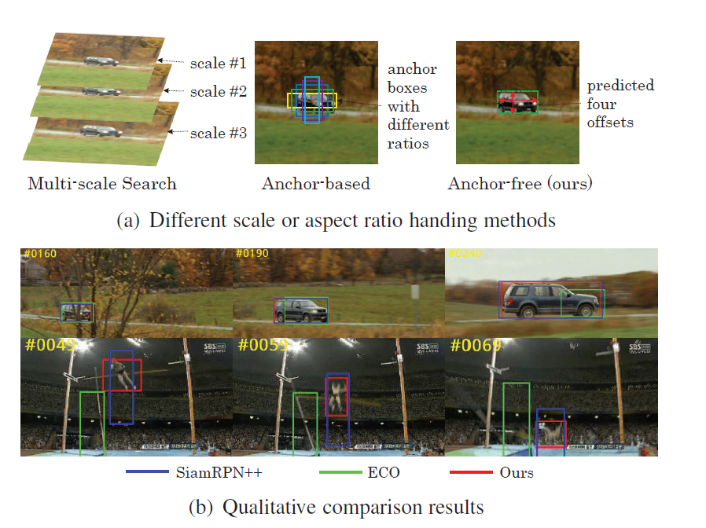
Motivation
Most of the existing trackers usually rely on either a multi-scale searching scheme or pre-defined anchor boxes to accurately estimate the scale and aspect ratio of a target.
Unfortunately, they typically call for tedious and heuristic configurations.
ECO : multi-scale search
SiamPRN++ : anchor-based
Ours : anchor-free
Notes:
更合理的大小和长宽比

Slide 3
Contribution
design a Siamese box adaptive network, which can perform end-to-end offline training with deep convolutional neural networks
The no-prior box design in SiamBAN avoids hyperparameters associated with the candidate boxes, making our tracker more flexible and general
The proposed SiamBAN not only achieves state-of-the-art results, but also runs at 40 FPS on tracking benchmarks

Slide 4
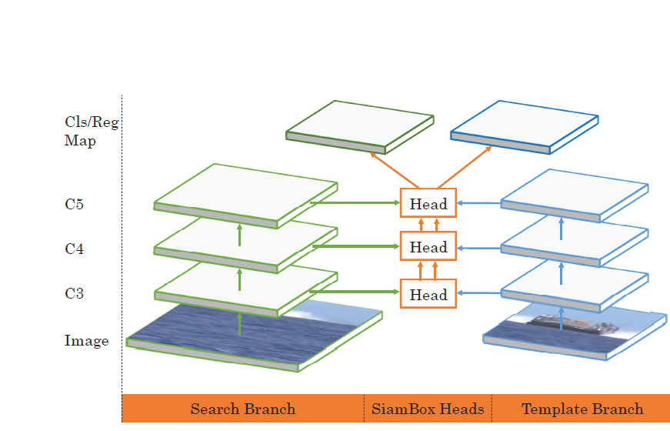
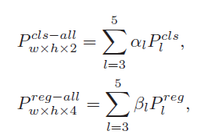
Output feature:
φ(x)
Output feature:
φ(z)
Input:search patch, x
Input:template patch, z

Slide 5
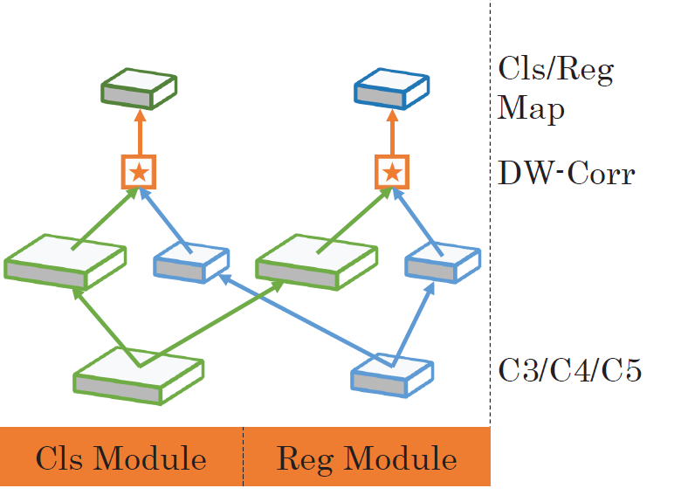
Box adaptive head
output two channels for foreground-background classification
output four channels for prediction of the bounding box
depth-wise cross-correlation operation
φ(x)
φ(z)

Slide 6
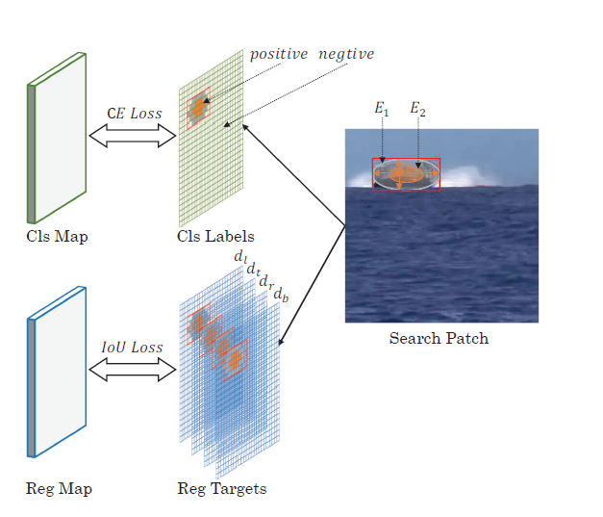
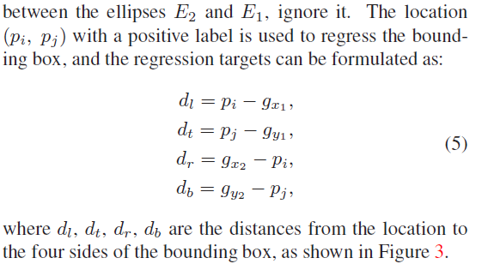
Ground-truth and Loss
The width, height, top-left corner, center point and bottom-right corner of the ground-truth bounding box are represented by gw, gh, (gx1 , gy1), (gxc , gyc) and (gx2 , gy2), respectively.

Slide 7
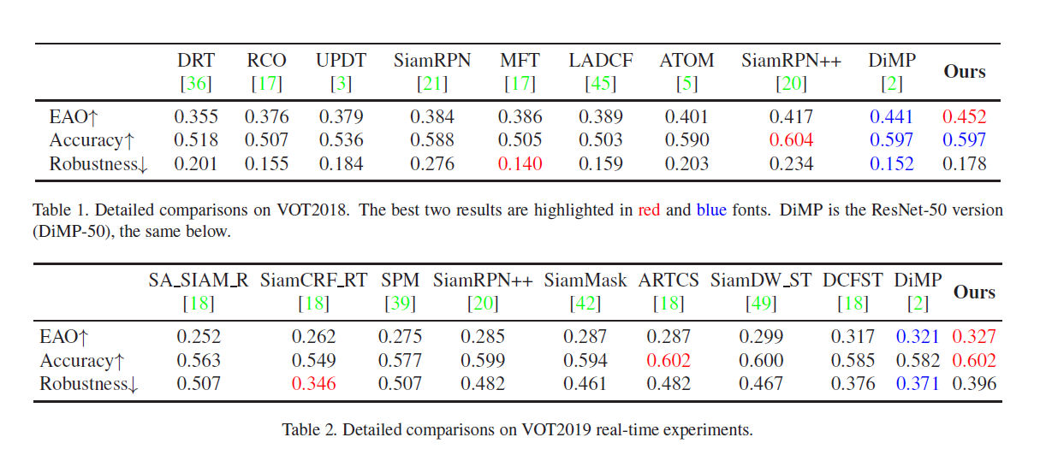
Experiments
Notes:
在6个数据集上都做了实验

Slide 8
Ablation study

