Slide 2
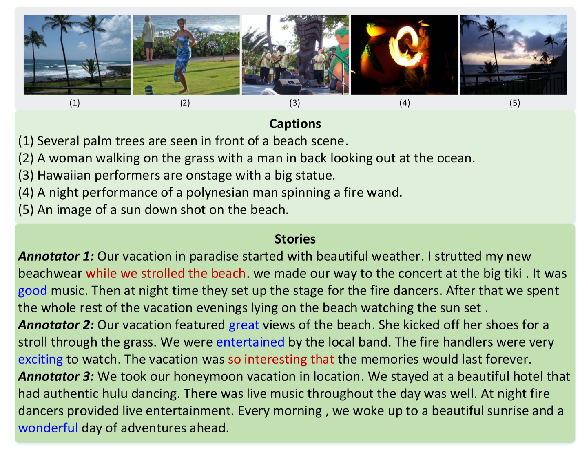
Task

Slide 3
Motivation
Complex story structure
Story-style narrative

Slide 5
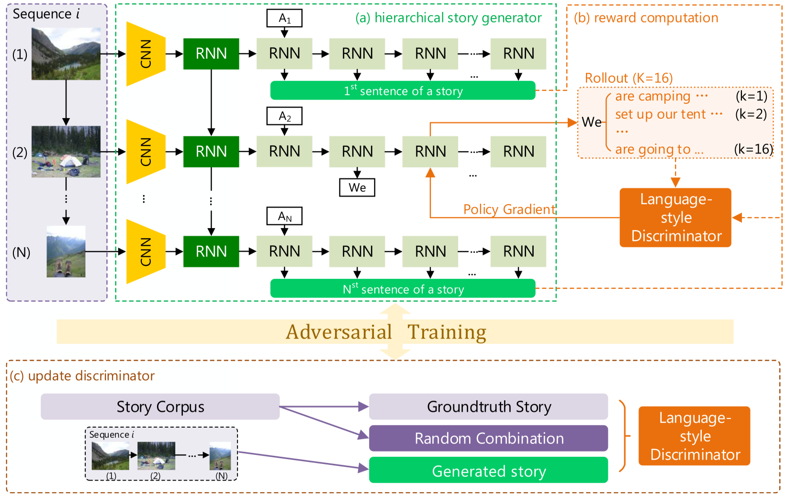
Framework

Slide 6
Reward

Slide 7
Reward

Slide 8
Loss

Slide 9
Experiments
Sentence-Concatenate: image to caption -> concatenate caption
Story-Flat: image sequence -> word sequence
S2VT: stacked LSTM seq-to-seq
Regions-hierarchical: region to sentence
HGRL: w/o attribute features

Slide 10
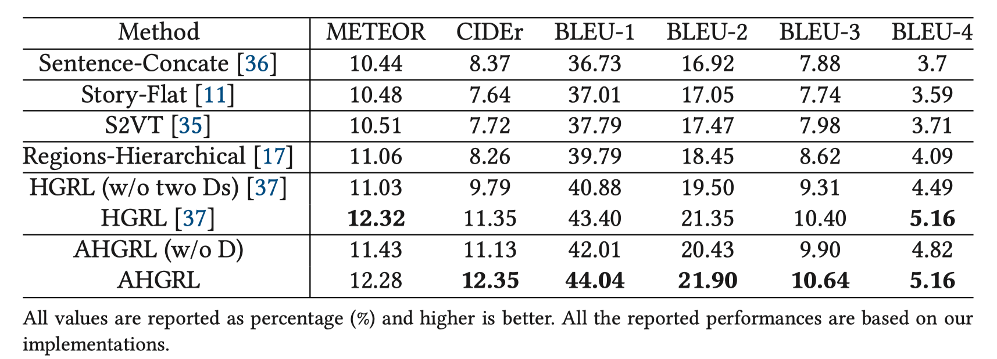
Experiments

Slide 11
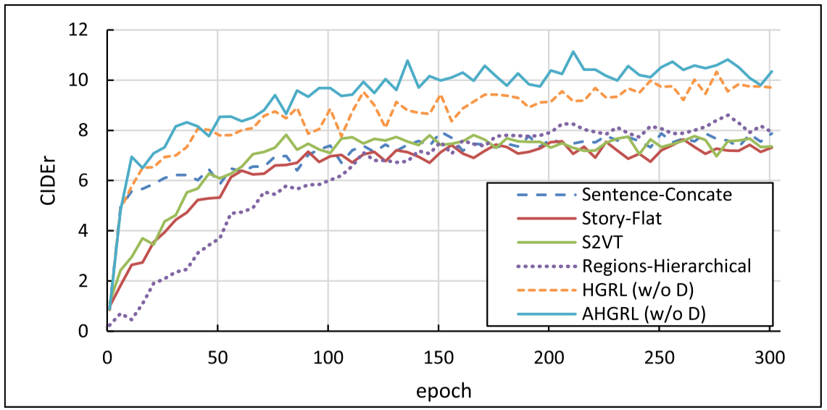
Experiments

Slide 12
Experiments

