Slide 1
Arxiv 2021

Slide 2
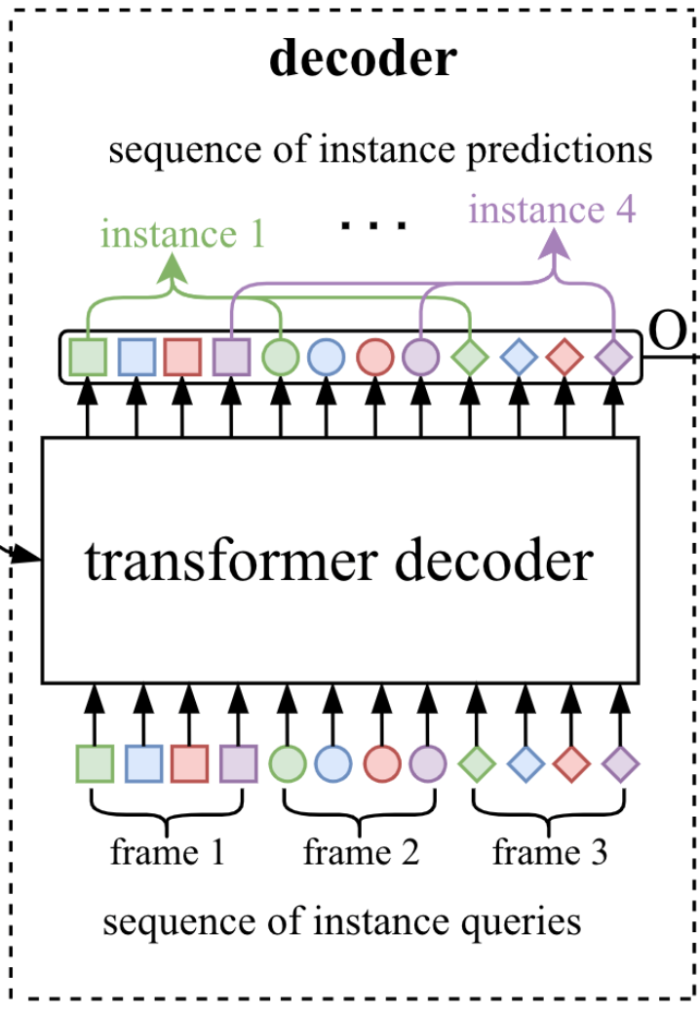
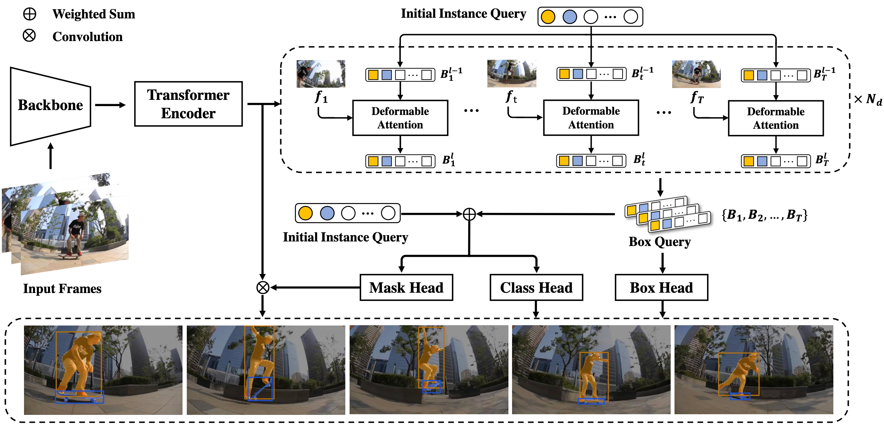
Motivation
VisTR
SeqFormer

Slide 3
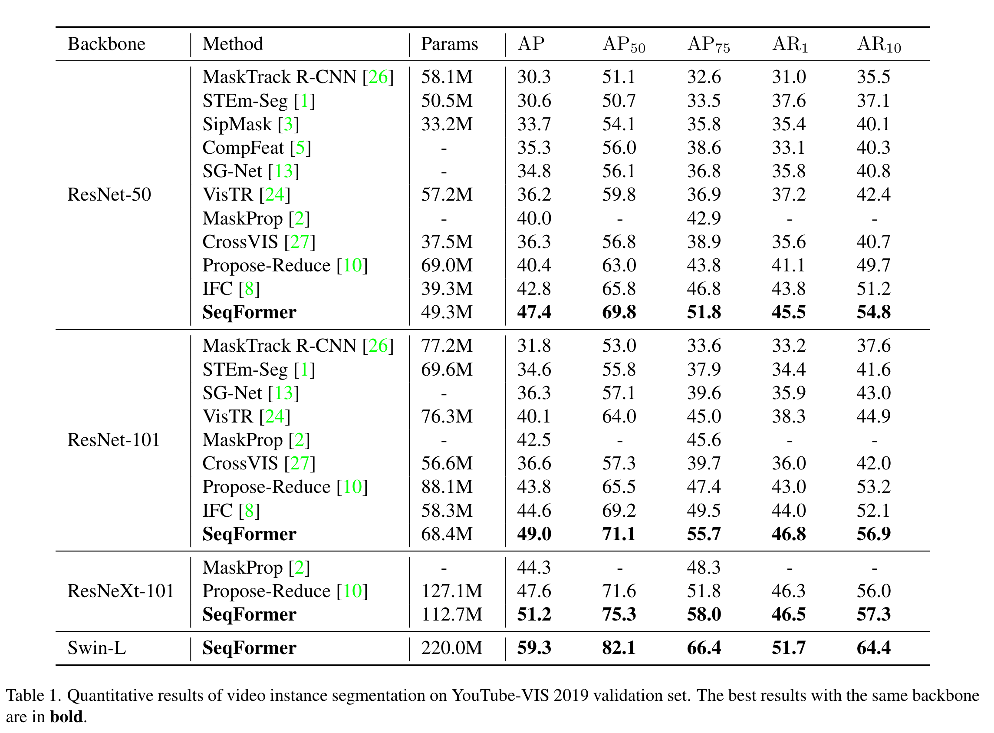
Experiments

