Slide 1
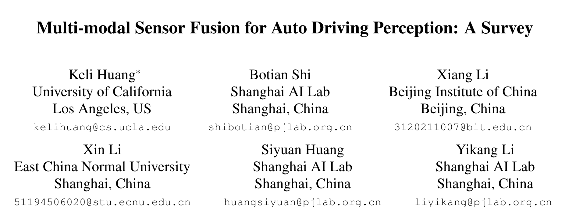

Slide 2
Limitations of single-modal data perception
Camera
Mainly captured in the lower position of the front view
Objects may be occluded in more complex scenes
Lidar
Various resolutions at different distances
Vulnerable to extreme weather

Slide 3
Contributions
A new taxonomy defined by the feature representation
Strong-fusion
Early-fusion, deep-fusion, late-fusion, asymmetry-fusion
Weak-fusion
An in-depth survey about the data format and representation of the LiDAR and camera branch and a discussion about their different characteristics
A detailed analysis about the remaining problems and an introduction to several potential research directions

Slide 4
Multi-modal Sensor Fusion Perception Tasks
Object Detection
Semantic Segmentation
Others
Object classification
Depth completion and prediction

Slide 5
Open competitions and Datasets
KITTI
2D, 3D, BEV
Cars, pedestrians, cyclists
Easy, medium, hard
Waymo
20s / scene
Vehicles, cyclists, pedestrians
nuScenes
23 categories

Slide 6
Open competitions and Datasets

Slide 7
Representations for LiDAR
Point-based
Redundancy, slow
Voxel-based
Centroid, local density, local offset, local linearity, local curvature, …
Reduced redundancy, faster
2D-mapping-based
Camera plane map (CPM)
Bird’s eye view (BEV)

Slide 8
Fusion Methodology

Slide 9
Strong Fusion

Slide 10
Early-fusion
LiDAR: 3D points with reflectance, voxelized tensor, front-view / range-view / bird’s eye view, pseudo-point clouds
Camera: data-level or feature-level

Slide 11
Deep-fusion
LiDAR: feature-level
Camera: data-level or feature-level
Can be done in a cascading way, which both leverage raw and high-level semantic information

Slide 12
Late-fusion
Fuse the result of pipelines in each modality
Can be regarded as a kind of ensemble method that utilizes multi-modal information to optimize the final proposal

Slide 13
Asymmetry-fusion
Has at least one branch dominating while other branches provide auxiliary information to conduct the final task
Only have proposals from one branch

Slide 14
Weak Fusion
Use rule-based methods to utilize data in one modality as a supervision signal to guide the interaction of another modality

Slide 15
Opportunities in Multi-Modal Fusion
More Advanced Fusion Methodology
Misalignment and Information Loss
Inaccurate intrinsic and extrinsic, sensory noise
Information loss in transformation
More Reasonable Fusion Operations
Currently: concatenation, element-wise multiplication
Multi-Source Information Leverage
With More Potential Useful Information
Lack the effective use of temporal, contextual, and spatial information
Self-Supervision for Representation Learning
Use the multi-modal data for self-supervised learning

Slide 16
Opportunities in Multi-Modal Fusion (Cont.)
Intrinsic Problems in Perception Sensors
Data Domain Bias
Sensor, weather, season, location
Conflicts with Data Resolution
The spatial density of LiDAR is notably lower than that of the image

