Slide 1
20190917
Lejian Ren

Slide 2
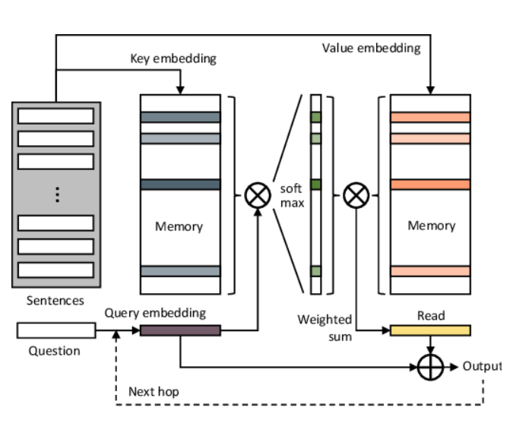
Background
Semi- supervised VOS
Memory Network
NLP
QA
Pixel wise memory

Slide 3
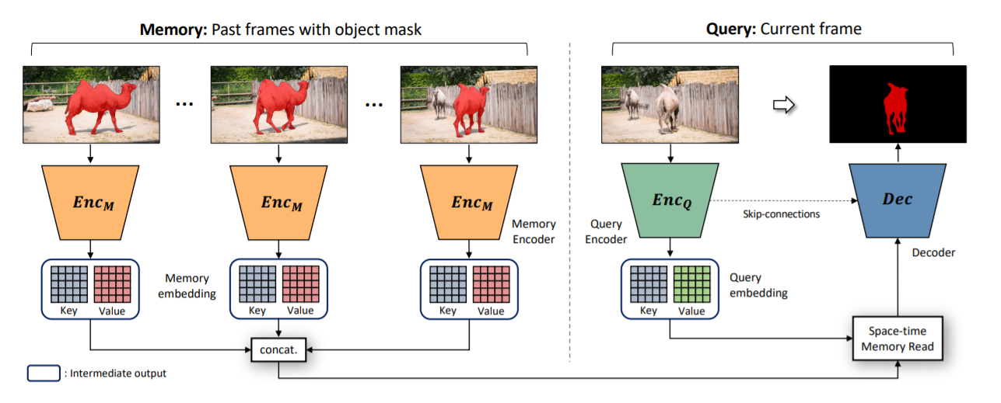
STMN

Slide 4
STMN
Encoder
Memory encoder (3+1 channels)
Query encoder (3)
Feature extractor + 2 heads
Memory reader
Non-local
Decoder
Refine unit

Slide 5
Training
Pre-training
Image
Transform (crop, rotate, etc)
Fine-tuning
Youtube-vos
Multi-objects

Slide 6
Inference
Memory
1st frame
Previous frame
Every N frames (N=5)
Multi-objects

Slide 7
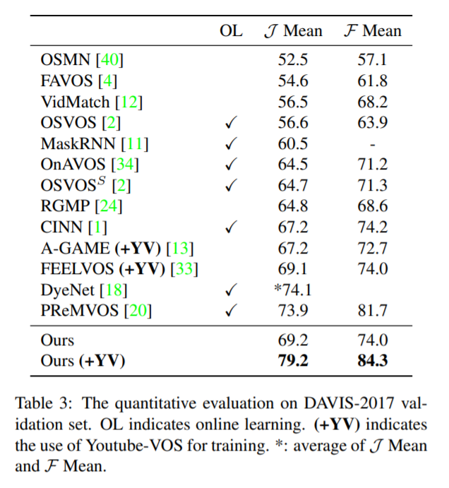
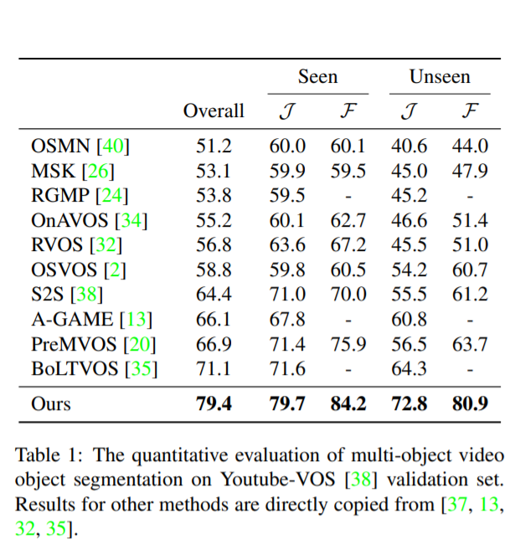
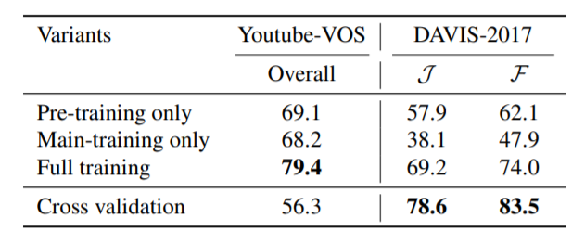
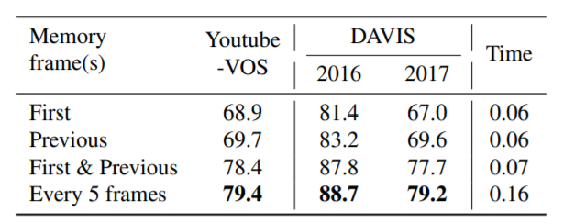
Experiments

