Slide 2
Motivation
Specifically, STEP consists of two components:
spatial refinement and temporal extension
This is motivated by the fact that the regression outputs can better follow actors and adapt to action tubes than the input proposals.

Slide 3
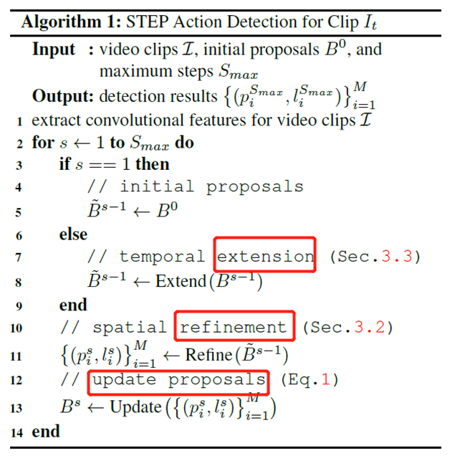

Slide 4
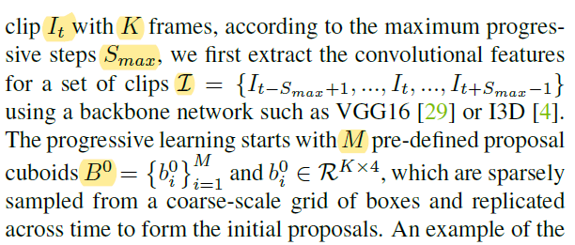
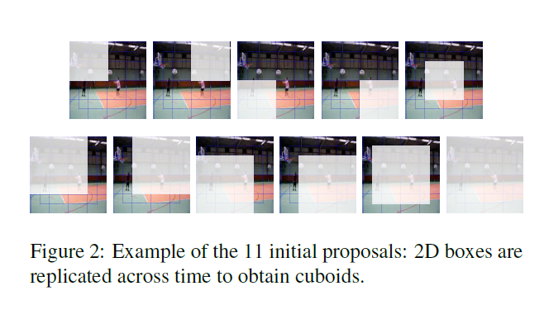
Framework Overview
Detection at clip level. First clip, then link them to build action tubes across a whole video.
Our target is to tackle the action detection problem through a few progressive steps, rather than directly detecting actions all at one run.

Slide 5
Spatial Refinement
At each step s:
action classification(demands context features in both space and time)
localization regression(needs more precise spatial cues at frame level)
Two-branch architecture
global branch
local branch

Slide 6
Spatial Refinement

Slide 7
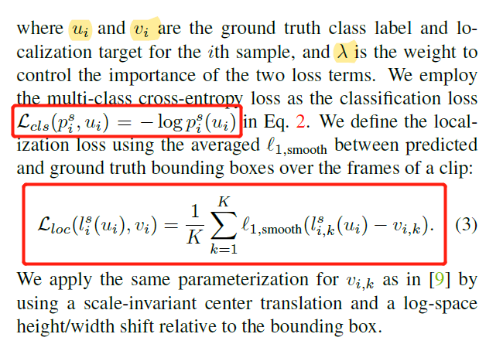
Spatial Refinement

Slide 8
Temporal Extension
Motivation: the spatial displacement problem becomes even more severe for longer sequences
extend the tubelet proposals to the two adjacent clips at a time.

Slide 9
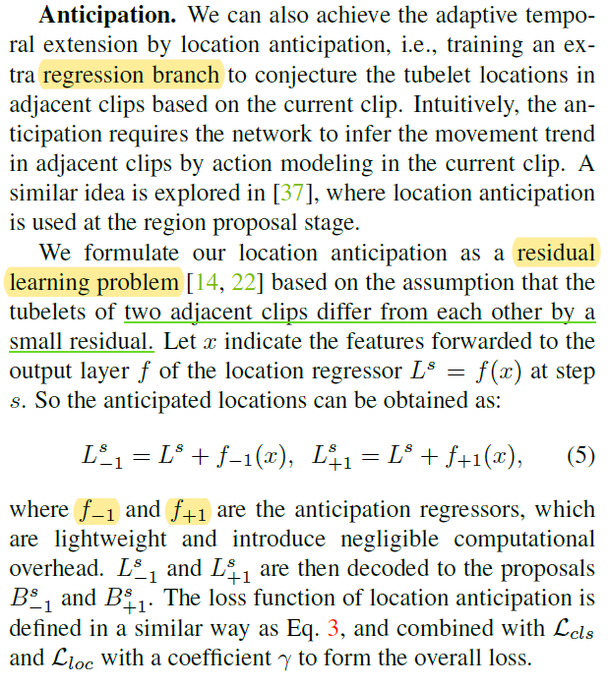
Temporal Extension

Slide 10
Experiment

Slide 11
Experiment

