Slide 1
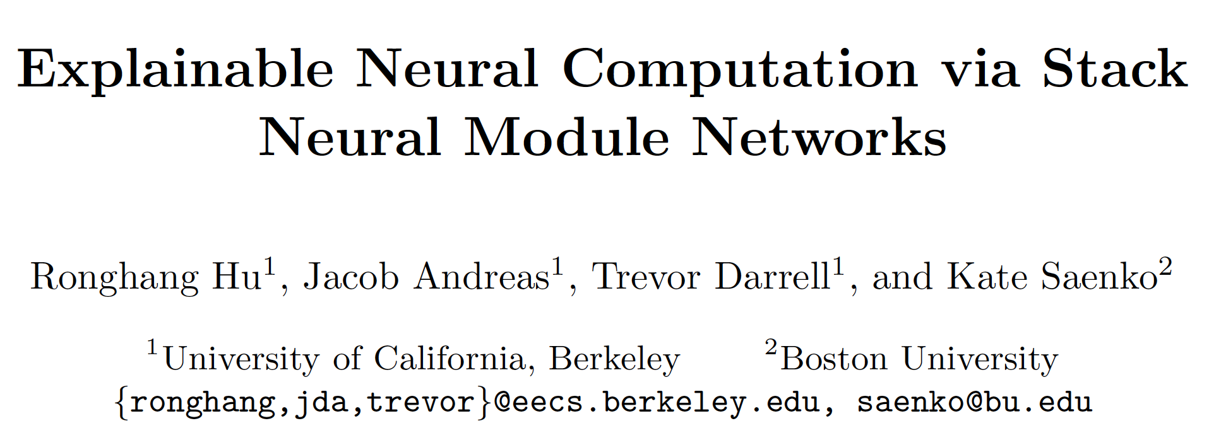

Slide 2
Background
Existing modular networks
first analyze the question and then predict a sequence of pre-defined modules that chain together to predict the answer.
need expert layout supervision for training
Our Stack Neural Network
trained without layout supervision
replaces the layout graph with a stack-based data structure

Slide 3
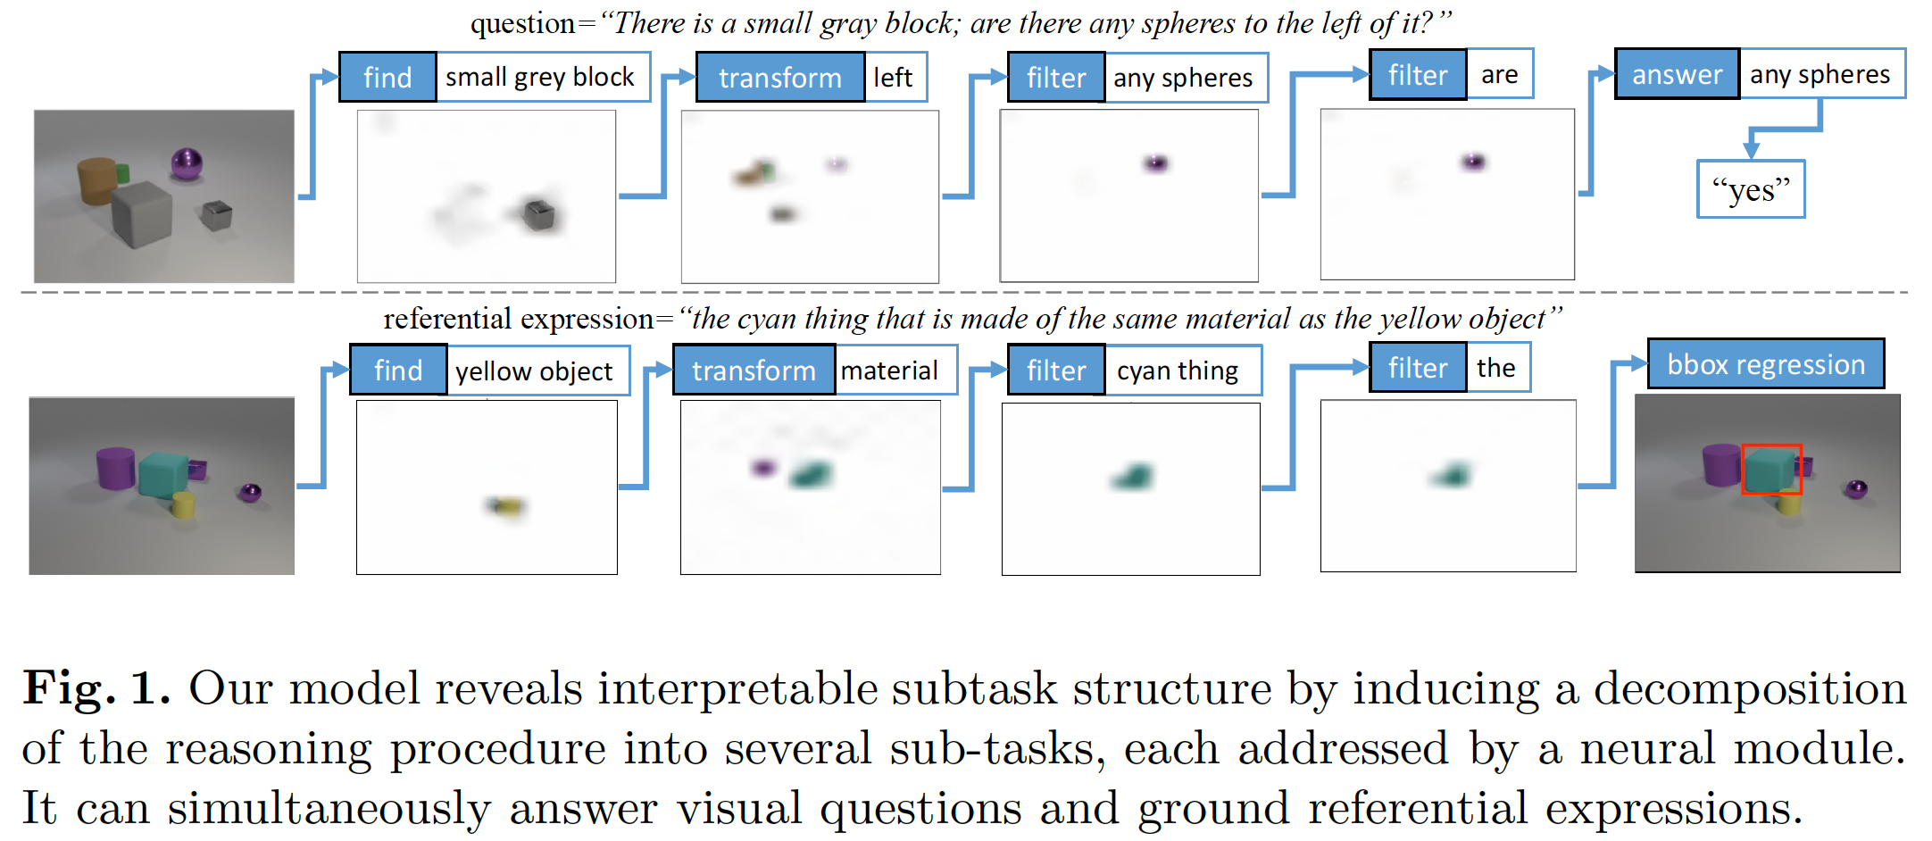

Slide 4
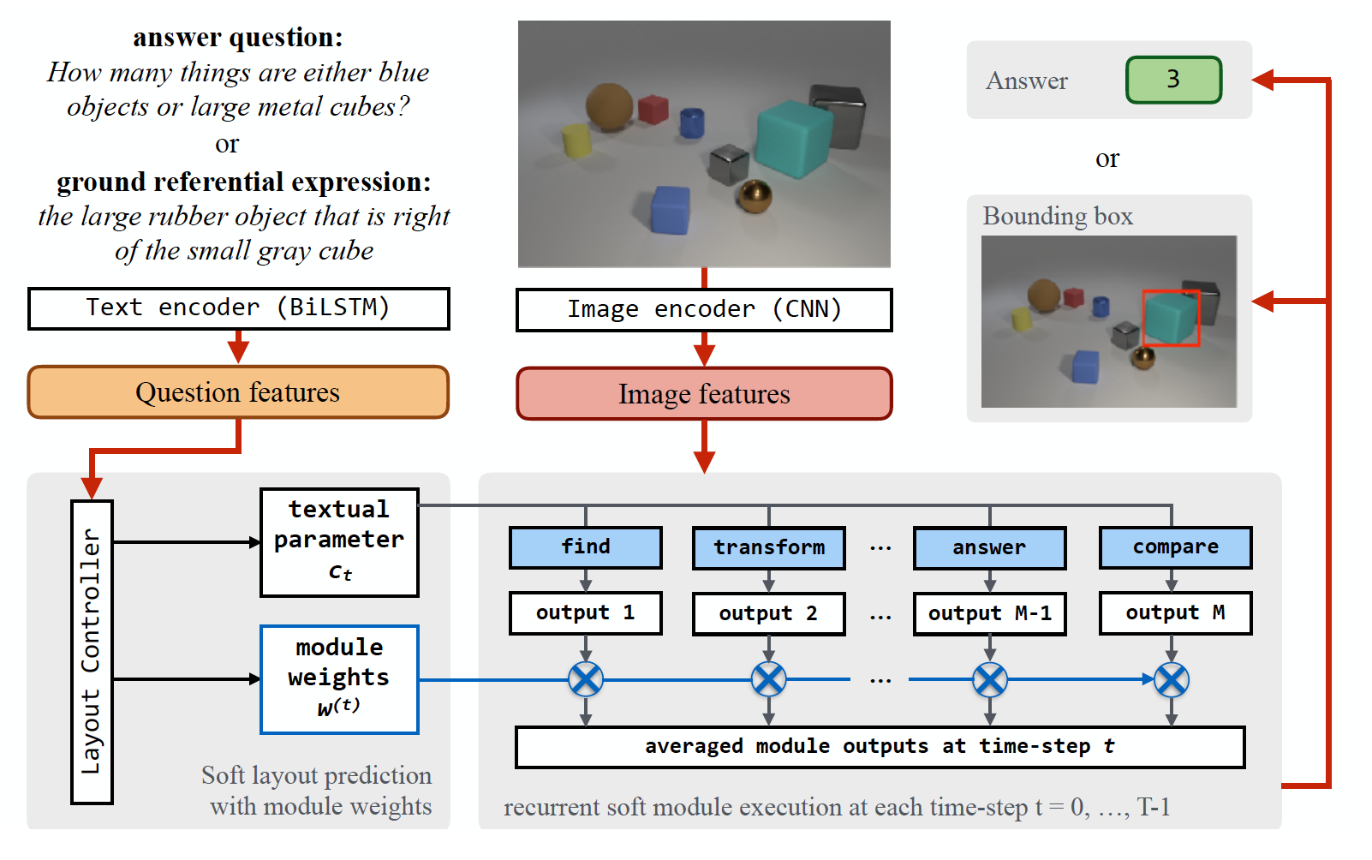
Network Architecture

Slide 5
Module Layout Controller
Input：$q$
Hidden State：$\left[h_{1}, h_{2},…,h_{S}\right]=BiLSTM\left(q\right)$
Output: textual parameter $c_{t}$, module weight $w^{(t)}$
$u=W_{2}\left[W_{1}^{\left(t\right)}q+b_{1};c_{t−1}\right]+b_{2}$
Module weights: $w^{(t)}=softmax(MLP(u)$
$cv_{t,s}=softmax\left(W_{3}\left(u⨀h_{s}\right)\right)$
Textual parameter: $c_{t}=Σ_{s=1}^{S}cv_{t,s}⋅h_{s}$

Slide 6
Neural modules with a memory stack
Differentiable memory stack $(A,p)$
Memory array: $A={\left\{A_{i}\right\}}_{i=1}^{L}$
Stack-top pointer: $p$ (L-D one-hot vector)
Push $z$
$p≔1d_conv(p, \left[0, 0, 1\right])$
$A_{i}≔A_{i}⋅\left(1−p_{i}\right)+z⋅p_{i}$
Top
$p≔1d_conv(p, \left[1, 0, 0\right])$
$z≔{Σ_{i=1}^{L}A}_{i}⋅p_{i}$

Slide 7
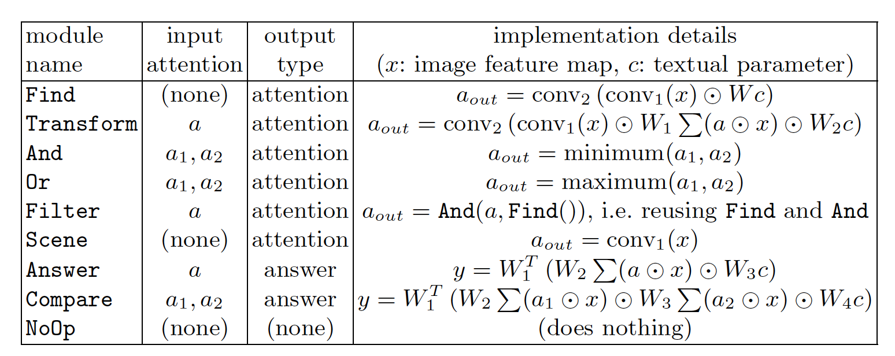
Neural modules with a memory stack
Soft program execution
Final Predict

Slide 8
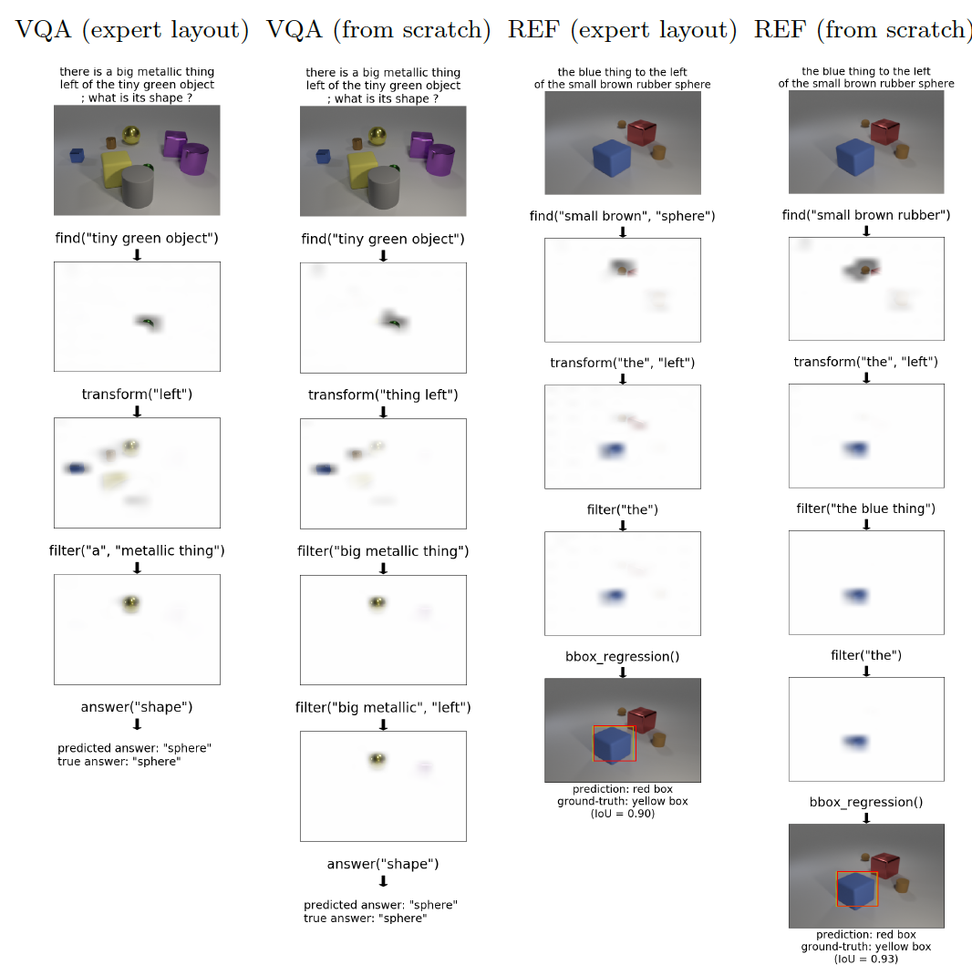
Visulization

Slide 9
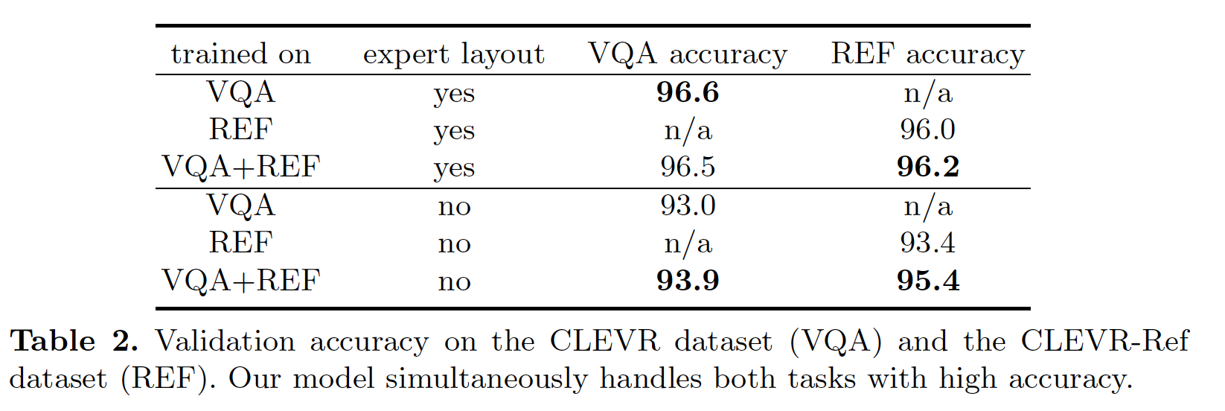
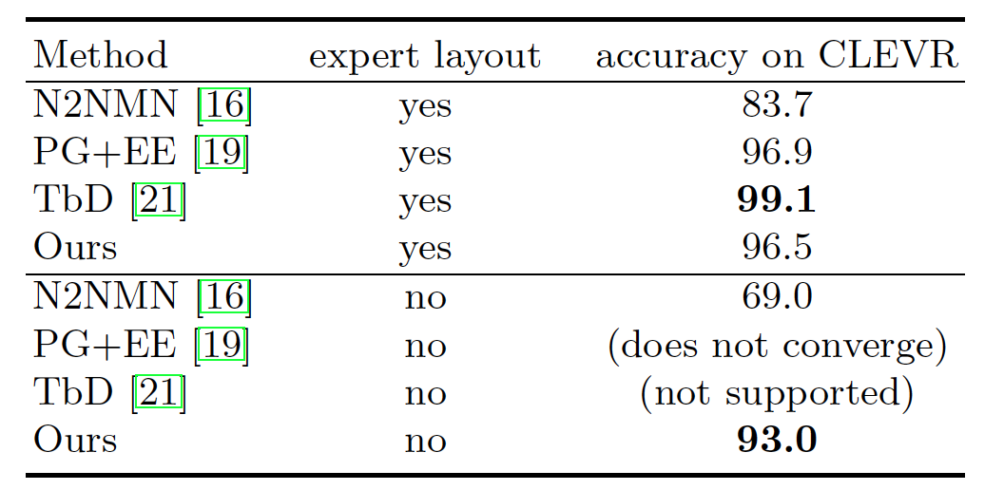
Experiment

