Slide 1
Report on TextVQA Challenge
Wang Zhaokai

Slide 2
Outline
0、TextVQA dataset
1、LoRRA (baseline) Accuracy: 27.63%
2、2019 winner Accuracy: 31.44%
3、2019 runner-up Accuracy: 30.54%
4、M4C Accuracy: 40.46%

Slide 3
TextVQA Dataset
VQA that are related to extracting text from images.

Slide 4
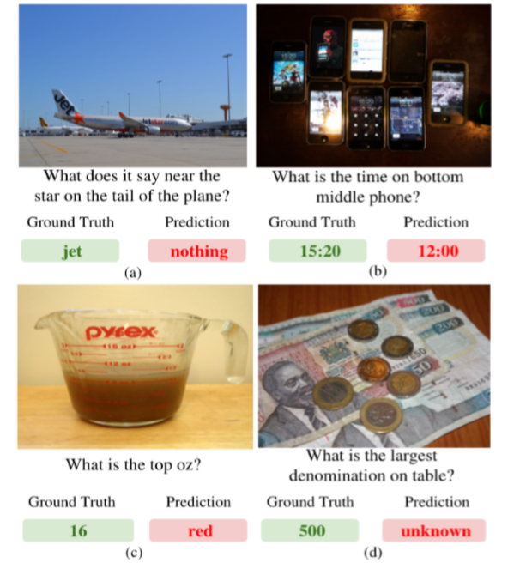
Examples of TextVQA dataset

Slide 5
Length of Questions and Answers

Slide 6
Number of OCR tokens

Slide 7
Most Common Questions and Answers

Slide 8
The model need to combine question, image and text, and choose between OCR results or fixed vocabulary.
VQA models do not perform well on TextVQA.

Slide 9
1、LoRRA (Baseline)
CVPR 2019

Slide 10
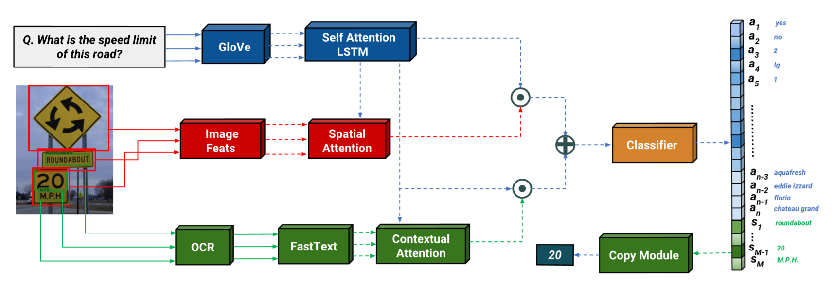

Slide 11
2、2019 TextVQA Challenge Winner
VQA-Dial Workshop 2019

Slide 13
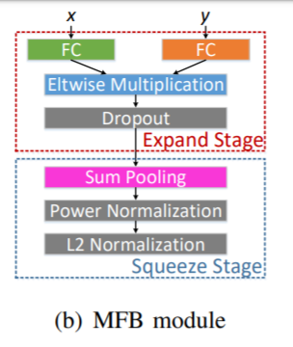
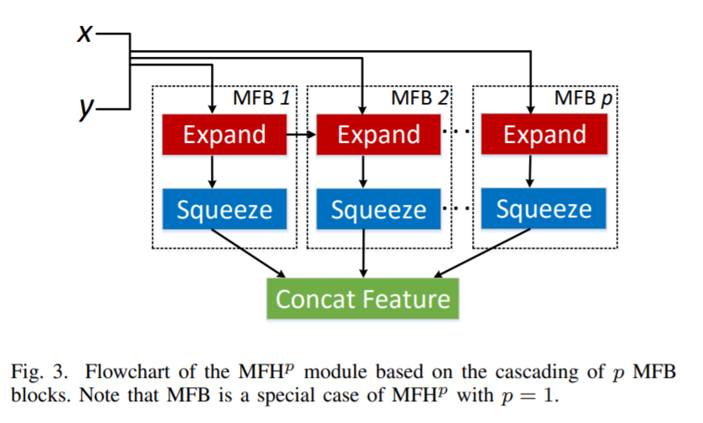
MFH module
Similar to co-attention

Slide 14
Calculate the similarity between Answer Embedding and OCR / Top-K Answer from fixed vocabulary

Slide 15
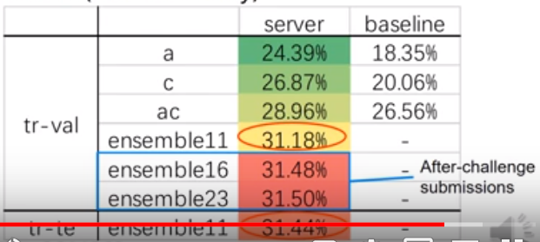
Results

Slide 16
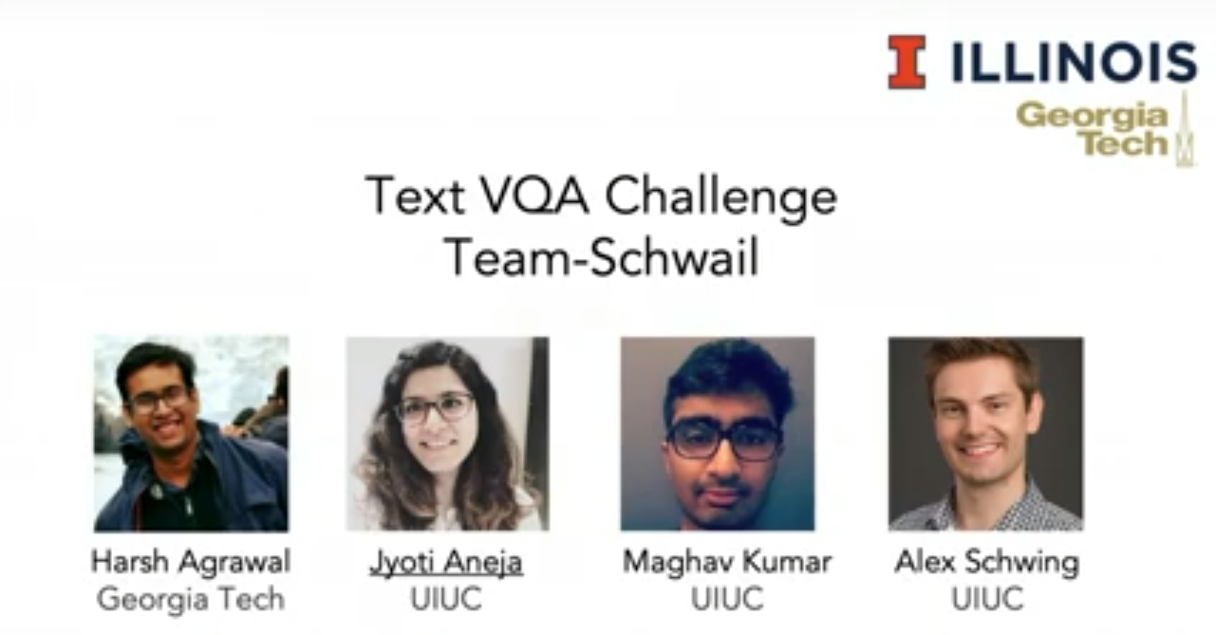
3、2019 TextVQA Challenge Runner-up
VQA-Dial Workshop 2019

Slide 19
4、M4C
From arxiv

Slide 20
Motivation
Current models:
fusion between two modalities (question & image, question & OCR tokens)
Single-step classification
Insufficient text representation (ignore font, color or location of the text)
M4C：
Multimodal transformers
Iterative Answer Prediction
Rich representation of text

Slide 21
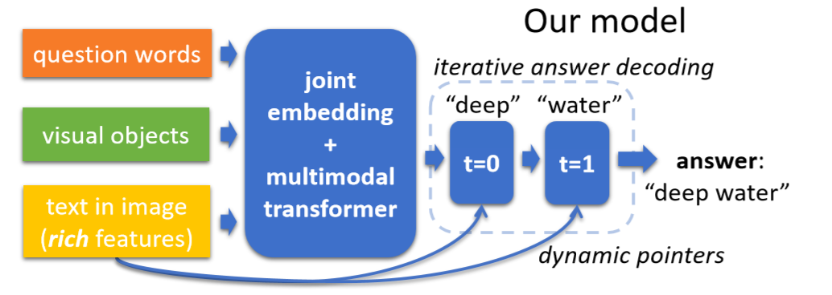

Slide 22
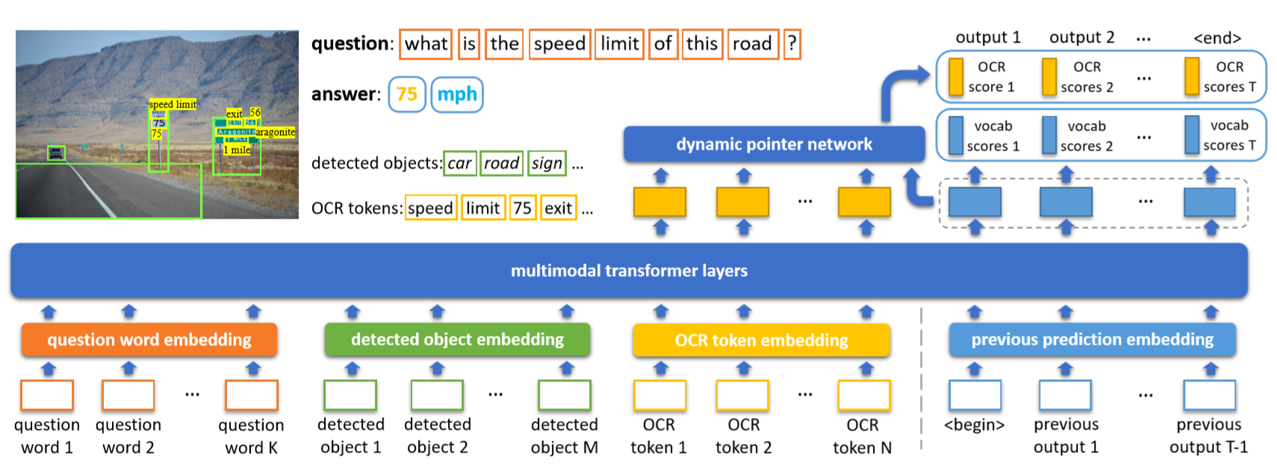
Model
Common embedding space
Multimodal Transformers
Iterative Answer Prediction

Slide 23
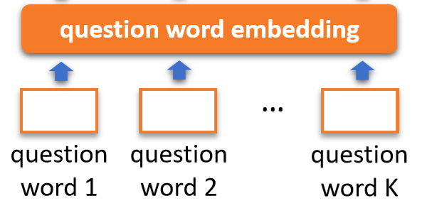
Common Embedding Space (d dimension)
Embedding of question words:
Pre-trained BERT and fine-tune during training

Slide 24
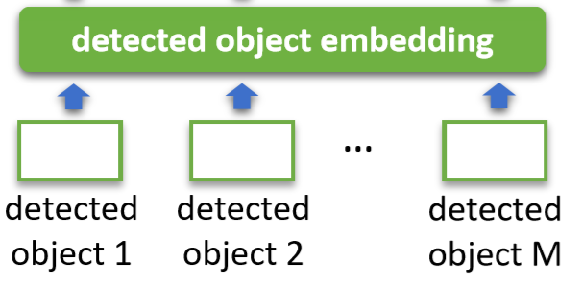
Embedding of detected objects:
where (appearance feature)is extracted by Faster R-CNN
(location feature) =

Slide 25
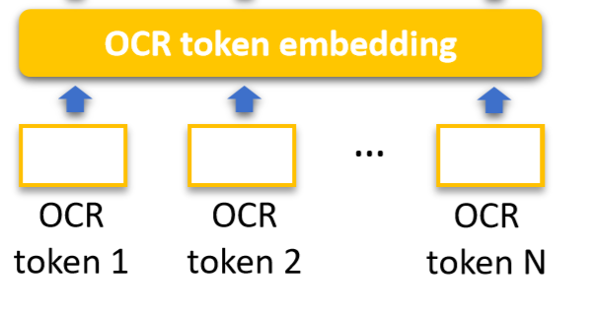
Embedding of OCR with rich representations
character, appearance (font, color), location
: OCR tokens → FastText → word embedding with subword information
:: bounding box → Faster R-CNN
: character in tokens → PHOC
: (location feature) =

Slide 26
Multimodal Fusion
Allow attention between entities from different modalities

Slide 27
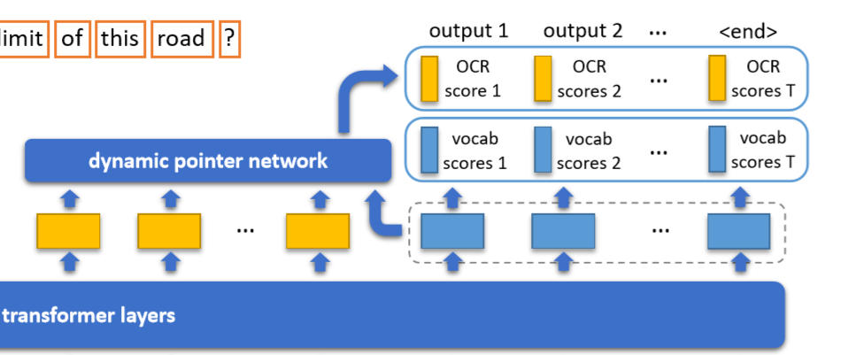
Dynamic Pointer Network
Take in previous word and predict next word with dynamic pointer network
Predict scores of i-th word in vocabulary and n-th OCR token.

Slide 28
……
or

Slide 29
Answer Prediction
Take argmax of , to predict next word with the highest score

Slide 30
Extra Token
Add position embedding of step t
Add type embedding (whether previous word is from vocabulary or OCR)
Add <start> and <end> token
Use multi-label sigmoid loss

Slide 31
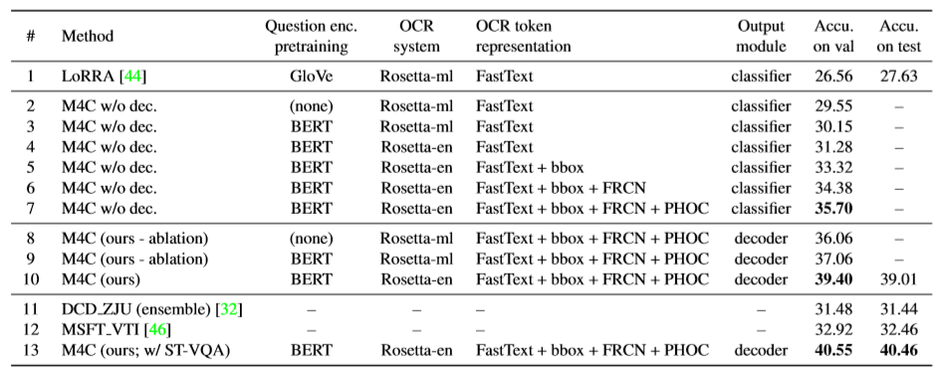
Experiments
TextVQA dataset

Slide 32
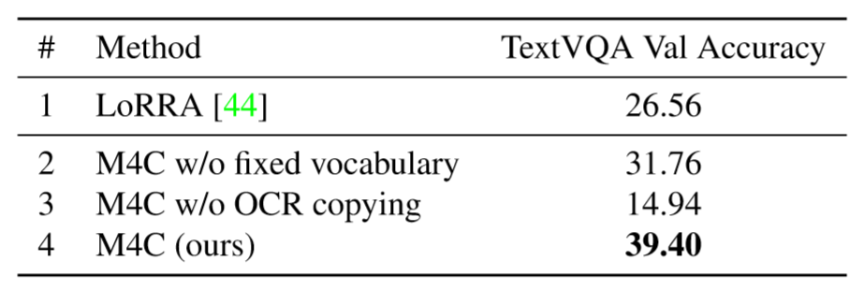
Important to have both fixed vocabulary and OCR copying

Slide 33
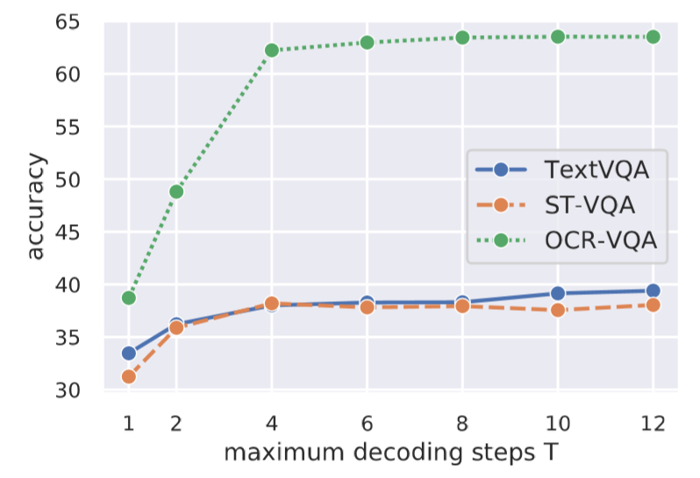
Giant improvement from 1-step to 2-step

Slide 34
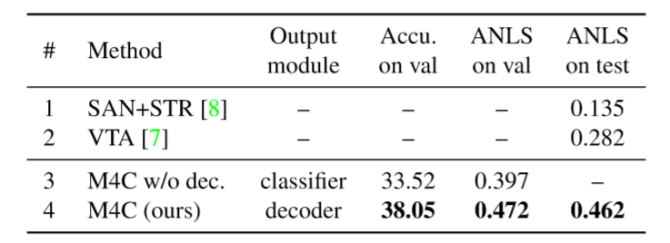
ST-VQA dataset

Slide 35
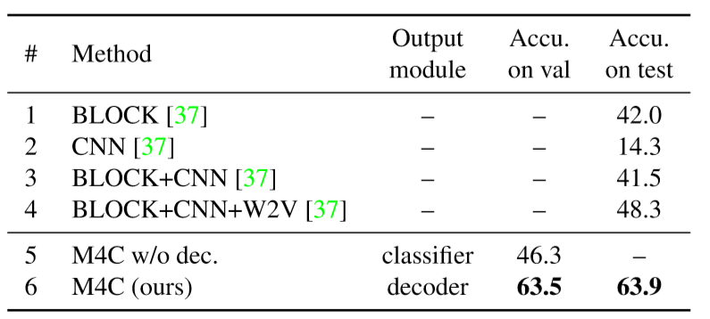
OCR-VQA dataset

Slide 36
Qualitative Results

Slide 37
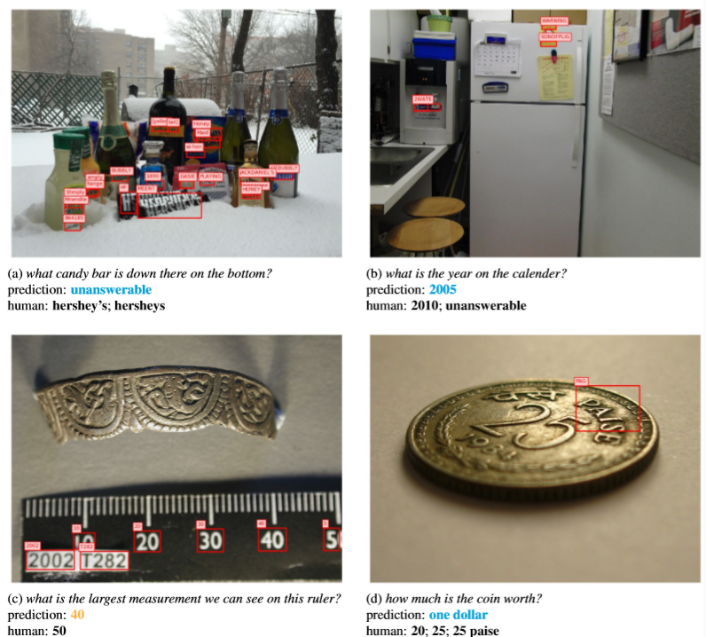
-
Most errors come from OCR

Slide 38
My Understanding
Key point: how to combine 3 modalities (question, image, OCR tokens) and how to choose answers from OCR or fixed vocabulary.
(compared to VQA：only 2 modalities; answers only from fixed vocabulary)

Slide 39
Preparations
2020.2
Basic Knowledge (cs231n, cs224n)
Papers (LoRRA, M4C)
Environment (pythia)
2020.3
Run LoRRA model, achieve same accuracy
2020.4 – 2020.5
Train model and fine-tune, improve accuracy by 2%
Deadline: 5.27

