Slide 1
DETR Related Work in Detection
Mingfei Chen

Slide 2
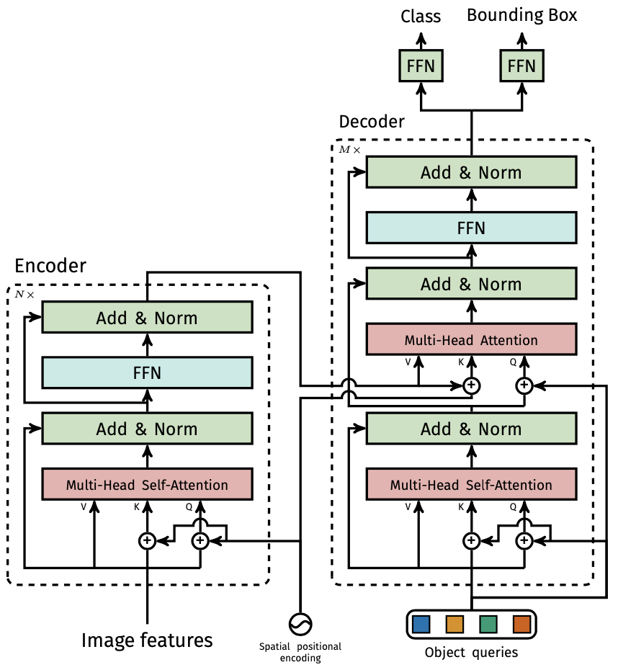
DETR
Sparse proposals
High accuracy (especially on large objects)
No need for NMS

Slide 3
Problems
Long training epochs to converge
Co-attention -> No need to focus on the features that are far away ?
Self-attention -> No need to do self-attention with similar features ?
Set-based Matching -> Unstable matching will interfere with training in the early epochs ?
aux loss -> Any better choice to do iterative prediction ?
Comparably low accuracy on small objects
Scale -> Single scale detection will impair the detection accuracy for small objects ?

Slide 4
Possible Solutions
Long training epochs to converge
Co-attention -> Only sample neighbor points to focus on: e.g. deformable convolution.
Self-attention -> Clustering query features of self-attention: e.g. in encoder.
Set-based Matching -> Guide the matching based on scale range.
aux loss -> Propose the boxes iteratively.
Comparably low accuracy on small objects
Scale -> Involve multi-scale queries: e.g. queries from multi out layers from the backbone.

Slide 5
Deformable DETR
Deformable Co-Attention
Multi-scale
Iterative Prediction
Two-stage Proposal

Slide 6
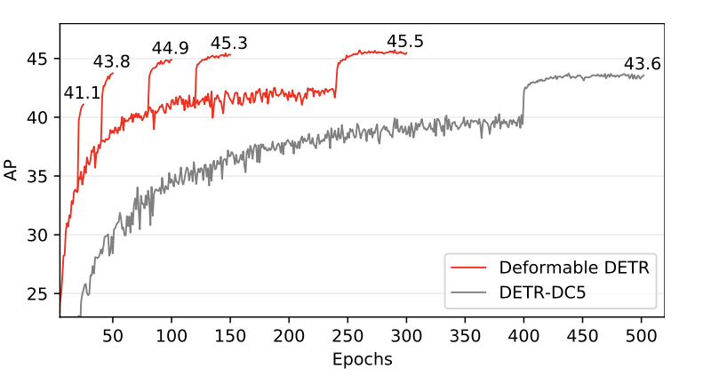
Deformable DETR
Zhu X, Su W, Lu L, et al. Deformable DETR: Deformable Transformers for End-to-End Object Detection[J].
arXiv preprint arXiv:2010.04159, 2020.

Slide 7
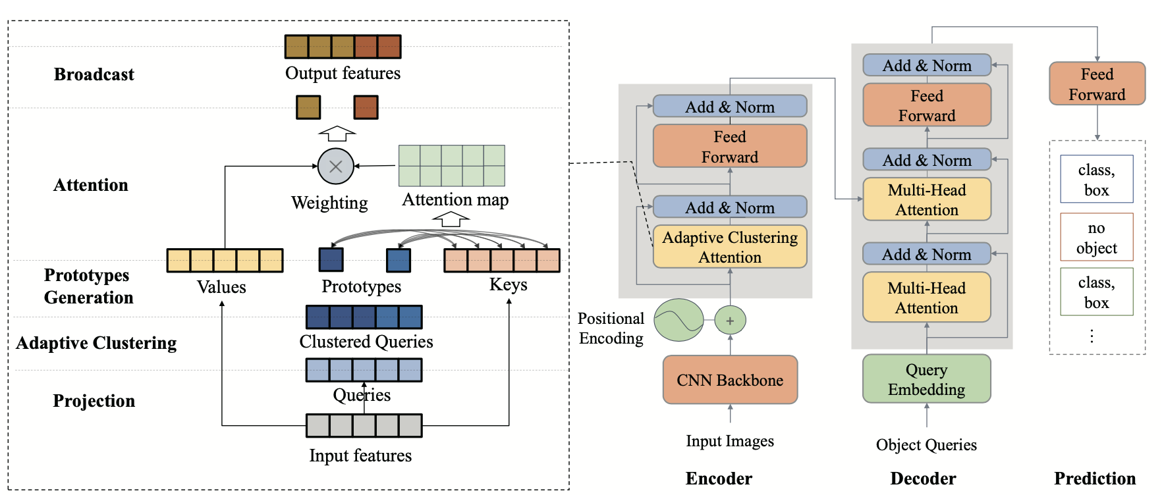
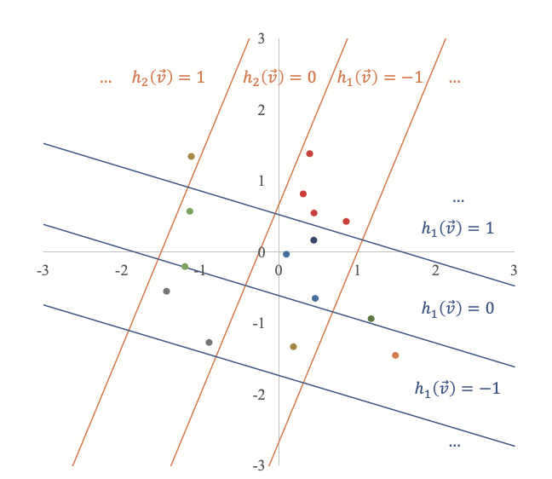
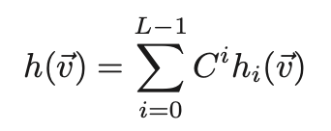
Adaptive Clustering Transformer
Euclidean Locality Sensitive Hashing:
Zheng M, Gao P, Wang X, et al. End-to-End Object Detection with Adaptive Clustering Transformer[J].
arXiv preprint arXiv:2011.09315, 2020.

Slide 8
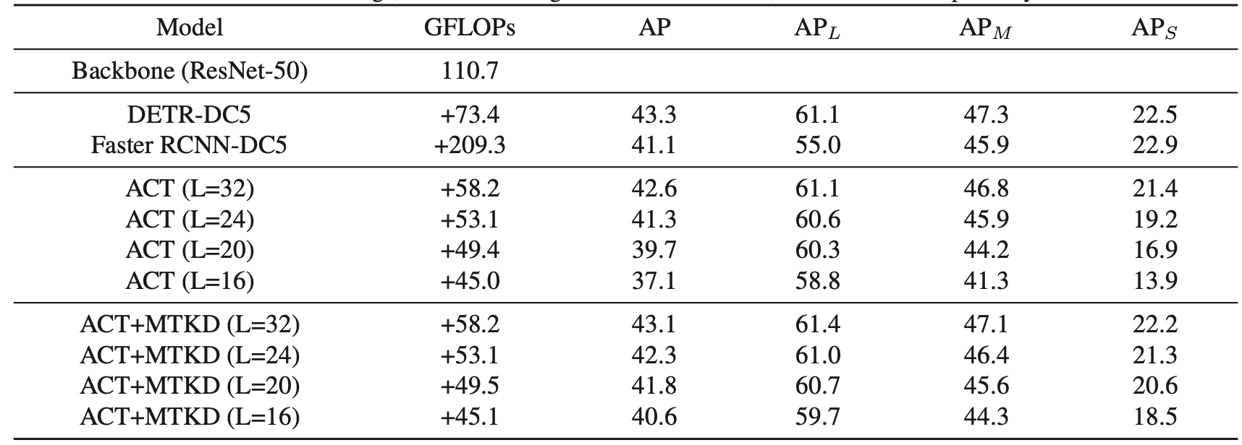
Adaptive Clustering Transformer

Slide 9
Rethinking Transformer-based Set Prediction
Rethinking: ???
Set-based match loss
Co-attention in decoder
Co-attention necessity
Scale range based set matching
Sun Z, Cao S, Yang Y, et al. Rethinking Transformer-based Set Prediction for Object Detection[J].
arXiv preprint arXiv:2011.10881, 2020.

Slide 10
Rethinking Transformer-based Set Prediction

Slide 11
Multi-queries for One Object
Dai Z, Cai B, Lin Y, et al. UP-DETR: Unsupervised Pre-training for Object Detection with Transformers[J].
arXiv preprint arXiv:2011.09094, 2020.

Slide 12
Sparse RCNN
Sun P, Zhang R, Jiang Y, et al. Sparse R-CNN: End-to-End Object Detection with Learnable Proposals[J].
arXiv preprint arXiv:2011.12450, 2020.

Slide 13
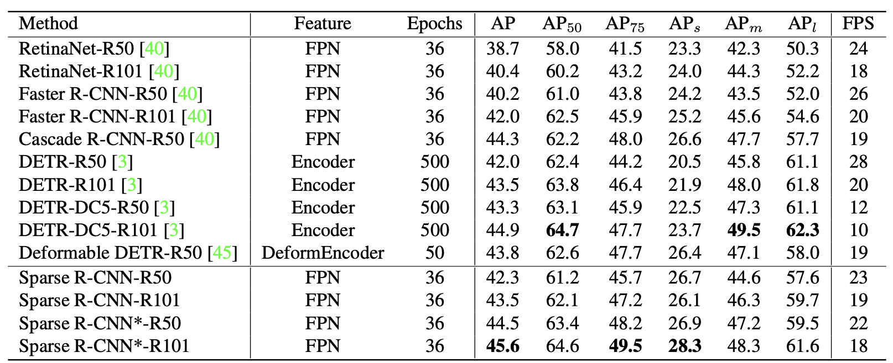
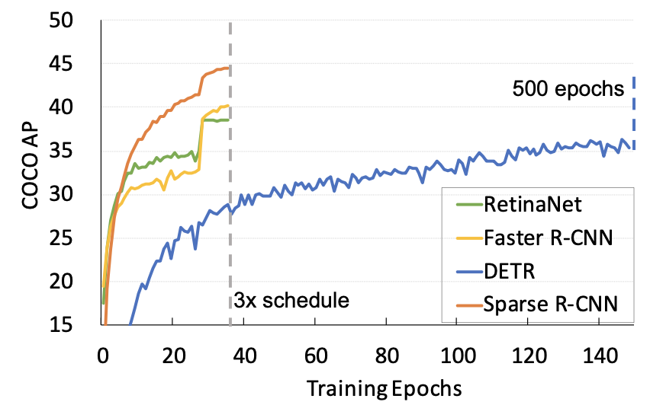
Sparse RCNN

Slide 14
Thanks !

